Slide 1
Agenda
Project Blueberry
What did we do this week
  Challenges
  Updates
Tasks for next week
Future scope
References

Slide 2
Project BlueBerry
Weekly progress

Slide 3
What we did this week:
While trying to figure out the project in detail, we came up with some necessary modifications to be made to it:
We went to a cycle shop and talked to an engineer working there. We realized the complexity of the implementation of the locomotive track system.
We have decided to implement some changes in the type of motor and wheels we are going to use after talking to Prof. Rama Sreekanth. We are going to put two integrated gear-motors for the back wheels.
We came up with some modifications for power sources as well. We will use two rechargeable 9 V batteries for locomotion, and rechargeable AA batteries.
The robotic arm will be implemented next semester if we can’t add it now. This is kept on low priority for some time.

Slide 4
What we did this week:
It’s been decided that we are going to replace the tracks with regular wheels and work on tracks for the next semester.
Although we did come up with an updated block diagram, we have to make some modifications this week.
Core components have been ordered.
We also made a logo.

Slide 5


Slide 6
The challenges we have faced
We aim to put in a steering mechanism for the future iterations of this project, but for the limit amount of time and experience we have, we will use the swing turn mechanism.
The parts for the track/ conveyor belt locomotive system aren’t available yet, so we will move to having regular four wheeled locomotive system.
Voice recognition isn’t feasible enough to be implement yet because of the cost of the module, mic and another nano board.
Finding a use case for the robot.

Slide 7
Updates:
We have ordered many of the core components for the project.
We have already received one core component- 120 Jumper wires (Male to male, female to female, male to female).
We have ditched the voice controlled calculator for now which, although is easy to implement, will be done in a more attractive way once we are done with the lighting display system.
We are aiming for a new facial display system using LED matrices. It will involve showing welcome messages and eyes (possibly).
Basic functionalities like cleaning the floor will still be available.

Slide 8
Updates:
To make the robot more useful we have thought of making it more of a home security robot rather than an assistant bot.
It will use different sensors to detect motion once it is set to. It will use motion detection, temperature detection and/or light detection to establish if there is an anomaly.
Once triggered, the robot will analyse the threat by cross verifying two or more sensor inputs. If it has a positive in two or more inputs, it will trigger an alarm (Maybe a dog’s bark?), call/send a message to the owner.
We are aiming to also implement a crying baby noise recognition. This will enable parents to know if their baby is hungry or needs something.
This will implement a line following and/or obstacle avoiding principles for now.

Slide 9
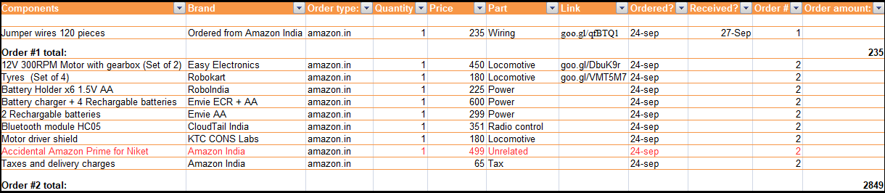
Components update:

Slide 10
What will we do now
Coming up with a definite design for the proposed idea.
Receiving the ordered parts, ordering more.
Having a finalized list of items.
Testing them.
Start assembling the parts, drawing circuit diagrams.
Money collection is underway. Target budget is Rs. 10,000.

Slide 11
What the future scope is:
Since it is essentially going to be a security bot, we will try to make it a dog bot.
This will auto-charge itself, be more smart in recognizing things.
Solar charge will be added to conserve power.
We can implement image recognition to it along with better robust alarm systems.
With the availability of Raspberry Pi next year, we can leverage IoT to make it more interactive and useful like- connecting to a cloud server like AWS and obeying instructions remotely.
In the foreseeable future, we are going to make it autonomous due to better computational power combining Arduino and Raspberry Pi and more experience.

Slide 12
What the future scope is:
Data analysis can be done in remote computational servers, and the output can be returned to the bot.
With Artificial Intelligence implementation coupled with Machine Learning, we will try to inject a dog’s behavioral patterns to it, which will although sounds tough, but a simple implementation can do wonders.
We are trying to make it a scalable project.

Slide 13




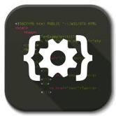


Timeline chart
Literature Survey
913/09/17
Problems Identified
16/09/17
Hardware Analysis
23/09/17
Programming the arduino board
22/10/17
Debugging and integration
23/10/17
Testing
31/10/17
DELIVERY
November Week #1

