Slide 1

Bicycle Tire Sales & Global Pandemics
Group: Variable Grade = A
David Dam, Jae Park, Louis Cheng

Slide 2
Our Data
Sales data for bicycle tires. Separated by Application, Size and Diameter.
Why we picked it – we wanted a dataset where we can see the real-world applications firsthand.

Slide 3
Questions and Analysis goals
Has there been a significant difference in overall sales quantity compared to expected projections?
Has there been a significant change in the type of application?
Compare Mountain to other categories
Has there been a significant change in the most popular tire sizes?
Compare the top tire sizes 27.5” vs 29”

Slide 4
The big question
How did COVID affect bicycle tire sales in 2020 and beyond?
Hypothesis: If there is a global pandemic that prevents people from doing indoor activities then there will be an increase in outdoor recreational activities. Of which we can measure via bicycle tire sales as a consumable.

Slide 5
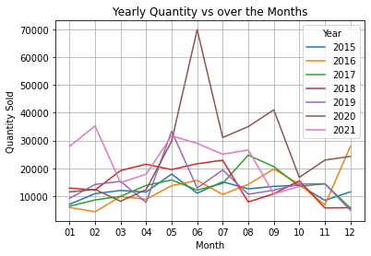
A quick glance at Sales volume over the past 7 years

Slide 6
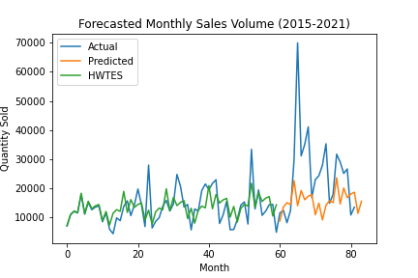
Has there been a significant difference in overall sales quantity compared to expected projections?
However, if we follow the historical data then we see a large spike more than doubling the next highest year in our dataset. Then slowly tapering off the next year.
Overall North American sales from 2015 to 2021 YTD, shows there has been steady growth over the years.

Slide 7
Has there been a significant difference in overall sales quantity compared to expected projections?
Year | Quantity | Forecast
2015 | 145656 | 149113
2016 | 152066 | 154639
2017 | 160371 | 161912
2018 | 175695 | 170569
2019 | 168569 | 177373
2020 | 315350 | 184502
2021 | 232646 | 192619
We can say that there can be a correlation between current events and the sale of bicycle tires.
Some large single month highs in previous years could coincide with inventory closeouts.
The drop in sales beyond the peak in sales in mid-2020 may not be entirely indicative of market as much as limited inventory due to supply chain challenges.
Years | Critical Value | Power divergence statistic | P-value
2018-2019 | 5.991464547107979 | 591.0394315517315 | 1.4887379627639045e-130
2020-2021 | 5.991464547107979 | 79576.40323390791 | 0.0

Slide 8
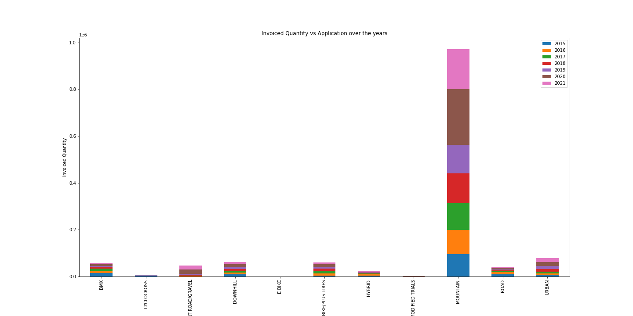
Changes in the application
Has there been a significant change in the type of application?
Compare Mountain to other categories
As seen in "Invoiced Quantity vs Application over the years.png"
While the number of purchases remained increased.
The purchase ration by application did not change. Mountain bike tires remain the best sellers with Urban coming in second.

Slide 9
Changes in the application
Application | 2015 | 2016 | 2017 | 2018 | 2019 | 2020 | 2021
BMX | 14526 | 10365 | 8591 | 6116 | 4856 | 7523 | 6566
CYCLOCROSS | 1058 | 639 | 1605 | 1298 | 1336 | 893 | 711
DIRT ROAD/GRAVEL | 158 | 1257 | 2269 | 2546 | 5904 | 17922 | 17663
DOWNHILL | 9902 | 6792 | 6003 | 9879 | 7553 | 13209 | 8014
E BIKE |  |  | 38 | 47 | 227 | 57 | 28
FAT BIKE/PLUS TIRES | 4051 | 9196 | 11484 | 8634 | 6720 | 13287 | 6127
HYBRID | 3420 | 5142 | 4420 | 4441 | 1851 | 974 | 1735
MODIFIED TRIALS | 183 | 193 | 177 | 134 | 213 | 277 | 310
MOUNTAIN | 95255 | 103177 | 114649 | 127527 | 122379 | 238279 | 169624
ROAD | 9599 | 8930 | 3811 | 3873 | 4479 | 6622 | 3942
URBAN | 7504 | 6375 | 7324 | 11200 | 13051 | 16307 | 17926

Slide 10
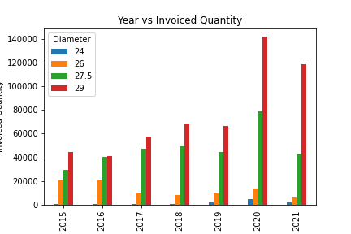
Tire Sizes
Has there been a significant change in the most popular tire sizes?
Compare the top tire sizes 27.5 vs 29
The years prior to 2020 26, 27.5 and 29 had similar and constant popularity.
In 2020 there is a spike in purchases for 29" tires. From this we can discern that there was a shift in popularity of the size of the tire.
While 26 and 27.5 and 29 where roughly equally as popular in the past. 29" has become the most popular tire by far.

Slide 11
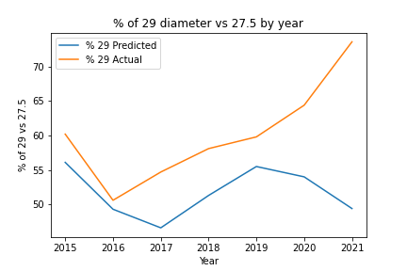
Tire Sizes
Year | 27.5 | 27.5 Forecast | 29 | 29 Forecast | 29 Actual % | 29 Predicted %
2015 | 29671 | 34017 | 44833 | 43532 | 60.2 | 56.1
2016 | 40405 | 42218 | 41380 | 40975 | 50.6 | 49.3
2017 | 47500 | 51920 | 57391 | 45250 | 54.7 | 46.6
2018 | 49531 | 63396 | 68764 | 66834 | 58.1 | 51.3
2019 | 44642 | 51162 | 66495 | 63831 | 59.8 | 55.5
2020 | 78576 | 54801 | 141842 | 64303 | 64.4 | 54
2021 | 42606 | 67273 | 118794 | 65602 | 73.6 | 49.4
Comparing the 2 most popular tire sizes (27.5” and 29”)
There has been steady rise in the % sales of 29” tires compared to 27.5
This could likely be explained that many bicycle manufacturers have changed their product line to largely 29”
Note: Other forecasting models will need to be explored to better fit the data.

Slide 12

Conclusion
How did COVID affect bicycle tire sales in 2020 and beyond?
Examining all the data and the charts, it is clear that COVID had a large impact on bicycle tire sales.
While sales tended to remain the same through out historical data. In 2020 when covid was at its peak, sales skyrocketed to more than triple of the previous year.
In conclusion, we can clearly say that our hypothesis was proven correct. The drastic reduction of options for indoor entertainment had caused a major increase in outdoor entertainment thus, an increase in sales of outdoor recreational equipment.

Slide 13

Closing Remarks

