Slide 1
Sale data
Group: Variable Grade = A
David Dam, Jae Park, Louis Cheng

Slide 2
Our Data
Sales data for bicycle tires. Separated by Application, Size and Diameter.
Why we picked it – we wanted a dataset where we can see the real world applications first hand.

Slide 3
Goals of this project
Has there been a significant difference in overall sales quantity compared to expected projections?
Has there been a significant change in the type of application?
Compare Mountain to other categories
Has there been a significant change in the most popular tire sizes?
Compare the top tire sizes 27.5 vs 29

Slide 4
The big question
How did COVID affect bicycle tire sales in 2020 and beyond?
Hypothesis: If there is a global pandemic that prevents people from doing indoor activities then there will be an increase in outdoor recreational activities. Of which we can measure via bicycle tire sales as a consumable.

Slide 5
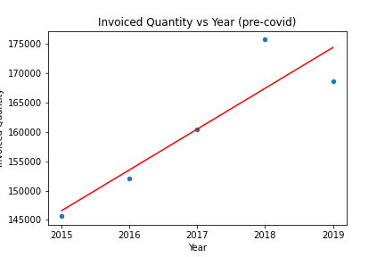
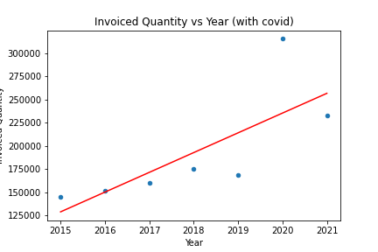
Covid Data

Slide 6
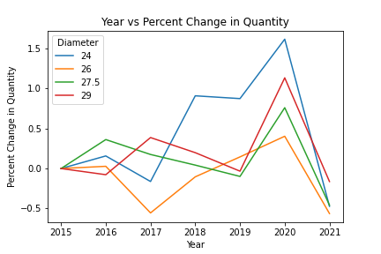
Overall Change in the quantity of sales
Has there been a significant difference in overall sales quantity compared to expected projections?

Slide 7
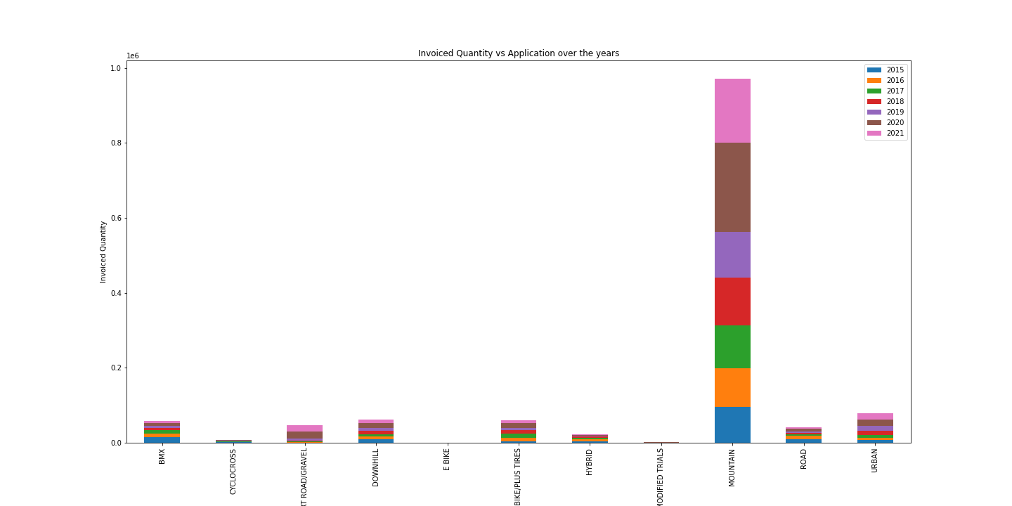
Changes in the application
Has there been a significant change in the type of application?
Compare Mountain to other categories

Slide 8
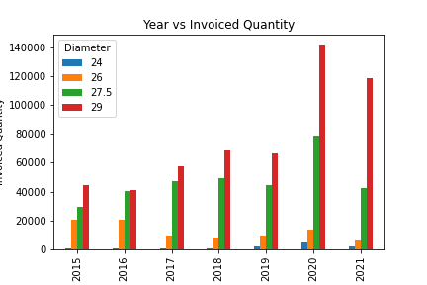
Tire Sizes
Has there been a significant change in the most popular tire sizes?
Compare the top tire sizes 27.5 vs 29

Slide 9
How did Covid impact supply and forecasting? (Build a good story to showcase the real time industry dataset, current Covid situation, sales trends etc.)

Slide 10
Close Remarks

