Slide 1
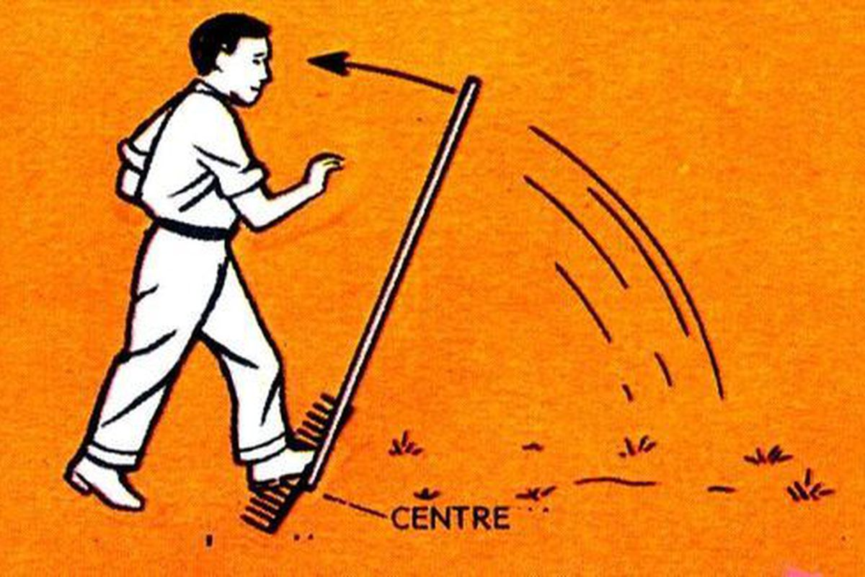
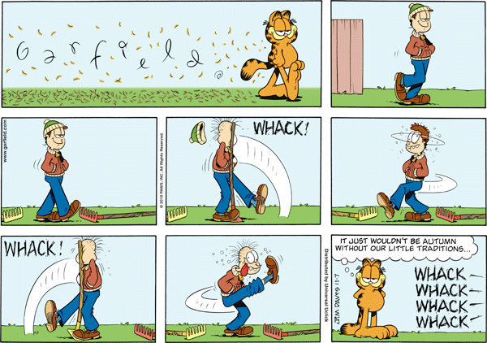
V(SWR)
The Principle
The Result
Mirror, Mirror, Darkly, Darkly

Slide 2
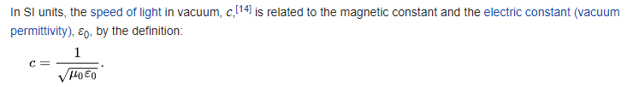
Question time!!
What do you think VSWR (SWR) mean to you?
What does one mean by a transmission line?
Coaxial line
Waveguide
Water pipe
Tunnel (Top Gear, The Grand Tour)
Relative permittivity.
Vacuum = 1.00000
Air = κ_{air} = 1.0006.
Why is the concept of an infinite transmission line of any use?
Notes:
What do you think VSWR or even SWR mean to you?
It is the summation of the forward wave and the reflected wave and value derived from the reflection coefficient (Γ).
What does one mean by transmission line?
A homogonous system which has a defined characteristic impedance
. Why is the concept of an infinite transmission line of any use?
See slide XXX
Permittivity = 8.86 * 10 ^ -12 farads/meter
Permeability = 4* PI * 10 ^-7 H/M or 1.25663706 * 10 ^ -6N/A^2

Slide 3
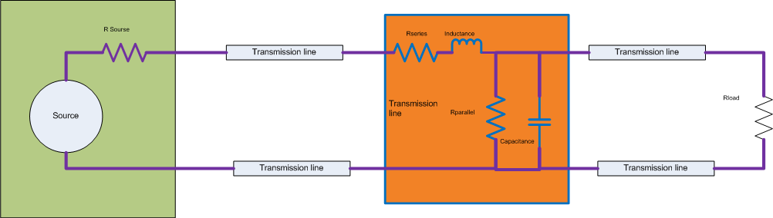
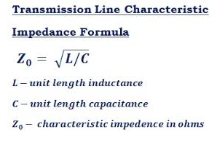
VSWR Schematic
The elements in the orange box represents the equivelent circuit of a transmission line. This circuit demonstrates that the characteristics of the line are determined by mechanical effects:
Capacitance is proportional to the area divided by the gap.
Inductance is proportional to the number turns and area of the loop
Resistance is determined by the material it is made up of.
Notes:
The circuit comprises of a generator with a source impedance, A transmission line and a load resistance.
The diagram illustrates the maximum power theorem where the transfer of power from source to load is when the source matches the load.
In RF transmitters the load is zero, but conjugally matched so the source works on the slope of the maximum power curve which results:
If the source is not zero the reflected power will be dissipated in the source. The real danger is high voltages being developed across the source from reflection flashing over and destroying your transmitter.
Due to the zero impedance of the transmitter, the output power will all go out to the load.
The losses are the continual reflections over the cable being absorbed by the cable losses in both directions.

Slide 4
Some Definitions
What is meant by an infinite transmission line and what does have to matching and hence, VSWR.
Any line that is perfectly matched, by definition has VSWR of 1:1
A line which has infinite length (free space=377Ώ).
A large attenuator
A transmission line can have any impedance.
Notes:
Note:
An infinite transmission line can be defined as line with zero attenuation and no mismatch.
This means no power is reflected back.
This can be seen as a line of infinite length or a line of finite length with a perfect match at the distance end.
The only infinite transmission line is free space (Vacuum of space such as earth to mars)

Slide 5
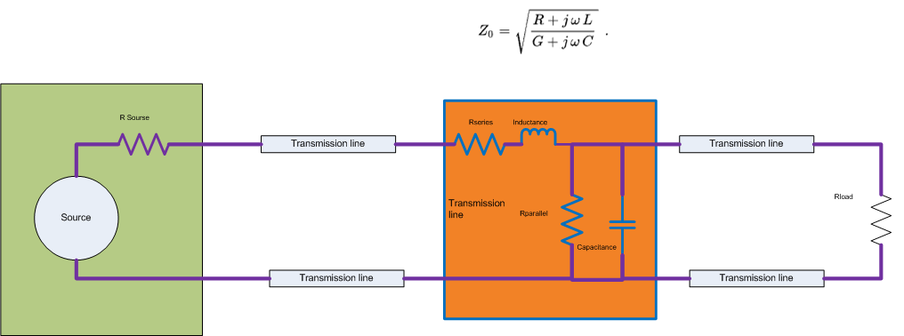
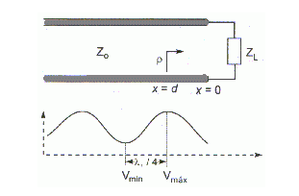
VSWR Waveform
Circuit
Notes:
The circuit comprises of a generator with a source impedance, A transmission line and a source resistance.
The diagram illustrates the maximum power theorem where the transfer of power from source to load is when the source matches the load.
In RF transmitters the load is zero, but conjugally matched so the source works on the slope of the maximum power curve which results:
If the source is not zero the reflected power will be dissipated in the source. The real danger is high voltages being developed across the source from reflection flashing over and destroying your transmitter.
Due to the zero impedance of the transmitter, the output power will all go out to the load.
The losses are the continual reflections over the cable being absorbed by the cable losses in both directions.

Slide 6
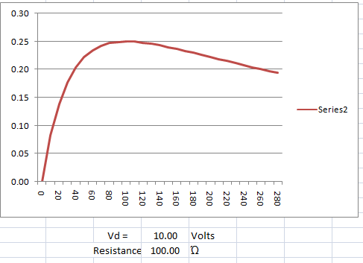
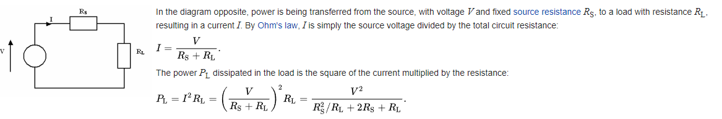
Maximum power transfer theorem
The theorem shows the maximum power transfer with source and resistance set to 100Ώ
Notes:
The left graph shows the maximum power transfer theorem with a 100Ώ source resistance and a load which varies between 0Ώ to 2000 Ώ.
The right graph shows the setting a transmitter source output resistance of 0.1 Ώ and load resistance of approx 50 Ώs on the same curve.

Slide 7
Some more Definitions
What is VSWR?
VSWR is the acronym for Voltage (Standing Wave Ratio).
VSWR has no units, its a ratio of the max and min values of the standing wave.
VSVR value can be between 1 to ∞ or 1 to 0.
Some features of VSWR
The max and min occur every ¼λ
Repeats every ½λ (Smith chart repeats likewise)
Short circuit would give 0 volts and 2*I amps; zero power
Where I and V are the matched currents and voltages
Open circuit would give 2*V and 0 amps; zero power
SWR meters measure incident and reflected power

Slide 8
This is based on the Reflection Coefficient (Γ)
What is the value of VSWR:
VSWR = (1-Γ)/(1+Γ)
VSWR:
This is based on the derivation of the reflection coefficient (Γ).
The reflection coefficient is the ratio of the max reflected voltage to the min reflected voltage.
The max and min occur at every quarter wavelength.
Notes:
What is the value of VSWR
The value of VSWR is an indication of the goodness of a transmission system
What is VSWR
VSWR is based on the reflection coefficient. The reflection coefficient is the ratio of the maximum value of the reflection to the minimum reflection voltage.

Slide 9
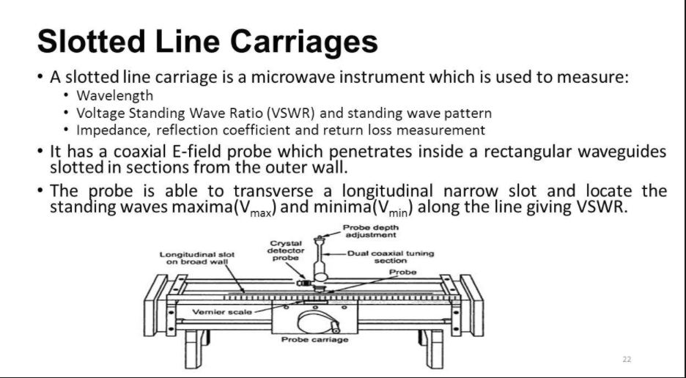
Simple way of measuring VSWR
Notes:
The slotted line was the classic way of measuring WSWR and the frequency of the signal.
The carriage first find the first maximum closest to the load and the position and DC value noted.
The carriage is then moved back to find the minimum and the position and DC value noted.
The distance between first and second calculated and this is a quarter wavelength distance.
The velocity of propagation is 1, i.e. the wave travels at the speed of light, so using the speed of light the wavelength can be calculated.
The frequency is the inverse of wavelength.
The two DC values are reflection coefficients and using the VSWR formulas.
Note: Probe is inserted to minimise the disturbance in the field inside the coaxial line (Air spaced).

Slide 10
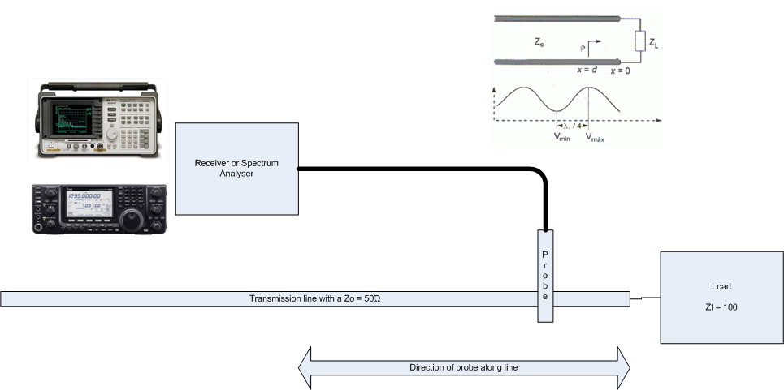
VSWR Measurement.
Receiver approach.
It is useful if you know the velocity of propagation of the cable. (A number between 0 and 1)
Notes:
Demonstration.
The test set shows a simple method of finding the VSWR and knowing the propagation constant a simple method to calculate the frequency of transmission.
Frequency =(Speed of light * Velocity of propagation) divided by (distance in meters between two maximum voltage times 4)

Slide 11
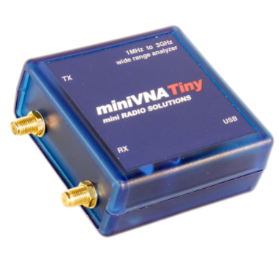
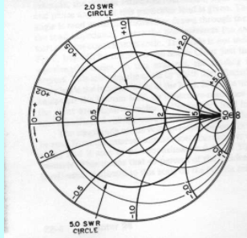
Using a network analyser (Mini MVNA tiny)
Frequency range 50MHz to 3GHz
Cal kit: Short Circuit, Open Circuit and Load.
Display: Cartesians (XY plot) or Smith chart.
VSWR requires one port.
Notes:
Smith Chart showing VSWR circles.
Named after its inventor, Phillip H. Smith (Bell Laboratories), the Smith Chart was originally described in Electronics for January 1939.

Slide 12
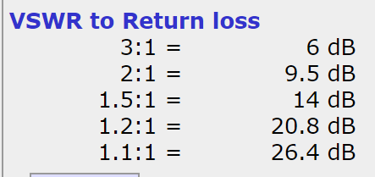
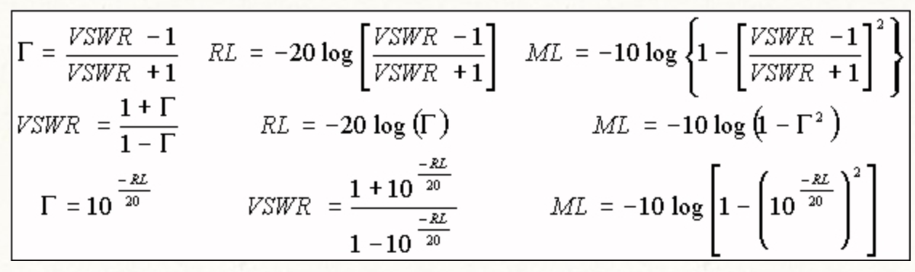
Useful Formulas
Definitions:
Γ = Reflection coefficient
RL = Return loss
ML = Mis-Match loss
Notes:
Mismatch loss in transmission line theory is the amount of power expressed in decibels that will not be available on the output due to impedance mismatches and signal reflections.
A transmission line that is properly terminated, that is, terminated with the same impedance as that of the characteristic impedance of the transmission line, will have no reflections and therefore no mismatch loss.
Mismatch loss represents the amount of power wasted in the system.
Γ = Reflection coefficient
RL = Return loss
ML = Mis-Match loss
Return loss is the loss of power in the signal returned/reflected by a discontinuity in a transmission line or optical fiber. Increasing return loss corresponds to lower SWR. Return loss is a measure of how well devices or lines are matched.
A match is good if the return loss is high. A high return loss is desirable and results in a lower insertion loss.
Return loss is used in modern practice in preference to SWR because it has better resolution for small values of reflected wave.^{[1]}
Mismatch loss (ML) is the ratio of incident power to the difference between incident and reflected power:

Slide 13
Mis-Match Test Cases
Test case 1 |  |  |  |  |  | Test case 2 |  |  |  |  |  | Test case 3
100 | watts |  | 20.00 | dBW |  | 100 | watts |  | 20.00 | dBW |  | 100 | watts |  | 20.00 | dBW
 |  |  | 50.00 | dBm |  |  |  |  | 50.00 | dBm |  |  |  |  | 50.00 | dBm
Return loss |  |  | 3.00 | dB |  | Return loss |  |  | 9.50 | dB |  | Return loss |  |  | 20.80 | dB
Power |  |  | 50.12 | Watts |  | Power |  |  | 11.22 | Watts |  | Power |  |  | 0.83 | Watts
 |  |  | 17.00 | dBW |  |  |  |  | 10.50 | dBW |  |  |  |  | -0.80 | dBW
Power transmitted to load |  |  | 49.88 | Watts |  | Power transmitted to load |  |  | 88.78 | Watts |  | Power transmitted to load |  |  | 99.17 | Watts
 |  | VSWR = | 5.85 |  |  |  |  | VSWR = | 2.01 |  |  |  |  | VSWR = | 1.20
Notes:
This shows that a perfect VSWR of 1 to 1 is not important. What is important is to get an acceptable VSWR across the band.
With a VSWR of 2 : 1 only looses 10 watts.
Because of reflection from the Tx end this power actually goes up the antennas. The power loss is due to the cable losses in both directions.

Slide 14
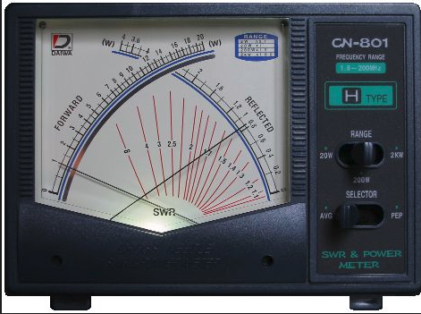
VSWR meters
The picture depicts a typical VSWR meter
The important point is that the two scales indicate power. (Incident and reflective)
From these two readings the return loss is calculated.
From the return loss the VSWR is calculated
This calculation is shown in the excel computation below and this is calculated by the meter in the VSWR curves in red and the indicated VSWR is where the two needles cross.
 |  | From Return loss to VSWR
 |  | incedent power |  | 100.00 | mw |  | 20.00 | dBm
 |  | Reflected power |  | 10.00 | mw |  | 10.00 | dBm
 |  | Transmitted power |  | 90.00 | mw |  | 19.54 | dBm
 |  | Return loss = |  | 10.00 | dB |  | 10.00 | dB
 |  | Mis-Match loss = |  | 0.46 | dB
 |  | VSWR = |  | 1.92 | :1

Slide 15
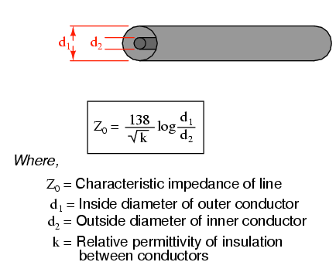
Common transmission lines
If the transmission line is coaxial in construction, the characteristic impedance follows a different equation:
Calculation of the line impeadance
 | d1 = | 3.00 | mm
 | d2= | 2.00 | mm
 | k = | 1.00 | permitivity
 | Z0 = | 24.30
Notes:
The characteristic impedance is proportional to diameter d1 and inversely proportional to the diameter d2.
Increase diameter d2 reduces characteristic impedance
Increase diameter d1 to increase characteristic impedance

Slide 16
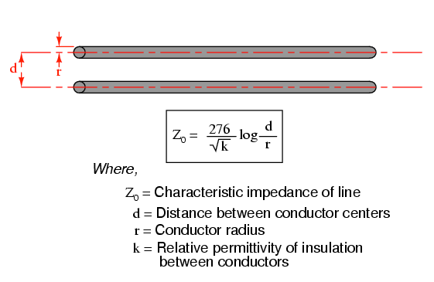
Common transmission lines
For a parallel-wire line with air insulation, the characteristic impedance may be calculated as such:
Calculation of the line impedance
 | d = | 3.00 | mm
 | r = | 2.00 | mm
 | k = | 1.00 | permitivity
 | Z0 = | 48.60
Calculation of the line impeadance
 | d = | 23.40 | mm
 | r = | 1.00 | mm
 | k = | 1.00 | permitivity
 | Z0 = | 377.90
Notes:
The characteristic impedance is proportional to distance and inversely proportional to the diameter.
Increase diameter reduces characteristic impedance
Increase spacing to increase characteristic impedance
The 50 ohm example is not physically possible with these wire radius.

Slide 17
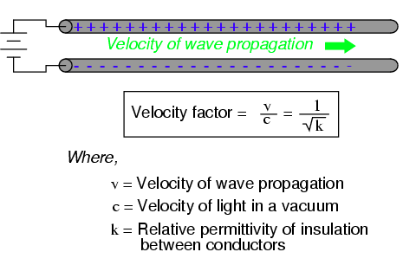
Velocity factor
Velocity factor is purely a factor of the insulating material’s relative permittivity (otherwise known as its dielectric constant), defined as the ratio of a material’s electric field permittivity to that of a pure vacuum. The velocity factor of any cable type—coaxial or otherwise—may be calculated quite simply by the following formula:
Velocity of propogation
 | k = | 1.00 | permitivity
Notes:
Permittivity of air -= κ_{air} = 1.0006.
Velocity in a vacuum = 3 * 10 ^ 8 m/s
Velocity in air = 2.99955 * 10 ^ 8 m/s
Difference is 0.0015%

Slide 18
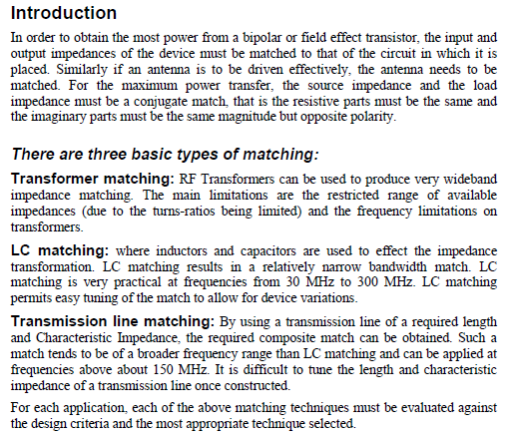
VSWR and its relationship to Transmitter amplifier
The transmitter has to get all the power to the antenna structure. (Transmission line and antenna).
The power amplifier must be matched to the transmission system.
It must be able withstand full reflected power.
It must be efficient in the use of input power.

Slide 19
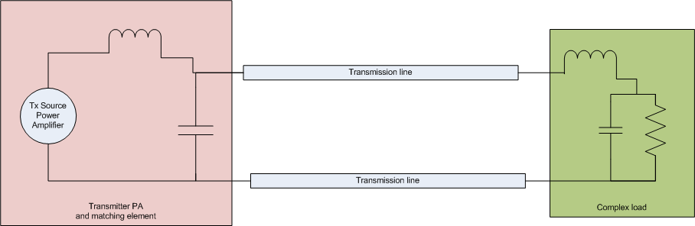
Transmitter Equivalent Circuit
The circuit below depicts a typical circuit for a transmitter PA delivering power to a complex load via a transmission line
Notes:
There is a theorem that is called the maximum transfer theorem which states:
The maximum power transferred is when then the source and load are matched. If it is RF then the transmission line must be of the same impedance.
This results the source dissipating the same power as the load. Not good for Power RF Amplifiers.
So the source output resistance tends to be zero. (Maximum power transfer theorem ???????)
The way around it is to use part of the maximum power curve which tends to zero dissipation in the source and the problems are:
The source has to be conjunctively matched to the line to give maximum power.
The load must be matched to the transmission line to absorb maximum power.
The line has to loss-less to transmit the power.

Slide 20
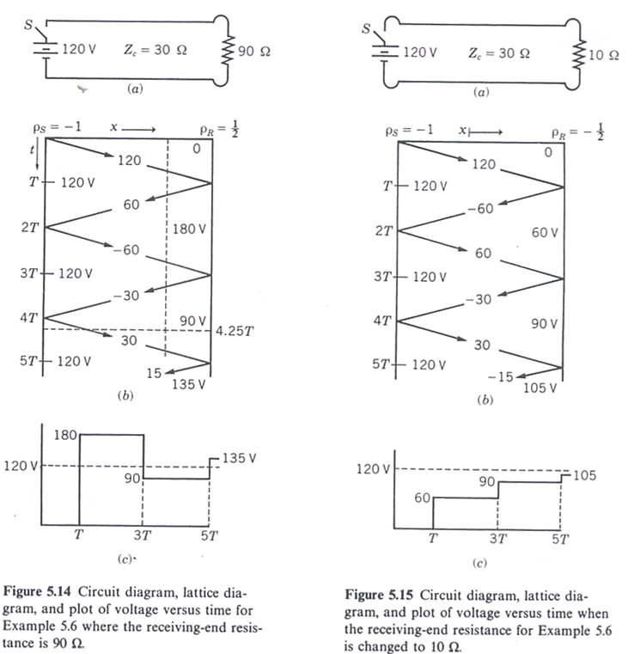
Lattice (bounce) diagram
This is a space/time diagram which is used to keep track of multiple reflections.
Ideal voltage source
z
z
Voltage at the receiving end

Slide 21
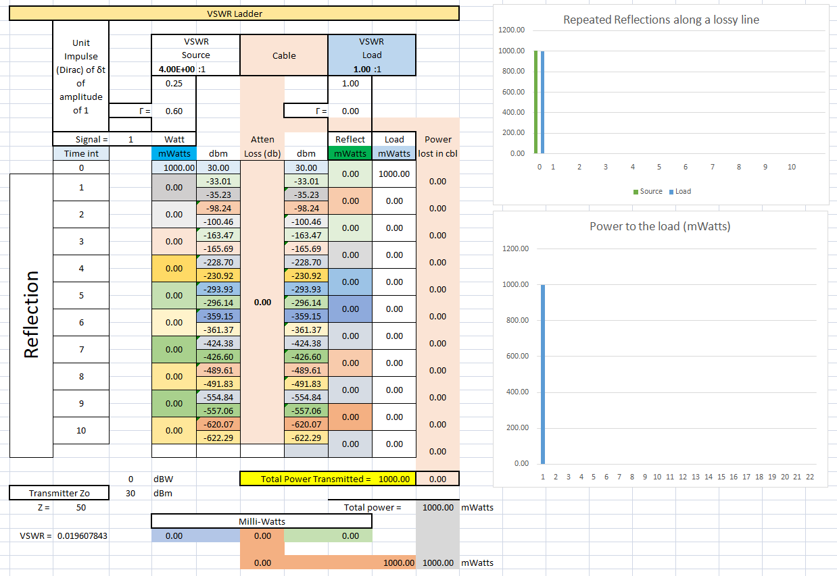
Ladder diagram showing the reflection in a cable driven by an impulse function
Notes:
The ladder shows the reflections in a transmission line
It will demonstrate the various scenarios:
Source at zero and various mismatches which demonstrates how the output transmit all the power.
How a lossy line absorbs power in both direction
Show where the power is absorbed.

Slide 22
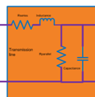
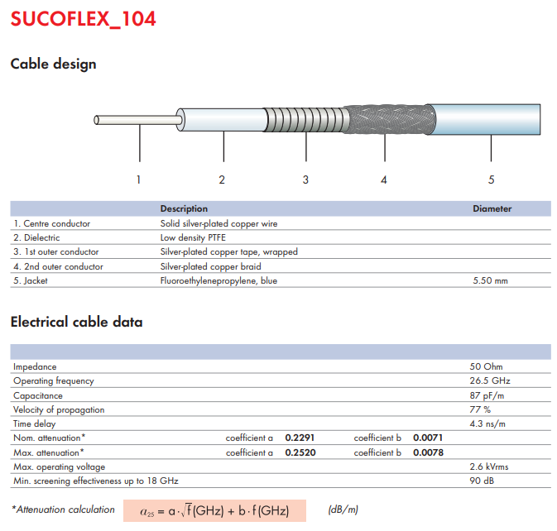
Confirming the cable constants of a Sucoflex 104E coax cable

Slide 23
Practical implications of SWR
The most common case for measuring and examining SWR is when installing and tuning transmitting antennas. When a transmitter is connected to an antenna by a feed line, the driving point impedance of the antenna must be resistive and matching the characteristic impedance of the feed line in order for the transmitter to see the impedance it was designed for (the impedance of the feed line, usually 50 or 75 ohms).
The impedance of a particular antenna design can vary due to a number of factors that cannot always be clearly identified. This includes the transmitter frequency (as compared to the antenna's design or resonant frequency), the antenna's height above the ground and proximity to large metal structures, and variations in the exact size of the conductors used to construct the antenna.^{[4]}
When an antenna and feed line do not have matching impedances, the transmitter sees an unexpected impedance, where it might not be able to produce its full power, and can even damage the transmitter in some cases.^{[5]} The reflected power in the transmission line increases the average current and therefore losses in the transmission line compared to power actually delivered to the load.^{[6]} It is the interaction of these reflected waves with forward waves which causes standing wave patterns,^{[5]} with the negative repercussions we have noted.^{[7]}
Matching the impedance of the antenna to the impedance of the feed line can sometimes be accomplished through adjusting the antenna itself, but otherwise is possible using an antenna tuner, an impedance matching device. Installing the tuner between the feed line and the antenna allows for the feed line to see a load close to its characteristic impedance, while sending most of the transmitter's power (a small amount may be dissipated within the tuner) to be radiated by the antenna despite its otherwise unacceptable feed point impedance. Installing a tuner in between the transmitter and the feed line can also transform the impedance seen at the transmitter end of the feed line to one preferred by the transmitter. However, in the latter case, the feed line still has a high SWR present, with the resulting increased feed line losses unmitigated.
The magnitude of those losses are dependent on the type of transmission line, and its length. They always increase with frequency. For example, a certain antenna used well away from its resonant frequency may have an SWR of 6:1. For a frequency of 3.5 MHz, with that antenna fed through 75 meters of RG-8A coax, the loss due to standing waves would be 2.2 dB. However the same 6:1 mismatch through 75 meters of RG-8A coax would incur 10.8 dB of loss at 146 MHz.^{[5]} Thus, a better match of the antenna to the feed line, that is, a lower SWR, becomes increasingly important with increasing frequency, even if the transmitter is able to accommodate the impedance seen (or an antenna tuner is used between the transmitter and feed line).
Certain types of transmissions can suffer other negative effects from reflected waves on a transmission line. Analogue TV can experience "ghosts" from delayed signals bouncing back and forth on a long line. FM stereo can also be affected and digital signals can experience delayed pulses leading to bit errors. Whenever the delay times for a signal going back down and then again up the line are comparable to the modulation time constants, effects occur. For this reason, these types of transmissions require a low SWR on the feed line, even if SWR induced loss might be acceptable and matching is done at the transmitter.

Slide 24
Review
Standing waves are waves of voltage and current which do not propagate (i.e. they are stationary), but are the result of interference between incident and reflected waves along a transmission line.
A node is a point on a standing wave of minimum amplitude.
An antinode is a point on a standing wave of maximum amplitude.
Standing waves can only exist in a transmission line when the terminating impedance does not match the line’s characteristic impedance. In a perfectly terminated line, there are no reflected waves, and therefore no standing waves at all.
At certain frequencies, the nodes and antinodes of standing waves will correlate with the ends of a transmission line, resulting in resonance.
The lowest-frequency resonant point on a transmission line is where the line is one quarter-wavelength long. Resonant points exist at every harmonic (integer-multiple) frequency of the fundamental (quarter-wavelength).

Slide 25

The End
Any questions
No!!!
then Time for Tea

