Slide 1
BBHN HSMM
Amateur Radio Mesh Data Network
An introductory talk by Peter 2E0PGS, Martin G7NSY and Rob 2E0RPT (via Video Link)
at The North Bristol Amateur Radio Club (NBARC)

Slide 2
Contents
What is BroadBand-HamNet (BBHN)
What is a Mesh?
Why BBHN? What is in it for me?
Demonstrations of Practical Use of BBHN
How do I get started?
Where do I get help?
BBHN Membership is FREE!!

Slide 3
What is BBHN ?
BroadBand-HamNet (BBHN) was known as High Speed Multi-Media (HSMM) Mesh by ARRL
High Speed 54 Mbps vs Packet 1200bps (45,000 x) / 9,6kbps (5,625 x)
Special Firmware based on OpenWRT (developed by HAM) that transforms consumer Wi-Fi Routers for specialised ham radio functions – Open Source! FREE!
Channels 1-6 of Wi-Fi are within Ham Bands
A Mesh Network - Data can be transferred at high speed. Over RF (on Microwave Bands)
Standard TCP/IP Data Network with Automatic Configuration and Neighbor Discovery (OSLR)
LOW COST HARDWARE
Cheap to get started in Microwave Communications

Slide 4
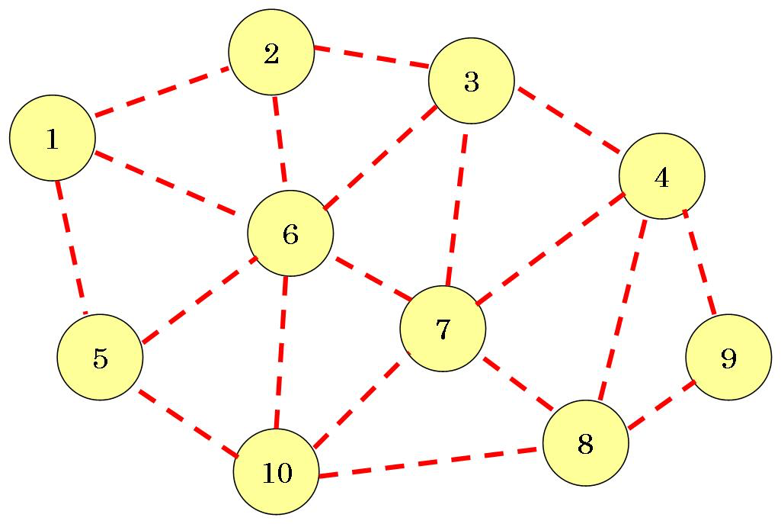
What is a MESH ?
Not Mesh (Mashed) Potato !!
A network made up of Inter-connected nodes over RF (or over other types of medium) allowing data to be sent from ANY one Node to ANY OTHER Node.
Data can be sent directly between neighboring nodes
Data can ALSO be sent via one or more “transit” node(s)

Slide 5
What is in it for me ?
Data ? More than just Data
Voice (Echo Link, VoIP)
Text Chat
APRS
Web Pages
Video Streaming (DATV)
Repeaters Linking (DMR, D-Star)
Personal Radio Hotspot
Software Defined Radio (SDR)
Remote Control / Remote Station
Endless Possibilities
Not to replace traditional HAM operations BUT add MORE FUN
SDR-Based Signal Directional Finding (Simultaneous RX + Analysis Realtime Triangulation and Positioning) - Proposed by Martin G7NSY

Slide 6

Guest Presenter Rob 2E0RPT
Over to ROB 2E0RPT (Video Link)
VIDEO LINK over BBHN

Slide 7
Demonstrations
A Typical BBHN Node
Webpages
TowerCam
Weather Station
Video Streaming

Slide 8
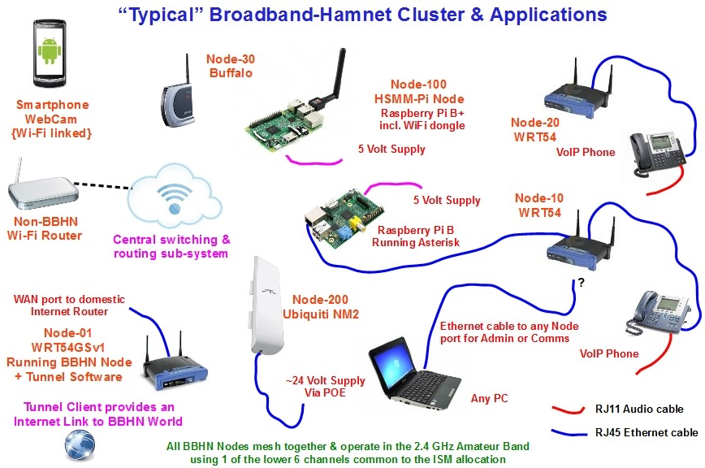
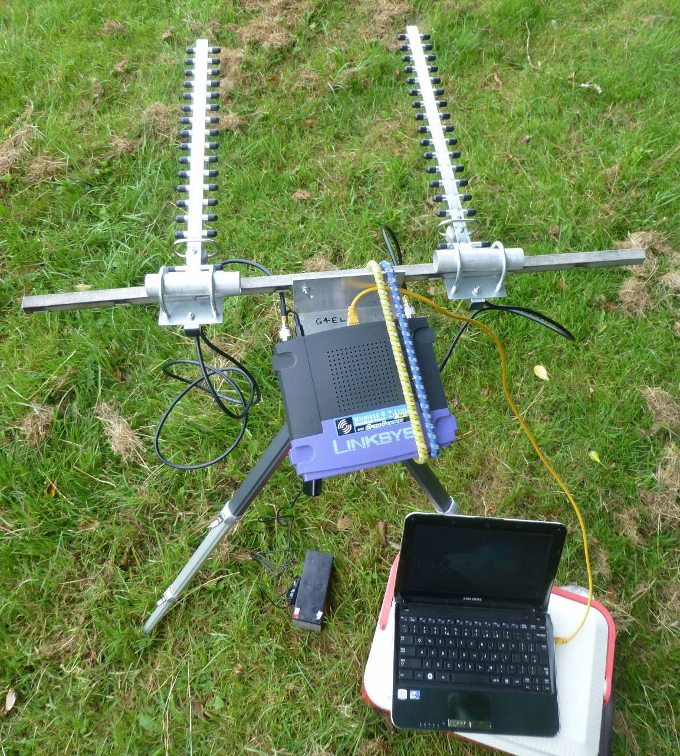
Be Part of the fun….
Courtesy of Ted G4ELM

Slide 9
How do I get started
Find the suitable Wi-Fi Router (Linksys on Ebay from less than £10, Raspberry Pi £30, Ubiquiti Devices £80)
Load the correct firmware onto the router www.broadband-hamnet.org
Find an appropriate antenna (Directional Yagi £8, Directional Panel Antenna £9, Omni-directional White-Stick £30, or even a Dish £50)
Plug-in your computer, setup your callsign as per instructions, then you are done!
Rob, 2E0RPT runs BBHN-UK support website: bbhnuk.onthewifi.com
Peter 2E0PGS and Martin G7NSY offer help locally in Bristol, bring in your hardware and we will help you out.

Slide 10

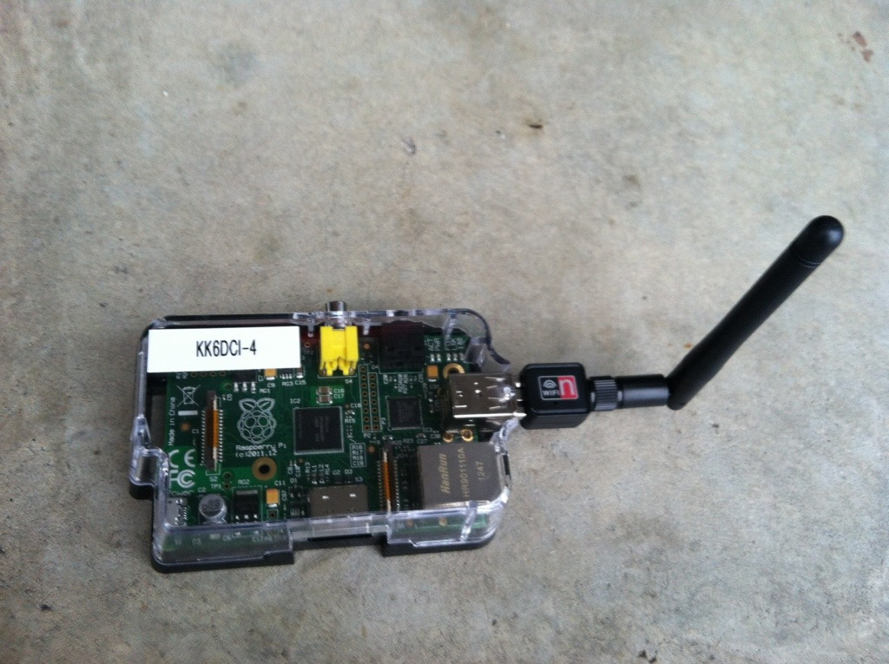

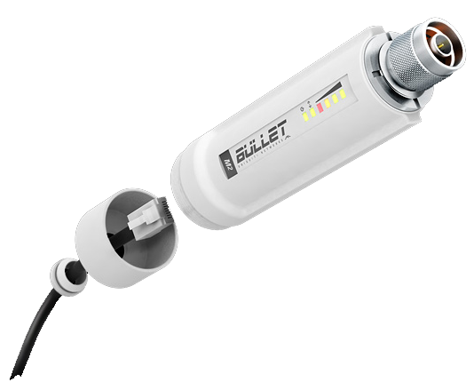
Hardware
Linksys WRT-54GS/GL
Raspberry Pi
Ubiquiti Bullet M2
Ubiquiti Nanostation M2
WRT-54GS v1, v2, v3 are the best ones to get as they have more flash memory and system memory.
Approx 19dBm (69mW) Power
Needs RP-TNC adapters if you wish to use external antenna.
A cheaper Buffalo WHR-HP-G54 will also do the job.
Any Raspberry Pi
USB WI-Fi Dongle
Power will depend on the Wi-Fi Dongle
Uses HSMM-Pi Firmware
N-Type Connector
Plenty of flash memory and Flash Memory
High Power 28dBm (630mW)
Beware of stock firmware new than version 5.5.X. Downgrade firmware first before installing BBHN-Firmware
Internal Antenna 10dBi
Plenty of flash memory and Flash Memory
High Power 28dBm (630mW)
Beware of stock firmware new than version 5.5.X. Downgrade firmware first before installing BBHN-Firmware

Slide 11
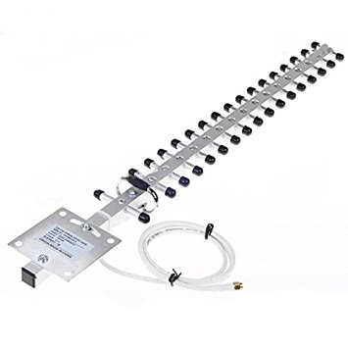


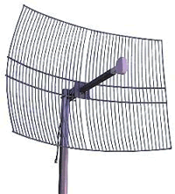
Antenna
Yagi Antenna
Panel Antenna
Co-linear Antenna
Dish Antenna
Directional
Typical Gain for a meter long boom length is approx 18dBi or higher
Directional
Small, typical gain 6 – 18dBi
Omni Directional
Typical Gain 10-15dBi
Directional
Very narrow beam width
Very High Gain >24dBi

Slide 12
Announcing your presence
Once you have got everything setup, it would be the best to make your node known...
Peter 2E0PGS will talk about how this is done
Over to Peter...

Slide 13
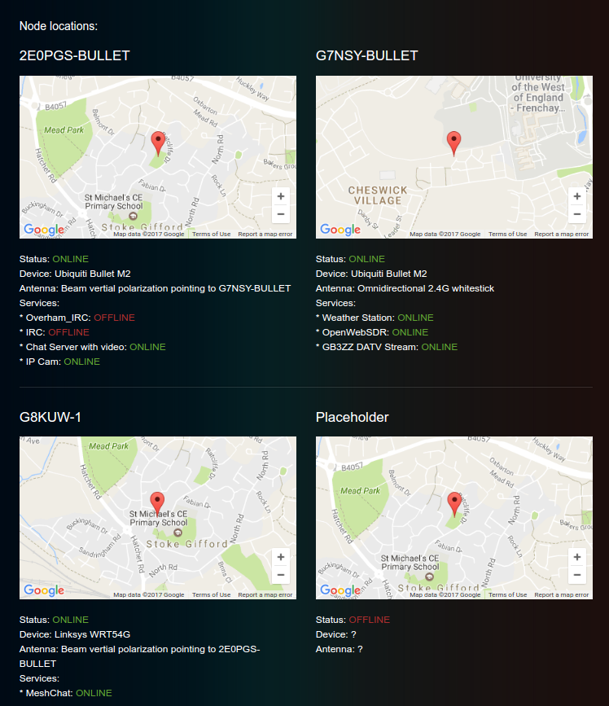
Where can I see the nodes on a map?
2E0PGS Website: http://m3pgs.weebly.com/hsmm-mesh.html

Slide 14
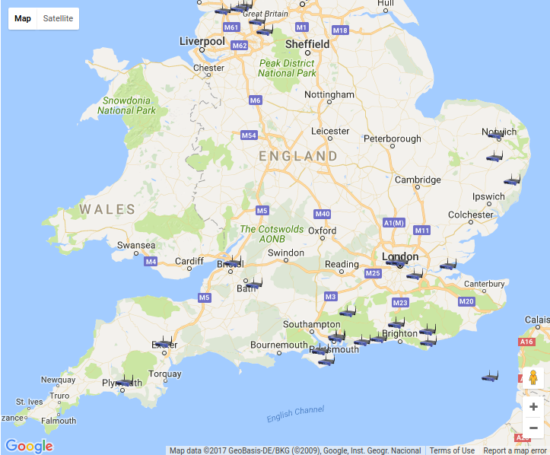
Where can I see the nodes on a map continue...
Broadband-Hamnet.org: http://www.broadband-hamnet.org/googlemapped-mesh-nodes.html

Slide 15
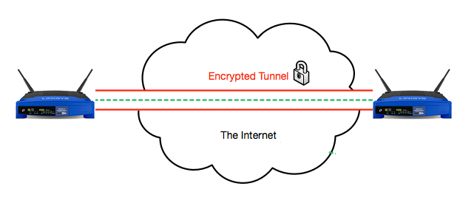
Join the world
via RF Beam and hunt for the nearest node
if no near-by node can be found, you can connect still get yourself connected via Tunneling over the Internet
Your Node
Partner Node
BBHN – Tunneling over the internet
You can of course do both RF + Tunneling to maximise your reach….

Slide 16
Example basic setup

Slide 17
BBHN UK
bbhnuk.onthewifi.com
Driving Force behind Amateur Radio Mesh Network in UK
Free Membership
Commitment Free
Promote BBHN
Free Support
A cheap way to start microwave and advanced digital communications

Slide 18
Special Thanks
Ted, G4ELM – One of the first pioneers to start and to promote BBHN in UK, also help us to revise this talk
Rob, 2E0RPT – Thanks for his remote presentation as well as running BBHN UK Support Site
And Everyone who joined the talk

