Slide 1
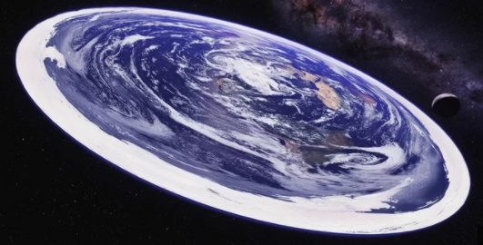
Oh what a lovely load of Garbage
Only 66 percent of 18- to 24-year-olds in the U.S. are confident that the world is round, according to a new national survey.
Notes:
Only 66 percent of 18- to 24-year-olds in the U.S. are confident that the world is round, according to a new national survey.
The findings don't necessarily indicate an epidemic of flat-Earthism, as only 4 percent of the 18- to 24-year-old age group said they actually believe the world is flat. Rather, there seem to be a relatively large number in this age group who are willing to entertain doubts: 9 percent said they had always believed the world was round but were recently having doubts, 5 percent said they had always believed the world was flat but were becoming sceptical of that conclusion and 16 percent just weren't sure.
Flat-Earth philosophy has been around since the 19th century, but it has recently blown up online, particularly on YouTube and Twitter. Believers post videos and memes arguing their case for a flat Earth and positing conspiracy theories to explain away everything that makes it clear that the planet is, in fact, a globe.

Slide 2
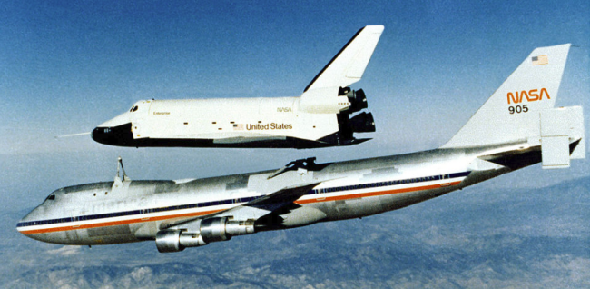
Facts and figures about the shuttle
Shuttle performance:
Shuttle empty = 165000 pounds, 73.7 tons.
External tank empty = 78100 pounds, 34.8 tons.
Solid rocket boosters empty each = 186000 pounds, 83 tons.
Each solid rocket booster holds = 1.1 million pounds of fuel, 491 tons.
Gross lift off weight is 4.5 million pounds, 2009 tons.
Velocity 17500 mph.
Orbit range 115 to 400 miles.
Total trust at lift off is 7 million pounds (3125 tons)
Main engine provides (3 off) 3.7 million pounds of thrust.
Payload into orbit LEO( 60000 pounds 26.7tons).
Payload to ISS (35380 pounds, 15.8 tons).
Payload to GTO (8400 pounds, 3.75 tons).
Main engine lifetime of 27000 seconds. (equivalent to 55 missions).
Cost of launch in 2011 is $1.5 billion.
Riding the Booster with enhanced sound.mp4
Notes:
Empty a swimming pool in three seconds
The thrust of shuttle is less than a Saturn five 7.5 million pounds.
GTO = Geo Transfer Orbit (PAM-D satellite booster).
Escape velocity is about MAC 33 which is about 20000 MPH.

Slide 3
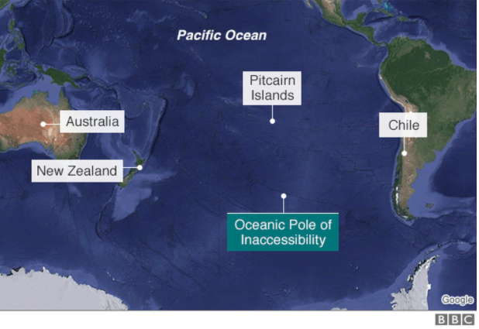
Spacecraft grave-yard. Pole of inaccessibility
This oceanic pole of inaccessibility is not only of interest to explorers, satellite operators are interested in it as well. That's because most of the satellites placed in orbit around the Earth will eventually come down, but where?
Smaller satellites will burn up but pieces of the larger ones will survive to reach the Earth's surface. To avoid crashing on a populated area they are brought down near the point of oceanic inaccessibility.
Scattered over an area of approximately 1,500 sq km (580 sq miles) on the ocean floor of this region is a graveyard of satellites. At last count there were more than 260 of them, mostly Russian.
Notes:
Explorers and adventurers often look for new places to conquer now that the highest peaks have been climbed, the poles reached and vast oceans and deserts crossed.
Some of these new places are called the poles of inaccessibility. Two of them are particularly interesting.
One is called the continental pole of inaccessibility - it's the place on Earth furthest from the ocean. There is some debate as to its exact position but it's considered by many to be near the so-called Dzungarian Gate - a mountain pass between China and Central Asia.
The equivalent point in the ocean - the place furthest away from land - lies in the South Pacific some 2,700km (1,680 miles) south of the Pitcairn Islands – somewhere in the no-man's land, or rather no-man's-sea, between Australia, New Zealand and South America.
This oceanic pole of inaccessibility is not only of interest to explorers, satellite operators are interested in it as well. That's because most of the satellites placed in orbit around the Earth will eventually come down, but where?
Smaller satellites will burn up but pieces of the larger ones will survive to reach the Earth's surface. To avoid crashing on a populated area they are brought down near the point of oceanic inaccessibility.
Scattered over an area of approximately 1,500 sq km (580 sq miles) on the ocean floor of this region is a graveyard of satellites. At last count there were more than 260 of them, mostly Russian.

Slide 4
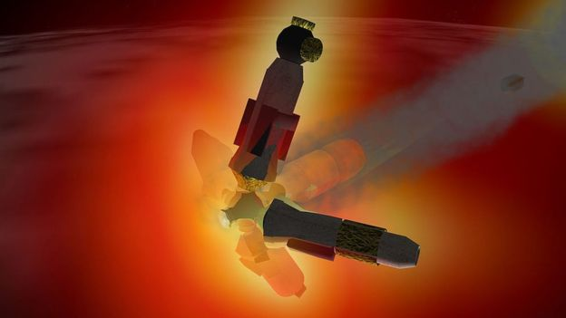
Artists impression of the re-entry of MIR in 2001
Launched in 1986 and dumped in the ocean in 2001, with fragmenting mass of 120 tons
Notes:
The wreckage of the Mir space station lies there. It was launched in 1986 and was visited by many teams of cosmonauts and international visitors.
With a mass of 120 tonnes it was never going to burn up in the atmosphere, so it was ditched in the region in 2001 and was seen by some fishermen as a fragmenting mass of glowing debris racing across the sky.

Slide 5
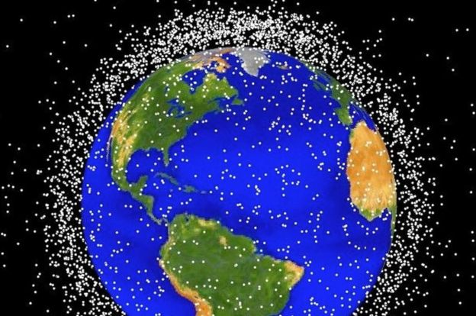
Space Junk in orbit around the earth.
For Geo-stationary satellites the graveyard for spent satellites is a few hundred kilometres above the geo orbit of ≈26000 miles
About 1,100 active satellites, both government and private. Plus there are about 2,600 ones that no longer work. Russia launched the first satellite, Sputnik 1, in 1957.
Vanguard 1 was the first satellite to have solar electric power. Although communication with the satellite was lost in 1964, it remains the oldest man-made object still in orbit, together with the upper stage of its launch vehicle
Notes:
Sometimes however, it's not possible to bring a satellite or space station down in the South Pacific if ground controllers have lost contact with it.
Such a thing happened with the 36-tonne Salyut 7 space station in 1991 which came down in South America or the American Skylab that struck Australia in 1979. No one on the ground was injured, or indeed as far as we know, ever has been hit by a piece of falling spacecraft debris.
We will face that problem again next year.
Between January and April the Chinese Tiangong-1 will come back to Earth. It was launched in 2011 as China's first space station. The following year it was visited by China's first female astronaut, Liu Yang.
Tiangong-1's orbit is decaying as it heads towards re-entry. But Chinese engineers have lost control of it and cannot fire its thrusters to bring it down in the South Pacific.
Instead it will come down somewhere between 42.8 degrees north and south. That's between the latitude of northern Spain and southern Australia, and we won't be able to be more precise than that until just a few hours before it burns up.
Tiangong-1 is one space station that probably won't join its companions in the remote South Pacific.

Slide 6
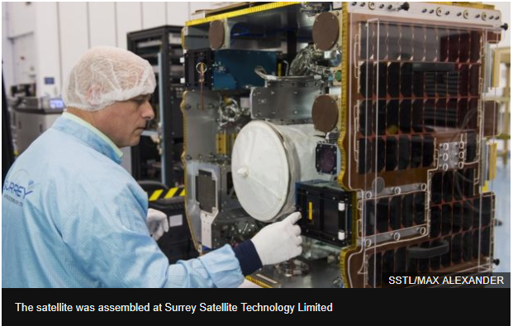
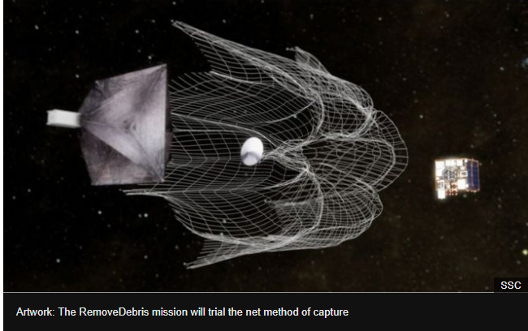
Launch of a debris clearer Trials will start in May 2018
A UK-led experiment to tackle space junk has been sent into orbit.
It takes the form of a small satellite that will practise techniques for tracking debris and capturing it.
The RemoveDebris system is heading to the International Space Station where astronauts are expected to set the experiment running in late May.
Space debris - efforts to clean up space.mp4
Notes:
The 100kg demonstrator left Earth on Monday onboard a SpaceX Falcon 9 rocket. It should arrive at the ISS on Wednesday.

Slide 7
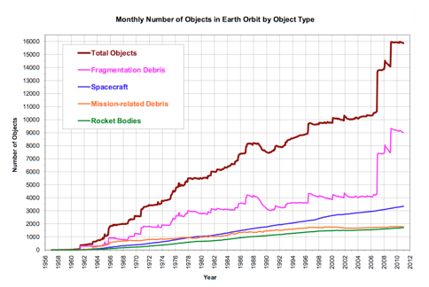
Objects in Orbit

Slide 8
How much junk is up there, satellites I mean!
How many of these orbiting satellites are working? The Union of Concerned Scientists (UCS) keeps a record of the operational satellites and you may be surprised to know that only 37.5% of the orbiting satellites are active, just 1 738 according to the August 2017 update.
This means that there are 2 897 pieces of junk metal hurtling around the Earth at high speed!
According the UCS the main purposes for the operational satellites are:
Communications: 742 satellites
Earth observation: 596 satellites
Technology development/demonstration: 193 satellites
Navigation/Positioning: 108 satellites
Space science: 66 satellites
Earth science: 24 satellites
Space observation: 9 satellites

Slide 9
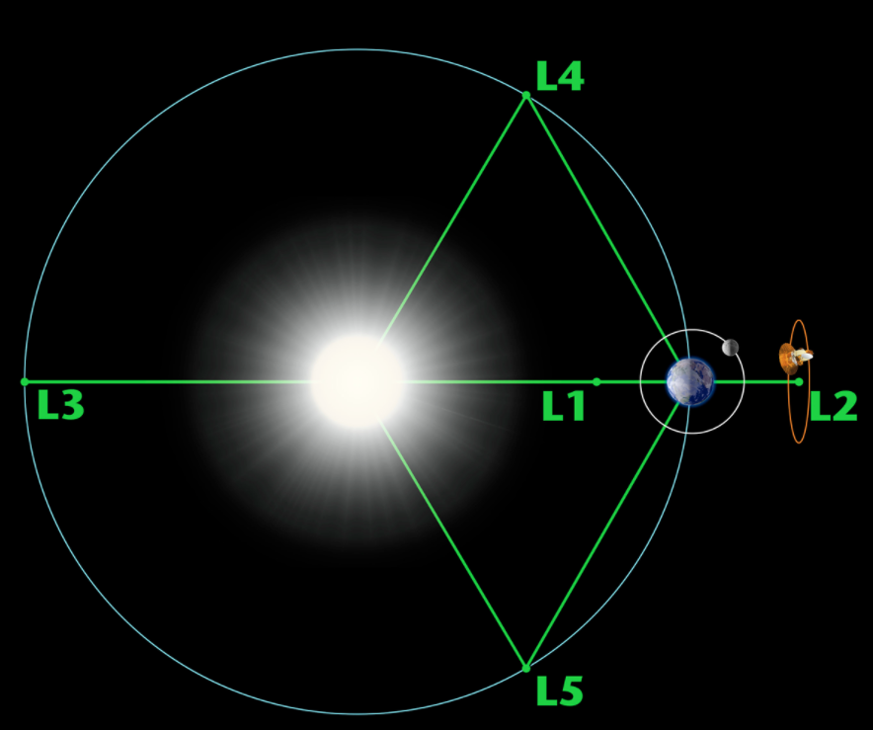
The five Lagrange points
centrifugal force felt by a much smaller third body. The interaction of the forces creates a point of equilibrium where a spacecraft may be "parked" to make observations.
These points are named after Joseph-Louis Lagrange, an 18th-century mathematician who wrote about them in a 1772 paper concerning what he called the "three-body problem." They are also called Lagrangian points and liberation points.
NASA - 'L2' Will be the James Webb Space Telescope's Home in Space
lagrange points animation.mp4
Notes:
A Lagrange point is a location in space where the combined gravitational forces of two large bodies, such as Earth and the sun or Earth and the moon, equal the centrifugal force felt by a much smaller third body. The interaction of the forces creates a point of equilibrium where a spacecraft may be "parked" to make observations.
These points are named after Joseph-Louis Lagrange, an 18th-century mathematician who wrote about them in a 1772 paper concerning what he called the "three-body problem." They are also called Lagrangian points and liberation points.
Structure of Lagrange points
There are five Lagrange points around major bodies such as a planet or a star. Three of them lie along the line connecting the two large bodies. In the Earth-sun system, for example, the first point, L1, lies between Earth and the sun at about 1 million miles from Earth. L1 gets an uninterrupted view of the sun, and is currently occupied by the Solar and Heliospheric Observatory (SOHO) and the Deep Space Climate Observatory.
L2 also lies a million miles from Earth, but in the opposite direction of the sun. At this point, with the Earth, moon and sun behind it, a spacecraft can get a clear view of deep space. NASA's Wilkinson Microwave Anisotropy Probe (WMAP) is currently at this spot measuring the cosmic background radiationleft over from the Big Bang. The James Webb Space Telescope will move into this region in 2018.
The third Lagrange point, L3, lies behind the sun, opposite Earth's orbit. For now, science has not found a use for this spot, although science fiction has.
“NASA is unlikely to find any use for the L3 point since it remains hidden behind the sun at all times,” NASA wrote on a web page about Lagrange points. “The idea of a hidden 'Planet-X' at the L3 point has been a popular topic in science fiction writing. The instability of Planet X's orbit (on a time scale of 150 years) didn't stop Hollywood from turning out classics like 'The Man from Planet X.'”
L1, L2 and L3 are all unstable points with precarious equilibrium. If a spacecraft at L3 drifted toward or away from Earth, it would fall irreversibly toward the sun or Earth, "like a barely balanced cart atop a steep hill," according to astronomer Neil DeGrasse Tyson. Spacecraft must make slight adjustments to maintain their orbits.
Points L4 and L5, however, are stable, "like a ball in a large bowl," according to the European Space Agency. These points lie along Earth's orbit at 60 degrees ahead of and behind Earth, forming the apex of two equilateral triangles that have the large masses (Earth and the sun, for example) as their vertices.
Because of the stability of these points, dust and asteroids tend to accumulate in these regions. Asteroids that surround the L4 and L5 points are called Trojans in honor of the asteroids Agamemnon, Achilles and Hector (all characters in the story of the siege of Troy) that are between Jupiter and the Sun. NASA states that there have been thousands of these types of asteroids found in our solar system, including Earth’s only known Trojan asteroid, 2010 TK7.
00:2302:29
L4 and L5 are also possible points for a space colony due to their relative proximity to Earth, at least according to the writings of Gerard O'Neill and related thinkers. In the 1970s and 1980s, a group called the L5 Society promoted this idea among its members. In the late 1980s, it merged into a group that is now known as the National Space Society, an advocacy organization that promotes the idea of forming civilizations beyond Earth.
Benefits of Lagrange points
If a spacecraft uses a Lagrange point close to Earth, there are many benefits to the location, the Jet Propulsion Laboratory's Amy Mainzer told Space.com.
Mainzer is principal investigator of NEOWISE, a mission that searches for near-Earth asteroids using the Wide-field Infrared Survey Explorer (WISE) spacecraft that orbits close to our planet. While WISE is doing well with its current three-year mission that concludes in 2016, Mainzer said, a spacecraft placed at a Lagrange point would be able to do more.
Far from the interfering heat and light of the sun, an asteroid-hunting spacecraft at a Lagrange point would be more sensitive to the tiny infrared signals from asteroids. It could point over a wide range of directions, except very close to the sun. And it wouldn't need coolant to stay cool, as WISE required for the first phase of its mission between 2009 and 2011 — the location itself would allow for natural cooling. The James Webb Space Telescope will take advantage of the thermal environment at the sun-Earth L2 point to help keep cool.
L1 and L2 also “allow you to have enormous bandwidth” because over conventional Ka-band radio, the communication speeds are very high, Mainzer said. “Otherwise, the data rates just become very slow,” she said, since a spacecraft in orbit around the sun (known as heliocentric orbit) would eventually drift far from Earth.
Lagrange point science
Multiple astronomical and Earth observatories are located at Lagrange points, providing a vantage point of our planet and space that you can't get from close-up. Scientists also perform periodic studies of small bodies naturally occurring at Lagrange points. Here are some recent science results:
In 2016, NASA released a video of the Earth spinning through an entire year. The time-lapse was based on 3,000 pictures taken every two hours by the EPIC camera on the Deep Space Climate Observatory (DSCOVR) satellite, which was at L1. Besides showing pretty views, EPIC provides scientists with metrics on climate such as cloud height, ultraviolet reflectivity, or ozone and aerosol levels.
In February 2017, the OSIRIS-REX mission — then on its way to asteroid Bennu — spent about 10 days looking for additional Trojan asteroids in Lagrange points near Earth. "That would be the most fascinating thing we could discover," mission lead scientist Dante Lauretta, a planetary scientist with the University of Arizona's Lunar and Planetary Laboratory, told a NASA science advisory group in January. The search revealed no new Trojans, but perhaps other spacecraft will look again in the future.
A 2017 study suggests that Trojan asteroids near Mars are from the planet, and not captured asteroids from other regions in space. The smoking gun is that at least three of Mars' nine Trojan asteroids are high in olivine. This mineral is rare in asteroids, but common on larger bodies (including Mars, which has it in impact basins). While Earth and Venus have olivine as well, lead author David Polishook, a researcher at the Weizmann Institute in Israel, told Space.com that it's much easier for Mars to capture asteroids from its own surface.
Reference Editor Tim Sharp contributed to this article.
Abstract
In a system of two celestial bodies such as the Sun-Earth and Earth-Moon systems, there are five points where the geometries are right so that the gravitational pulls of the two large bodies are balanced. These points are called Lagrange points and some are stable and allow for objects to remain at the point while others are unstable and require station keeping in order to remain at the point. In the Earth-Moon system, these points allow for stationary observations of the Moon, low energy transfers, supply depot, sample return and possible temporary base or transfer points. This paper will further investigate the uses of the Earth-Moon Lagrange points in these regards for means of exploring and settling the Moon in the coming future.
Introduction
Lagrange Points
For a circular restricted three body problem, the Lagrange points are locations where the gravitational pull of two large bodies is balanced when acting on a third small body. For a two body system like the Earth Moon system, there are five of these points in the rotating coordinate system. Two of the points (L₄ and L₅) are stable and the remaining three (L₁, L₂, and L₃) are unstable. An object inserted exactly at the Lagrange points will remain at all points, stable or unstable, in the three body problem. However, in the real solar system, minor perturbations can cause an object to fall away from an unstable point which then causes the gravity of the two primary bodies to pull the objects further from the unstable points. If the object is located at a stable point, these external perturbations might push the object away from the stable point but the gravity of the two primary bodies will tend to keep the object at the Lagrange point. In order to avoid the effects of these external perturbations, a satellite that wishes to remain at an unstable Lagrange point must perform some minor station keeping maneuvers in order to remain at the Lagrange point. The Earth-Moon Lagrange points are shown below in Figure 1. The arrows represent the gradient of the potential around each of the Lagrange Points. The blue curves around L₄ and L₅ show that those two points are stable. The other three points are saddle points and are stable along the axis between the two primary bodies and are unstable in the other direction.
Figure 1 Earth-Moon Lagrange Points^{[6]}
The circular three body problem can be solved in the circular rotating frame and used to determine the Lagrange points. The problem can be reduced to the CRTBP equations of motion which are then used to find the positions of the points. The positions can be solved by setting velocities and accelerations in the equations of motion equal to 0 in all directions and solving for the positions in the x-y plane. The equations of motion for the CRTBP are shown below.
With these equations the velocity and accelerations are set to 0 and solved for the x and y positions below.
The equations for the x and y positions in the synodic frame are solved for the five Lagrange points. The solutions for the five point positions are shown below.
The Lagrange points are calculated using the equations above and plotted in the Earth-Moon system in Figure 2 below using MATLAB.
Figure 2 Earth-Moon Lagrange Points
While on the surface it seems that the Lagrange points are only useful as stationary points in a circular rotating reference frame, there are more applications for Lagrange points that are not immediately visible. Due to the nature of the three body problem, the Lagrange points have halo orbits that perform periodic motions nearby but do not actually orbit around the point itself. The halo orbits form a family of orbits that have varying sizes. The orbits extend out of the plane of the two primary bodies. An example of a family of Halo orbits is shown below in Figure 3.
Figure 3 L₁ and L₂ Halo Orbits^{[5]}
Along with providing a stable orbit near the Lagrange points, Halo orbits can also provide a stable transfer point by providing low energy manifolds to transfer into and out of the Lagrange orbits. Stable invariant manifolds are manifolds that allow an object to approach and then settle into a halo orbit. Unstable invariant manifolds are the paths that an object in a halo orbit could take after a small perturbation. Both stable and unstable manifolds are zero thrust and can be used as cheap maneuvers to transfer into or out of Lagrange points. An example of a stable manifold into a halo orbit is shown below in Figure 4.
Figure 4 Stable Halo Orbit Manifold^{[5]}
Lissajou orbits and Lyapunov orbits are special quasi periodic orbits that enter a non-periodic, halo like orbit without any thrusts by using a low energy transfer manifold. Lyapunov orbits are in the plane of the two primary bodies while the Lissajou have components both in plane and perpendicular to the plane. Both orbits are important when interacting with halo orbits but the development of both types is not performed here.
Problem of Interest
Lunar Exploration History
The exploration of the lunar surface has historically been performed with Apollo like trajectories that require a tangential burn from an Earth parking orbit then a burn to insert into a low lunar parking orbit. The transfers to the Moon are expensive in terms of delta-V but are relatively short for transfer duration. Transfer orbits of manned missions are created to have a short flight time, while orbiters and impacters have taken these simple Hohmann type trajectories based on flight legacy. Only in recent years have Lagrange points been used as orbits for NASA Missions. ACE, SOHO, and two others have been sent to the Sun Earth L₁ point within the last two decades while three missions including WMAP have been sent to the Sun Earth L₂ point. At the end of the THEMIS A mission, the spacecraft was renamed ARTEMIS and sent into a halo orbit about the Earth-Moon L₁ and L₂. In doing so, ARTEMIS became the first spacecraft to enter halo orbits about the Earth-Moon Lagrange points. The GRAIL mission that recently entered orbit around the Moon performed a low energy ballistic lunar trajectory that flew past the Earth-Moon L₁ point before entering orbit at the Moon. For the most part however, Lagrange points have not been used for missions to or near the Moon.
Lunar Exploration Future
In the coming decades a few rovers and orbiters will be sent to the Moon by different entities around the world. As lunar exploration increases the temporary and more permanent presence of manned missions on the surface of the Moon will play an increasing role. In order to establish a more permanent presence on the surface of the Moon additional infrastructure and support will be needed. Communication satellites like those orbiting Mars will be useful to establish and maintain communications between a crew on the surface and the Earth. To establish a base and manned presence would require a large infrastructure and many launches to the Moon’s surface. Reducing delta-V and therefore fuel for transfer maneuvers will drastically help to reduce the launch costs for creating a base. Launches that do not contain crew can be allowed to take longer to reach the Moon if they instead save a large amount of weight in order to do so. Return trajectories can also have reduced velocity to reduce the requirements on the vehicles that are returning to LEO. Overall, the realm of lunar exploration missions is wide open and has a large range of possible courses for the future.
Extension
To expand the use of lunar Lagrange points, many different possible applications of Earth-Moon Lagrange points are evaluated and applied to the possibility of a future lunar exploration plan. These different applications include low thrust transfers to and from the Moon, sample return missions, halo orbits, and halo orbit manifolds. All of these different aspects of the Lagrange points can add many benefits to the future of lunar exploration and settlement when comparing them to current and past missions.
Low Thrust Transfers
The standard mission to the surface of the Moon is performed by leaving Earth from a parking orbit, performing a velocity maneuver in the parking orbit in order to leave on a direct transfer to the Moon, then performing an additional maneuver to become captured by the mMoon. The lowest total burn for this type of direct transfer is a Hohmann transfer from the parking orbit to the Moon's orbit. In order to reduce the total delta-V, the three body problem that creates the Lagrange point solutions also allows for some low energy transfers that reduce the delta-V required to reach the Moon. There are families of low thrust orbits that use small burns to slowly increase an orbit semi major axis until the orbit reaches the Moon. In addition to the low thrust transfer, there are also families of Ballistic Lunar Trajectories(BLT) that involve a path from Earth out towards the Sun-Earth system L₁ point where the gravitational pull of the sun alters the trajectory of the spacecraft causing it to enter a path towards the Moon where it can then be captured. The three different families of transfers are shown below in Figure 5.
Figure 5 Trajectory Comparisons^{[5]}
The direct transfer with the lowest change in velocity is a Hohmann transfer from the parking orbit to the orbit of the Moon with a burn to be captured on arrival. The Hohmann transfer from a 185 km Earth parking orbit to a 100 km Moon parking orbit is shown in Figure 6 below. The orbit of the Moon is simplified to a circle and the two body assumption is used with the Earth as the central body.Figure 6 Hohmann Transfer
The Hohmann transfer performed using the simplified Moon orbits results in the following values.The minimum velocity change for a direct transfer is 3.957 km/s. This value can be lowered by taking the different transfer routes previously shown. A Low thrust trajectory is not explored further here but the family of orbits can provide some fuel savings for thrusters that fire with low thrust but over a long period of time. A BLT the savings from the BLTs can be further increased by using a BLT to transfer into a halo orbit around a lunar Lagrange point. The fuel savings for these different types of transfers were calculated by Parker for a spacecraft travelling from a low Earth orbit to the L₂ Lagrange point^{[5]}. A direct transfer is compared with increasingly longer flight durations and then transfers to L₁ and eventually some BLTs in Figure 7 below.
Figure 7 Trajectory Burn Comparisons^{[5]}
First the results of the study by Parker^{[5]} show that the direct transfer from LEO to L₂ has the same change in velocity as calculated in the Hohmann case previously shown. The table also shows that the BLT option, while 38 times longer in duration, drastically improve fuel savings. This savings can be directly converted to either a reduction in payload and therefore mass and cost, or it can allow more mass to be sent to the Moon for the same propulsion fuel mass. This increase in mass can have many different applications for future lunar missions.
First, the low thrust transfers can allow for construction materials and supplies to be sent to the Moon ahead of a human crew where they can wait in a halo orbit until construction of a base is ready. The low thrust transfers used in this manner help to decrease the overall size of the first lunar missions used to construct a lunar base. In order to setup a base using an architecture similar to past mission architectures, multiple launches with crew and equipment would be needed. In the same way that the ISS was constructed pieces at a time through many EVA hours, constructing a base will take many EVA man hours even if many portions are setup with the help of robotic prep missions. However, if many of the base components are sent early to the Moon, the number of manned missions can be reduced by not causing them to bring everything with them for each trip to the Moon. These base components can be sent early using a BLT where they wait in a halo orbit until a crew is sent a few months later. In addition to this mission structure reorganization, the low thrust transfers allow up to 35% more equipment to be sent to the Moon for a comparable rocket. This increase in mass per launch reduces the overall number of launches required to send the components of the base to the Moon.
In addition to the initial mass savings for missions to the surface, missions that involve remaining in halo orbits (to be discussed later) can be sent from Earth with only one maneuver performed in the parking orbit. Once the spacecraft is put into the stable manifold of the halo orbit no further maneuvers are needed except for minor station keeping maneuvers to account for external perturbations. By reducing the number of maneuvers, the chance for an incorrect or misaligned maneuver to alter the spacecraft position is reduced. If there is only one maneuver instead of two there is less chance for an error to compromise the mission or force a contingency burn to correct for an error. These missions to Lagrange point halo orbits are also a viable candidate for these low thrust trajectories.
Sample Return
Using a combination of two different low energy transfer orbits, a low energy trajectory from the surface of the Moon to the Earth can be constructed. For a mission without a crew the time of flight is not an important constraint so it can be relaxed in favor of low energy transfers. Lo and Chung^{[3]} perform a simple example of a sample return mission that returns a sample from the far side of the Moon back to Earth. A trajectory that they develop requires only 2.4 km/s to depart the surface of the Moon and take a large orbit out near the Sun-Earth Lagrange points. This orbit takes advantage of some of the Sun-Earth dynamics before returning to the Earth. While the flight is a very low energy transfer, the duration is more than 100 days. This long duration return flight is shown below in Figure 8. The return orbit shown in the left half of the figure completes two large circular orbits that span nearly to the Sun-Earth Lagrange points EL₁ and EL₂. The initial approach from the Earth to the Moon is a Lissajous envelope that allows the lander to land on the back side of the Moon from a halo orbit around L₂.
Figure 8 Low Energy Sample Return^{[3]}
The thrust required to return to the Earth from the surface is only 200 m/s larger than the delta-V required for the ascent stage of Apollo 11. The command module then had to perform a burn to return back to Earth. The thrust savings for the example sample return mission is possible because there is not a crew that needs to return in a matter of a few days instead of a few months. By reducing the delta-V however, samples can be collected on the surface by a crew at a lunar base and they can easily be sent back to Earth with only a small vehicle to send samples autonomously. The sample return mission calculated by Lo and Chung is compared to a return to Earth from the surface of the Moon by performing a Hohmann transfer. The results for the sample return launches are shown below.
In addition to the launch fuel savings shown above, there are also savings gained at the arrival of Earth which is not accounted for above. The return trajectory for the unstable manifold can be pointed to a reentry trajectory with a relatively small maneuver at apoapsis while the Hohmann transfer approaches Earth in such a way that without a burn to become captured at the parking orbit. As shown previously in the Hohmann transfer example, the burn to transfer between the Hohmann and parking orbit is around 3 km/s so even more would be required to enter an orbit that allows entry into Earth. The savings on the fuel for the entirety of the sample return mission make this type of trajectory very appealing for missions that do not have restraints on trajectory duration.
Overall, the weight savings gained by performing a low thrust transfer can allow a larger total mass of samples to be returned over the course of a mission. By reducing the fuel that has to be launched from the surface of the Moon, the front end mass to get all the fuel and the infrastructure to the Moon in the first place is also reduced. This two fold mass savings makes sample return trajectories like these a very appealing option for future lunar missions.
Halo Orbits
One benefit of the Lagrange points discussed earlier is the presence of stable halo orbits that periodically oscillate near the points. For lunar missions, the L₁ and L₂ point halo orbits are good candidates for many different types of support orbits. The stability of these orbits near the Lagrange points make the halo orbits a good candidate for communications satellites, an orbiting space station, or even a fueling station that can act as a gateway to further solar system exploration. The family of halo orbits that orbit the Lagrange points can be setup so that they are always in view of one side of the Moon as well as being in view of the Earth. The halo orbits also have many stable and unstable manifolds which can be utilized for cheap travel into and out of the orbits which makes them a candidate for successful, low thrust missions.
Because the halo orbits around L₂ can be setup to have a constant view of the far side of the Moon while being large enough orbits to prevent being eclipsed by the Moon itself, they make great candidates for communication satellites. A satellite in a Halo orbit can communicate with the Deep Space Network and provide high data rate communications with a ground station on Earth. The spacecraft can then also link directly with a lunar base on the far side of the Moon. Because the halo orbits are always on the far side of the Moon, the communication satellite in this orbit will always be in contact with the base and with Earth. This is ideal in order to limit the number of satellites that need to be used to provide constant communication with a base like this. Without these halo orbits, a constellation of many satellites orbiting the Moon would be needed. This constellation would be expensive because each satellite would have to be equipped with high gain and high data rate communication hardware.
Another useful application of a lunar Lagrange halo orbit would be to establish a permanent space station that orbits near the far side of the Moon. A station like this could provide a staging point between a flight to the Moon and a trip to the surface. Crew members would be able to travel back and forth between the surface and the station. From the station, there are unstable manifolds that can send things back to Earth while there are also stable manifolds that allow supplies to be sent from Earth to the station with low thrust transfers. Supplies can be accepted by the station and crew and transferred to the surface easily from the halo orbits. This sort of station could also be coupled with a communication satellite in a halo orbit to further increase the effectiveness of the station.
A third use of the Lagrange points that has been recently proposed by Boeing is the use of a space station in a L₂ halo orbit as a gateway to further solar exploration. This station could serve as a layover point for future crews that are about to depart on a trajectory that leaves Earth and the Moon and progresses on to other planets through the use of stable manifolds that connect many different Lagrange points forming what is known as the interplanetary highway. Along with serving as a possible layover point for a crew waiting for the proper alignment between manifolds, this station could also serve as a refueling depot. Fuel can be sent to the station ahead of time and the spacecraft that is waiting to depart does not have to launch from Earth with all the fuel needed to travel to another planet or NEO. The ability to launch from Earth with lower mass reduces the overall mission cost for extra planetary missions which can be critical to reduce the number of launches required to prepare and assemble a spacecraft of that magnitude. In addition to fueling at the halo orbits, the manifolds provided by the halo orbits allow for spacecraft to depart the Earth Moon system with lower maneuver costs. This extra mass savings reduces the overall size of the spacecraft and again saves on mission costs.
Solar System Exploration
As previously mentioned, lunar Lagrange points can be used as a departure point for solar system exploration. To do so, the interplanetary highway is used to allow the spacecraft to travel between Lagrange points of the Earth-Moon system, and those of the Sun-Earth system, the Sun-Mars system and other planetary three body systems. By varying the Jacobi constants, the zero velocity curves of the three body system allow a spacecraft to leave the region immediately around the Earth on unstable manifolds. With proper alignment these manifolds that depart the system can be connected with stable manifolds that arrive in orbits around planetary Lagrange points. Pergola et al^{[4]} presented an example trajectory of a low thrust trajectory between Earth and Mars. The unstable manifold that departs the Earth Lagrange points causes the spacecraft to travel into a region that has a heliocentric orbit greater than that of Earth. From there, a small low thrust powered flight section is used to alter the trajectory so that the spacecraft can enter a stable arrival manifold into a Lagrange point in the sun-Mars system. The departure and arrival manifolds are shown below in Figure 9.
Figure 9 Heliocentric Orbits and Manifolds^{[4]}
The manifolds presented in the figure above are also shown in a heliocentric plot together with the powered phase of the orbit and the orbits of the Earth and Mars in Figure 10.
Figure 10 Earth Departure and Mars Arrival Manifolds^{[4]}
The interplanetary trajectory shown in the figures above is just one example of the usefulness of the Lagrange point and their halo orbits. In this manner, the lunar halo orbits can be used as a staging point for many different extra planetary trajectories. As with other halo orbit manifolds, the trajectories that utilize the planetary Lagrange points have lower thrust than a direct transfer but have much longer flight durations. For a mission like the one presented here, the duration from the Earth to Mars can be nearly 4 years. Flight durations of this magnitude might be a limiting factor for a crewed mission which uses limited consumables to keep the crew alive. A robotic mission however could benefit from the lower thrust requirements at the expense of a longer duration.
Conclusion
Lunar exploration is a field that will be open to a wide variety of missions in the near future. Many different mission concepts from different entities around the world are now starting to emerge to eventually establish a human presence on the surface of the Moon. International governments as well as commercial entities have been exploring options to return a robotic presence to the surface and will look to expand that into a temporary manned presence then into a full lunar base. For this to happen, many different components need to come together to create a successful infrastructure that can support a sustained presence far from the surface of the Earth.
Lagrange points and the three body problem provide a vast resource that can be utilized to help simplify these future missions by providing a multitude of different novel solutions. Low thrust transfers and ballistic lunar trajectories can provide a substantial savings in launch velocity and thrust required to leave the surface or a LEO parking orbit and proceed to the Moon. These fuel savings will help to reduce future mission costs by reducing mass to orbit and lowering the requirements on launch vehicles. Unstable manifolds of the halo orbits can help these launch savings even more drastically by allowing BLTs to greatly reduce the fuel required to travel from the surface of the Earth to a stable halo orbit. These manifolds can be used to help send communication satellites or even crewed space stations to orbit near the Moon. A low thrust trajectory from the surface of the Moon that can utilize some of these manifolds can be used to return samples or other equipment to the Earth from the Moon with lower thrust requirements both on the surface of the Moon and even possible during the flight in order to arrive at Earth in a reentry trajectory. Saving fuel like this can reduce the spacecraft size, the stress on the infrastructure of the lunar base, and launch costs on Earth to send the entire infrastructure in the first place. This mass reduction can directly be related to mission cost savings which can allow cheaper overall lunar missions in the future. The halo orbits themselves can be used for stable orbiters around the Moon or as a low thrust gateway between the Earth and the Moon’s surface or even other planets. The stable and unstable manifolds that accompany halo orbits provide many different options not only for trajectories that approach and settle into these halo orbits, but also missions that can use the unstable manifolds to perform the next leg of their mission. Some manifolds can be used as an alternative route for a spacecraft to reach the surface of the Moon while some can even be used to leave the Earth-Moon system altogether and travel to other planets or NEOs.
Overall, Lagrange points provide many different mission options for designers looking to create novel missions to the Moon. The many benefits of Lagrange points and the orbits and manifolds about them greatly increases the options for new missions while also providing a new and interesting means of traveling between the Earth and Moon. Although only a handful of missions have flown to the Sun-Earth Lagrange points and only a few missions have flown to or utilized the lunar Lagrange points, the usefulness of the Lagrange points and their properties is on the rise. New missions in the near future will benefit from taking advantage of these points and their properties and the missions involving them may be seen to rise with a push towards a manned presence outside Earth.

Slide 10
Interesting Facts!
Just a few of the interesting things we’ve pulled out of the UCS database:
The oldest active satellite is the AMSAT-Oscar 7 communications satellite which was launched 43 years ago today! (15th November 1974)
Planet operates the largest number of satellites with their constellations accounting for 191 of current active satellites – although with Planet this could have gone up already! Second largest operator is Iridium Communications with 83 satellites.
61.6% of operational satellites are in low-earth orbits (LEO), 30.6% in geostationary orbits, 5.6% in medium-earth orbits and 2.2% in elliptical orbits.
Of the LEO, 55.4% are sun-synchronous, 25.6% are non-polar inclined, 15.6% are polar, 1.9% are equatorial, 0.8% are elliptical and 0.1% are cislunar (and yes, we had to look that one up too!) The remainder did not specify an orbit type
A UK-led experiment to tackle space junk is set to head into orbit.
It takes the form of a small satellite that will practise techniques for tracking debris and capturing it.
The RemoveDebris system is going to the International Space Station where astronauts are expected to set the experiment running in late May.
Space junk is an ever-growing problem with more than 7,500 tonnes of redundant hardware now thought to be circling the Earth.
Ranging from old rocket bodies and defunct spacecraft through to screws and even flecks of paint - this material poses a collision hazard to operational missions.

Slide 11


Number of countries operating satellites

Slide 12
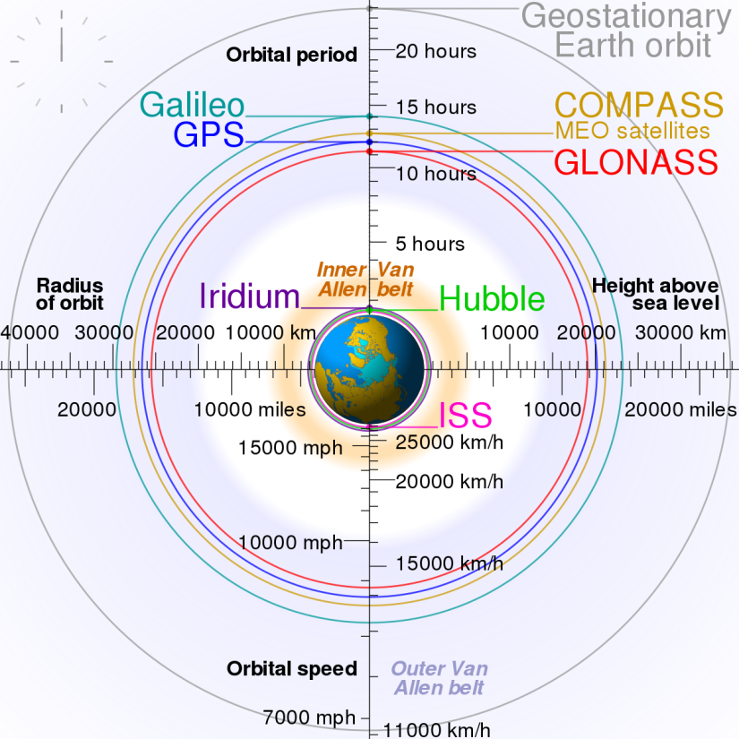
Some terms
LEO – Low earth orbit – 180 miles to about 1200 miles above the surface of the earth.
Orbital speeds are a balance between centripetal forces and centrifugal force
Approximately 120 miles (193 Km) up is considered space
A sounding rocket, used to study the atmosphere or perform brief experiments, is only capable of sub-orbital spaceflight and cannot reach orbit.
A small-lift launch vehicle is capable of lifting up to 2,000 kg (4,400 lb) of payload into low Earth orbit (LEO).
A medium-lift launch vehicle is capable of lifting 2,000 to 20,000 kg (4,400 to 44,100 lb) of payload into LEO.
A heavy-lift launch vehicle is capable of lifting 20,000 to 50,000 kg (44,000 to 110,000 lb) of payload into LEO.
A super-heavy lift vehicle is capable of lifting more than 50,000 kg (110,000 lb) of payload into LEO.
Notes:
By size[edit]
There are many ways to classify the sizes of launch vehicles. The US civilian space agency, NASA, uses a classification scheme^{[7][citation needed]} that was articulated by the Augustine Commission created to review plans for replacing the Space Shuttle:
A sounding rocket, used to study the atmosphere or perform brief experiments, is only capable of sub-orbital spaceflight and cannot reach orbit.
A small-lift launch vehicle is capable of lifting up to 2,000 kg (4,400 lb) of payload into low Earth orbit (LEO).^{[7]}
A medium-lift launch vehicle is capable of lifting 2,000 to 20,000 kg (4,400 to 44,100 lb) of payload into LEO.^{[7]}
A heavy-lift launch vehicle is capable of lifting 20,000 to 50,000 kg (44,000 to 110,000 lb) of payload into LEO.^{[7]}
A super-heavy lift vehicle is capable of lifting more than 50,000 kg (110,000 lb) of payload into LEO.^{[7][8]}
Similarly the leading European launch service provider, Arianespace, also uses the "heavy-lift" designation for its >20,000 kg (44,000 lb)-to-LEO Ariane 5launch vehicle^{[9]} and "medium-lift" for its array of launch vehicles that lift 2,000 to 20,000 kg (4,400 to 44,100 lb) to LEO, including the Starsem/Arianespace Soyuz ST^{[10]} and pre-1999 versions of the Ariane 5. It refers to its 1,500 kg (3,300 lb) to LEO Vega launch vehicle as "light lift".^{[10]}
How big is the boost from an equatorial launch? To make a rough estimate, we can determine Earth's circumference by multiplying its diameter by pi (3.1416). The diameter of Earth is approximately 7,926 miles (12,753 kilometers). Multiplying by pi yields a circumference of something like 24,900 miles (40,065 kilometers). To travel around that circumference in 24 hours, a point on Earth's surface has to move at 1,038 mph (1,669 kph). A launch from Florida's Cape Canaveral doesn't get as big a boost from Earth's rotational speed. The Kennedy Space Center's Launch Complex 39-A is located at 28 degrees 36 minutes 29.7014 seconds north latitude. The Earth's rotational speed there is about 894 mph (1,440 kph). The difference in Earth's surface speed between the equator and Kennedy Space Center, then, is about 144 mph (229 kph). (Note: The Earth is actually oblate -- fatter around the middle -- not a perfect sphere. For that reason, our estimate of Earth's circumference is a little small.)
Considering that rockets can go thousands of miles per hour, you may wonder why a difference of only 144 mph would even matter. The answer is that rockets, together with their fuel and their payloads, are very heavy. For example, the Feb. 11, 2000, liftoff of the space shuttle Endeavour required launching a total weight of 4,520,415 pounds (2,050,447 kilograms) [source: NASA]. It takes a huge amount of energy to accelerate such a mass to 144 mph, and therefore a significant amount of fuel. Launching from the equator makes a real difference.
Once the rocket reaches extremely thin air, at about 120 miles (193 kilometers) up, the rocket's navigational system fires small rockets, just enough to turn the launch vehicle into a horizontalposition. The satellite is then released. At that point, rockets are fired again to ensure some separation between the launch vehicle and the satellite itself.
Orbital characteristics[edit]
Circular Earth geosynchronous orbits have a radius of 42,164 km (26,199 mi). All Earth geosynchronous orbits, whether circular or elliptical, have the same semi-major axis.^{[5]} In fact, orbits with the same period always share the same semi-major axis:
{\displaystyle a={\sqrt[{3}]{\mu \left({\frac {P}{2\pi }}\right)^{2}}}}where a is the semi-major axis, P is the orbital period, and μ is the geocentric gravitational constant, equal to 398,600.4418 km³/s².
In the special case of a geostationary orbit, the ground track of a satellite is a single point on the equator. In the general case of a geosynchronous orbit with a non-zero inclination or eccentricity, the ground track is a more or less distorted figure-eight, returning to the same places once per sidereal day.

Slide 13

Geo stationary orbit
Orbital characteristics
Circular Earth geosynchronous orbits have a radius of 42,164 km (26,199 mi). All Earth geosynchronous orbits, whether circular or elliptical, have the same semi-major axis.^{[5]} In fact, orbits with the same period always share the same semi-major axis:
In the special case of a geostationary orbit, the ground track of a satellite is a single point on the equator. In the general case of a geosynchronous orbit with a non-zero inclination or eccentricity, the ground track is a more or less distorted figure-eight, returning to the same places once per sidereal day.
Sidereal day = 23 hours 56 minutes and 4.09 seconds.
where a is the semi-major axis, P is the orbital period, and μ is the geocentric gravitational constant, equal to 398,600.4418 km³/s².
Notes:
A sidereal day is 23 hours 56 minutes and 4.09 seconds long. A sidereal year is the time it takes for the sun to return to the same position with respect to the stars. Due to the precession of the equinoxes the sidereal year is about 20 minutes longer than the tropical year

Slide 14
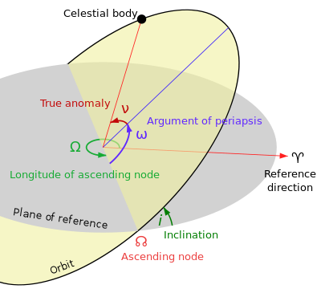
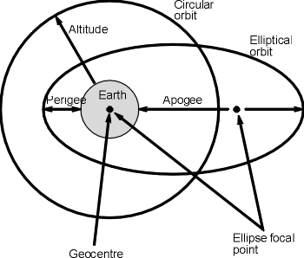
Some orbital terms

Slide 15
Acknowledgements: BBC news - Science and the environment 31/3/18. Internet searches. Web Sites Atomic rockets and a mission plan to go to Mars http://www.projectrho.com/public_html/rocket/infrastructure.php Description and explanation of the Lagrange points. https://books.google.co.uk/books?id=75b84eCulsC&pg=PA93&lpg=PA93&dq=earth+lagrange+points+spacecraft+graveyard&source=bl&ots=chPhxvPODB&sig=AvlL6aSWGhPL1IG56v1qkesuvjU&hl=en&sa=X&ved=0ahUKEwimncmakZfaAhVXF8AKHbarAE8Q6AEIYjAK#v=onepage&q=earth%20lagrange%20points%20spacecraft%20graveyard&f=false https://www.pixalytics.com/sats-orbiting-earth-2017/ Thanks for staying awake and for the lucky ones that are still lucid. The next slide is a video of the view from L1 entitled “Nuclear Art” released by NASA from the “Solar Dynamics Observatory (SDO)”. [9.3 million miles from earth or about 83 million miles from the SUN and the Suns diameter is 864,575.9 miles and subtends an angle of 0.53 deg.

Slide 16
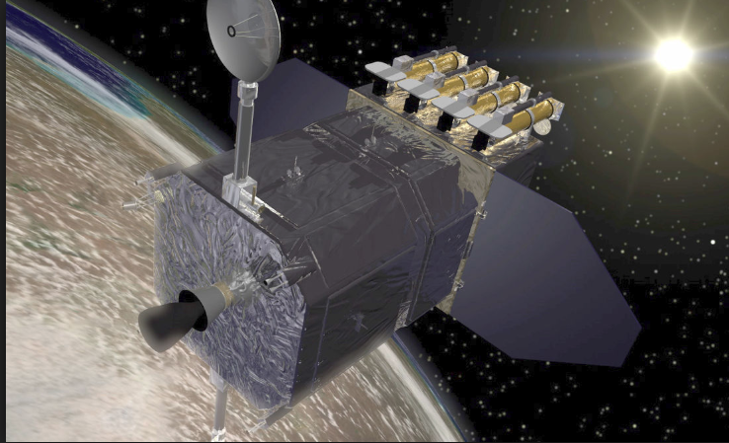
Nuclear Art
This is video created from the satellite (SDO) orbiting LaGrange point L1.
The Solar Dynamics Observatory is a NASA mission which has been observing the Sun since 2010. Launched on February 11, 2010, the observatory is part of the Living With a Star program NASA - Thermonuclear Art – The Sun In Ultra-HD (4K).mp4
Any Questions
Notes:
L1 is: If the distance is just right--about 4 times the distance to the Moon or 1/100 the distance to the Sun--the spacecraft, too, will need just one year to go around the Sun, and will keep its position between the Sun and the Earth. That position is the Lagrangian Point L1, so called after the Italian-French mathematician who pointed it out .

