Slide 1
IP and COM ports for amateur radio
Presented by: Peter Stevenson (2E0PGS)

Slide 2

Preamble
This is a introductory talk to IP (Internet Protocol) and COM (Communication) ports for use in Amateur Radio.
This is not a in depth discussion on the OSI model or RS232 standards.

Slide 3
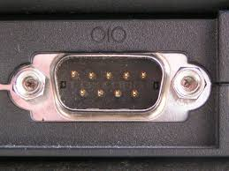
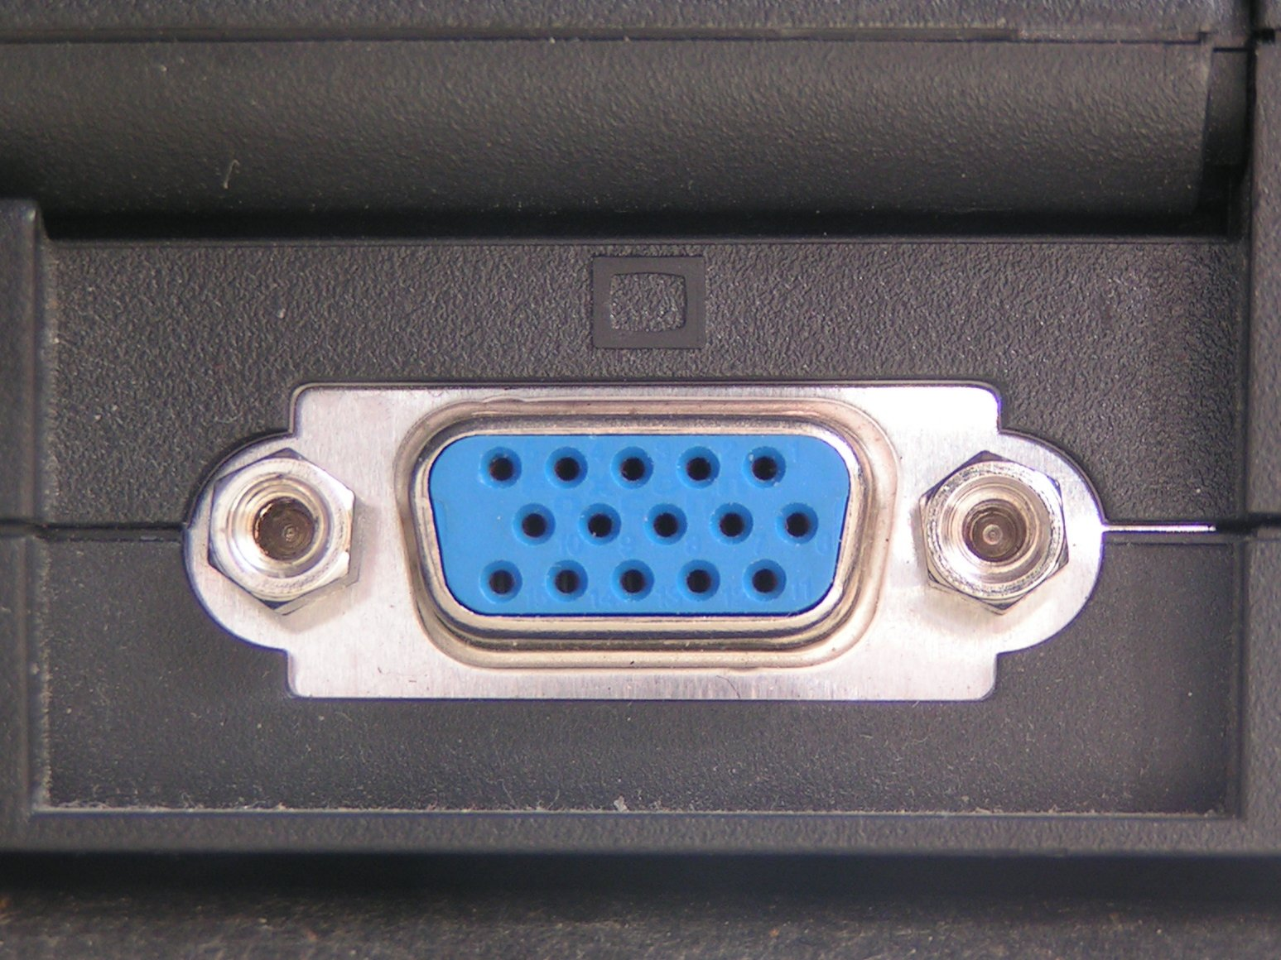
What is a COM port?
A COM (Communications) port is also called a serial port.
They look like this:
They are not to be confused with a VGA port:

Slide 4
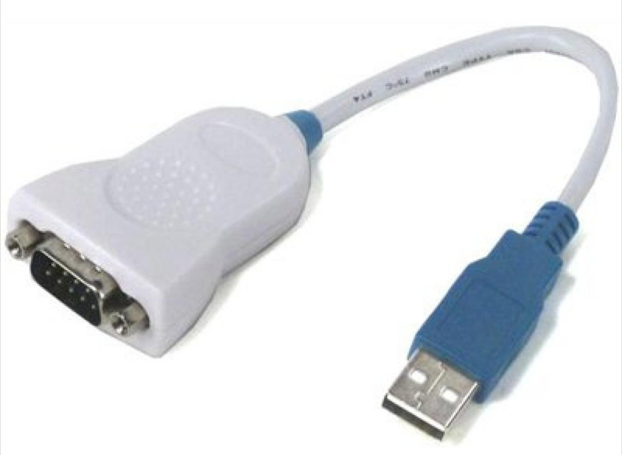
What if my PC has no COM port?
You need a serial to USB adapter. Also known as a USB to COM cable.
Be aware! You want to acquire a genuine FTDI chip adapter or you may end up struggling with dodgy drivers on Windows OS (Operating System).
Linux can be more forgiving with these.
Recommended cable:

Slide 5
Windows setup
In Windows OS (Operating System) you will be using the “Device Manager” to configure the COM port.
The device manager shows the allocated port ID/Identifier. For example COM1.
It will also show the status of the drivers.

Slide 6
Windows setup continued
COM1 is the most common ID.
COM IDs can progress in a non sequential order so if COM1 doesn’t work check the device manager.
The reason there are multiple IDs is in case you have multiple COM devices attached. For example an Arduino and a radio.
You can open the device manager in windows 8 or newer by right clicking the start menu and choosing device manager.

Slide 7
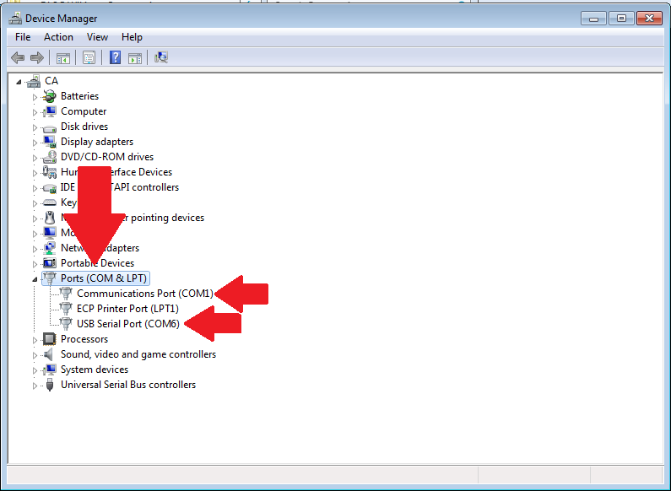
Device manager

Slide 8
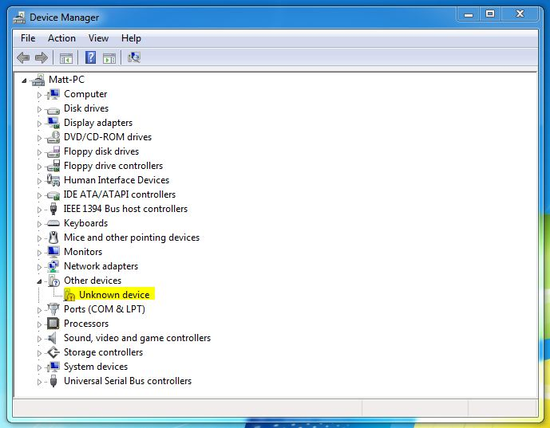
Device manager continued
Missing driver
may show up as
unknown device.

Slide 9
Linux setup
To find the USB COM port number on linux systems you need to run: ls /dev/ | grep ttyUSB
This will output the names of active USB serial ports.
Another option is to run: dmesg | grep tty
This will output:
[ 0.000000] console [tty0] enabled
[ 1.288070] 0000:00:16.3: ttyS4 at I/O 0x20b0 (irq = 19, base_baud = 115200) is a 16550A

Slide 10
CAT control
CAT or Computer Aided Transceiver is essentially serial communication over a COM port.
CAT just aids in electrical isolation between the radio and the PC.
CAT also has logic level converters.
Essentially CAT is just serial COM.

Slide 11
Tools
Putty (available on Linux and Windows).
WSPR-X (available on Linux and Windows).
HRD (Ham Radio Deluxe) (available on Windows).
Hamlib (available on Linux and Windows).

Slide 12
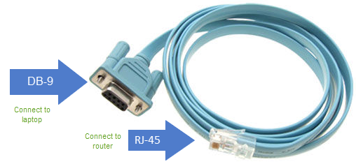
Putty
This tool is probably the most user friendly way to communicate with serial.
IP, COM with all the stops… stopbits.
SSH
COM cable for CISCO:

Slide 13
IP for amateur radio
More and more ham radio equipment is going digital.
Many SDRs and radios can be connected to your local home network and controlled from across the house over the local network.
You can even control the radio from across the world over the web. However be careful of remote operating licence terms.
It allows us to communicate with our radio. It is more advanced than COM.
Mesh networking (https://2e0pgs.github.io/ham-radio/hsmm-mesh.html)
  BBHN (BroadBand HamNet)
  HSMM-MESH (Former name for BBHN)
  AREDN (Amateur Radio Emergency Data Network)

Slide 14
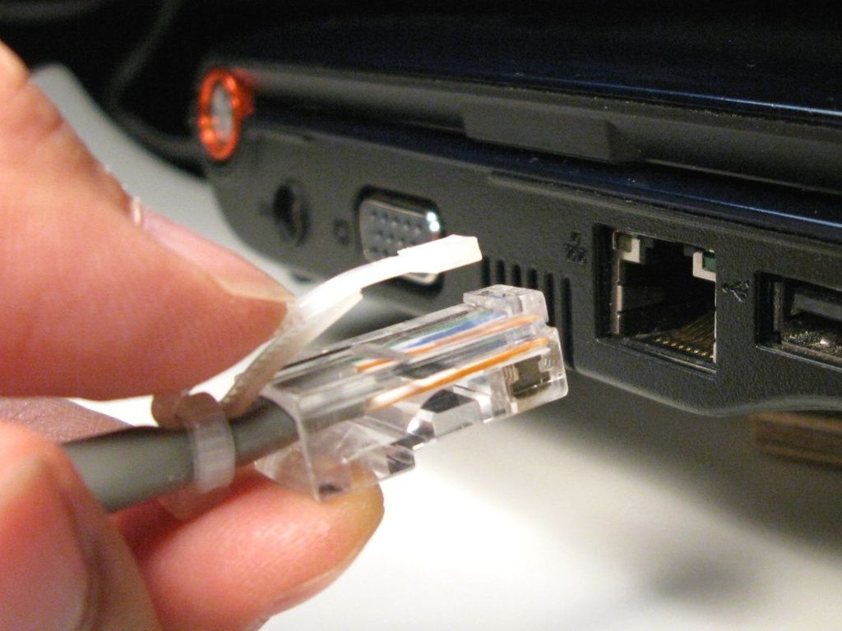
IP
IP just stands for Internet Protocol.
RJ-45 is the most common connector we use for IP based equipment.
Ethernet is the name
given to a network
made up of IP devices.

Slide 15
IP continued
You can connect two devices directly together thanks to something called Auto Negotiation (switch) or by using a Cross Over Cable.
However you will need to assign static IP addresses for each device for this to work.
Instead I recommend plugging them into a central network which has a router. This is because the router will assign them an IP automatically using DHCP.

Slide 16
IP address
An IP address is simply the ID of the device.
An address is where you address the information to be sent. Think of it as a postal address you send a letter to. The postman knows how to deliver the information because of its address.
Most home networks will have a subnet of:
  192.168.0.1/24
  192.168.1.1/24

Slide 17
IP address continued
We are only going to cover the class C address range.
192.168.0.1/24
  192.168 network
  0 network
  1 – 254 available for devices (255 is reserved for broadcast).
  /24 is just a notation so we know it’s a class C with 254 hosts max. Aka 255.255.255.0
e.g. 192.168.0.1 is normally the router
192.168.0.2, 192.168.0.3 are devices
192.168.1.3 would be a totally different network.
Subnet mask: https://www.aelius.com/njh/subnet_sheet.html

Slide 18
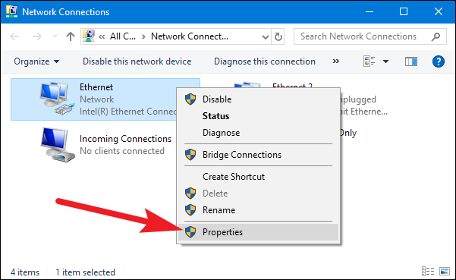
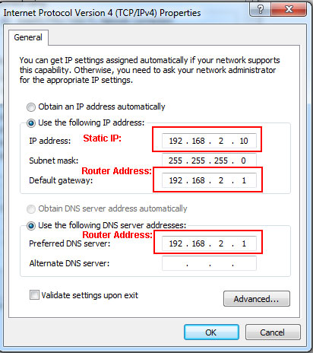
Windows static IP

Slide 19
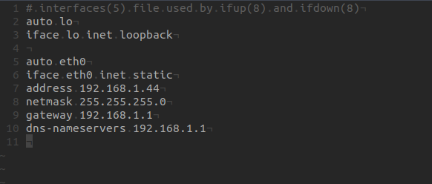
Linux static IP
Run: nano /etc/network/interfaces

Slide 20
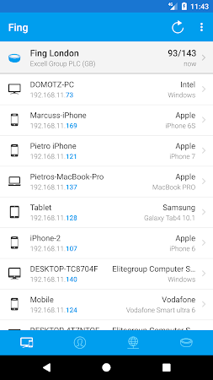
Finding the IP
A great tool for finding the IP of a
device on a local network is Fing.
You can download this from the
Google Play Store or IOS App Store.
https://www.fing.com/products/fing-app

Slide 21
Radios with IP connectivity
Many modern SDRs (Software Defined Radios) have Ethernet connectivity.
Flex SDR with the flex desktop app or mobile app for IOS.
Yaesu radios with remote control apps.

Slide 22
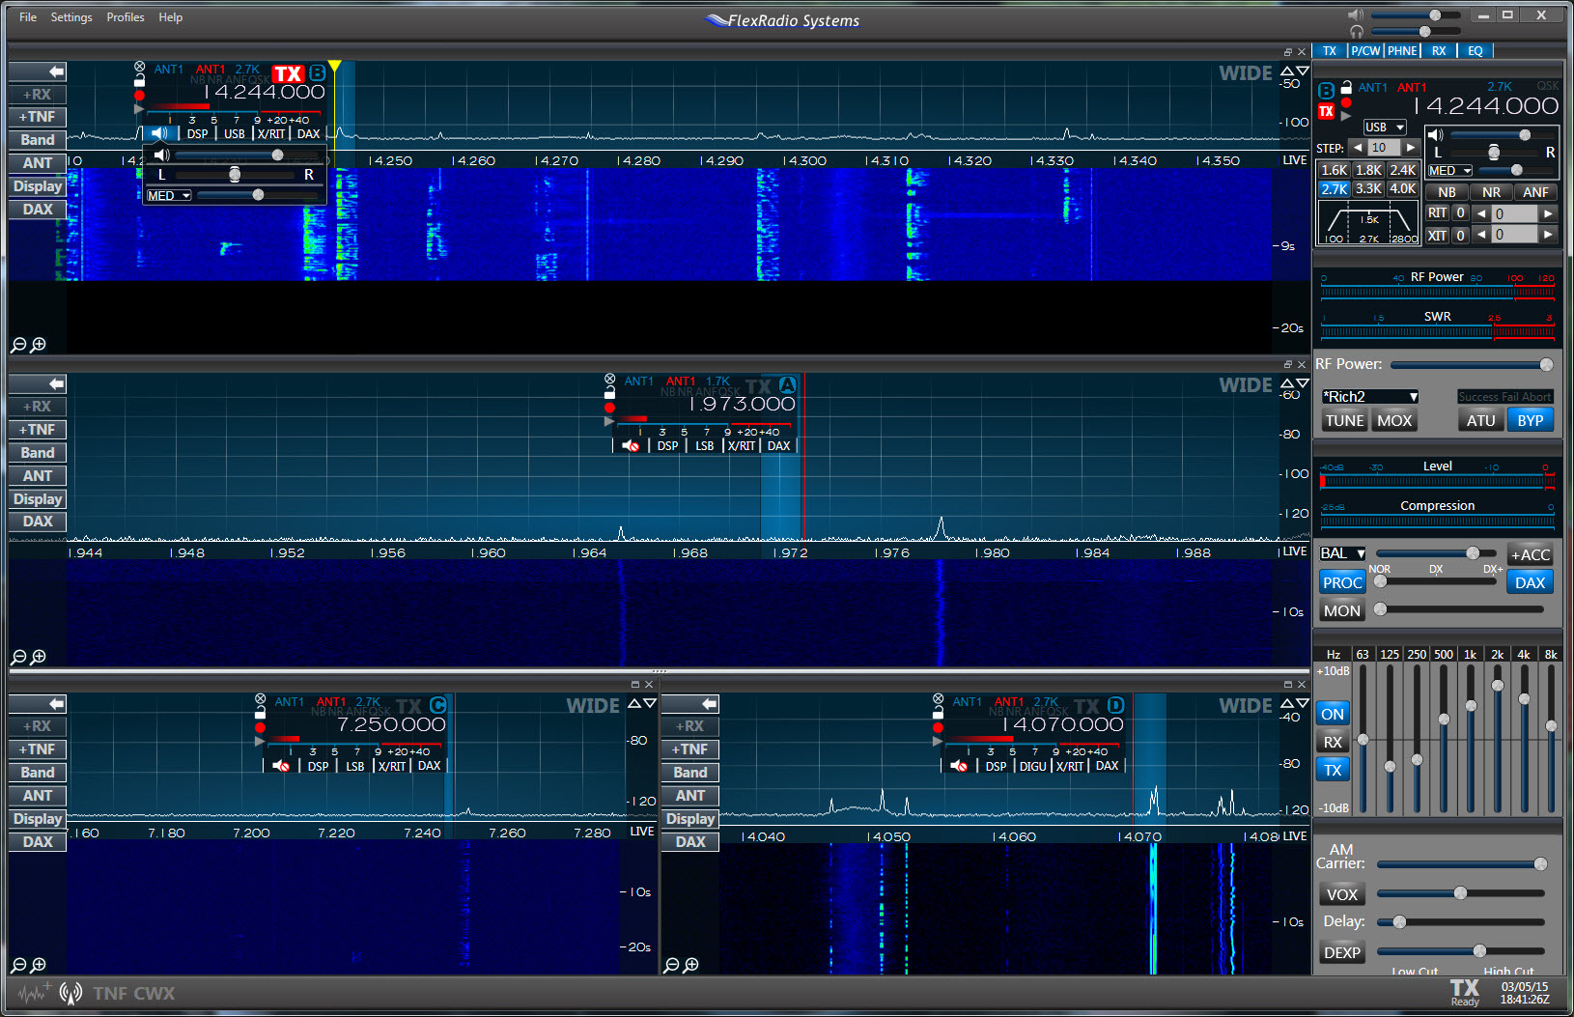
Flex

Slide 23
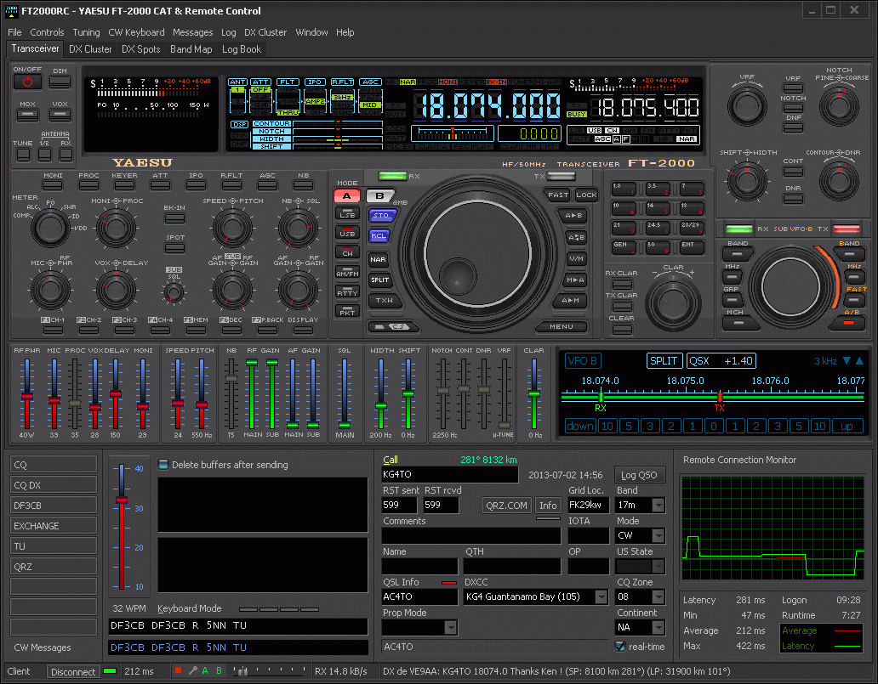
FT2000RC: CAT & Remote Control Software

Slide 24
Adding IP connectivity
Raspberry PI (RTL SDR, USB, COM).
Desktop or Laptop PC (RTL SDR, USB, COM).
Beaglebone board (Kiwi SDR).
WebSDR software (local SDR to a web enabled one).
Hamlib is a great piece of software for controlling radios over COM/USB. It has a feature that allows your PC connected to the radio to become a server for other machines over network to connect to and control the radio that’s local to the server. I use it myself: https://2e0pgs.github.io/blog/programming/2018/12/17/ic7100-hamlib/

Slide 25
Questions?

