Slide 1
화면설계.시작화면
Data Compensation
File Upload Form
Upload

Slide 2
화면설계.데이터보정(모달)
Upload Data Filename
Column Sample Data Exclude Include
column1
column2
column3
column4
column5
column6
Add

Slide 3
화면설계.보정목록
Data Compensation
File Upload Form
Upload
Sample1.csv
96,872 rows
Sample2.csv
10,335 rows
Sample3.csv
57,061 rows
Sample4.csv
5,449 rows
Sample5.csv
68,702 rows
Sample6.csv
31,897 rows
Sample7.csv
24,529 rows
Download

Slide 4
화면설계.실행및다운로드
Data Compensation
File Upload Form
Upload
Running......
Sample1.csv
96,872 rows
Sample2.csv
10,335 rows
Popup Save As Window
Sample3.csv
57,061 rows
Sample4.csv
5,449 rows
Sample5.csv
68,702 rows
Sample6.csv
31,897 rows
Sample7.csv
24,529 rows
Download

Slide 5
아키텍처
Data File
CSV Structure
Module
Line Limit
Module
Exclude
Module
Include
Module
Data Compensation File

Slide 6
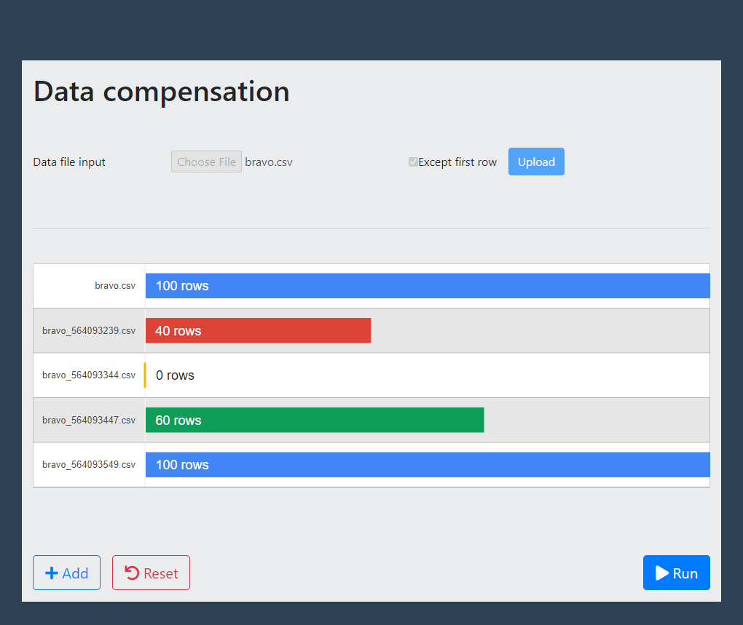
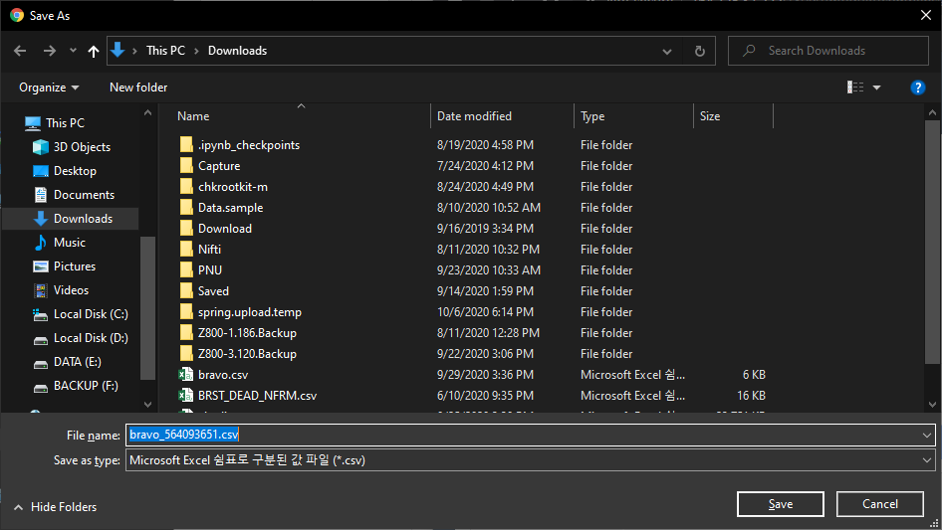

Slide 7
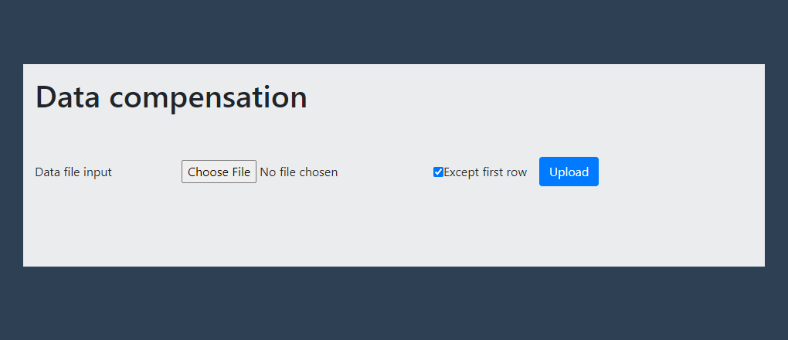

Slide 8
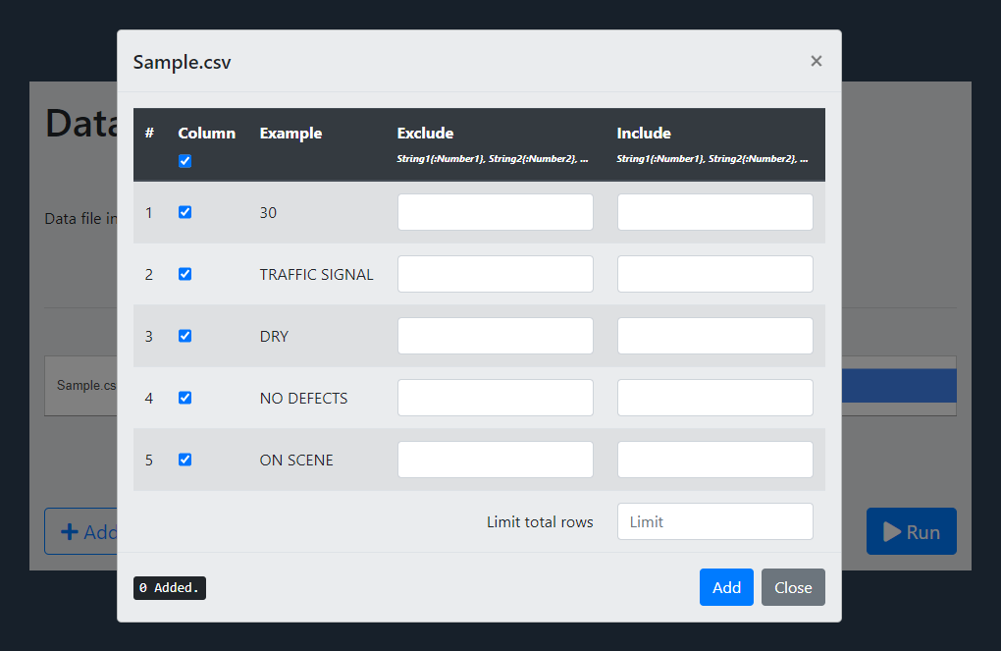

Slide 9
