Slide 1
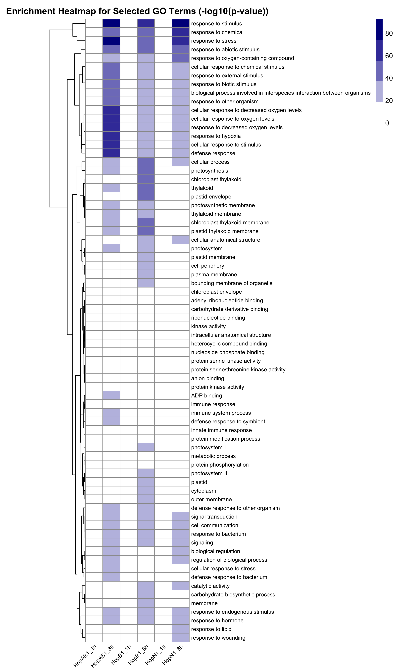
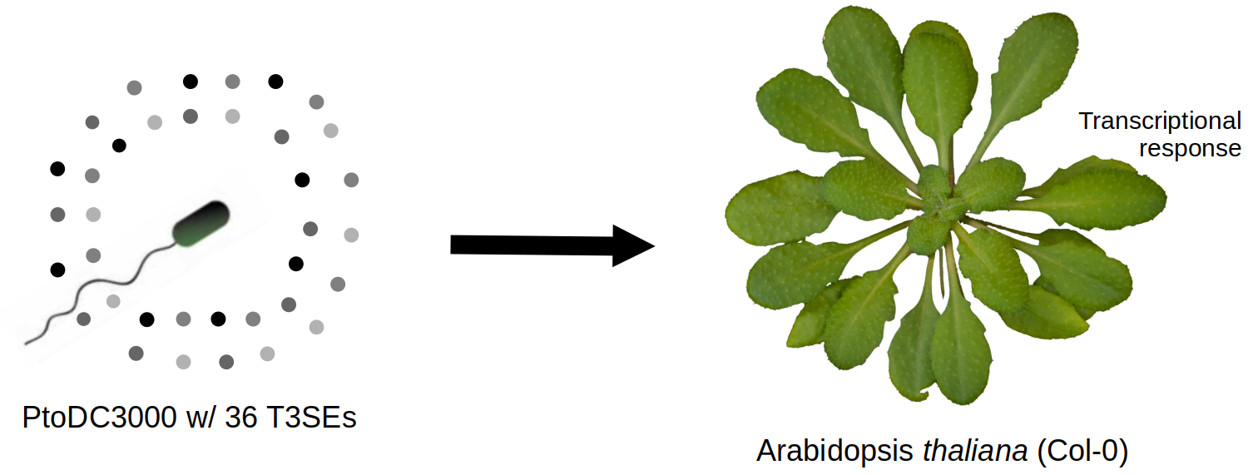
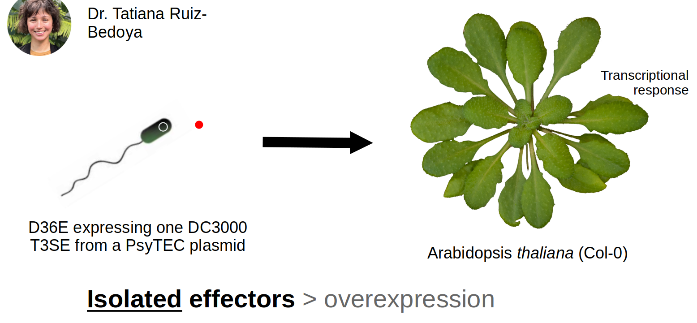



Pseudomonas syringae Type-III Secreted Effectors Elicit Unique Transcriptional Responses in Arabidopsis thaliana
Nicholas Garcia, Pauline Wang, Calvin Mok, Darrell Desveaux, David Guttman
Introduction
Pseudomonas syringae destroys millions of crops yearly using it’s repertoire of type-III secreted effector proteins.
But does each effector induce a unique transcriptional response in the plant?
We’ve have a system to
answer that question:
Results
Discussion
Or maybe a brief summary, whatever makes more sense for your poster. This is where you help your viewer understand what your results mean, and how they address your question. You’ll want to bring this back to your hypothesis or aims, to remind people of what you were trying to do.
This part might be wordier than the others, so maybe you won’t have a figure in it, but make sure it doesn’t turn into a massive wall of text. If you find yourself tempted to decrease the font size or shrink your figures into teensy unintelligible specks so you can fit more words, STOP. Think about the core message, and focus on that. Save the rest for the paper.
You can even caption it. You know you want to.
A diagram here can help illustrate the main problem.
It wouldn’t kill you to have an image here too.
Conclusions
This is a good place to talk about how your work fits in and adds to the current knowledge within your field of study. Bring it back to your intro, tie everything together, and remind the viewer of the context and relevance of your work.
Future directions (optional)
This is a good place to put your next steps, especially if you still have open questions that need to be addressed, or if the data showed something unexpected.
Project Outline
Infect A. thaliana with P. syringae effectors HopN1, HopB1, and HopAB1 individually (with an effector-less strain and 10 mM MgSO4 as controls).
Sequence and analyse the plant’s RNA to profile each effector’s induced transcriptional response.
Methods
Wet Lab Work
RNA-Seq Pipeline
Always use as little text as possible to get your point across. Let diagrams, figures, and graphs tell the story.
References
this can be in a super tiny font
if necessary, you can go down as low as 14pt for this part
but make sure you cite everything properly!
Acknowledgements
This part can be smaller too, but make sure you acknowledge the people who helped you - it’s only polite! If you need to add big logos for your funding agencies or school, put them here instead of in your title area. It just looks nicer.

