Slide 1
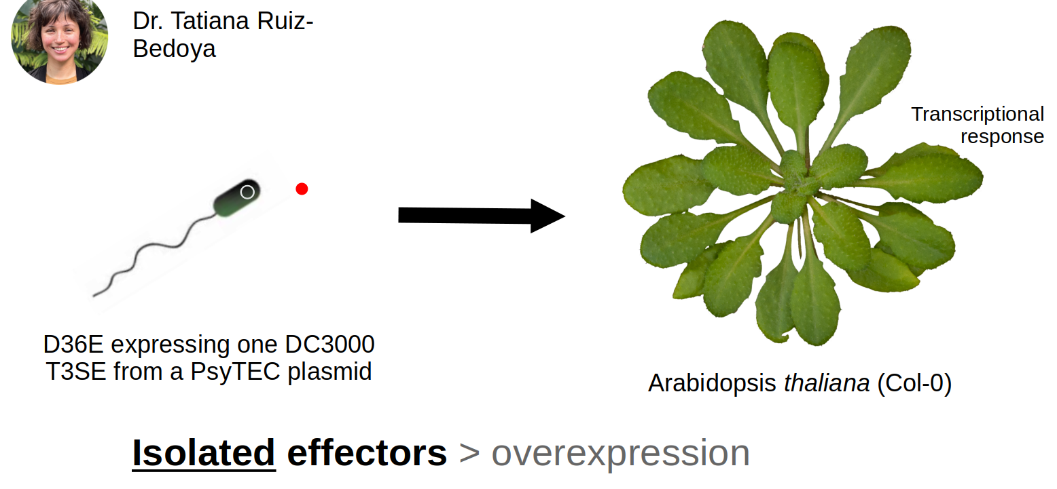



Pseudomonas syringae Type-III Secreted Effectors Elicit Unique Transcriptional Responses in Arabidopsis thaliana
Nicholas Garcia, Pauline Wang^{1,2}, Calvin Mok^{1,2}, Darrell Desveaux¹, David Guttman^{1,2}
¹ Centre for the Analysis of Genome Evolution and Function, University of Toronto
² Department of Cell & Systems Biology, University of Toronto
Introduction
The phytobacterium Pseudomonas syringae destroys millions of dollars of crops as a neurotrophic pest.
P. syringae enters the stomata and secrets its type-III secreted effector proteins^{[1]} into the symplast to disable host immunity. The plant responds with a transcriptional counter-attack (PAMP-triggered immunity).
But does each effector induce a unique transcriptional response in the plant?
We’ve adapted a system developed by Wei et. Al (2015) to answer that question^{[2]}:
Results
Discussion
Or maybe a brief summary, whatever makes more sense for your poster. This is where you help your viewer understand what your results mean, and how they address your question. You’ll want to bring this back to your hypothesis or aims, to remind people of what you were trying to do.
This part might be wordier than the others, so maybe you won’t have a figure in it, but make sure it doesn’t turn into a massive wall of text. If you find yourself tempted to decrease the font size or shrink your figures into teensy unintelligible specks so you can fit more words, STOP. Think about the core message, and focus on that. Save the rest for the paper.
You can even caption it. You know you want to.
It wouldn’t kill you to have an image here too.
Genes with significantly-altered expression
Data comparison | Timepoint post-infection | Total | Induced | Repressed
D36E::HopN1a vs D36E::EV | 1 hour | 2 | 1 | 1
D36E::HopN1a vs D36E::EV | 8 hours | 14 | 4 | 10
D36E::HopB1a vs D36E::EV | 1 hour | 1 | 1 | 0
D36E::HopB1a vs D36E::EV | 8 hours | 960 | 659 | 301
D36E::HopAB1j vs D36E::EV | 1 hour | 5 | 4 | 1
D36E::HopABj vs D36E::EV | 8 hours | 543 | 474 | 69
Conclusions
This is a good place to talk about how your work fits in and adds to the current knowledge within your field of study. Bring it back to your intro, tie everything together, and remind the viewer of the context and relevance of your work.
Future directions (optional)
This is a good place to put your next steps, especially if you still have open questions that need to be addressed, or if the data showed something unexpected.
Methods
Infect A. thaliana with D36E::HopN1a, D36E::HopB1a, and D36E::HopAB1j (with D36E::EV and MgSO4 as controls) in biological triplicate.
Extract, analyze, and sequence the plant’s RNA profile each effector’s induced transcriptional response.
Computational analysis pipeline:
References
Xin X, Kvitko B, He SY. “Pseudomonas syringae: what it takes to be a pathogen”. Nat Rev Microbiol, 16, 5, 2018, pp. 316-318. 10.1038/nrmicro.2018.17
Wei H, Chakravarthy S, Mathieu J, Swingle B, Martin G, Collmer A. “Pseudomonas syringae pv. tomato DC3000 Type III Secretion Effector Polymutants Reveal an Interplay between HopAD1 and AvrPtoB”. Cell Host & Microbe, 17, 2015, pp. 752-762. 10.1016/j.chom.2015.05.007
.fastq files
FastQC
fdsfsfsdf
Trimmomatic
.bam alignment files
Hisat2
FastQC
.fastq files
Acknowledgements
This part can be smaller too, but make sure you acknowledge the people who helped you - it’s only polite! If you need to add big logos for your funding agencies or school, put them here instead of in your title area. It just looks nicer.
TAIR10 reference genome
featureCounts
.csv count files
Enriched Genes
Deseq2
gProfiler2
Enriched GO Terms

