Slide 1
Policy Continuation with Hindsight Inverse Dynamics
Hao Sun¹, Zhizhong Li¹, Xiaotong Liu², Dahua Lin¹, Bolei Zhou¹
1: The Chinese University of Hong Kong
^{2:} ^{Peking University}

Slide 2
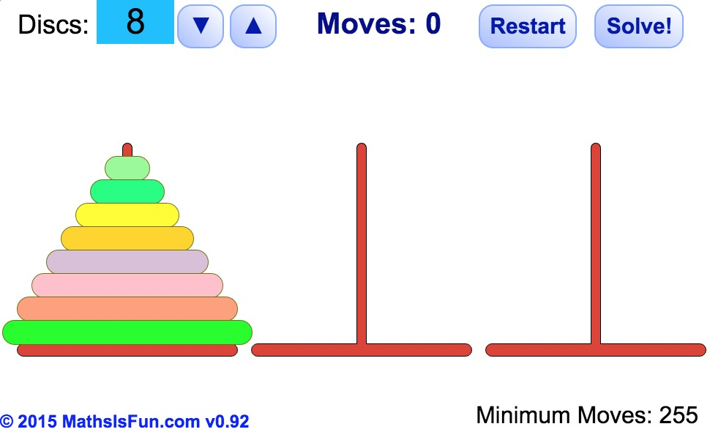
Reward Sparse Tasks in RL
Extrapolation of Policy!
Notes:
https://www.mathsisfun.com/games/towerofhanoi.html

Slide 3
Hindsight Experience Replay (HER)
Assign Credit to Hindsight Experience
If the goal is changed, previous failures might be successes.
Any goal-oriented problem can be regarded as navigation in the state-goal space

Slide 4
Inspirations of PCHID
Self-Imitation Learning: Supervised self-imitation learning can assign credit faster than RL
Curriculum Learning: People learn complex skills based on easier ones
Learn to get success from failures: Like in HER, If the goal is changed, previous failures might be successes.
Extrapolation Ability of Human: Previous skills act as priors in learning of new skills.

Slide 5
Hindsight Inverse Dynamics and PC
1-step Hindsight Inverse Dynamics:
Optimality is guaranteed
Multi-step Hindsight Inverse Dynamics:
How to guarantee their optimality
Policy Continuation!
find easy-task solver before looking for solver for more complex-task, and let latter policies be continuation of previous policies.
If a sampled K-step state-goal pair can not be reached within K-1 steps, the sampled trajectory must be an optimal trajectory!

