Slide 1

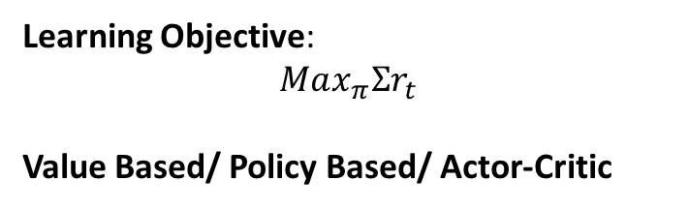
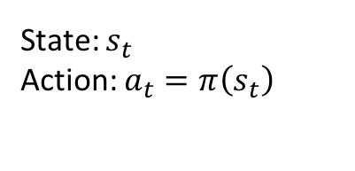
Environment
(Dynamics)
Prof.
Feedback
Reward $r_{t}$
PhD
Paper
State: $s_{t}$
Action: $a_{t}=π\left(s_{t}\right)$
paper-----
--------------------------------------------------
Learning Objective:
$$Max_{π}Σr_{t}$$
Value Based/ Policy Based/ Actor-Critic
Dense Reward: Once you have a commitment, you receive a feedback
Sparse Reward: Your professor is busy
Model Based/ Model Free

