Slide 1
Supply-Demand Model of the Environment
The supply-demand model of the U.S. motor gasoline market is derived from the research of Espey (1996). The following diagrams are all cases covered by the cost-sharing environment.
The price is initially defaulted to a unit price of 1, and will then be affected by the movements of supply and demand of motor gasoline.
The supply consists of the total inventory of barrels of gasoline plus the additional production after each week. This quantity is set to be sold at the unit price. Hence, the supply curve is shifted by the current quantity of the inventory.
The demand is determined by a time series model based on real-life data which forecasts the movement along the demand curve. Then, the curve is shifted by some kind of demand shock (if occurs) as determined by a stochastic event forecasting model.
The price floor to counter extremely low prices is defaulted to the unit price.
The price ceiling to counter inflated prices can be optionally set to avoid incentivizing firms to produce less.

Slide 2

Price
1
Quantity
$$Q_{median}$$

Slide 3




Price
$$P$$
$$C$$
1
Excess demand
Quantity
$$Q_{m}$$
$$Q_{demand}$$

Slide 4


Price
1
Excess supply
Quantity
$$Q_{d}$$
$$Q_{m}$$

Slide 5


Price
1
Excess supply
Quantity
$$Q_{m}$$
$$Q_{supply}$$

Slide 6




Price
$$P$$
1
Excess demand
Quantity
$$Q_{m}$$
$$Q_{s}$$
$$Q_{d}$$

Slide 7


Price
1
Excess supply
Quantity
$$Q_{m}$$
$$Q_{d}$$
$$Q_{s}$$

Slide 8

Price
1
Excess supply
Quantity
$$Q_{d}$$
$$Q_{m}$$
$$Q_{s}$$

Slide 9

Price
1
Excess demand
Quantity
$$Q_{s}$$
$$Q_{m}$$

Slide 10





Price
$$P$$
$$C$$
1
Excess demand
Quantity
$$Q_{s}$$
$$Q_{m}$$
$$Q_{d}$$

Slide 11



Price
1
Excess supply
Quantity
$$Q_{d}$$
$$Q_{s}$$
$$Q_{median}$$

Slide 12


Price
1
Excess demand
Quantity
$$Q_{s}$$
$$Q_{d}$$
$$Q_{median}$$

Slide 13
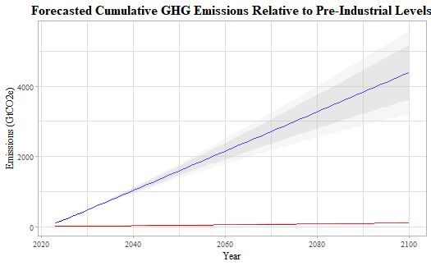
Emissions Level (GtCO2e) | Forecasted Period | Target (°C) | Chance of success (%)
41 [0.996] | 2022 | 1.5°C | 100%
100 [2.431] | 2023-2024 | 1.5°C | 83%
150 [3.647] | 2024-2025 | 1.5°C | 67%
250 [6.078] | 2025-2026 | 1.5°C | 50%
300 [7.293] | 2026-2027 | 1.5°C | 33%
500 [12.155] | 2030-2031 | 1.5°C | 17%
800 [19.448] | 2035-2036 | 2.0°C | 83%
950 [23.095] | 2038-2039 | 2.0°C | 67%
1150 [27.957] | 2042-2043 | 2.0°C | 50%
1450 [35.250] | 2047-2048 | 2.0°C | 33%
2000 [48.620] | 2057-2058 | 2.0°C | 17%

Slide 14
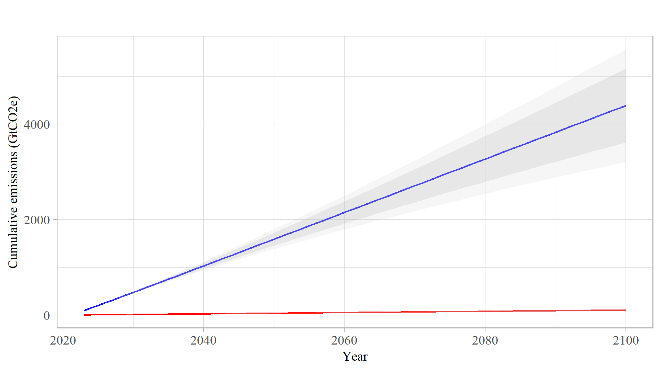
Emissions Level (GtCO2e) | Forecasted Period | Target (°C) | Chance of success (%)
41 [0.996] | 2022 | 1.5°C | 100%
100 [2.431] | 2023-2024 | 1.5°C | 83%
150 [3.647] | 2024-2025 | 1.5°C | 67%
250 [6.078] | 2025-2026 | 1.5°C | 50%
300 [7.293] | 2026-2027 | 1.5°C | 33%
500 [12.155] | 2030-2031 | 1.5°C | 17%
800 [19.448] | 2035-2036 | 2.0°C | 83%
950 [23.095] | 2038-2039 | 2.0°C | 67%
1150 [27.957] | 2042-2043 | 2.0°C | 50%
1450 [35.250] | 2047-2048 | 2.0°C | 33%
2000 [48.620] | 2057-2058 | 2.0°C | 17%

Slide 15
