Slide 1
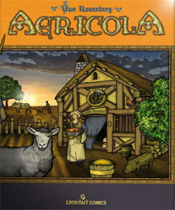
Agricola
Agricola is a game based on farming,
building a family, and providing for them
by obtaining resources from the land and
working other occupations.
Gameplay & Mechanics
Each player starts with their own game board, two person tokens (family members), 7 occupation cards, and 7 minor improvement cards. A player’s strategy is influenced heavily by the occupation cards that were dealt to them.
Main board has a set of fixed actions and spaces for “round” cards that also have associated actions. Each round card is revealed one at a time, at the beginning of each round, so action related to card can be available at beginning of each round.
Player uses each person token once every round to perform an action. An action includes acquiring resources, plowing or sowing a field, fencing pastures, acquiring food, building the family, etc…
There are 14 rounds and 6 harvests, at every harvest players must feed their families. If they cannot they must use a beggars card to obtain food.
Game ends at harvest after round 14, player with most points wins. Points are tallied by size of family, cards used, livestock, each beggar card used will cost negative points.

Slide 2
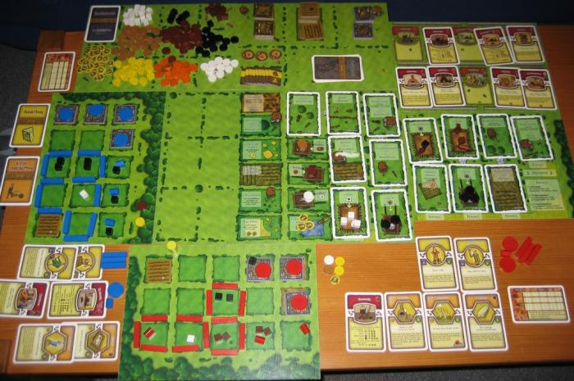
Analysis
Agricola is a worker/resource management game with the goal of building the biggest farm, largest family (used as workers), and therefore doing this will obtaining the most points will win the game.
The game was fun, but set-up time was just too long. It was nice that you could develop your own farm without much influence from the other players, besides competing for the same resources during each round.
This meant that you can develop your farm the way you want each time playing and with the addition of the other decks that are included in the game (easy, interactive, complex) the gameplay is flexible and there is plenty of replay value.
There was information on the cards of economic things that may happen to the farm, but I do not think that there was any historical facts. For economic purposes, there is revolving economies that influence one another using the cards

Slide 3
Agricola With Medieval Cooking
Due to the nature of the game, Agricola fits very well with medieval cooking.
After a harvest, you must make sure you have enough food; otherwise you must take a beggar card which results in a loss of points
As an alternative to the normal rules, if you got a recipe as one of your minor improvement cards you may pay the cost for the recipe and get a number of different results modifying your food amount. You may:
Effectively trade resources. This is a recipe that would require certain resources and you would get back at least one different resource. These cards typically trade 1:1 except in the case of rarer resources.
Combine resources to create a meal greater than the sum of its parts. This is a recipe that gives back the same resources you put in, but in greater quantity. These cards always trade above 1:1, but the actual amount depends on the resources used, the quantity of the resources used, and how rare the card is.

Slide 4
Minecraft Questing with Medieval Cooking
Our final project is based in a fictional medieval castle/town where you go around helping people with various odds-and-ends (be it the king or a lowly peasant).
Agricola gives us an idea of what a successful farmer looks like and what an almost successful farmer looks like. This allows us to set up quests to help a farmer significantly without doing his job for him (e.g. you are bringing him materials for some tools, not completing his harvest for him).

