Slide 1
Internet Technology (Unit Code: SWD400)

Slide 3
Unit team
Joe Appleton– Unit leader
Lecturer in Programming (web)
10 years industry experience specialising in programming web applications
Founded and sold one tech business
Sole founder of www.livelifechange.co.uk, an online diet and fitness social network
Currently working with the merchant navy to connetct up welfare service information

Slide 4
Internet Technology (week 1)
About the Unit
Introduction to HTML

Slide 5
About the Unit
10 Credits
Provides a foundation in enabling technologies for the Internet and their application
Focus on the client side technologies
Usability and requirements of designing to standards as established by the W3C organisation

Slide 6
Why This Unit Is Exciting
There’s a huge demand for the skills covered
680 million websites live on the web
Thousands more being added daily
HTML5 is no longer static, it allows us to create feature rich stunning graphical applications
Want to know the hostory of the world
Amazing interactive graphics
Another Example

Slide 7
Unit Progression in Web Development
Level 4 Block 1
Internet Technology
Level 4 Block 2
Cient Side Scripting
Level 5
Developing for the Internet
Level 6
Web Application Development
Notes:
Web Design and Development: all 3

Slide 8
Who is this Unit for?
For students who want to learn how to build HTML5 dynamic web sites
For students who seek a deeper understanding of the core web technologies and practices
Notes:
Most web developers are self-taught via blogs, books, articles, workshops …
One characteristic of the self-taught is that our knowledge is often “a mile wide and an inch deep”. There are good reasons for this: developing for the web is a highly practical task and our knowledge “a mile deep and an inch wide” is of little use in this field. But it does mean that we often lack an inside –out understandking of even our core technologies: e.g. the DOM element object or CSS attribute selectors. And all too often, once we’ve figured one way to accomplish a particular task, we tend to use that method over and over again instead of seeking our possible better alternatives
Therefore, this unit is also for experienced developers who want to deepen their understanding of their practice, and of the technologies they use, to go beyond the methods and models they already know

Slide 9
What will you get from this Unit?
The goal is to help you build an understating of HTML5, CSS3 Developing with Web Standards!
A passion for web development ☺
Notes:
For web developer, no matter how knowledgeable or proficient they are, they cannot (or not necessary to) remember each aspect of every feature of the HTML, CSS or Javascript. But if you understand the core technologies of web development – how they work and don’t work, why they work the way they do …then you know what to look for.
Can’t remember how to make a checkbox checked by default?
Can’t remember whether it is text-align or text-alignment?
That’s all fine, because you will know what question to ask and where to go to get the answer

Slide 10
What you won’t get from this Unit?
This unit does not provide information about what happens on the server
This unit will not consider mobile web development
Level 5: “Developing for the Internet”
Level 6: “Web Application Development”

Slide 11
Unit Commitments
A one hour lecture each week
Up to a 2 hour practical weekly
A Time Constrained Assessment(100%) delivered in mid January 2017 (date tbc)

Slide 12
Other Information
Attend all classes and please arrive on time!
Prior knowledge and skills varies across students
Not allowed to use Dreamweaver, Frontpage etc. for your web development
Update your work regularly on University’s network drive
Useful website: w3schools.com

Slide 13
Any Questions ?

Slide 14
What is HTML?
Hyper Text Markup Language
Designed for the creation of web pages and other information viewable in a browser
We’re currently on version 5
File extension:
.html or .htm
Notes:
A little bit history about hypertext. Originated from Vannevar Bush, hypertext is an idea of linking documents together to make it easier to keep track of relationships between documents. The concept is more focus on individual, instead of a global system linking documents from many sources.
----
Other then the obvious, the letter "L," there's not much of a difference between the two extensions. Most, if not all, web browsers and servers will treat a file with an HTM extension exactly as it would a file with an HTML extension, and vice versa
http://www.sightspecific.com/~mosh/WWW_FAQ/ext.html
-----

Slide 15
Simple HTML Demo
We need a text editor first!

Slide 16
Terminology (1): Elements
An HTML document is made up of elements
elements are containers for content
everything from the start tag to the end tag
some types of element may contain other elements
<!DOCTYPE html>
<html> <head> <title>my first page</title> </head> <body> <h1>This is my first Web Page</h1> <p>I should write a paragraph about myself</p> <img src="image.jpg" alt="describe the image” > <a href="http://www.solent.ac.uk">University</a> </body> </html>
Notes:
The link address is specified in the href attribute

Slide 17
Terminology (2): Attributes
- Each element may have one or more attributes
<img src="image.jpg" alt="describe the image" />
<a href="http://www.solent.ac.uk">University</a>
attribute
attribute
attribute
Notes:
Src stands for "source". The value of the src attribute is the URL of the image you want to display
The alt attribute provides alternative information for an image if a user for some reason cannot view it (because of slow connection, an error in the src attribute, or if the user uses a screen reader).
The link address is specified in the href attribute

Slide 18
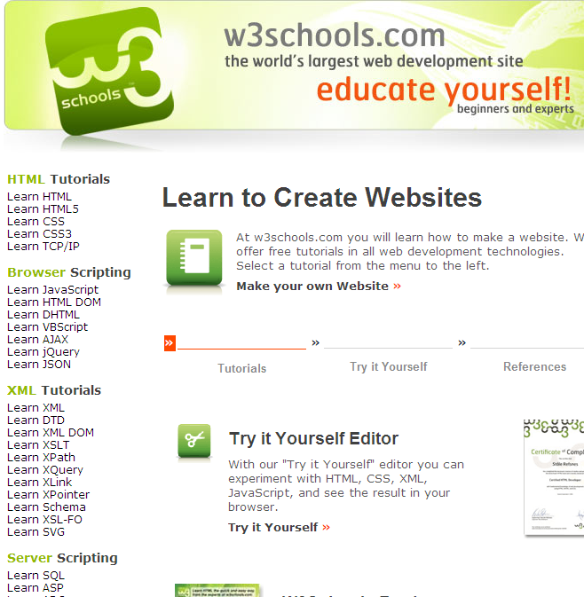
W3Schools Online Web Tutorials

Slide 19
Week 1 Practical Task
Basic HTML Structure
Creating a title
Including section headers
Starting a paragraph
Inserting images on a page
Creating a link to another web page

Slide 20
References
Notepad++ available online at http://notepad-plus-plus.org/
Sir Tim Berners-Lee Biography http://www.w3.org/People/Berners-Lee/
W3C http://www.w3.org/
HTML5 Introduction http://www.w3schools.com/html/html5_intro.asp

