Slide 1
Internet Technology (Unit Code: SWD400)

Slide 2
Unit team
Joe Appleton– Unit leader
Lecturer in Programming (web)
10 years industry experience specialising in programming web applications
Founded and sold one tech business
Sole founder of www.livelifechange.co.uk, an online diet and fitness social network
Currently working with the merchant navy to connetct up welfare service information

Slide 3
University Differs From School
Try and find a productivity system that works for you!
I’ve had great success with the Pompodoro Technic!

Slide 5
Internet Technology (week 1)
About the Unit
Introduction to HTML

Slide 6
About the Unit
10 Credits
Provides a foundation in enabling technologies for the Internet and their application
Focus on the client side technologies
Usability and requirements of designing to standards as established by the W3C organisation

Slide 7
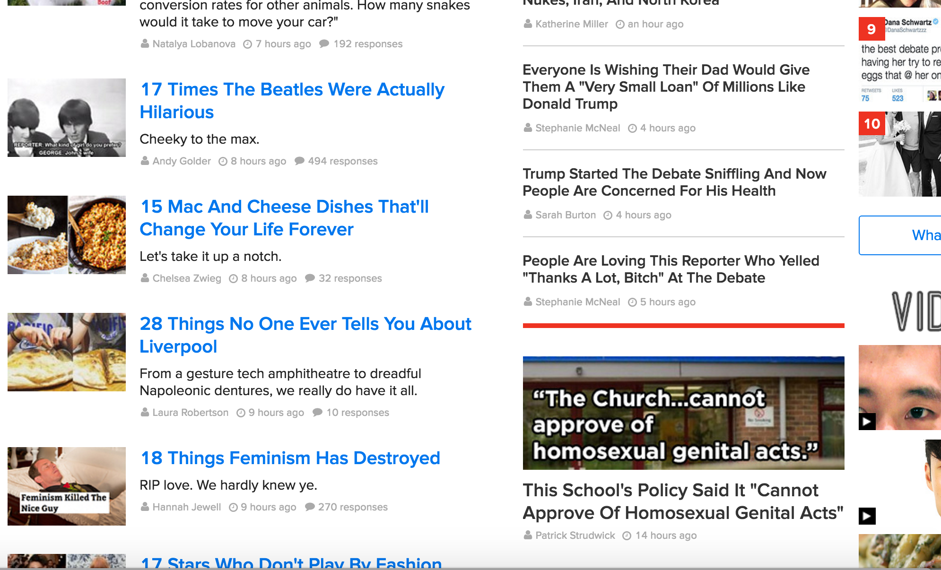
You’ll Learn
How To Make Websites Using HTML and CSS
A little bit of legislation
A little bit of SEO and Marketing
Buzzfeed.com

Slide 8
Unit Commitments
A one hour lecture each week
Up to a 2 hour practical weekly
A Time Constrained Assessment(100%) delivered in mid January 2017 (date tbc)

Slide 9
Unit Progression in Web Development
Level 4 Block 1
Internet Technology
Level 4 Block 2
Cient Side Scripting
Level 5
Developing for the Internet
Level 6
Web Application Development
Notes:
Web Design and Development: all 3

Slide 10
Why This Unit Is Exciting
There’s a huge demand for the skills covered
680 million websites live on the web
Thousands more being added daily
HTML5 is no longer static, it allows us to create feature rich stunning graphical applications
Want to know the hostory of the world
Amazing interactive graphics
Another Example

Slide 11
The internet offers a great buisness opportunity
A business example

Slide 12
Other Information
Attend all classes and please arrive on time!
Prior knowledge and skills varies across students
Not allowed to use Dreamweaver, Frontpage etc. for your web development
Update your work regularly on University’s network drive
Useful website: w3schools.com

Slide 13
Any Questions ?

Slide 14
What is HTML?
Hyper Text Markup Language
Designed for the creation of web pages and other information viewable in a browser
We’re currently on version 5
File extension:
.html or .htm
Notes:
A little bit history about hypertext. Originated from Vannevar Bush, hypertext is an idea of linking documents together to make it easier to keep track of relationships between documents. The concept is more focus on individual, instead of a global system linking documents from many sources.
----
Other then the obvious, the letter "L," there's not much of a difference between the two extensions. Most, if not all, web browsers and servers will treat a file with an HTM extension exactly as it would a file with an HTML extension, and vice versa
http://www.sightspecific.com/~mosh/WWW_FAQ/ext.html
-----

Slide 15
Simple HTML Demo
We need a text editor first!

Slide 16
Terminology (1): Elements
An HTML document is made up of elements
elements are containers for content
everything from the start tag to the end tag
some types of element may contain other elements
<!DOCTYPE html>
<html> <head> <title>my first page</title> </head> <body> <h1>This is my first Web Page</h1> <p>I should write a paragraph about myself</p> <img src="image.jpg" alt="describe the image” > <a href="http://www.solent.ac.uk">University</a> </body> </html>
Notes:
The link address is specified in the href attribute

Slide 17
Terminology (2): Attributes
- Each element may have one or more attributes
<img src="image.jpg" alt="describe the image" />
<a href="http://www.solent.ac.uk">University</a>
attribute
attribute
attribute
Notes:
Src stands for "source". The value of the src attribute is the URL of the image you want to display
The alt attribute provides alternative information for an image if a user for some reason cannot view it (because of slow connection, an error in the src attribute, or if the user uses a screen reader).
The link address is specified in the href attribute

Slide 18
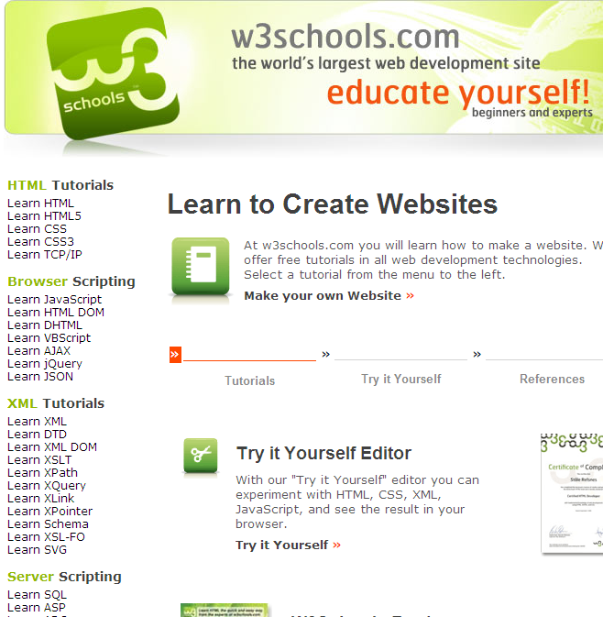
W3Schools Online Web Tutorials

Slide 19
Week 1 Practical Task
Basic HTML Structure
Creating a title
Including section headers
Starting a paragraph
Inserting images on a page
Creating a link to another web page

Slide 20
References
Notepad++ available online at http://notepad-plus-plus.org/
Sir Tim Berners-Lee Biography http://www.w3.org/People/Berners-Lee/
W3C http://www.w3.org/
HTML5 Introduction http://www.w3schools.com/html/html5_intro.asp

