Slide 1




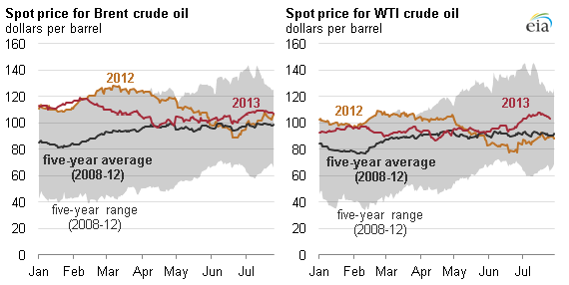


CLIENTS
CLIENT
LAYER
APP
LAYER
DEPLOYMENT
API
BACK-END
PERSISTENT
LAYER
DEV
PRD
GitHub
REPOSITORIES
LDAP
AUTHENTICATION
DATABASE

Slide 2
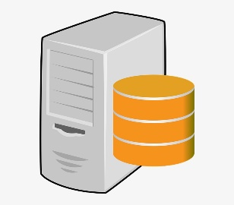


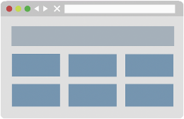






ACTIVE DIRECTORY
SERVER
APP
SERVICE PLAN
DATA STORAGE
AUTHENTICATION
CLIENT
BROWSERS
HTTP
INTERNET
AZURE
APP GATEWAY
WEB APP
RESOURCE GROUP
API REQUEST
REQUEST RESPONSE
AZURE
DNS

