Slide 1
Non-native Phoneme Generalization
Jared Jolton

Slide 2

Distinguishing phonemes in non-native languages is hard
French
Japanese
“the difficulties adults may have in learning new speech contrasts in adulthood might reflect an undesirable characteristic of Hebbian synaptic modification.” (McClelland, Fiez, & McCandliss, 2002)

Slide 3
Hebbian Synaptic Modification
The synaptic connections that allow us to differentiate between the sounds of our own languages get strengthened, but no such process occurs for the sounds of languages that we are not exposed to.
Coarse coding and distributed representations
The same network of neurons is used to detect all kinds of speech sounds.
The graded activity of these neurons allow for (relatively) few detectors to represent many different things.

Slide 4
Why is this so problematic?
We specialize the weights associated with our “phoneme detectors” so as to make recognition of sounds in familiar languages accurate and efficient.
Without practice (error driven learning), the ability to differentiate between sounds diminishes.

Slide 5
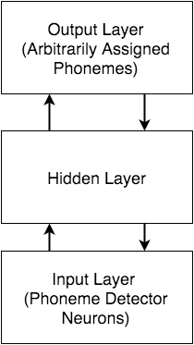
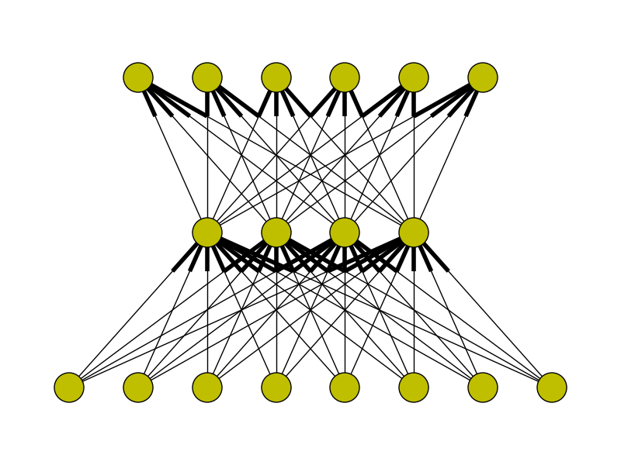
Network Structure

Slide 6

Learning Algorithms
Input unit activations:
Pixel color value converted to float between 0 and 1
Sigmoid activation function:

Slide 7
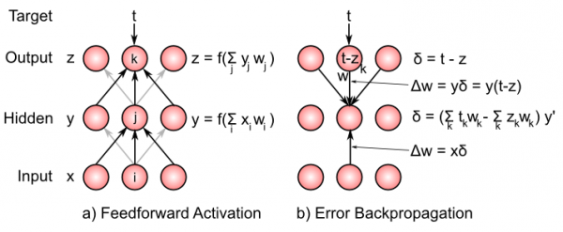
Backprop

Slide 8
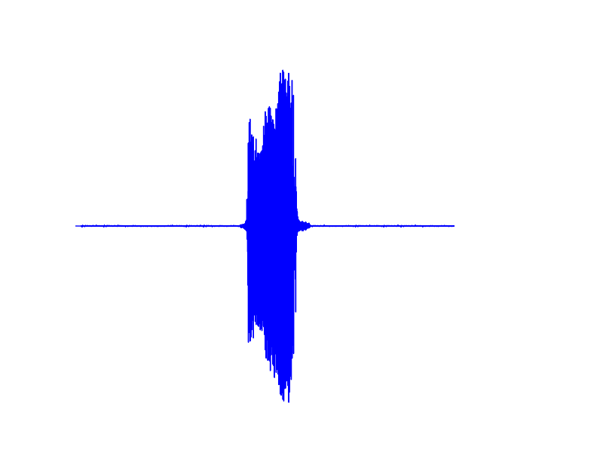
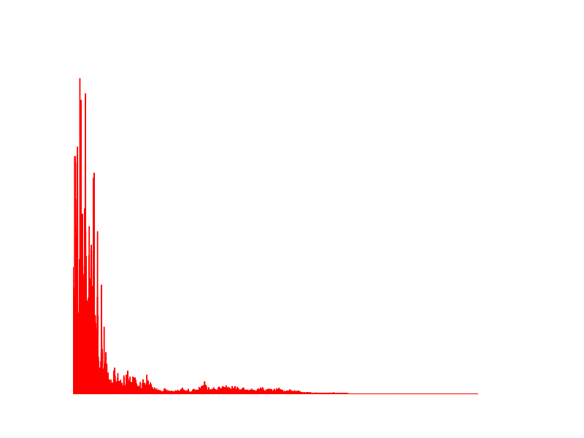
Visually Representing Sound
Amplitude
FFT

Slide 9
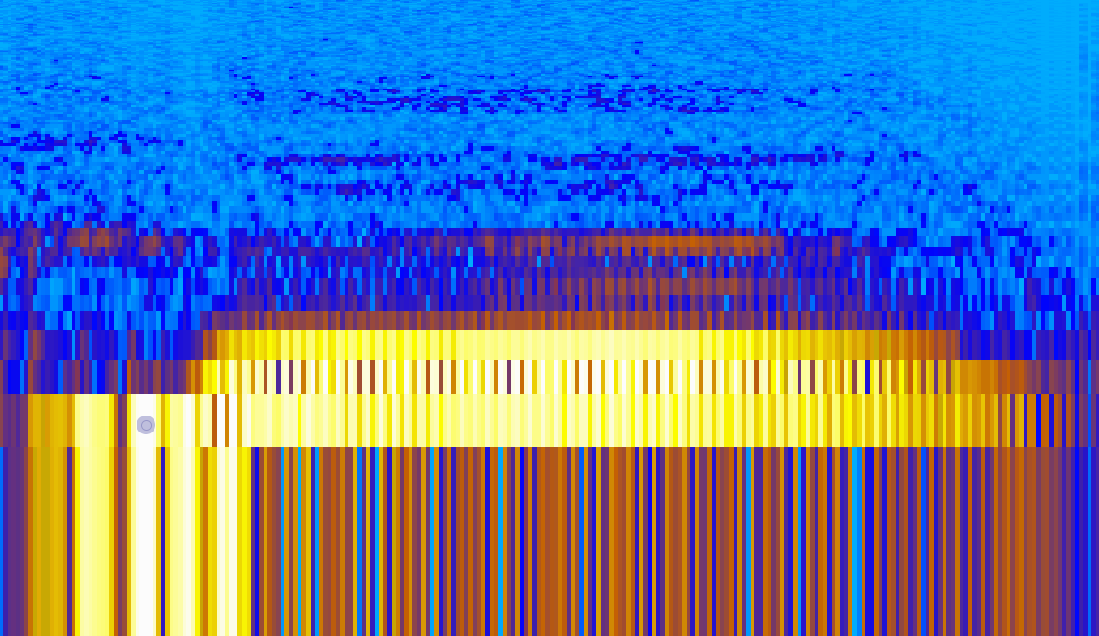
Sonogram
Frequency (logarithmically scaled)
Time

Slide 10
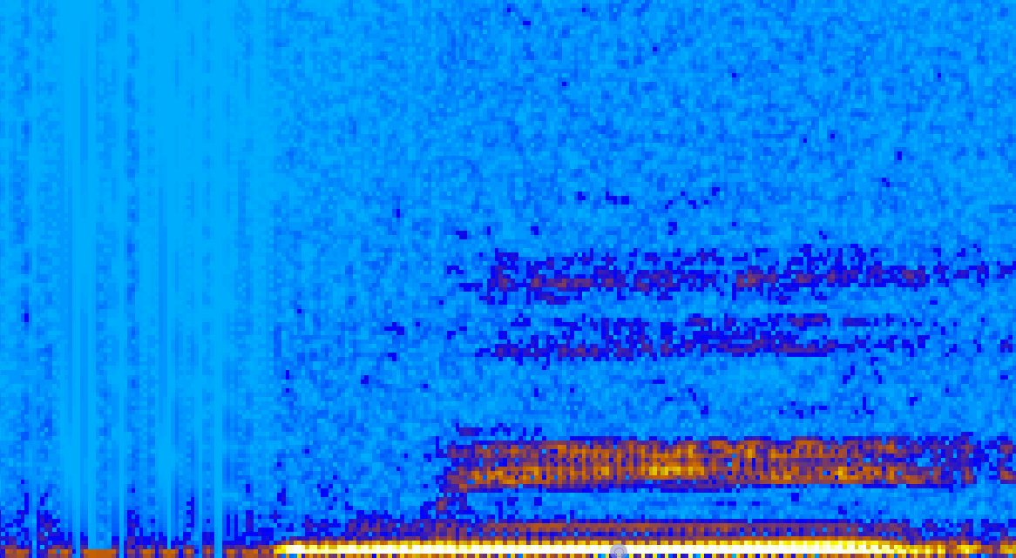
Linear Scale

Slide 11
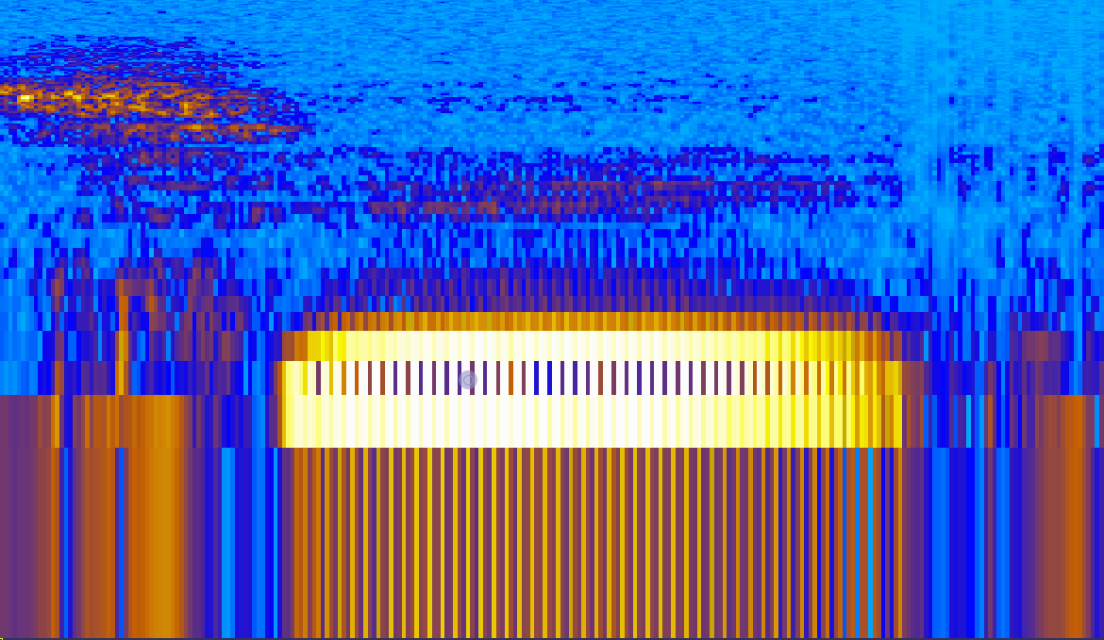
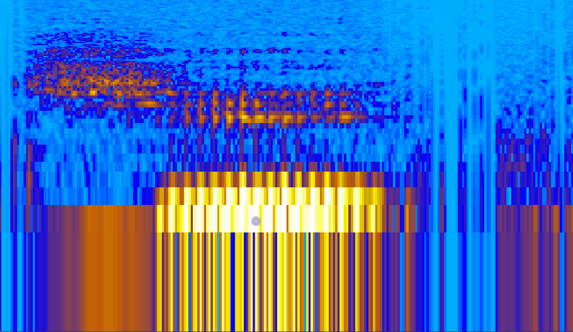
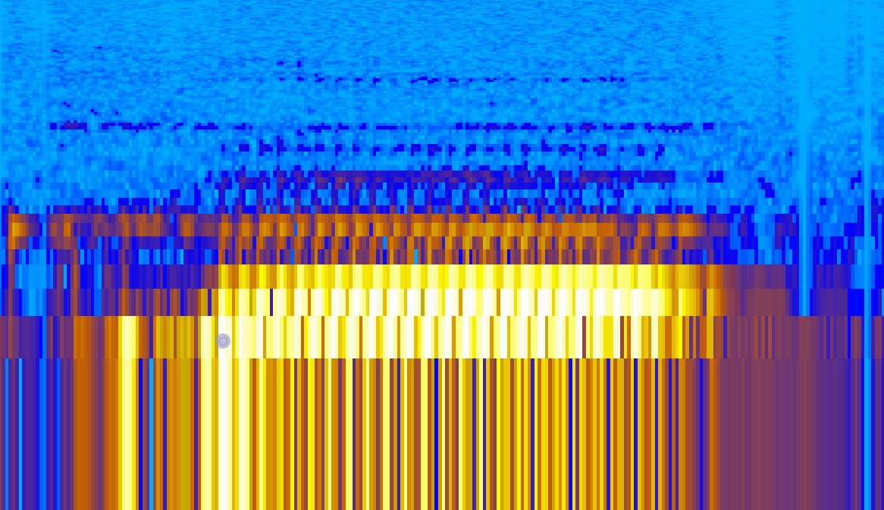
Hard Stuff
chi (female)
chi (male)
ku (female)
ku (male)

Slide 12

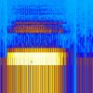
Made Harder
fu (male)
i (male)

Slide 13
Performance
Network has learned to classify 10 phoneme variants in ~12 epochs
5 with female voice
5 with male voice
The program makes around 800,000,000 computations each epoch! … which can take a while
Performance is largely dependent on initial random weights
Just like how some people have more trouble than others learning to distinguish foreign speech sounds

Slide 14
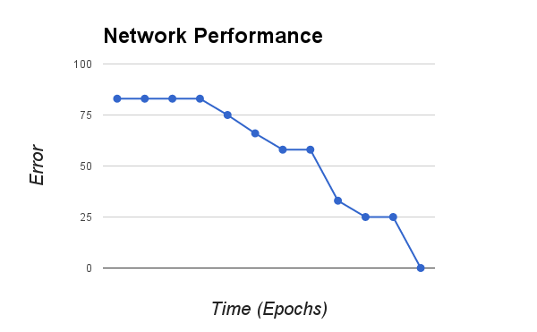

Slide 15
Generalizing to new sounds
As hypothesized, the network trained on the Japanese phonemes cannot accurately distinguish between novel speech sounds.
It takes a highly specific weight pattern to detect / classify specific phonemes.
Without training, the network will not have a pattern of weights that will allow for new sounds to have their own representations.

Slide 16
todo
Might not be setting the network up for success at the generalization task
Matrix/vector implementation
Floating threshold
Inhibitory competition / Lateral connectivity
Different network structure
(i.e. V1→V4→IT→Output) like objrec model
Different phoneme representation?

Slide 17
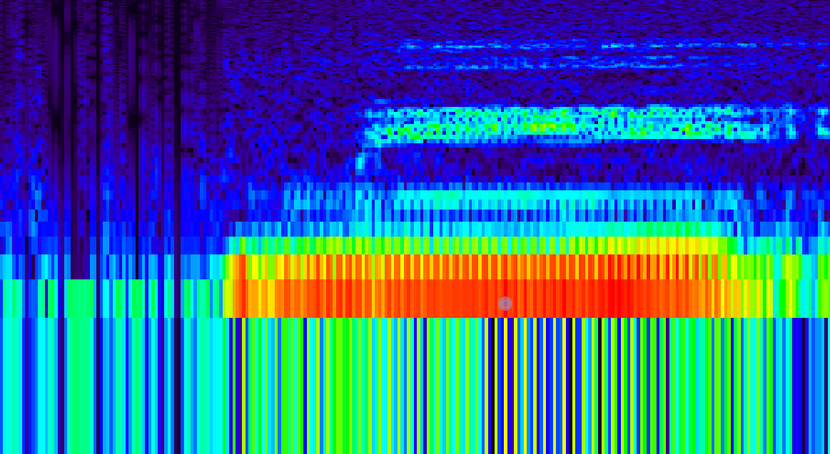
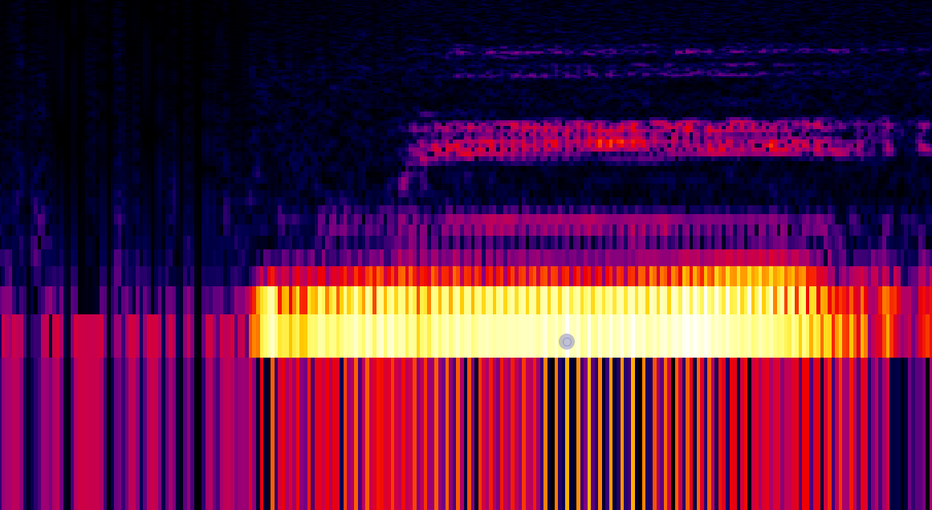
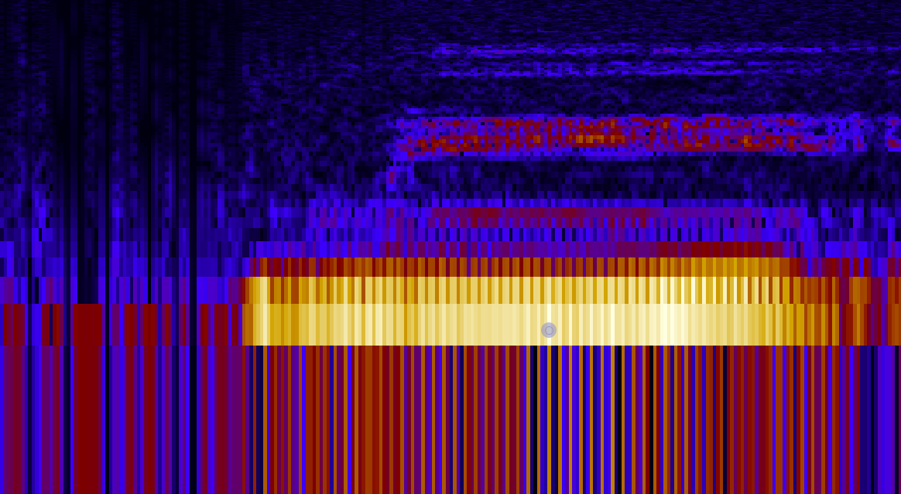

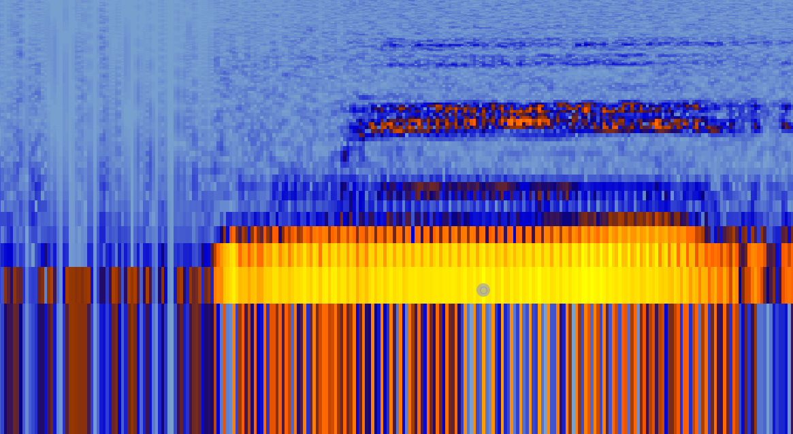

Slide 18
https://github.com/2PacIsAlive

Slide 19
References
Escudero, P. (2005). Linguistic perception and second language acquisition: Explaining the attainment of optimal phonological categorization. Netherlands Graduate School of Linguistics.
Francis, A., & Nusbaum, H. (2002). Selective attention and the acquisition of new phonetic categories. Journal of Experimental Psychology: Human Perception and Performance, 349-366.
Hebb, D. (1949). The organization of behavior; a neuropsychological theory. New York: Wiley.
Iverson, P. (2002). A Perceptual Interference Account Of Acquisition Difficulties For Non-native Phonemes. Cognition, B47-B57.
Kavanagh, B. (2007). The phonemes of Japanese and English: A contrastive analysis study. 青森県立保健大学雑誌, 8(2), 283-292.
Mcclelland, J., Fiez, J., & Mccandliss, B. (2002). Teaching the /r/–/l/ discrimination to Japanese adults: Behavioral and neural aspects. Physiology & Behavior, 657-662.
O'Reilly, R. C., Munakata, Y., Frank, M. J., Hazy, T. E., and Contributors (2014). Computational Cognitive Neuroscience. Wiki Book, 2nd Edition. URL: http://ccnbook.colorado.edu
Sharma, A., & Dorman, M. (2000). Neurophysiologic Correlates Of Cross-language Phonetic Perception. The Journal of the Acoustical Society of America, 2697-2697.

