Slide 1
AJAX using fetch()
By Jason Rice
J.P. Morgan Chase

Slide 2
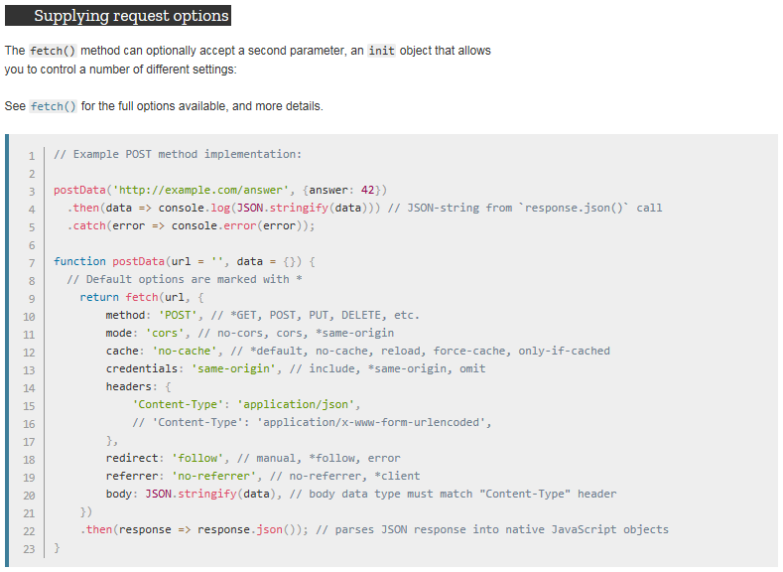
Supplying request options

Slide 3
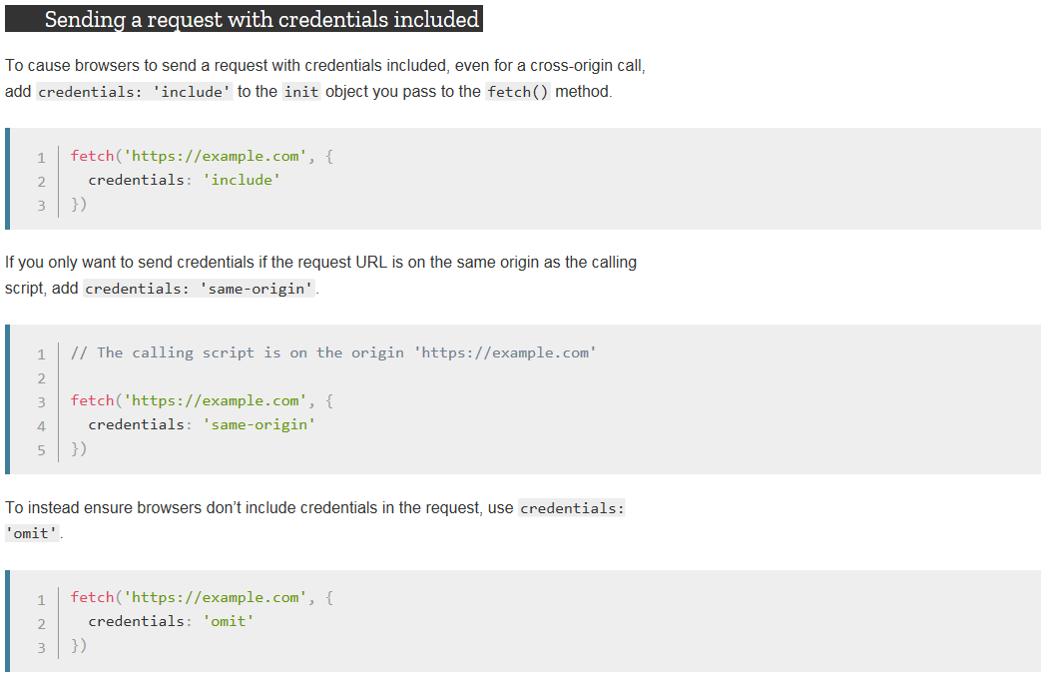
Sending a request with credentials included

Slide 4
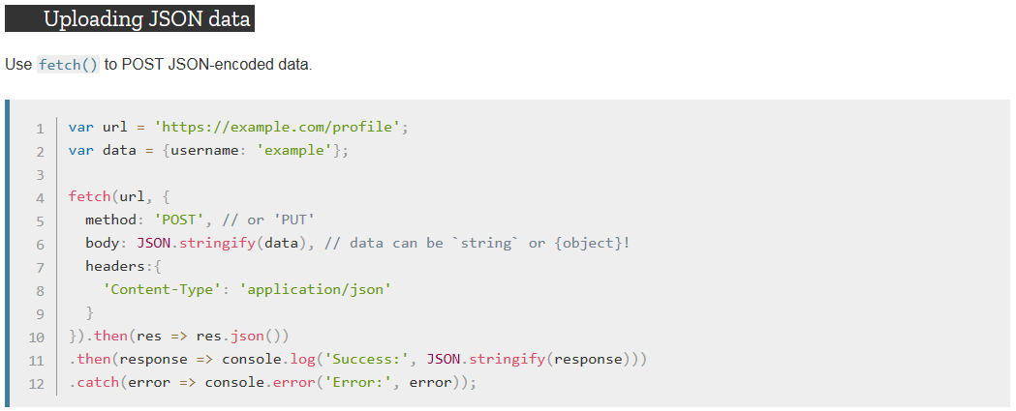
Uploading JSON data

Slide 5
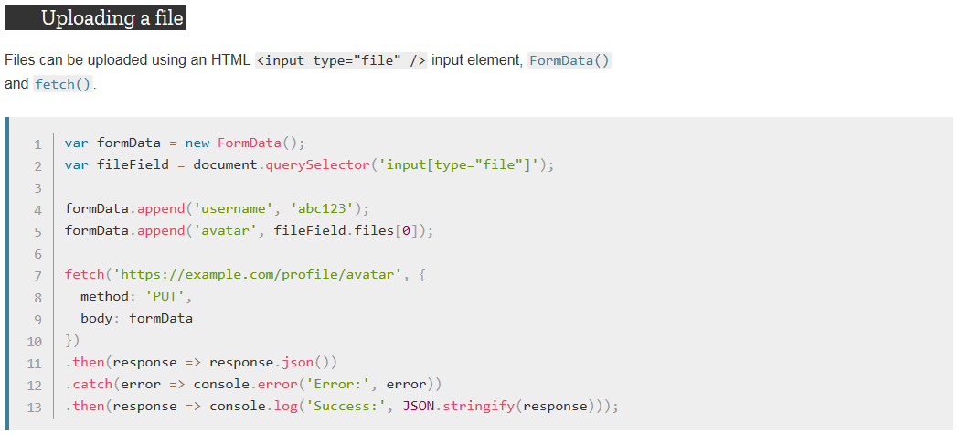
Uploading a file

Slide 6
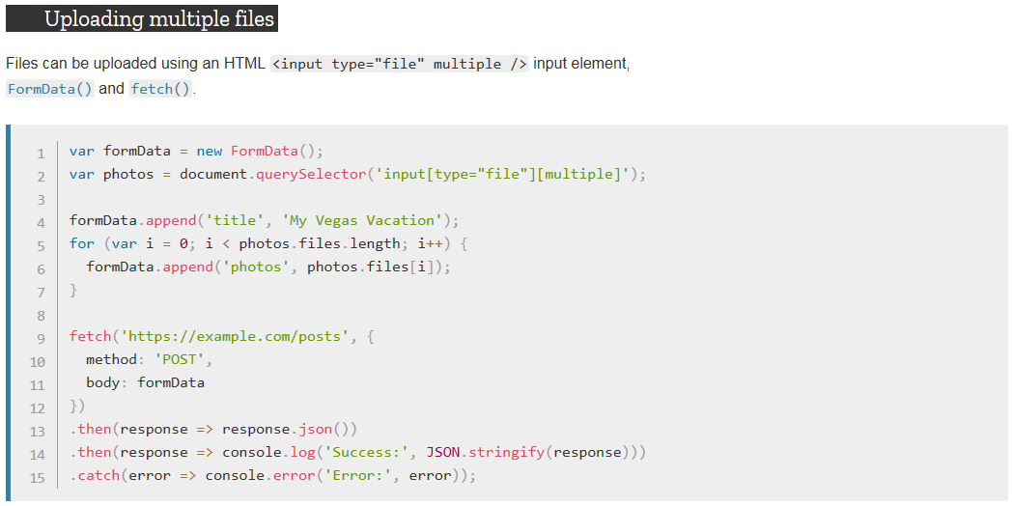
Uploading multiple files

Slide 7
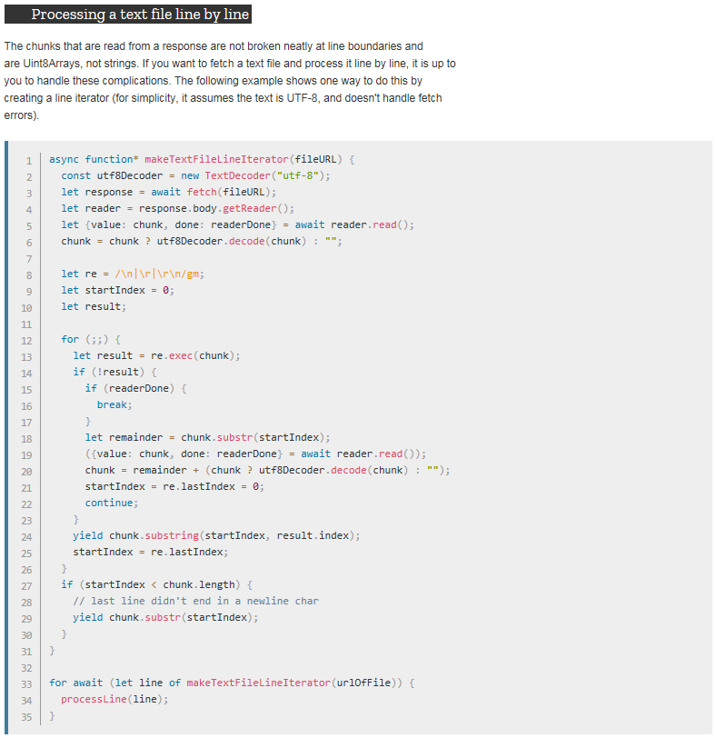
Processing a text file line by line

Slide 8
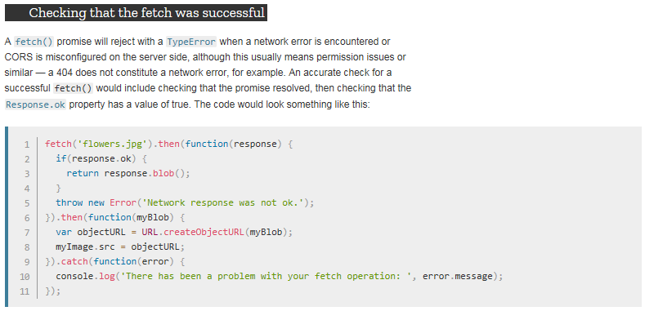
Checking that the fetch was successful

Slide 9
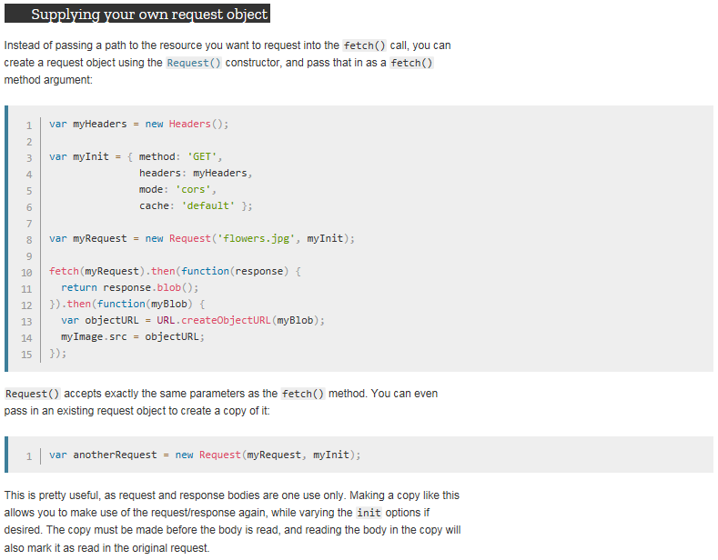
Supplying your own request object

Slide 10
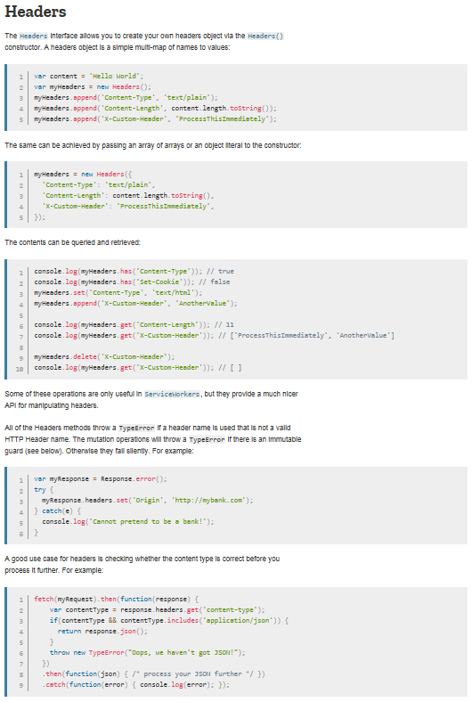
Headers

Slide 11
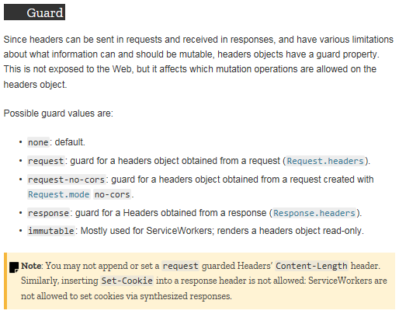
Guard

Slide 12
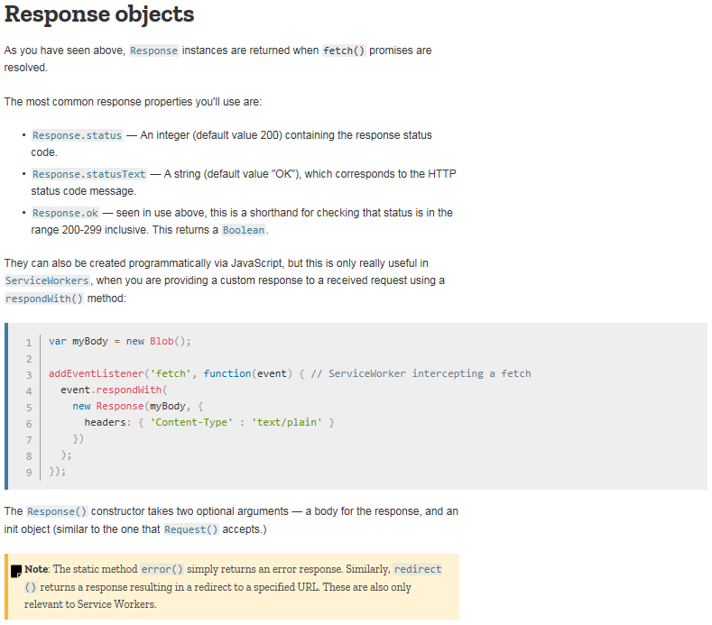
Response objects

Slide 13
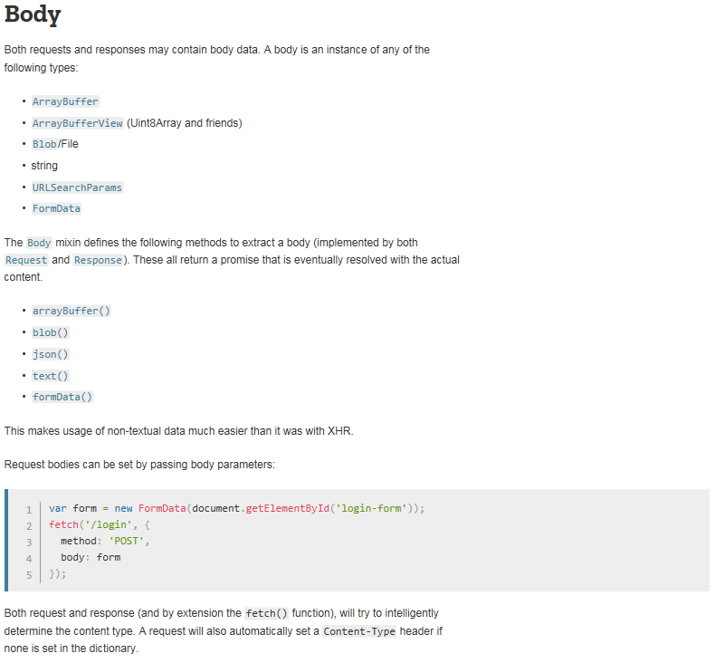
Body

Slide 14
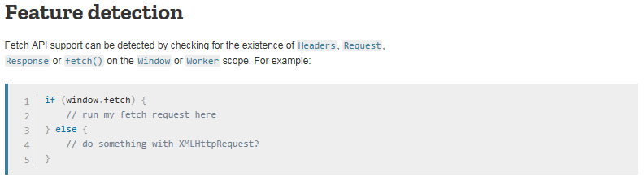
Feature detection

Slide 15

Polyfill

Slide 16
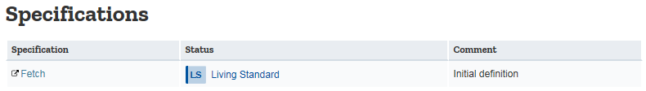
Specifications

Slide 17
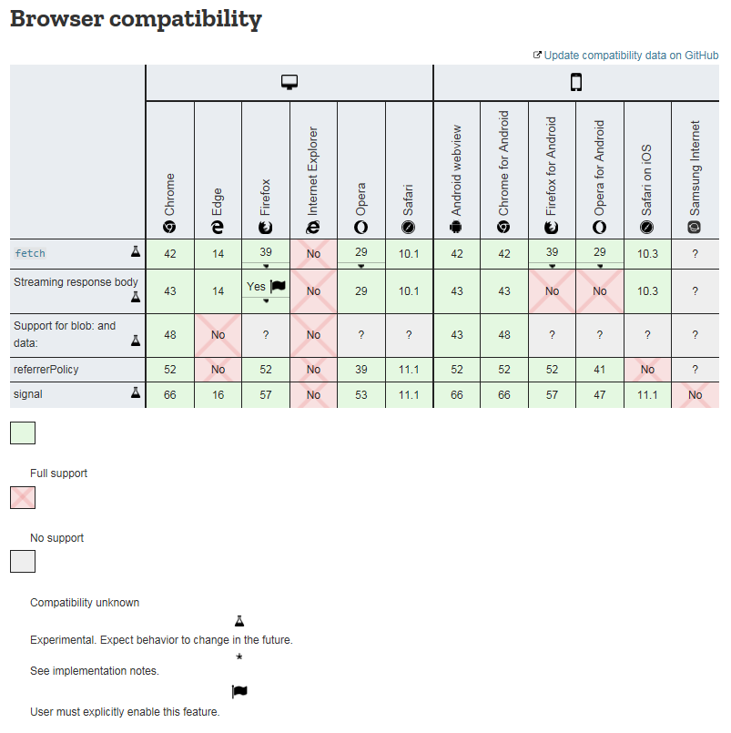
Browser compatibility

