Slide 1
How to Get access to IBM Watson Studio
IBM Watson Studio is the replacement for
Data Science Experience

Slide 2
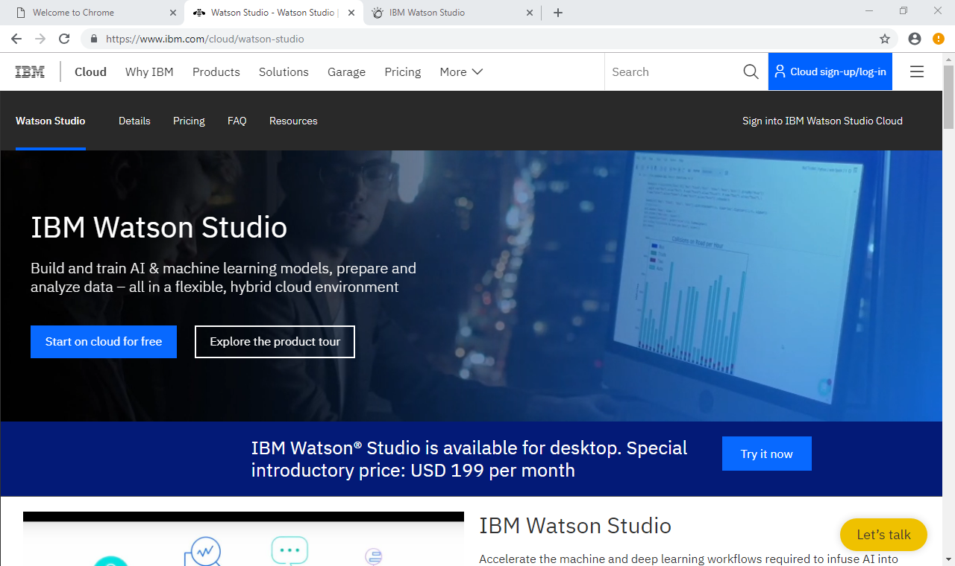
Go to this Hyperlink
Click on “Start on Cloud for Free”

Slide 3
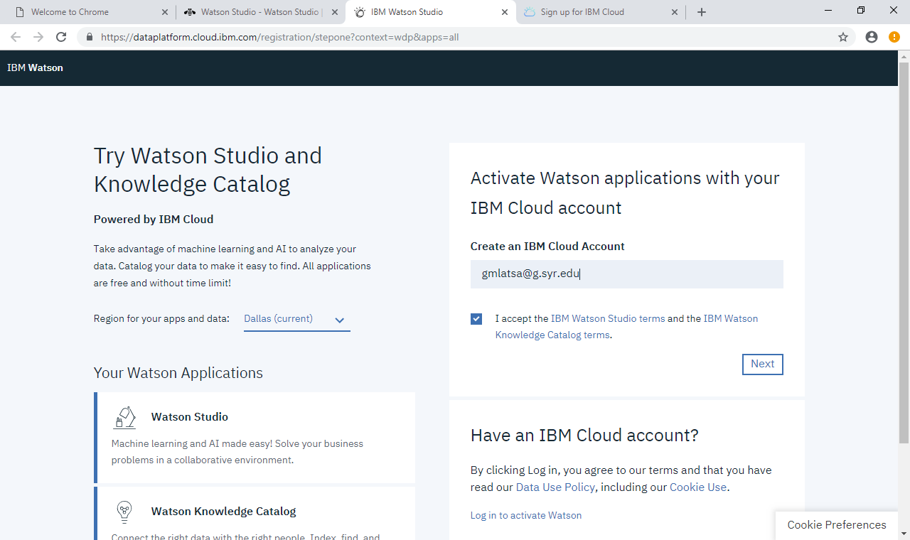
Enter your Email address
Click “I accept” Click Next “
Keep Dallas for the region

Slide 4
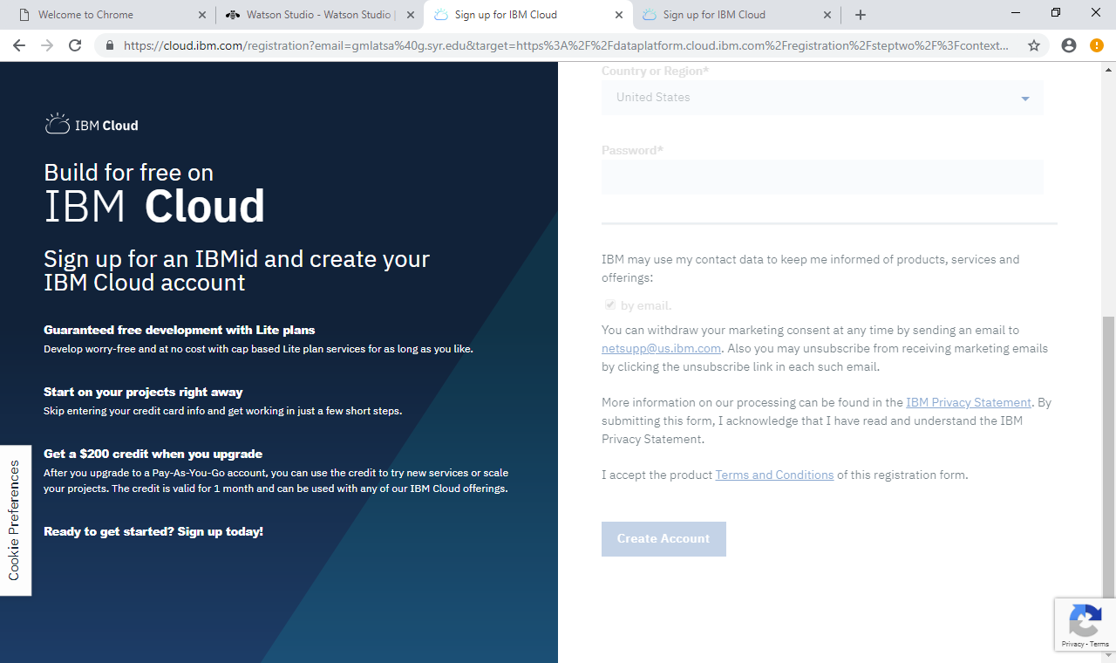
Fill out your Account Info
Click “Create Account”

Slide 5
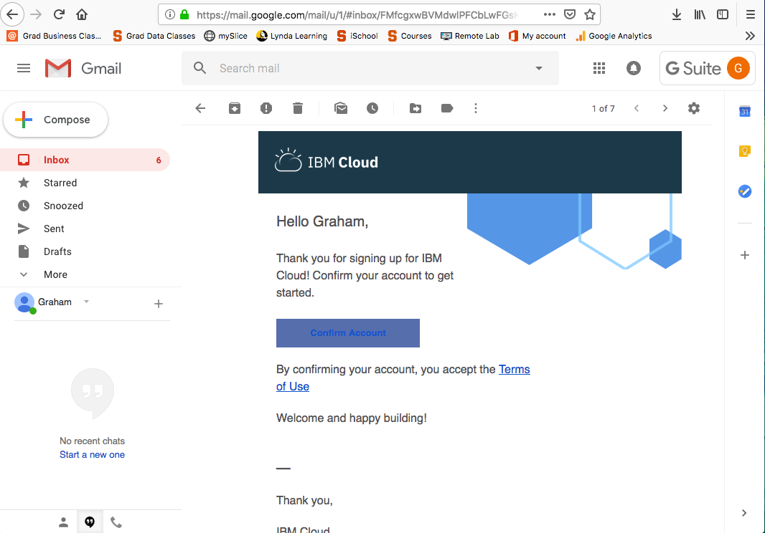
Go to Your email, open the email from IBM Cloud
Confirm the account

Slide 6
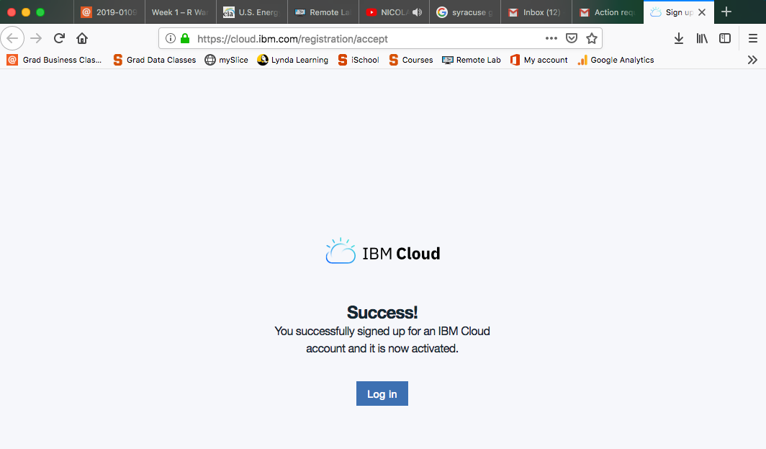
This is the website that Pop ups
Click Log in

Slide 7
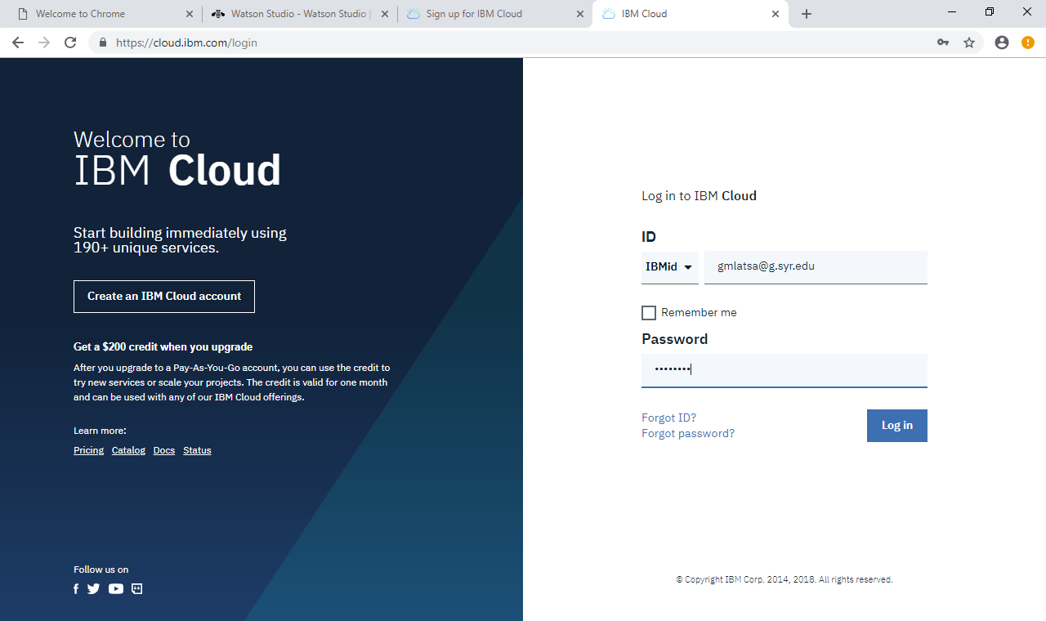
Log in From this page

Slide 8
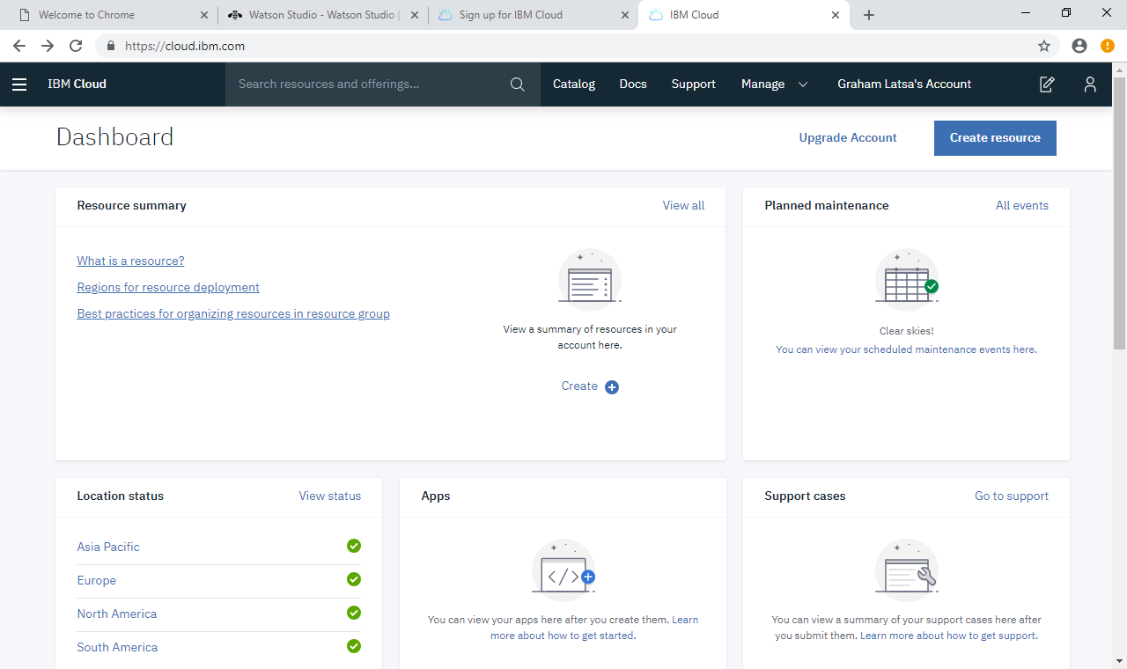
This is the IBM Cloud Page
Click On “Catalog”

Slide 9
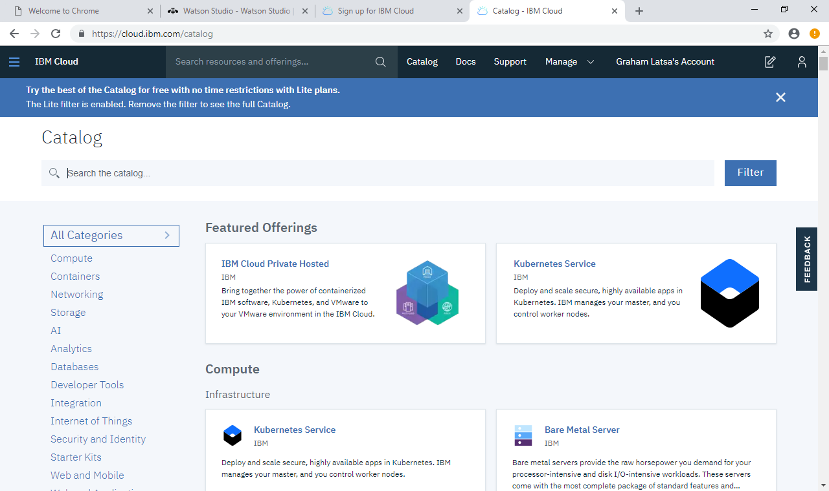
This is the Catalog Page
Enter “Watson Studio” in the Search the Catalog area

Slide 10
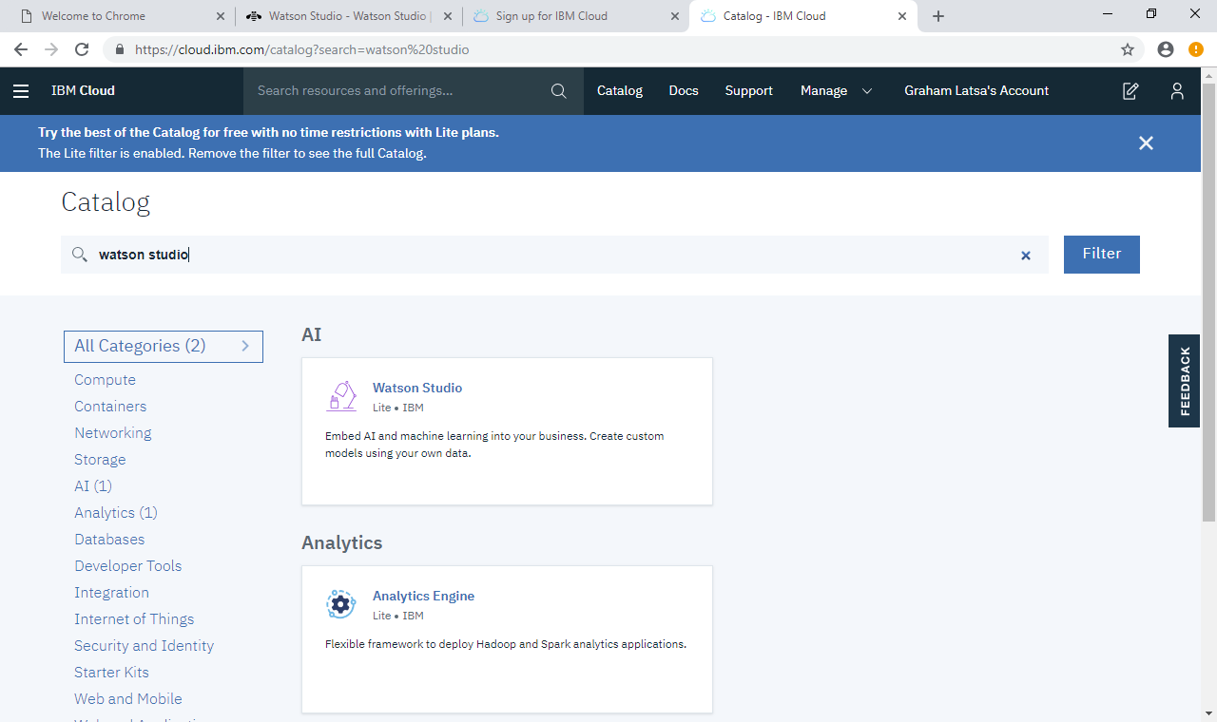
Open Watson Studio

Slide 11
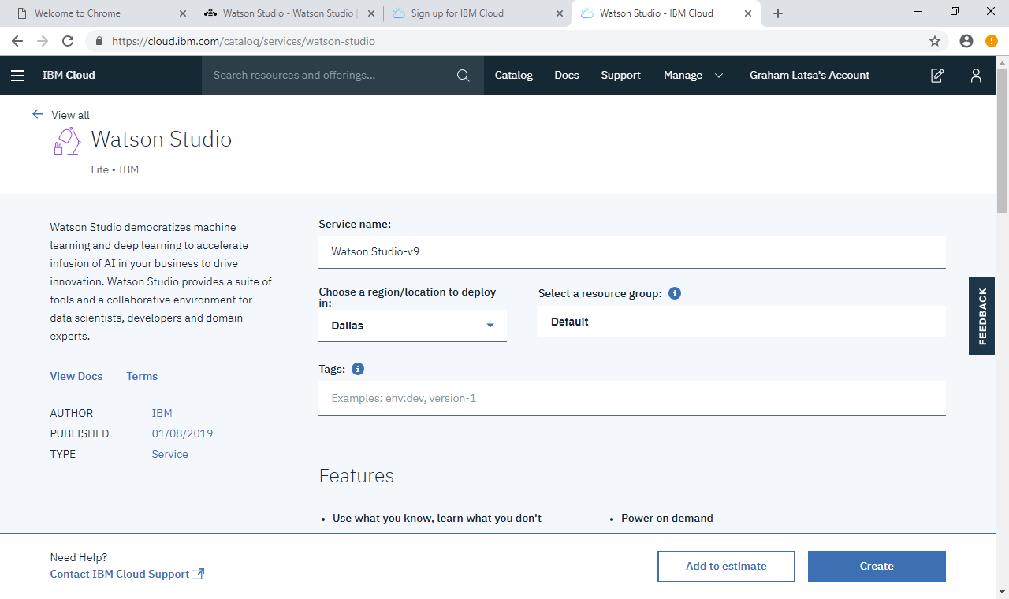
This is the Watson Studio app Set up page
Scroll down
Keep Dallas for the region

Slide 12
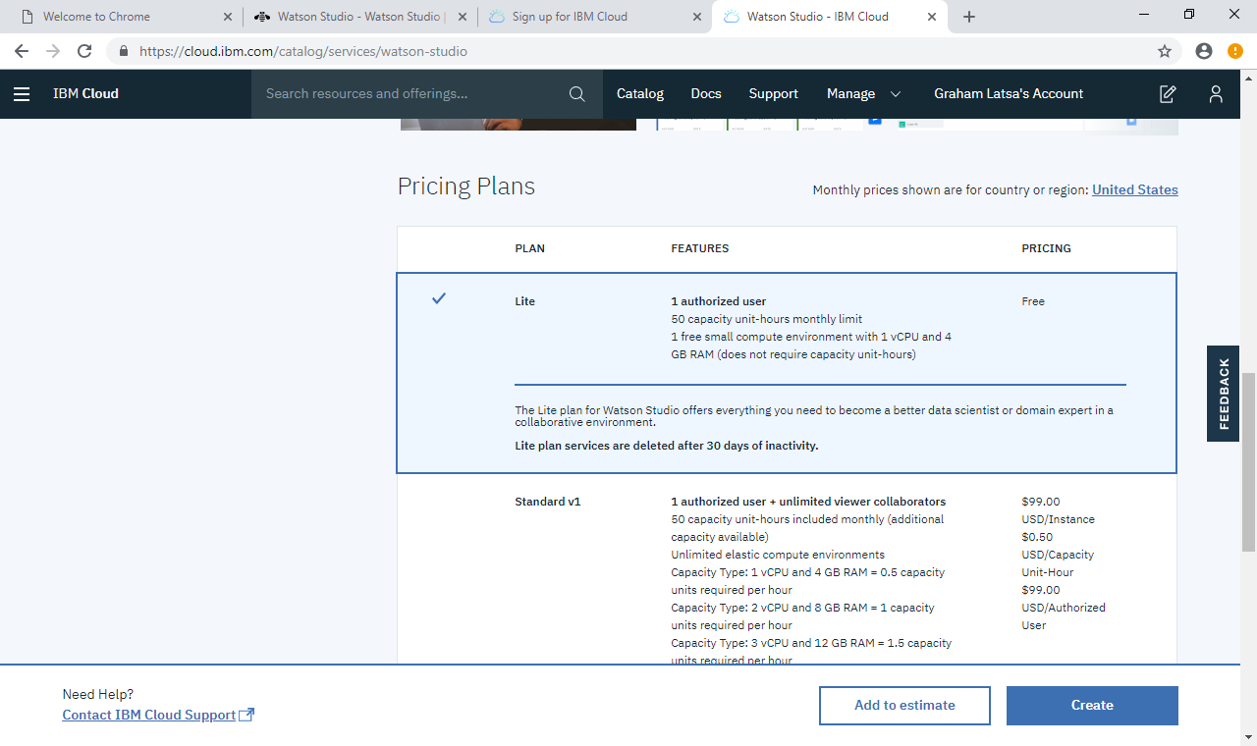
Select Lite Version
Click Create

Slide 13
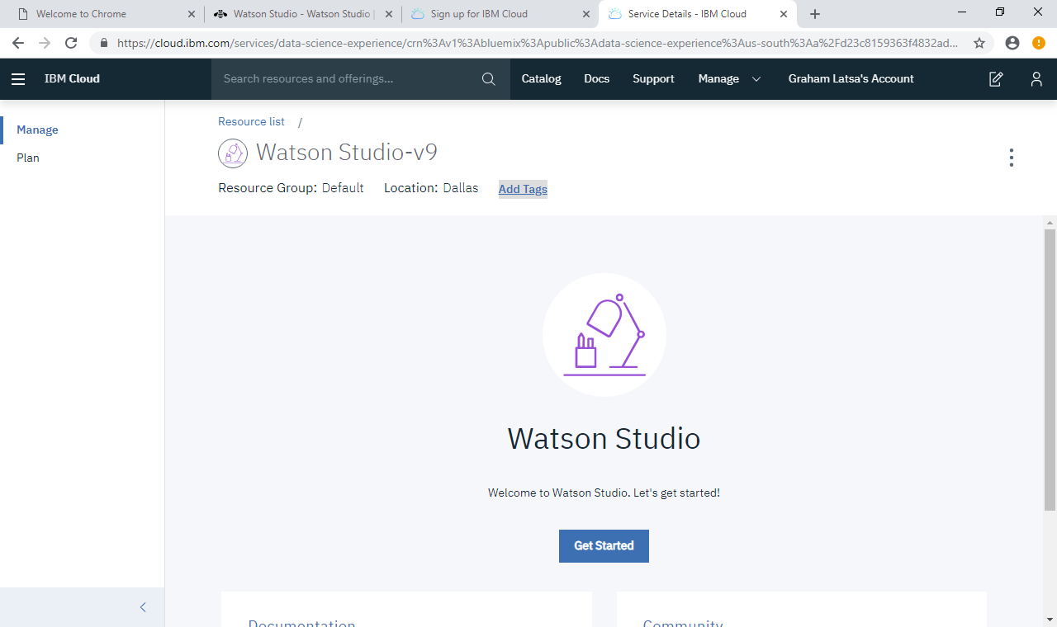
This is the Set up page for the Watson Studio App
Click “Get Started”

Slide 14
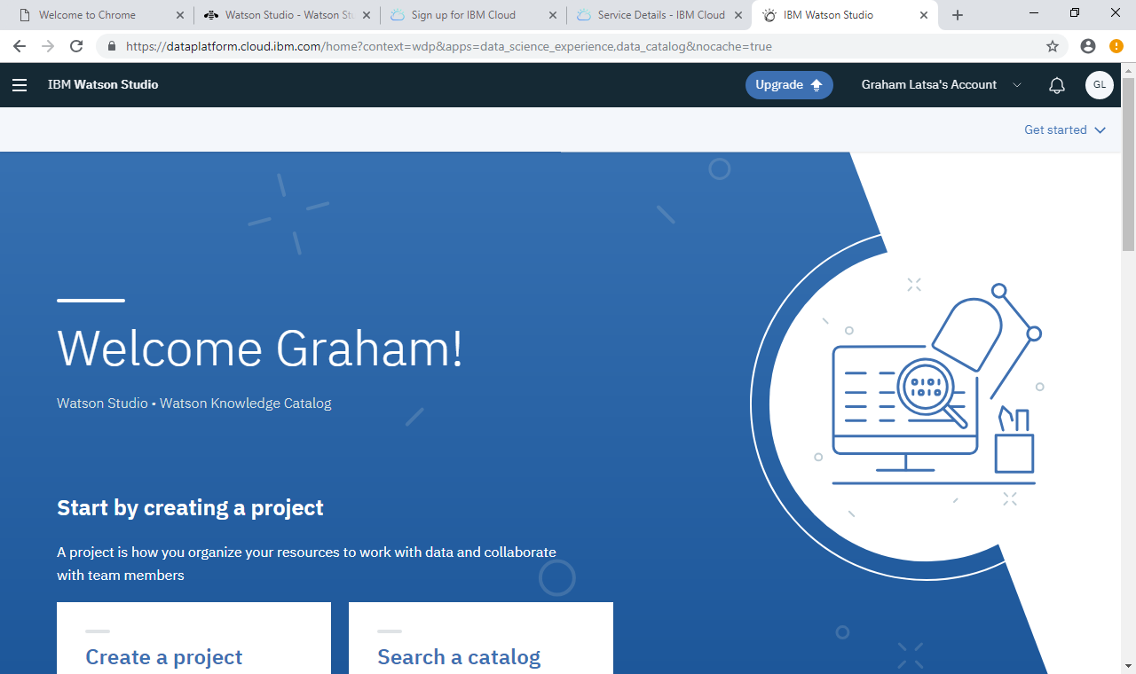
This is the installed Watson Studio App
Scroll down

Slide 15
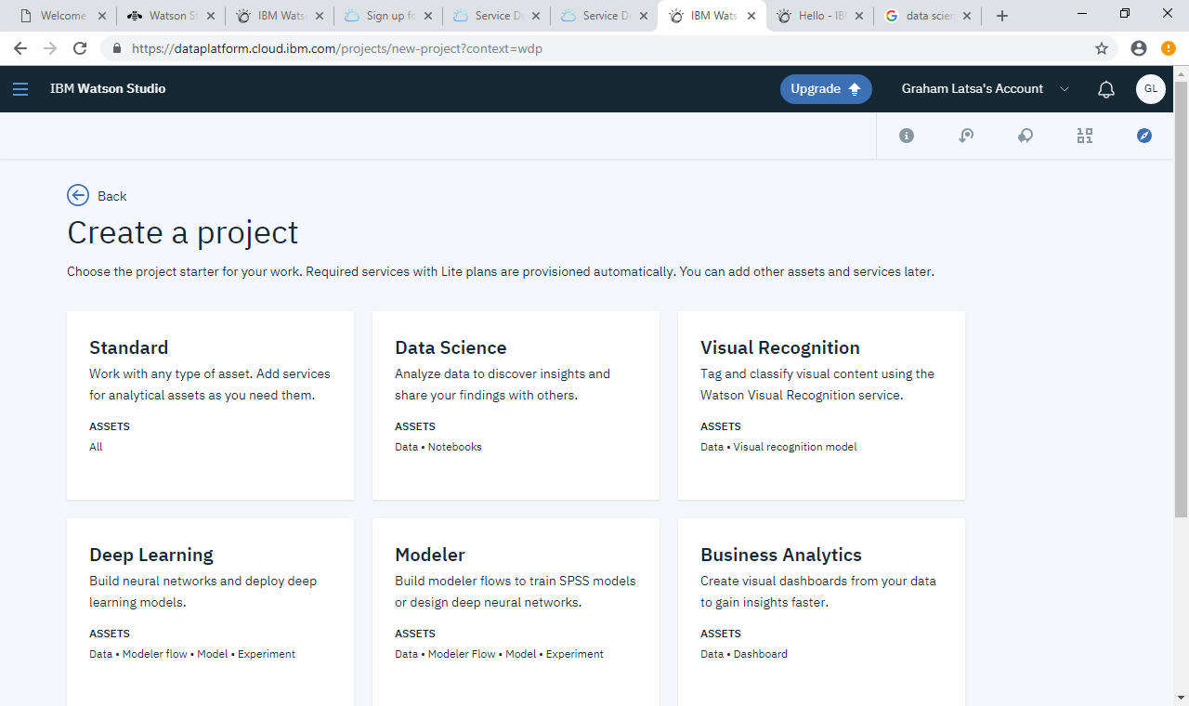
Click Data Science for the Project

Slide 16
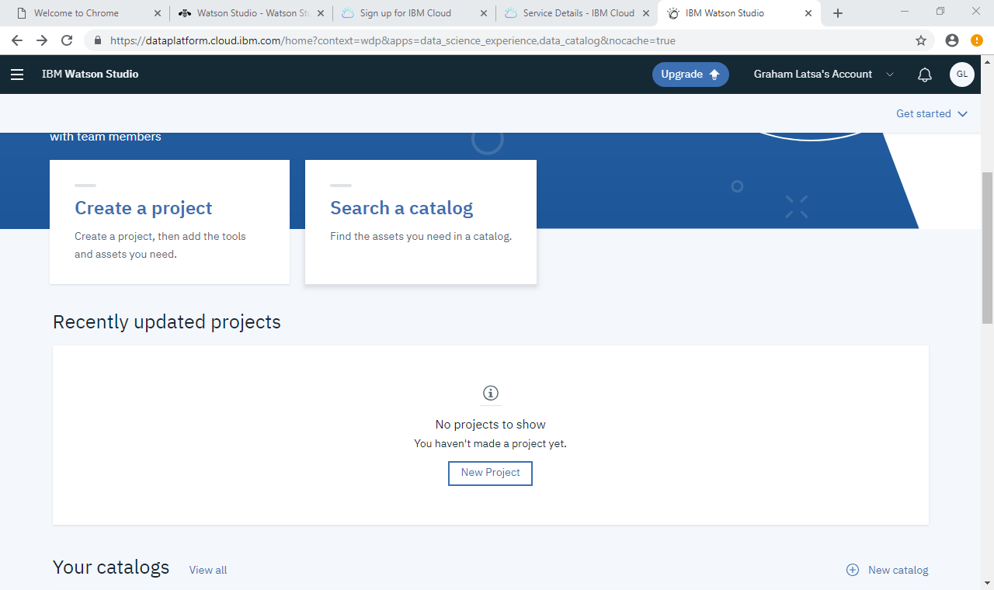
This is the installed Watson Studio App
Click “Create Project”

Slide 17
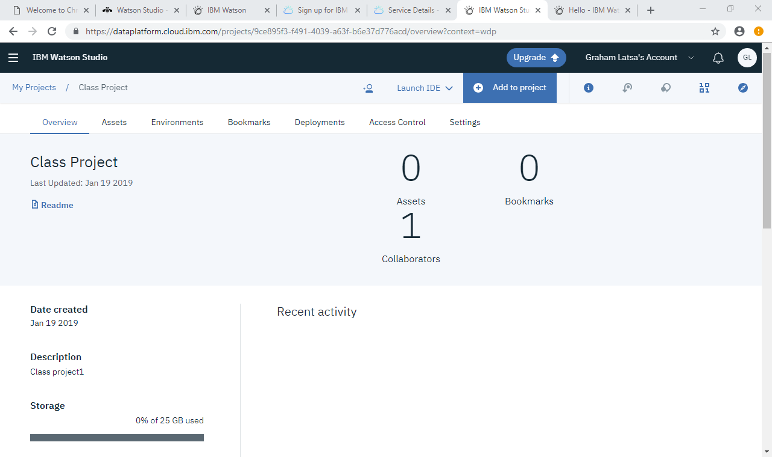
Project Page on Watson Studio
Click on Add to Project

Slide 18
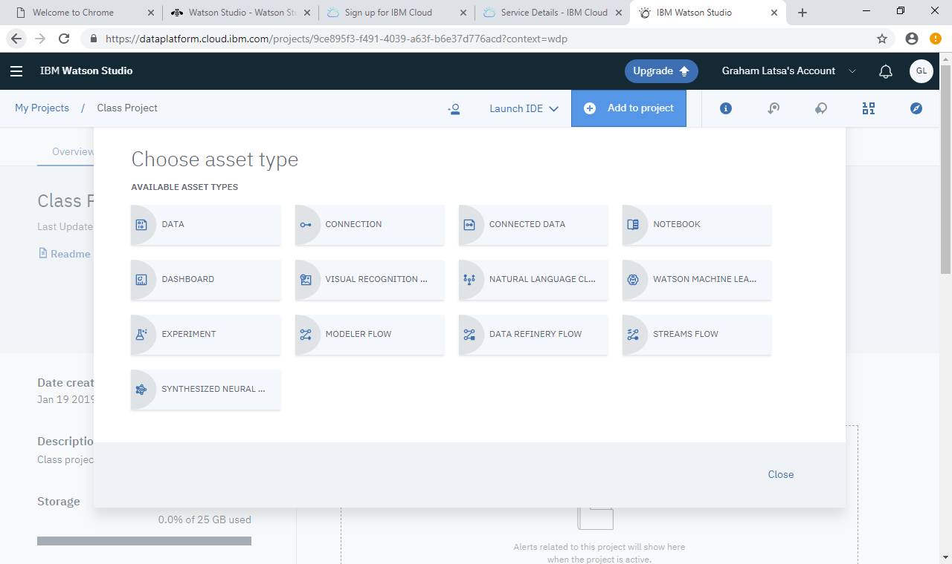
Click on Notebook
Enter Notebook information (I did not take screen shots)

Slide 19
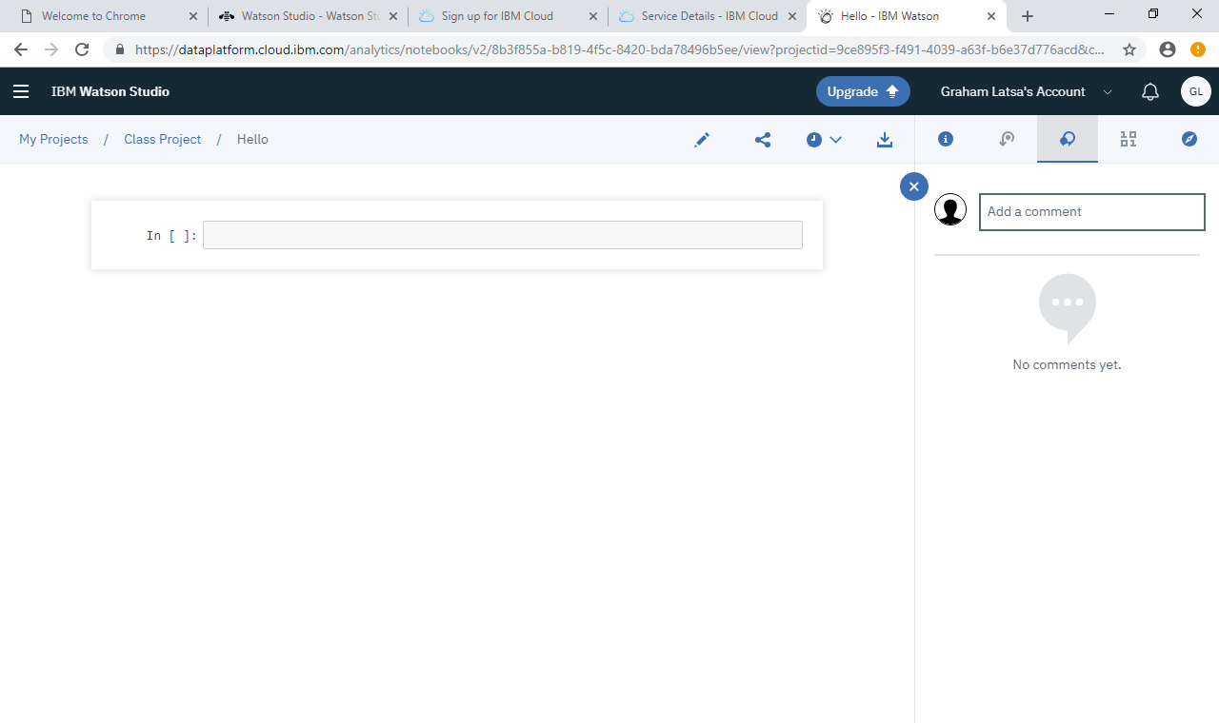
The Notebook on IBM Watson Studio

Slide 20
How to Get to Notebook from IBM Cloud Log in

Slide 21
Log in From this page

Slide 22
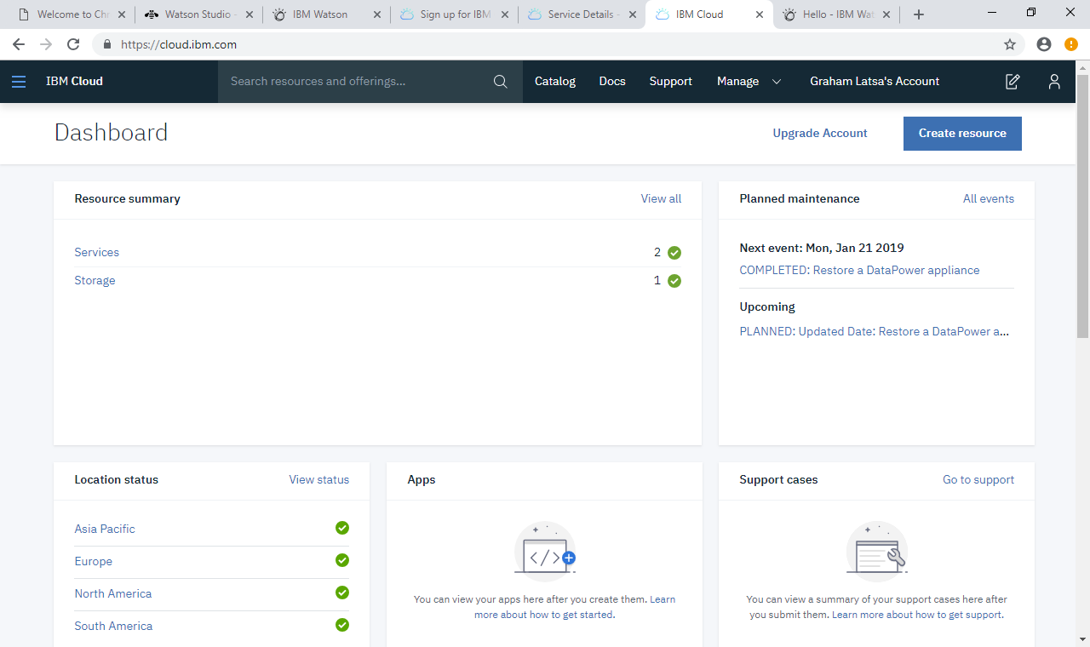
Click on Services

Slide 23
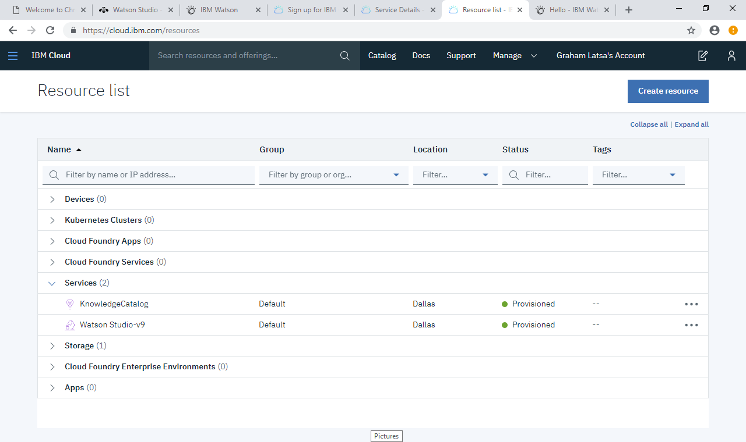
Click on Watson Studio

Slide 24
This is the Set up page for the Watson Studio App
Click “Get Started”

Slide 25
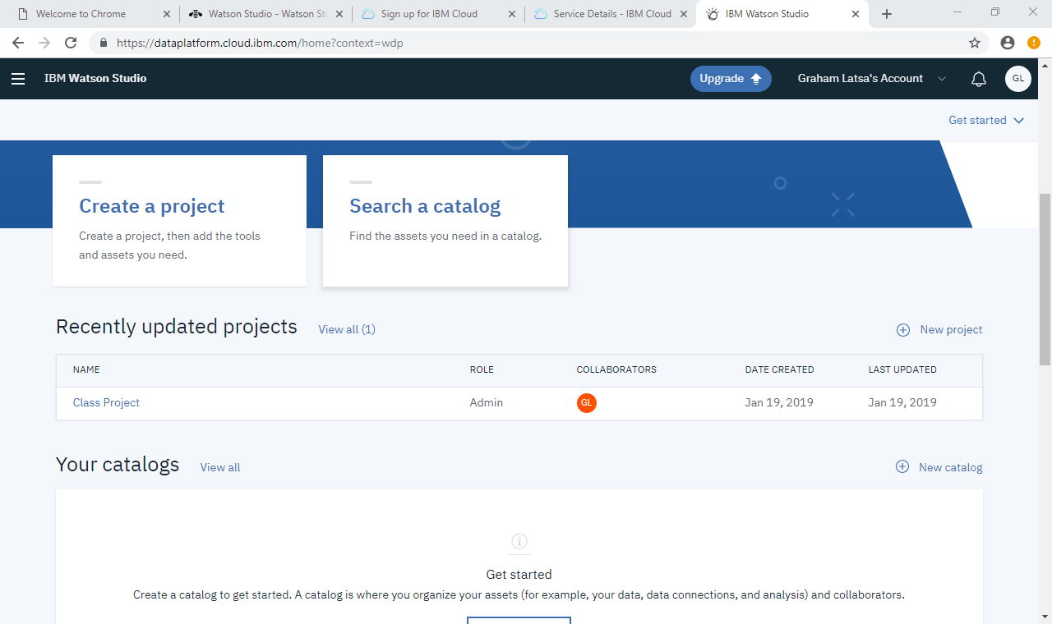
This is the page when your project is entered
Click on the Project hyperlink

Slide 26
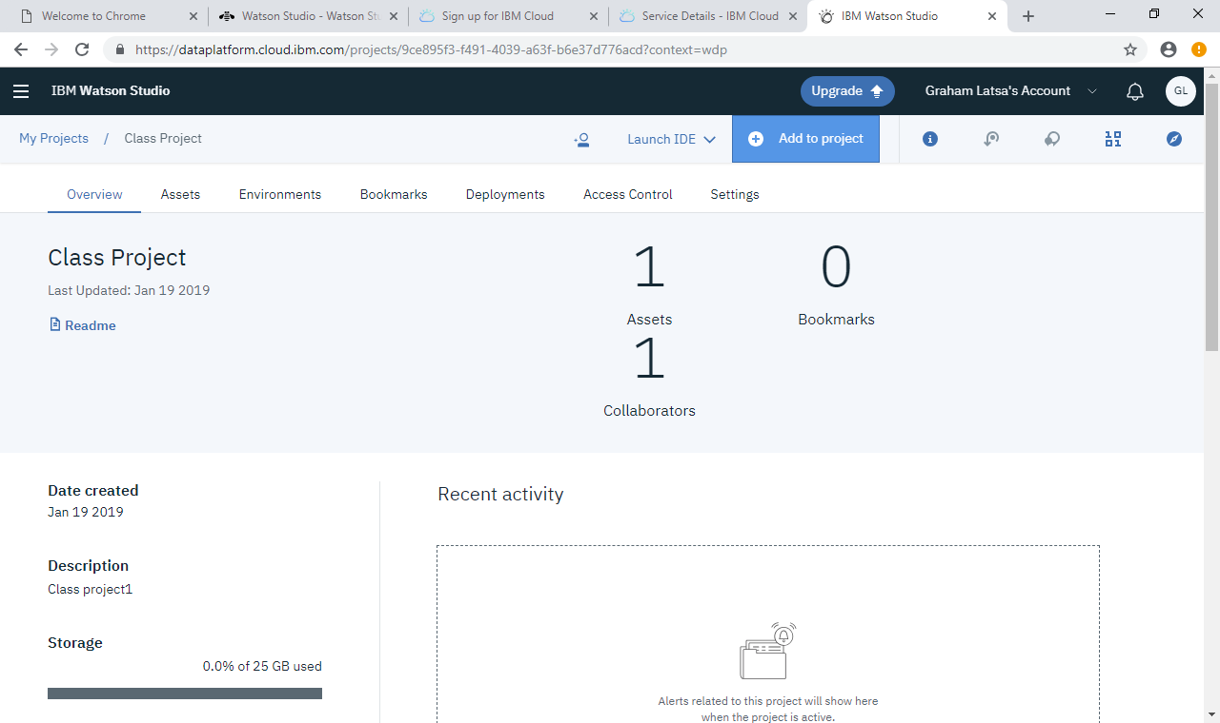
This is the project page
Click on Assets to find your notebooks

Slide 27
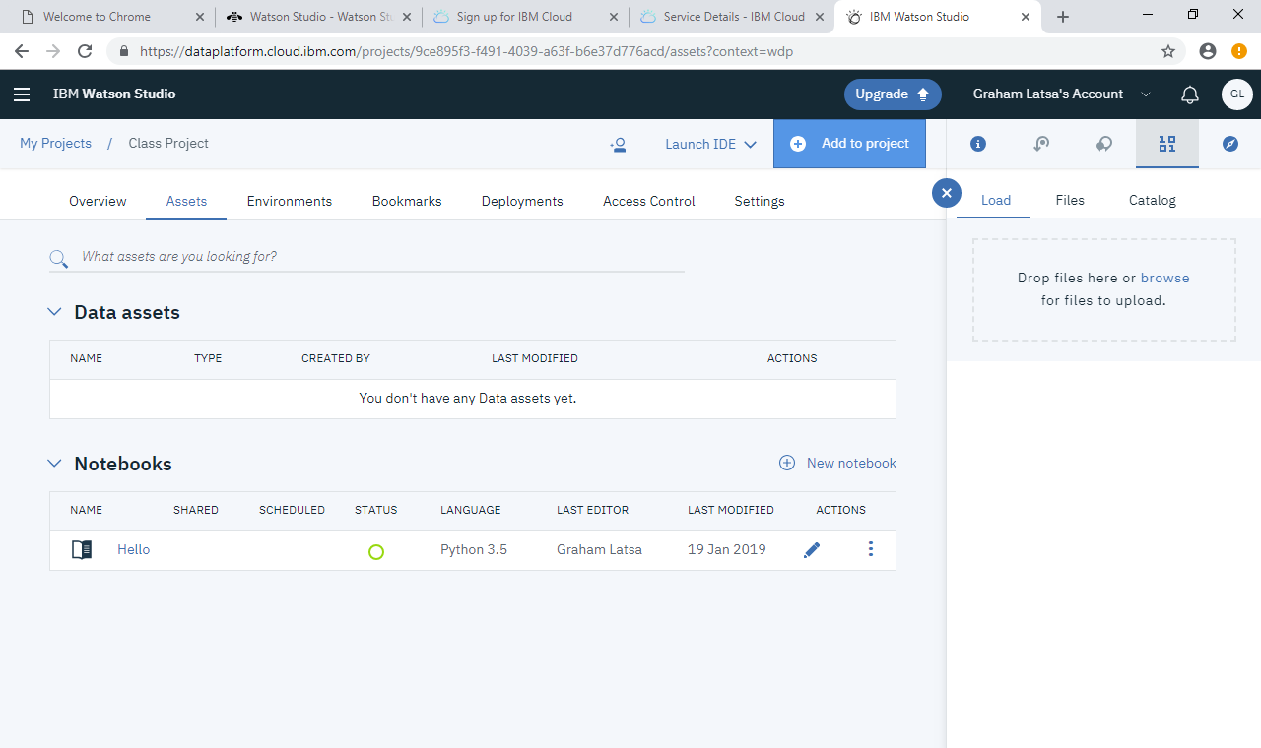
This is the asset page of Notebooks
Click on your notebook

