Slide 1

THE SYRIAN PRIVATE UNIVERSITY
FACULTY OF COMPUTER & INFORMATICS ENGINEERING
Learning Management System LMS
Prepared By:
Hajar Hamza Al-Zoubi
Sameh Yahya Orabi
Sulaf Walid Al-Samarra
Supervised by
Dr. Akram Masouh
June 2026

Slide 2
Abstract
need for a culturally-adapted, Arabic-native learning platform
Django framework and Bootstrap 5
93.3% test pass rate, 1.2 seconds average response time
role-based access control
Native Arabic interface design,
integrated certificate workflow

Slide 3
Problem Statement & Objectives
1. Problem:
Existing LMS platforms require extensive localization, lack native Arabic support, and impose high costs or complex configurations unsuitable for local institutions.
2. Main Objective:
Build an intelligent, Arabic-native learning management system to streamline course delivery, assessment, and academic administration.
3. Sub-objectives (SMART):
Achieve ≥90% test pass rate ✓ (Achieved: 93.3%)
Response time <2 seconds ✓ (Achieved: 1.2s)
100% Arabic RTL interface compliance ✓
Implement 29 core functional requirements ✓

Slide 4
Scope, Constraints & Assumptions
Scope
Web-based Platform
Three user Roles
Core Modules
Constraints
SQLite Database
Limited time
Open-source
Assumptions
Internet Connection
basic computer literacy
local deployment

Slide 5
Related Work & Research Gap
Study | Contribution | Limitation
Moodle | Open-source, modular architecture, extensive question bank | Requires manual RTL configuration, complex localization
Open edX | Microservices architecture, advanced analytics | Complex setup, Arabic needs additional configuration
Canvas LMS | Intuitive UX, cloud-native, mobile-responsive | Commercial SaaS, vendor-locked, limited customization
1. Research Gap:
No existing system provides native Arabic RTL support from inception with zero localization overhead tailored for Syrian academic regulations.
2. Our Innovation:
Localization-first design with culturally-aligned workflows, zero-cost deployment, and integrated certificate/approval mechanisms.

Slide 6
Development Methodology & Project Plan
Methodology: Incremental Development Model
Tools: GitHub, Trello, Visual Studio Code, draw.io

Slide 7
Key Requirements
ADMIN
Manage Users
Manage system Settings
Manage Payment Methods
Manage Categories
View Statistics
Export Reports
STUDENT
Manage Registrations
Manage Ratings
Manage Personal Certificates
TEACHER
Manage Courses
Manage Content
Manage Tests
Manage Registration Requests
Manage Certificates Requests

Slide 8
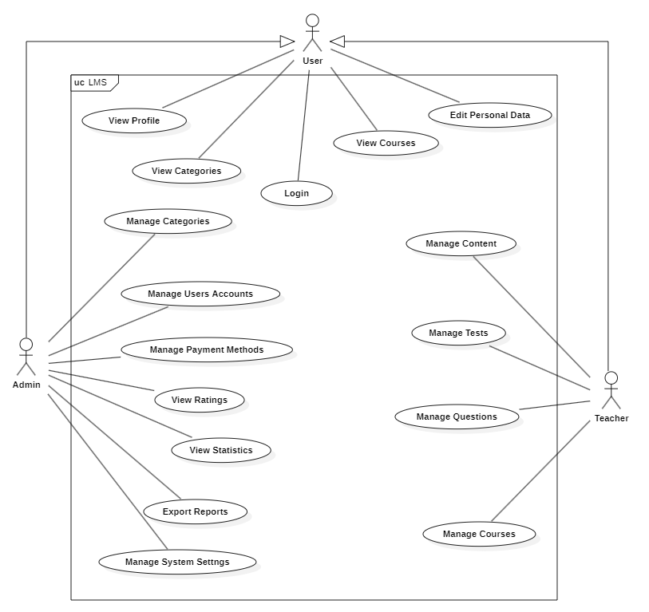
Project Use Case Diagram

Slide 9
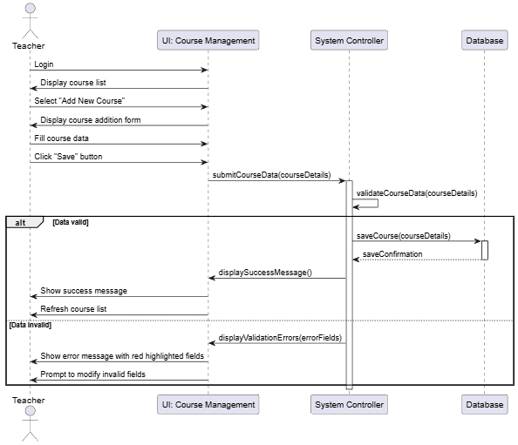
Sequence Diagram

Slide 10
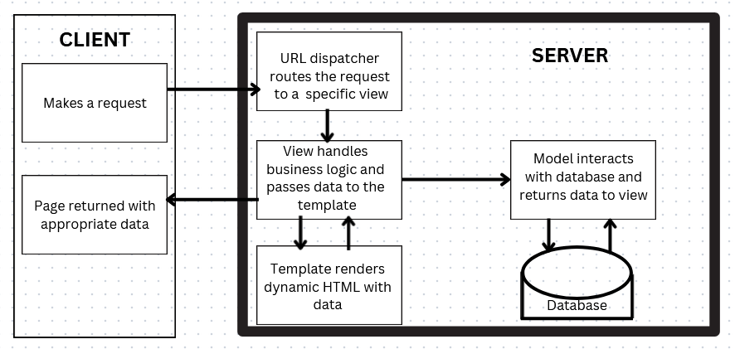
System Architecture
Client: The device that sends requests to the server. can be a computer, a smartphone, or any other network-connected device.
Server: This is the device that receives requests from clients, processes them, and sends the required response.

Slide 11
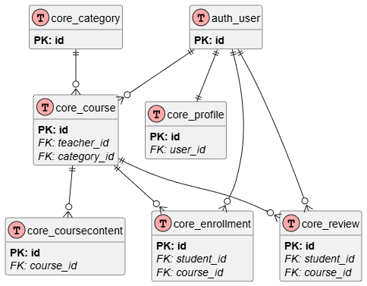
ERD

Slide 12
Interfaces Diagram
Landing Page
Login
Sign Up
Admin
Statistics
Users
Categories
Payment Methods
Reports
Teacher
Statistics
Courses
Settings
Courses
Content

Slide 13
Test Cases
Status | Expected Result | Test Data | Test Steps | Pre-Conditions | Description | ID
done | Login successful, control panel appears | Email: ad@admin.com Password: admin123 | 1. Navigate to the Sign-in page. 2. Enter email and password. 3. Click "Sign In". | User has a valid account | Log in using the correct details | TC-1
done | Error message appears: "Email or password is incorrect" | Email: ad@admin.com Password: WrongPass | 1. Navigate to the Sign-in page. 2. Enter email and password. 3. Click "Sign In". | User has a valid account | Logging in using incorrect data | TC-2
done | Profile updated successfully. Success message displayed. | Admin >> ad | 1. Go to "My Account". 2. Edit profile details 3. Click "Save Changes". | User is logged in | Personal account modification | TC-3
done | User details (Name, Email, Role) are displayed correctly. | — | 1. Navigate to "My Account" page. | User is logged in | View personal account | TC-4
Done | List of all users is displayed with pagination. | N/A | 1. Navigate to "Users Management". | Admin is logged in | View the list of users | TC-5
Done | User status updated to Blocked. | User ID: U-102 | 1. Select a user from the list. 2. Change status to "Blocked". 3. Save. | Admin is logged in | Manage the accounts of all users | TC-6
Done | List of available courses is displayed. | N/A | 1. Navigate to "Courses" section. | User is logged in | View the list of courses | TC-7
done | List of available tests is displayed. | N/A | 1. Navigate to "Tests" section. | User is logged in | View the list of tests | TC-8

Slide 14
RTM
System Test | Detailed Design | High Level Design | SRS Section | Associated Dependency | Title | ID
TC-1, TC-2 | sequence-1 | activity-1 | Requirements modeling and analysis | Login | Sign in | REQ-001
TC-3 | sequence-3 | activity-3 | Requirements modeling and analysis | Edit | Personal account modification | REQ-002
TC-4 | sequence-3 | activity-3 | Requirements modeling and analysis | View | View personal account | REQ-003
TC-5 | sequence-4 | activity-4 | Requirements modeling and analysis | View | View the list of users | REQ-004
TC-6 | sequence-7 | activity-7 | Requirements modeling and analysis | Edit | Manage the accounts of all users | REQ-005
TC-7 | sequence-4 | activity-4 | Requirements modeling and analysis | View | View the list of courses | REQ-006
TC-8 | sequence-5 | activity-5 | Requirements modeling and analysis | View | View the list of tests | REQ-007
TC-9 | sequence-10 | activity-10 | Requirements modeling and analysis | View | View statistics | REQ-008

Slide 15
Comparative Analysis & Objectives Met
System | Localization | Cost | Response Time | Ease of Use
Moodle | Manual RTL config | Free (hosting cost) | 2.1s | Moderate
Open edX | Complex setup | Free (high infra) | 2.8s | Complex
Canvas LMS | Limited customization | $/user/month | 1.5s | Easy
Our System | Native Arabic RTL | Free | 1.2s | Easy

Slide 16
Future Work
Integrate AI-driven course recommendations (NLP-based)
Develop mobile application (React Native/Flutter)
Add real-time analytics dashboard with predictive modeling
Implement LTI compliance for third-party tool integration

