Slide 1

THE SYRIAN PRIVATE UNIVERSITY
FACULTY OF COMPUTER & INFORMATICS ENGINEERING
Learning Management System LMS
Prepared By:
Hajar Hamza Al-Zoubi
Sameh Yahya Orabi
Supervised by
Dr. Akram Masouh
June 2026

Slide 2
Importance of the Project
interactive virtual environment
access study materials
Simplify registration procedures
Applying software engineering principles

Slide 3
Project Objectives
prioritize functional and non-functional requirements
ensuring separation of concerns, scalability, and maintainability.
Security and data protection
Financial aspect and payment methods
Analytics and statistics
implement a fully responsive, Arabic-only user interface

Slide 4
Literature Review
Criterion | Canvas LMS | Open edX | Moodle | Our System
User interface | ❒ | ❒ |  | 
User and account management |  |  |  | 
Course and content management |  |  |  | 
Testing and evaluation system |  |  |  | 
Certificate and documentation management |  |  | ❒ | 
Financial aspect and payment methods |  | ❒ | ❒ | 
Analytics and statistics |  |  |  | 
Suitability for Syrian institutions | ❒ | ❒ | ❒ | 

Slide 5
General Requirements
ADMIN
Manage Users
Manage system Settings
Manage Payment Methods
Manage Categories
View Statistics
Export Reports
STUDENT
Manage Registrations
Manage Ratings
Manage Personal Certificates
TEACHER
Manage Courses
Manage Content
Manage Tests
Manage Registration Requests
Manage Certificates Requests

Slide 6
Project’s Functional Requirements
ID | Title | Priority
REQ-030 | Add a test | 1
REQ-031 | Test adjustment | 1
REQ-032 | Delete a test | 1
REQ-033 | Changing the test case | 1
REQ-034 | View Test history | 1
REQ-035 | Add a question | 1
REQ-036 | Edit a question | 2
REQ-037 | Delete a question | 2
REQ-038 | View test questions | 2
REQ-039 | View student results | 2
REQ-040 | View performance statistics | 2
REQ-041 | View the list of registration requests | 2
REQ-042 | Change the status of a registration request | 3
REQ-043 | View the list of registrants within the course | 3
REQ-044 | Add a registration request | 3
REQ-045 | View order history | 3
REQ-046 | Track the status of a registration request | 3
REQ-047 | Applying for a test | 4
REQ-048 | View test result | 4
REQ-049 | View the history of submitted tests | 4
REQ-050 | View the test results log | 4
REQ-051 | Request a course completion certificate | 4
REQ-052 | View Certificate Application History | 4
REQ-053 | Tracking the status of a certificate request | 5
REQ-054 | Download the certificate document | 5
REQ-055 | View the list of certificate requests | 5
REQ-056 | Change the status of a certificate request | 5
REQ-057 | Add a rating | 5
REQ-058 | Update Rating | 5
REQ-059 | View ratings history

Slide 7
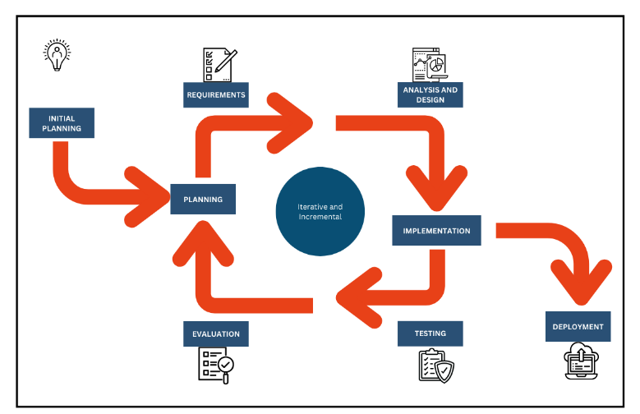
Project methodology
Incremental iterative methodology

Slide 8
Gantt Chart

Slide 9
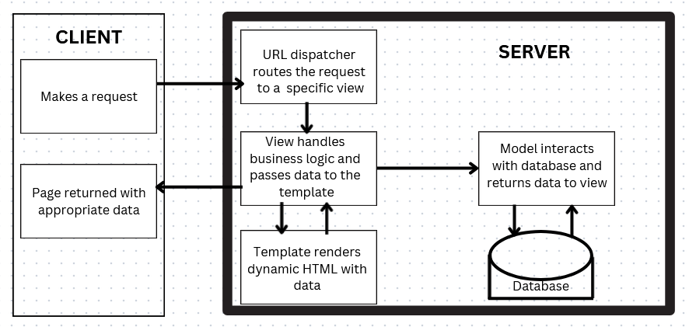
Project Architecture MVT
Client: The device that sends requests to the server. can be a computer, a smartphone, or any other network-connected device.
Server: This is the device that receives requests from clients, processes them, and sends the required response.

Slide 10



Project Tools
It features a wide range of presets that achieve savings in time and effort costs.
It is characterized by being a free library, used to facilitate the design of web interfaces (Frontend) in a responsive manner with page size (Responsive).
It is characterized by its flexibility, support for future expansion, ease of use, and data security.

Slide 11
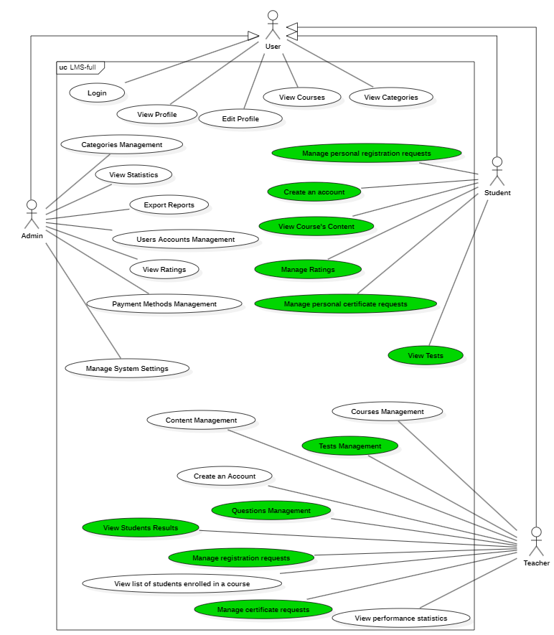
Use Case Diagram

Slide 12
Use Case Documentation Add a registration request
ID | REQ-044
Use Case | Add a registration request
Description | Submitting a new course entry registration request by a student for a specific course
Actors | Student
Pre-Conditions | Login
Subsequent-Conditions | Successful completion of the operation
Main Flow | Student opens a specific course detail view and selects the "Enroll in Course" option. The system checks global settings flags to ensure access boundaries. The system maps a new Enrollment object connecting the Student ID with the Course ID. The record is stored, and an update confirmation is shown.
Alternative Flow | If the platform administrator has disabled new entries via SystemSettings, the process is blocked and an error alert appears.

Slide 13
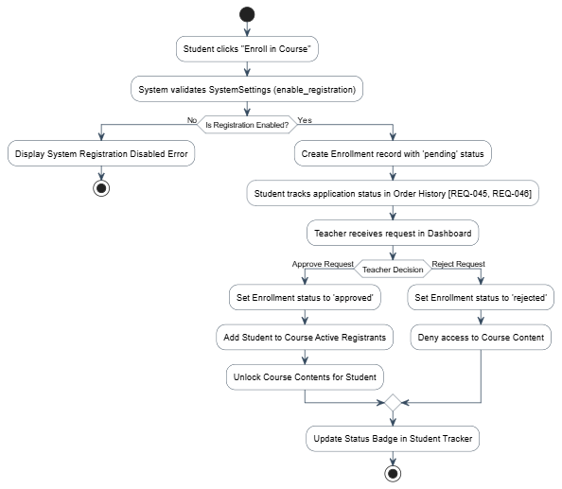
Activity Diagram Add a registration request

Slide 14
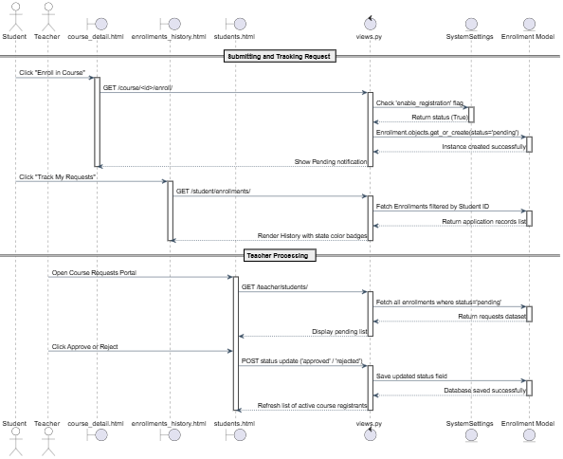
Sequence Diagram Add a registration request

Slide 15
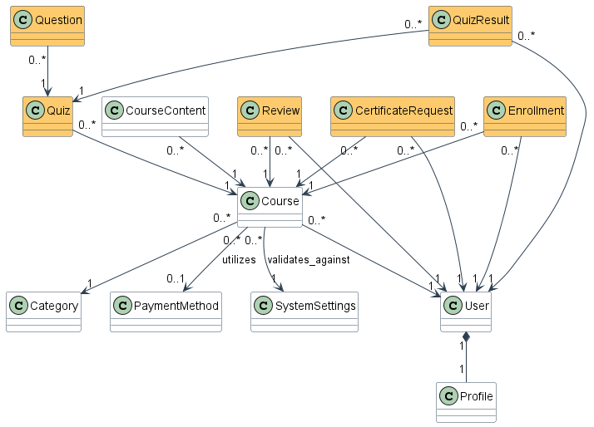
Class Diagram

Slide 16
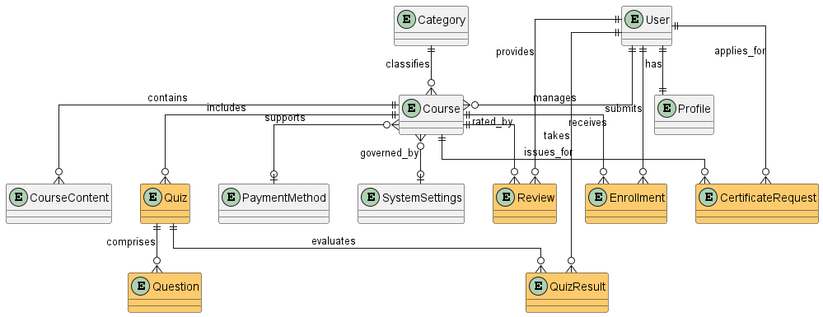
ERD

Slide 17
Interfaces Diagram
Landing Page
Login
Sign Up
Admin
Statistics
Users
Categories
Payment Methods
Reports
Teacher
Statistics
Courses
Settings
Courses
Content
Student
Quizzes
Questions
Results
Courses
Quizzes

Slide 18
Test Cases
Status | Expected Result | Test Data | Test Steps | Pre-Conditions | Description | ID
done | Test record created and linked to the course. | Title: Python Quiz 1 Duration: 30 mins | 1. Go to Course Tests. 2. Click "Add Test". 3. Fill Title, Duration, and Passing Score. 4. Click Save. | Teacher is logged in, Course exists | Add a test | TC-30
done | Test data updated successfully in DB. | Duration: 45 mins | 1. Click "Edit" on a test. 2. Modify Title or Duration. 3. Click Save. | Test exists, Teacher is logged in | Test adjustment | TC-31
done | Test and associated questions are removed from DB. | - | 1. Click "Delete" on a test. 2. Confirm deletion. | Test exists, Teacher is logged in | Delete a test | TC-32
done | Test status updated; hidden from students if inactive. | Status: Inactive | 1. Locate test in list. 2. Toggle status to Inactive/Active. 3. Save. | Test exists, Teacher is logged in | Change test status | TC-33
Done | List of all tests created by the teacher is displayed. | - | 1. Navigate to "Test History" page. | Teacher is logged in, Tests exist | View Test history | TC-34
Done | Question saved in QuestionBank model and linked to test. | Question: What is Django? Correct: A | 1. Open Test details. 2. Click "Add Question". 3. Enter Question text, options, and correct answer. 4. Save. | Test exists, Teacher is logged in | Add a question | TC-35
Done | Question updated successfully in DB. | Question: What is Python? | 1. Click "Edit" on a question. 2. Modify text or options. 3. Save. | Question exists, Teacher is logged in | Edit a question | TC-36
done | Question removed from the test. | - | 1. Click "Delete" on a question. 2. Confirm. | Question exists, Teacher is logged in | Delete a question | TC-37

Slide 19
RTM
System Test | Detailed Design | High Level Design | SRS Section | Associated Dependency | Title | ID
TC-30 | sequence-14 | activity-14 | Requirements modeling and analysis | Add | Add a test | REQ-030
TC-31 | sequence-14 | activity-14 | Requirements modeling and analysis | Edit | Test adjustment | REQ-031
TC-32 | sequence-14 | activity-14 | Requirements modeling and analysis | Delete | Delete a test | REQ-032
TC-33 | sequence-14 | activity-14 | Requirements modeling and analysis | Edit | Change test status | REQ-033
TC-34 | sequence-15 | activity-15 | Requirements modeling and analysis | View | View Test history | REQ-034
TC-35 | sequence-15 | Activity-15 | Requirements modeling and analysis | Add | Add a question | REQ-035
TC-36 | sequence-15 | activity-15 | Requirements modeling and analysis | Edit | Edit a question | REQ-036
TC-37 | sequence-15 | activity-15 | Requirements modeling and analysis | Delete | Delete a question | REQ-037

