Slide 1
Online Book store
Rohith vedantam-Pes2ug21cs437
Shashank kn-pes2ug21cs490
Sahil kamate-pes2ug21cs453

Slide 2
Abstract:
Book-store is a virtual store on the Internet where customers can browse the catalog and select books of interest. At checkout time, the items in the e-library will be presented as an order. At that time, more information will be needed to complete the request . Usually, the customer will be asked to fill online form. An e- mail notification is sent to the customer as soon as the order is placed .
The objective of this login page is simple, that a person accessing his web accounts from anywhere in the world is assured that no one can crack what his password is by any means and his identity is safe. The aim is to overcome the flaws in the current System. Allows to securely logging in a user to the system from any part of the world.
This project intends different types of forms with many types of books like story, drama , romance, history, adventures, etc. it can manage studying of books online, customers can choose many types of books categories, etc. Here, the user may select desired book and view its price. The user may even search for specific books on the website. Once the user selects a book, he then has to fill in a form and the book is provided for the user.

Slide 3
Modules :
React , React Dom , React Library
React Bootstrap
Mongoose for MongoDB connectivity
Maps API
Express JS

Slide 4
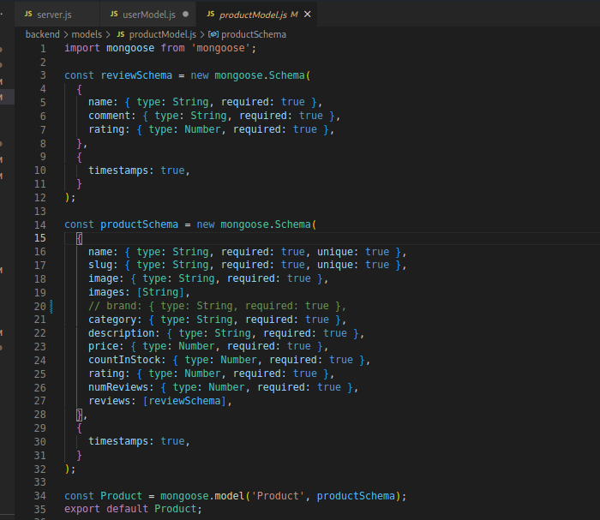
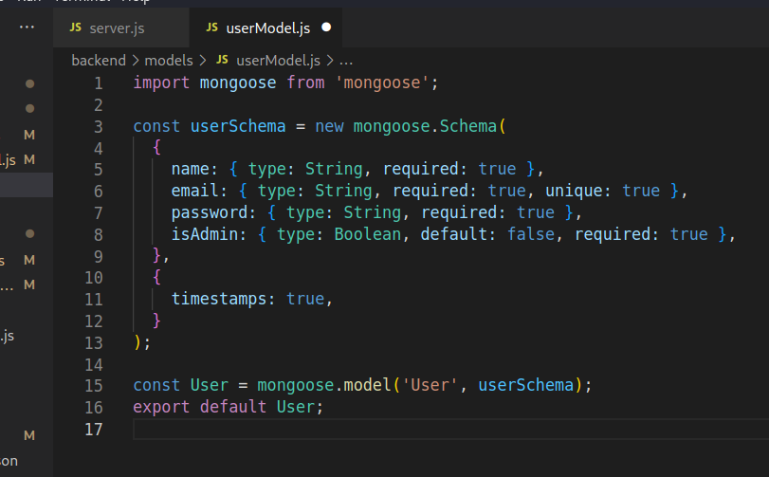
Code snippets:

Slide 5
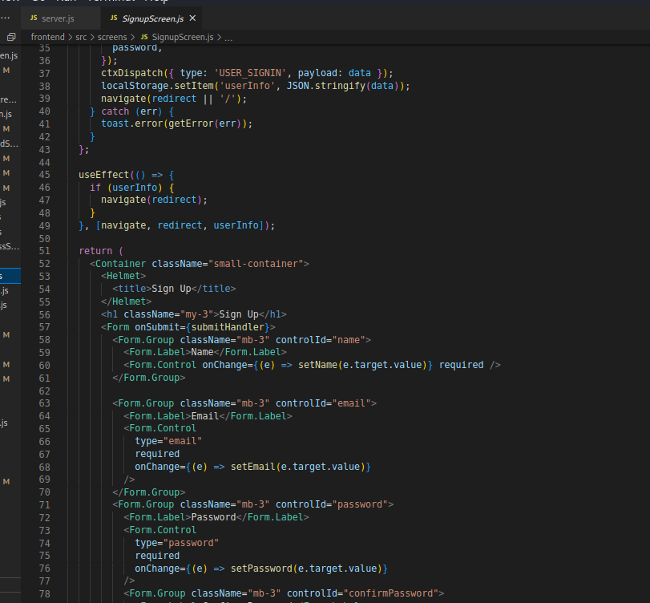
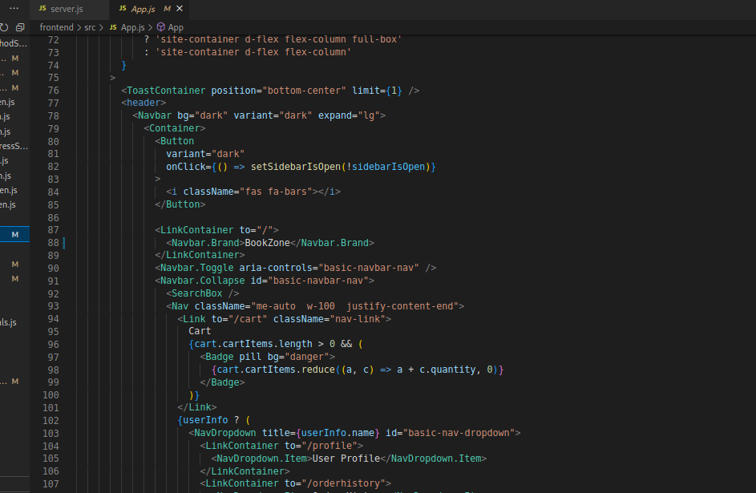

Slide 6
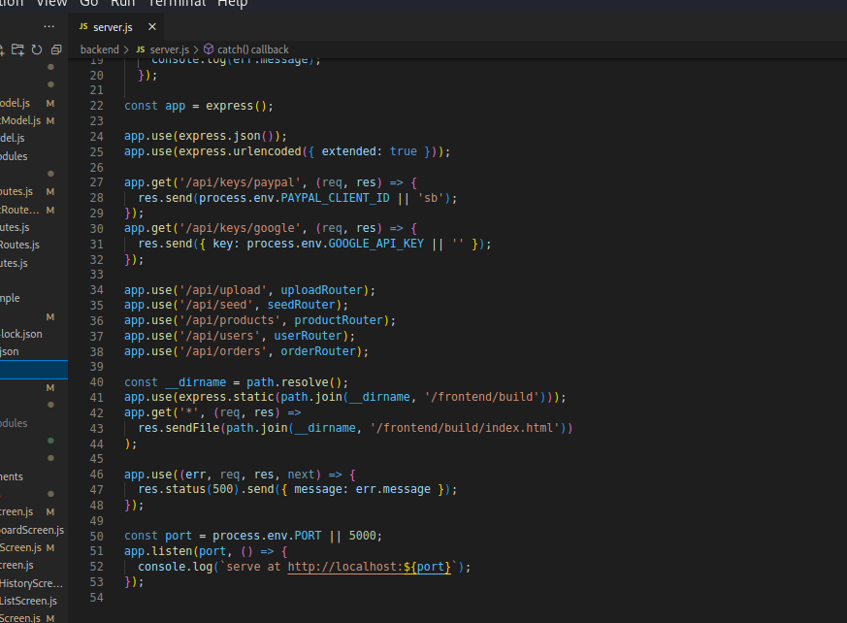
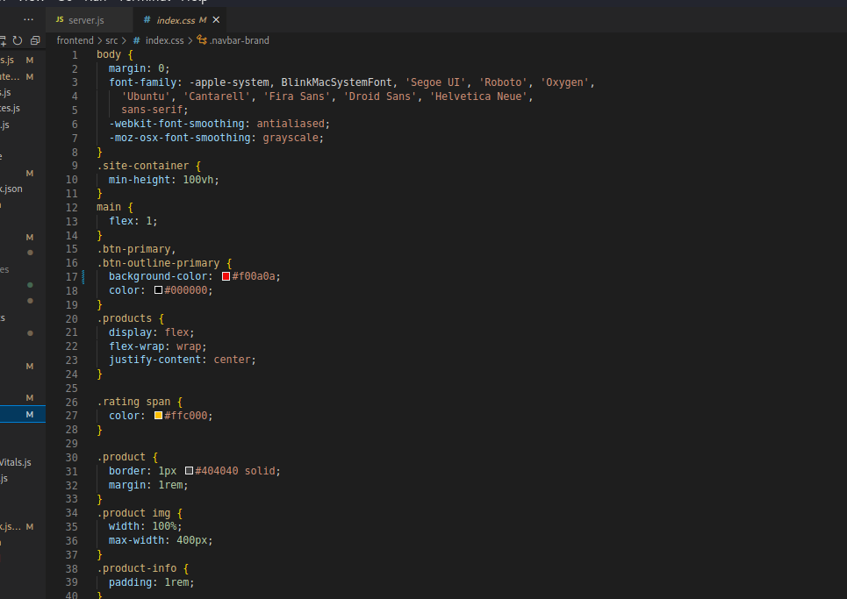

Slide 7
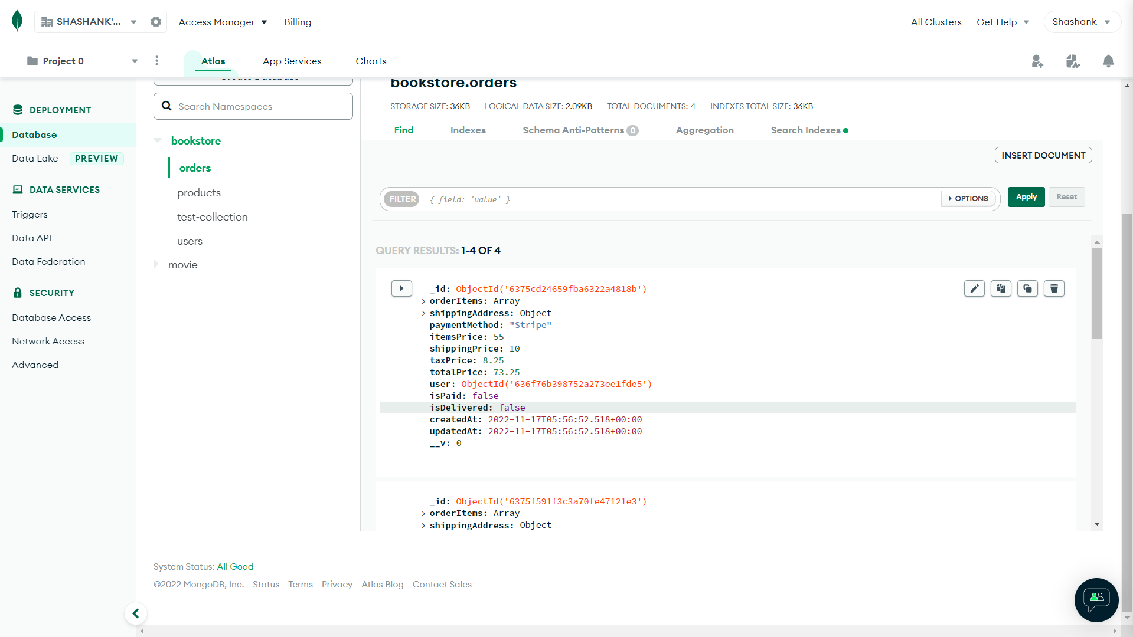
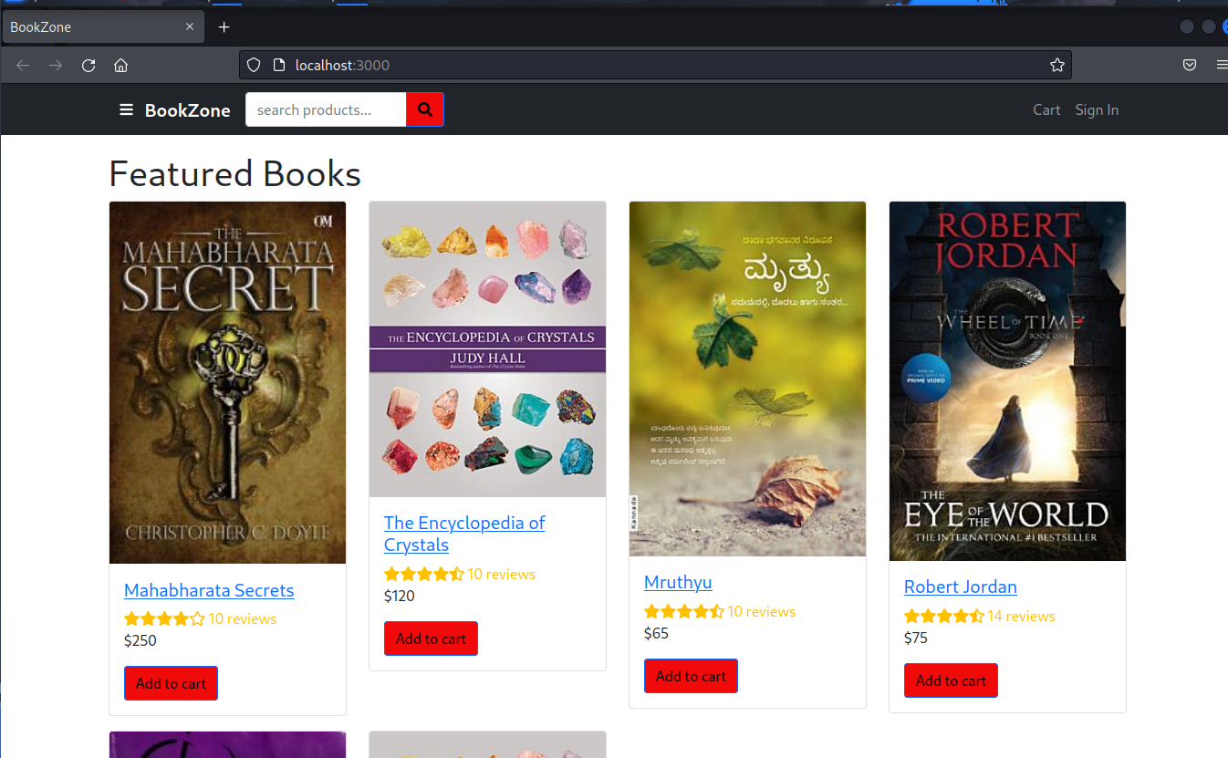
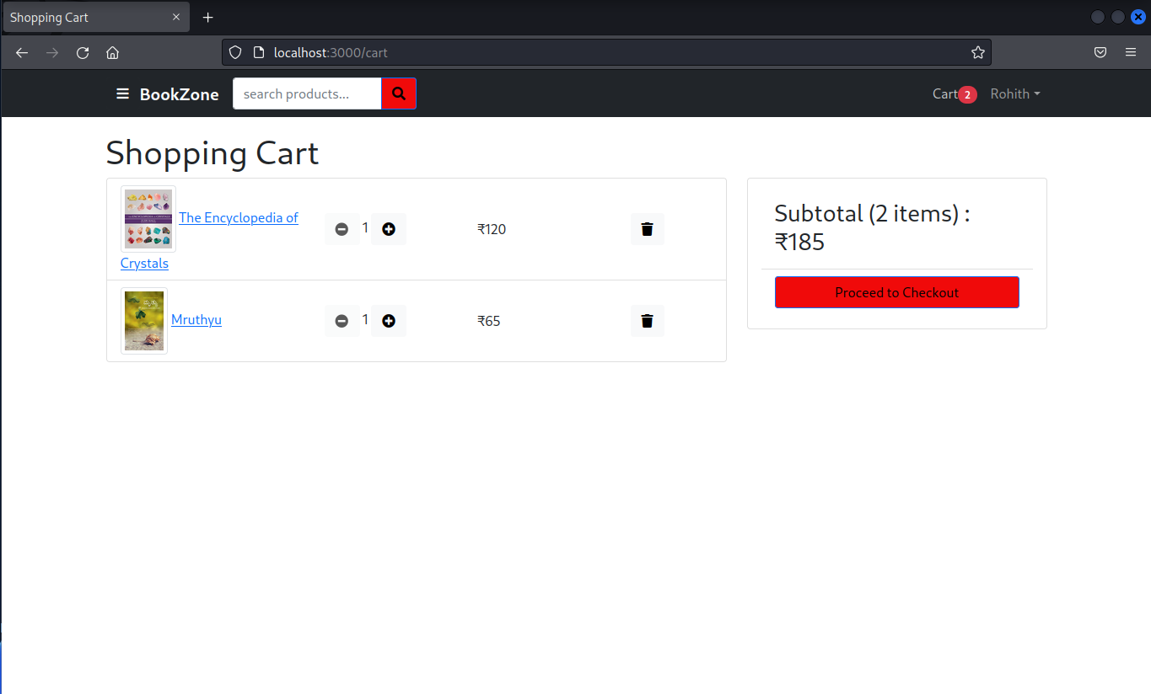
Output:

Slide 8
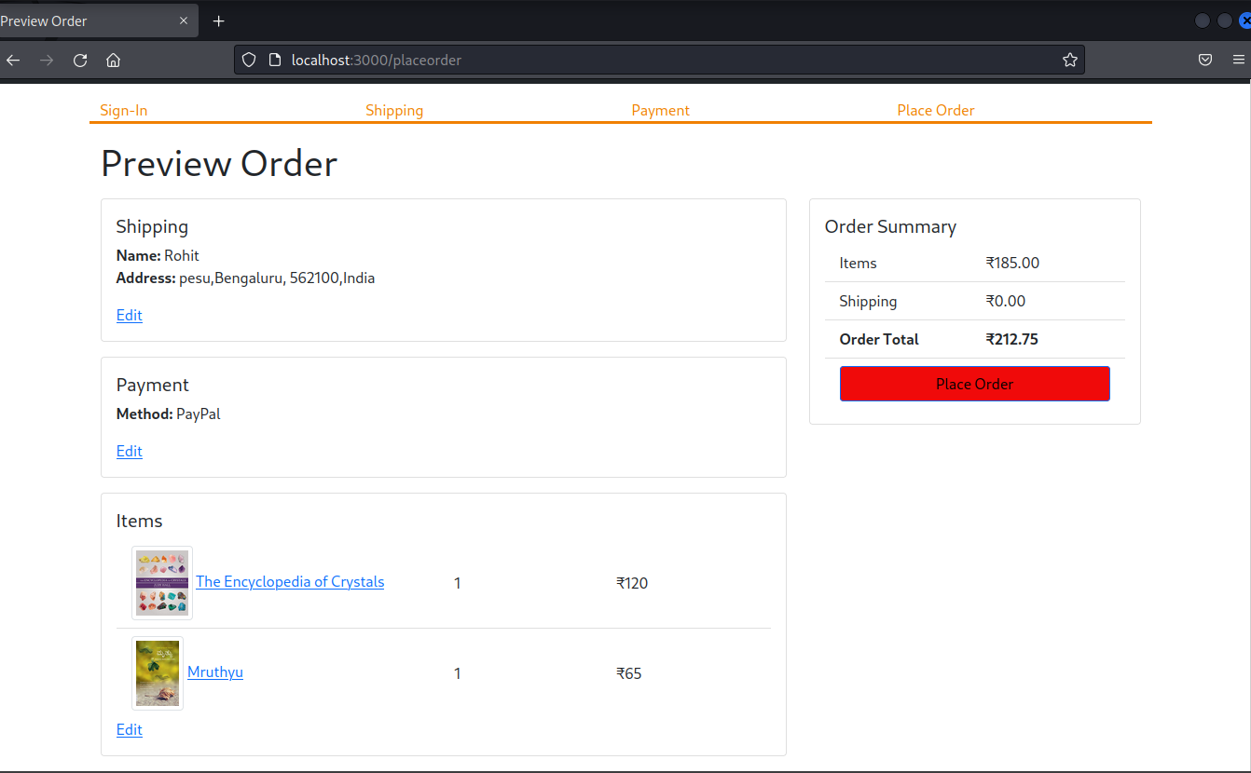
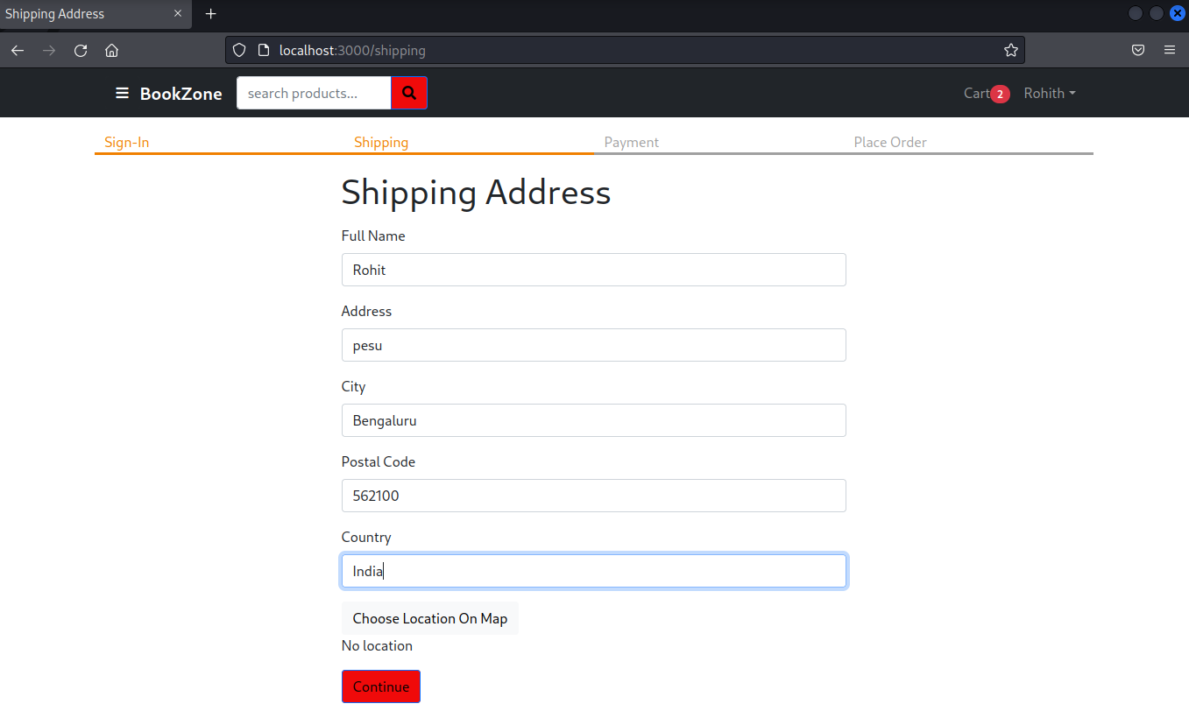
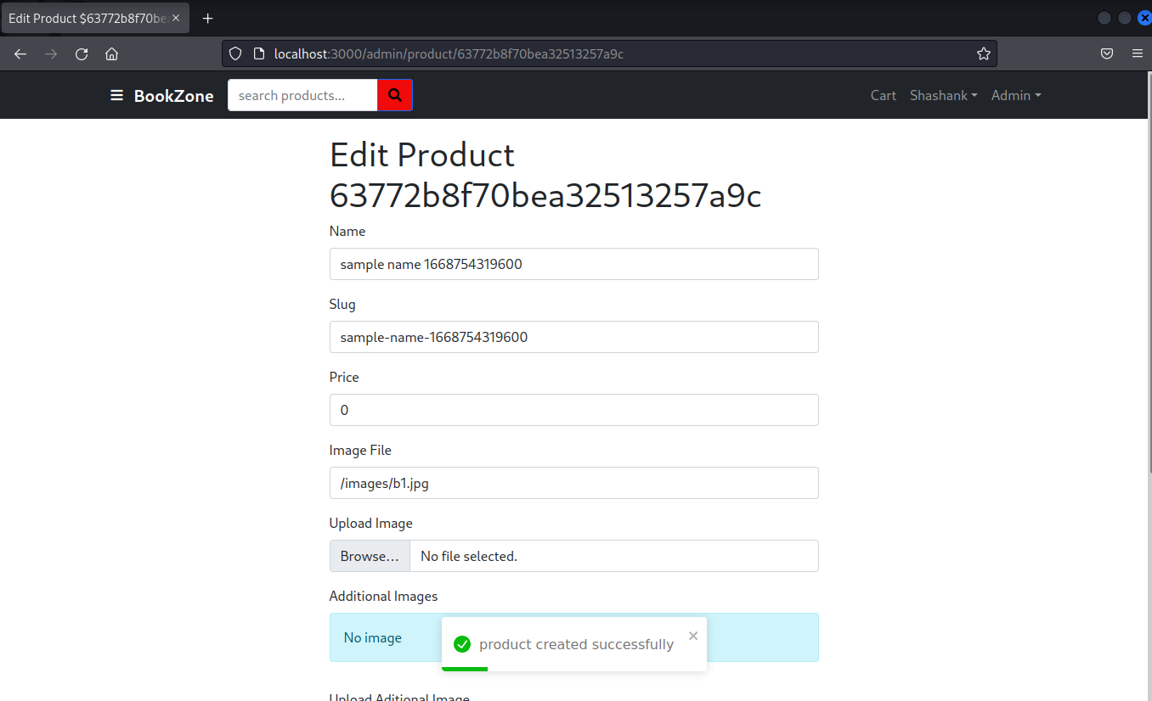

Slide 9
Thank you

