Slide 1

PRACTICE SCHOOL-II | PROJECT PRESENTATION
FRESHVISION
Identification and 5-Level Classification of Fruits and Vegetables using Machine Learning
Submitted by
Vishal Verma (240691) Harshul Saini
Under the supervision of
Dr. Aurobindo Behera
Department of Computer Science and Engineering (AI/ML)
School of Engineering and Technology
BML Munjal University, Haryana 122413, India
August 2026

Slide 2
PS-II STATION AND PROJECT OVERVIEW
PS-II STATION
Station BML Munjal University
Department Computer Science and Engineering (AI/ML)
Supervisor Dr. Aurobindo Behera
Nature of work Image-based produce quality assessment using deep learning
SCOPE OF THE WORK
External, image-based visual assessment only. Internal quality such as sugar content or firmness is not covered, since that would need destructive testing or a different sensing approach.
The 14 produce types are simply the ones present in the source dataset.
THE PROJECT AT A GLANCE
Two models, one backbone
MobileNetV2 transfer learning gives a 14-class produce identifier and a five-level freshness grader.
14 types · 5 freshness levels
Labels generated automatically
An HSV decay-score heuristic replaces manual freshness annotation across the whole dataset.
29,291 images · zero manual freshness labels
Results
Both models trained on a CPU-only machine, in five epochs per stage.
97.83% identification · 80.41% freshness
The central idea: grade freshness at five levels without paying for a single manually annotated freshness label.
FreshVision | Practice School-II | BML Munjal University
2

Slide 3
PROBLEM IDENTIFICATION AND RESEARCH GAP
Why automate produce quality checking?
• At most points in the supply chain, a person still judges freshness by eye — from colour and surface condition.
• Graders disagree with each other, the same grader gets less consistent late in a shift, and none of it is fast enough when thousands of items need sorting in a day.
• Produce type is an unambiguous label. Freshness is a graded judgement — and collecting consistent human freshness labels for tens of thousands of images costs far more than labelling produce type ever would.
RESEARCH GAP
Existing approach
Produce types
Freshness levels
Labelling
Accuracy
Amin et al. (2023) — AlexNet
3
2 (binary)
Manual
> 99%
Ghosh & Singh (2026) — CNN-LSTM
3
2 (binary)
Manual
98.9%
Fahad et al. (2022) — VGG-16 / YOLOv5
11
3
Fully manual
82–84%
This work — FreshVision
14
5
Automatic
97.8% / 80.4%
No existing work achieves wide produce coverage, fine-grained freshness and low labelling cost at the same time. That is the gap this project targets.
FreshVision | Practice School-II | BML Munjal University
3

Slide 4
PROBLEM STATEMENT AND OBJECTIVES
PROBLEM STATEMENT
Pair a 14-class produce identifier with a five-level freshness grader whose training labels come from an automated colour heuristic rather than manual annotation, and check whether an ensemble stage can clean up the label noise that heuristic introduces.
OBJECTIVES
O1
Train a 14-class produce identifier
MobileNetV2 transfer learning, targeting validation accuracy above 95%.
O2
Design an HSV decay-scoring heuristic
Measure surface decay automatically, giving a continuous freshness proxy that needs no manual annotation.
O3
Turn that score into five freshness levels
Convert the continuous decay score into five classes using a rank-based percentile split, and train a second MobileNetV2 on the result.
O4
Measure the effect of fine-tuning
Compare a frozen backbone against unfreezing the last 30 layers of the freshness model.
O5
Design an ensemble stage to reduce label noise
EfficientNetB0 features feeding an SVM, Random Forest, Logistic Regression, KNN and XGBoost ensemble, to correct the noise the heuristic introduces.
FreshVision | Practice School-II | BML Munjal University
4

Slide 5
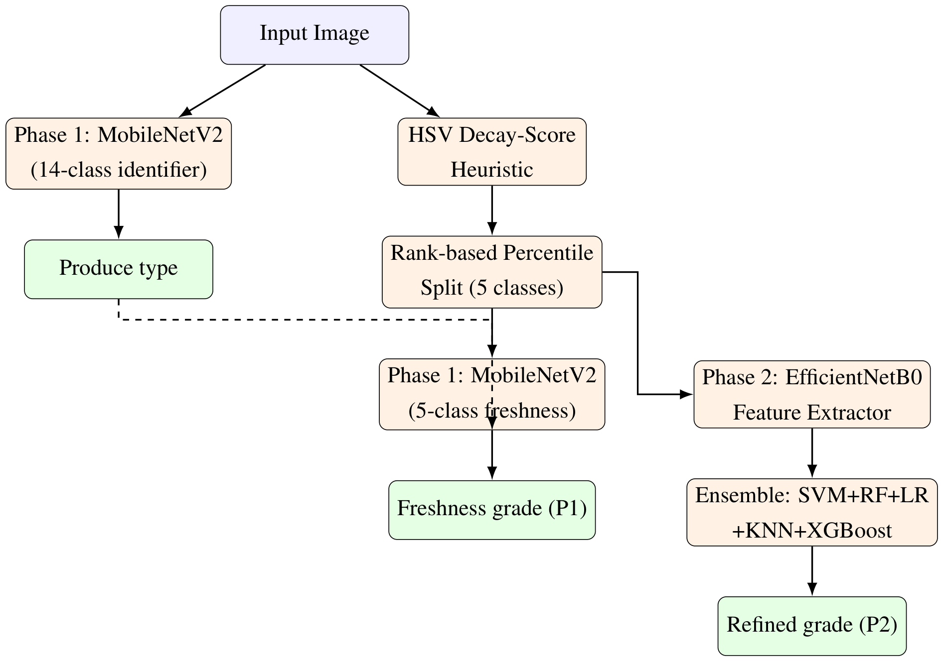
PROPOSED METHODOLOGY AND ARCHITECTURE
TWO BRANCHES, ONE IMAGE
Identification branch. A MobileNetV2 classifier predicts one of 14 produce types, trained on the dataset's existing folder labels — ground truth already exists here.
Freshness branch. No ready-made labels. The image gets an HSV decay score, that score becomes one of five classes through a rank-based split, and a second MobileNetV2 is trained on the result.
Phase 2 (proposed). EfficientNetB0 features feeding an SVM, Random Forest, Logistic Regression, KNN and XGBoost ensemble, to reduce label noise. Designed, not yet evaluated.
Figure 4.1 (report): both branches run over the same input image.
SHARED MODEL HEAD (both Phase 1 models)
MobileNetV2 (ImageNet, head removed) → GlobalAveragePooling → Dense(128, ReLU) → Dropout(0.3) → Dense(C, softmax)
C = 14 for identification, C = 5 for freshness. Trained with Adam and categorical cross-entropy.
FreshVision | Practice School-II | BML Munjal University
5

Slide 6
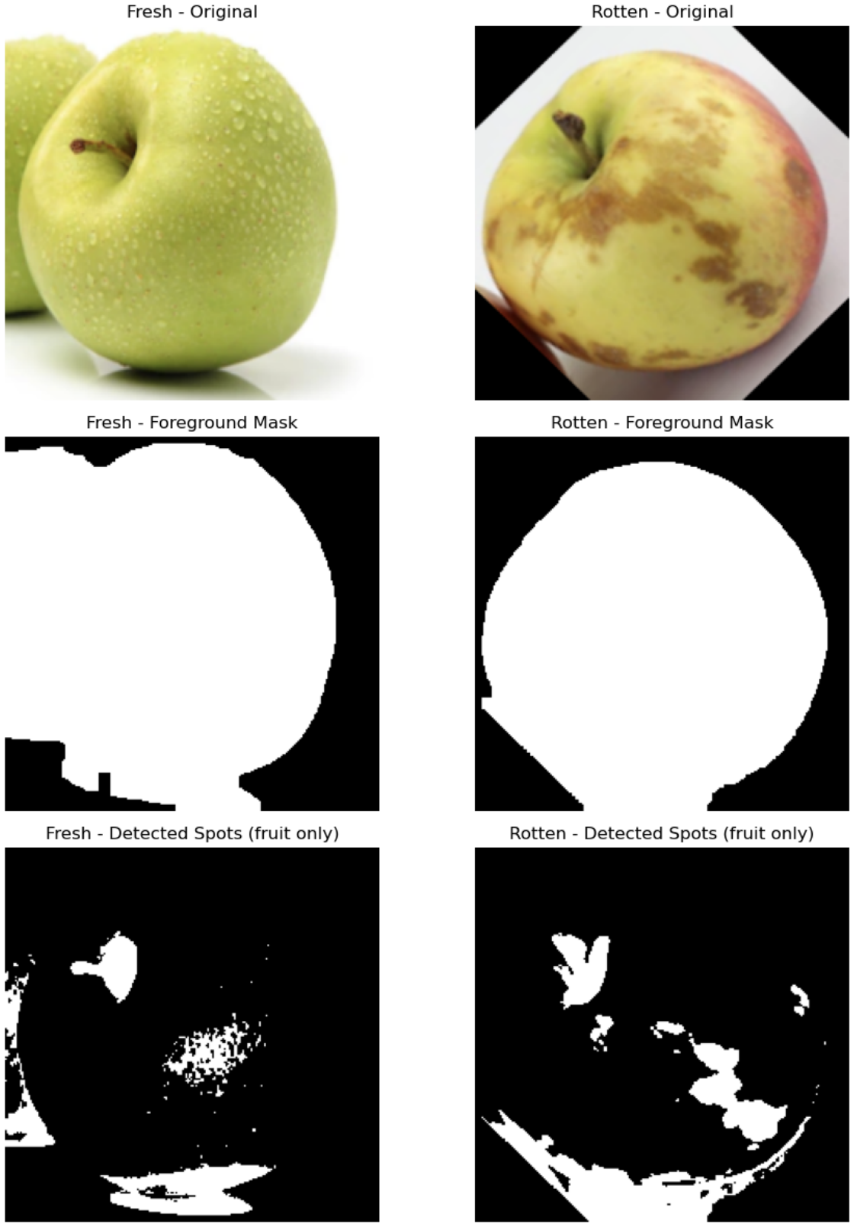
HSV DECAY-SCORE HEURISTIC
The problem: the dataset has only two labels — fresh and rotten. We needed five.
1.
Foreground mask
Threshold the HSV saturation channel at S > 40 to separate the produce from the background, then clean it up with morphological closing and opening (7 × 7 kernel).
2.
Discoloured-spot mask
Threshold within H ∈ [0, 35], S ∈ [30, 255], V ∈ [20, 160] — an empirically chosen range that picks up the brown patches typical of bruising and decay — restricted to the foreground region.
3.
Decay score
The percentage of foreground pixels flagged as decayed.
Decay Score = | M spot, fg | ÷ | M fg | × 100
On 20 fresh and 20 rotten apple images the mean decay score was 16.48% for fresh against 35.79% for rotten — the heuristic clearly separates the two groups on average.
Report Fig. 5.3: original image, foreground mask and detected decay spots, for a fresh and a rotten apple.
FreshVision | Practice School-II | BML Munjal University
6

Slide 7
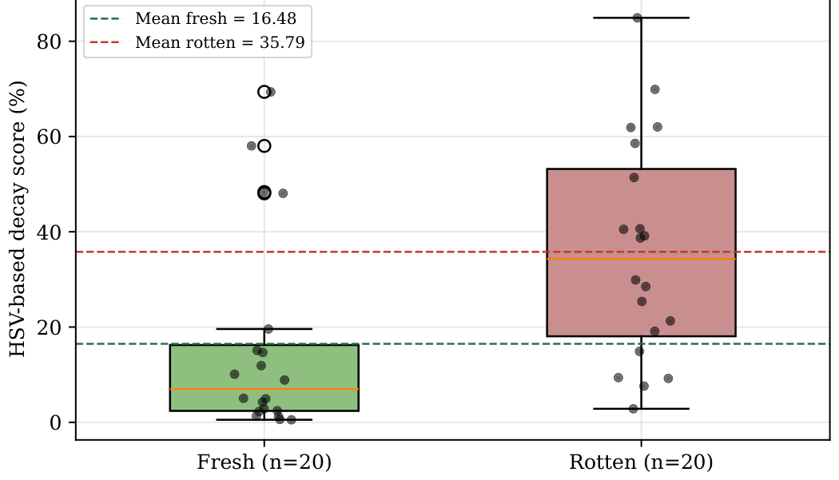
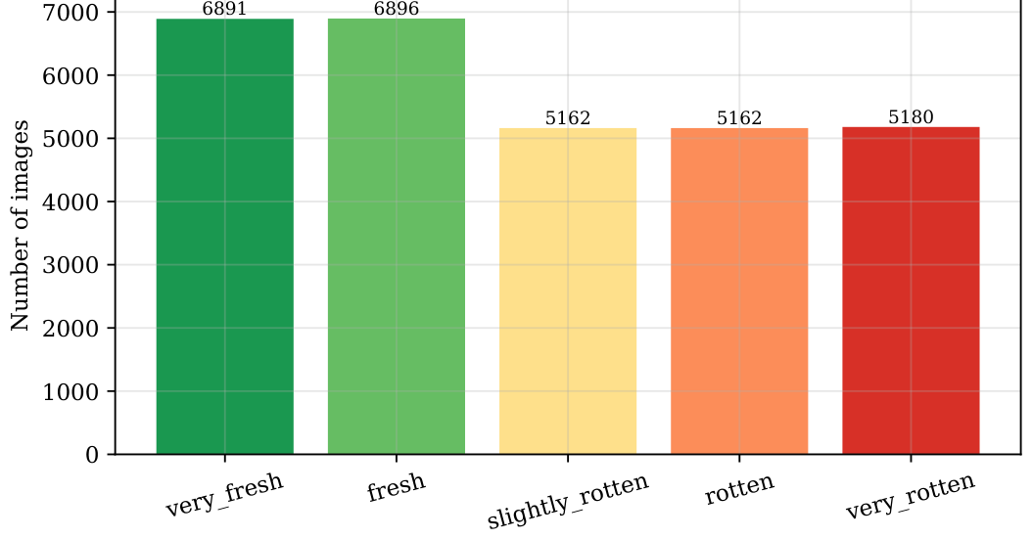
FROM DECAY SCORES TO FIVE FRESHNESS LABELS
RANK-BASED PERCENTILE SPLIT
• Group the images by produce type and by their original fresh / rotten folder.
• Sort by ascending decay score within each group, then split into equal-sized rank buckets — two from a “fresh” folder (very_fresh, fresh) and three from a “rotten” folder (slightly_rotten, rotten, very_rotten).
• Grouping per produce type matters: a rotten banana and a rotten apple are not the same colour, so a single global threshold would be wrong.
Figure 4.2: decay-score spread, 20 fresh vs 20 rotten apples.
Figure 4.3: the five auto-generated labels across 29,291 images.
Balanced by construction, but not perfect. The two distributions overlap, so an image sitting right at a percentile boundary can end up on the wrong side of it. That overlap is where the label noise comes from — and it is exactly what the proposed Phase 2 ensemble is meant to correct.
FreshVision | Practice School-II | BML Munjal University
7

Slide 8
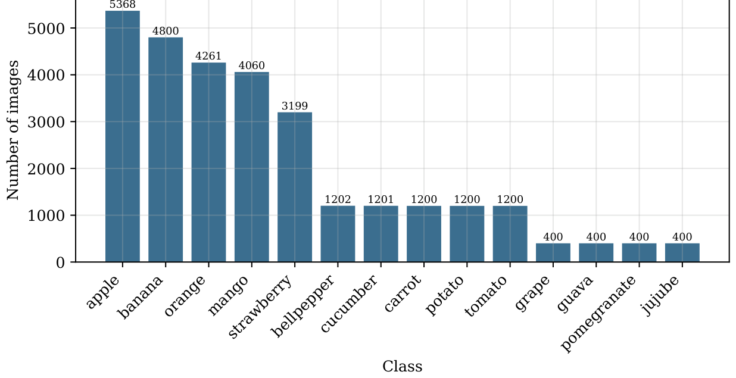
DATASET AND TRAINING SETUP
DATASET
PRE-PROCESSING AND SPLIT
• Fruit and Vegetable Dataset (Fresh vs. Rotten), from Kaggle — one folder per produce type, with fresh and rotten subfolders.
• 29,291 images across 14 produce types.
• Unevenly balanced: apple, banana, orange and mango alone make up 61.6% of the dataset, while grape, guava, pomegranate and jujube contribute only 400 each.
• Resized to 224 × 224 × 3 and normalised with MobileNetV2's own preprocess_input, matching how the network was originally pretrained.
• 80 / 20 stratified train / validation split with a fixed seed — 23,432 training and 5,859 validation images.
TRAINING
Identification
Freshness
Backbone
MobileNetV2
MobileNetV2
Batch size
32
32
Optimiser
Adam
Adam
Stage 1
5 epochs, frozen
5 epochs, frozen
Stage 2
—
5 epochs, last 30 layers, lr 1e-5
Figure 4.4: class-wise image distribution.
Trained on CPU only. No CUDA-capable GPU was detected, so TensorFlow fell back to its oneDNN CPU ops — roughly 7–9 minutes per epoch.
FreshVision | Practice School-II | BML Munjal University
8

Slide 9
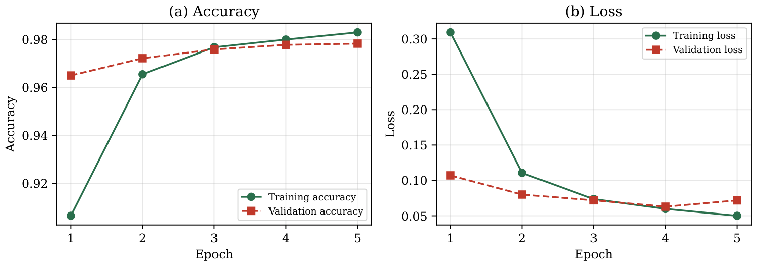
RESULTS — PRODUCE IDENTIFICATION
PER-CLASS HIGHLIGHTS
97.83% validation accuracy
14 produce types · 5 epochs · frozen backbone · 165,774 trainable parameters
Class
Prec.
Rec.
F1
n
Strawberry
1.00
1.00
1.00
640
Banana
1.00
0.99
0.99
958
Grape
1.00
0.99
0.99
80
Apple
0.99
0.97
0.98
1,071
Orange
0.99
0.98
0.98
852
Pomegranate
0.89
0.99
0.93
80
Potato
0.97
0.88
0.93
240
Weighted avg.
0.98
0.98
0.98
5,854
Figure 5.1: training and validation curves, identification model.
The two weakest classes
• Pomegranate — lower precision (0.89). It has one of the smallest training sets here, so other classes are occasionally mistaken for it.
• Potato — lower recall (0.88). It looks fairly similar to carrot in some of this dataset's images.
• Validation loss is essentially flat by epoch 4–5 (0.0629 → 0.0718) — a mild sign that a frozen-backbone model of this size is close to its ceiling on this task.
• Macro-average F1 0.97 and weighted-average F1 0.98 across 5,854 validation images.
FreshVision | Practice School-II | BML Munjal University
9

Slide 10
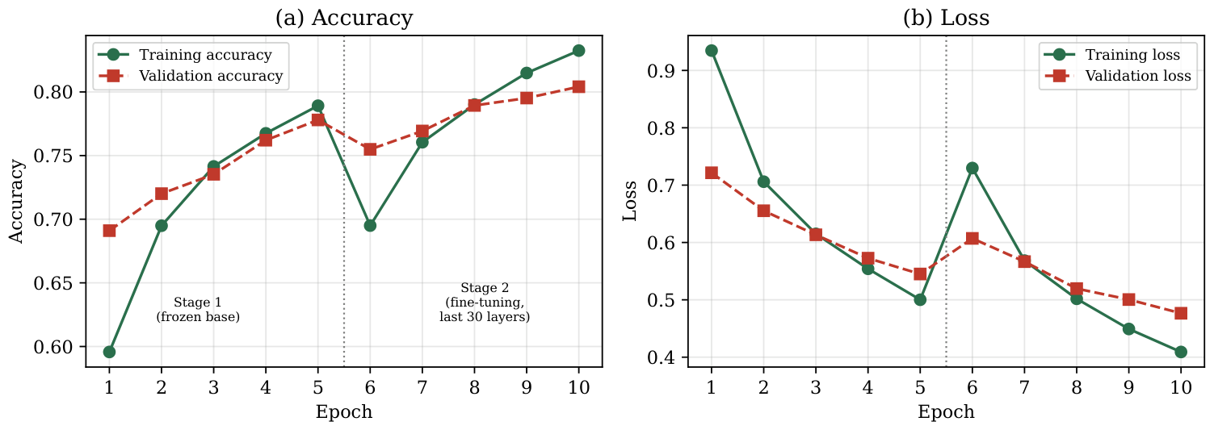
RESULTS — FRESHNESS GRADING
PER-CLASS RESULTS (n = 5,855)
77.80%
Stage 1 frozen backbone
80.41%
Stage 2 last 30 layers fine-tuned
Class
Prec.
Rec.
F1
n
Fresh
0.85
0.87
0.86
1,378
Very Fresh
0.85
0.86
0.85
1,378
Very Rotten
0.80
0.84
0.82
1,035
Slightly Rotten
0.80
0.78
0.79
1,032
Rotten
0.73
0.67
0.70
1,032
Weighted avg.
0.81
0.81
0.81
5,855
• Overall accuracy on the held-out set: 81.21%.
• Collapsed to a binary fresh-versus-rotten decision, accuracy rises to 98.19%.
• “Rotten” is the weakest class (F1 0.70). It sits between “slightly rotten” and “very rotten”, which is exactly where the heuristic labels are most ambiguous.
Figure 5.2: training and validation curves, both stages.
• Fine-tuning the last 30 layers adds a consistent +2.61 points.
• Note the dip at epoch 6: training accuracy falls from 0.7892 to 0.6950 the moment those layers unfreeze, then climbs past the Stage 1 level by epoch 8. The very small learning rate lets the network settle rather than overwrite what it knew.
FreshVision | Practice School-II | BML Munjal University
10

Slide 11
COMPARISON WITH RELATED WORK
AGAINST PUBLISHED WORK
Study
Produce types
Freshness levels
Accuracy
Amin et al. (2023) — AlexNet transfer learning
3
2 (manual)
> 99%
Ghosh & Singh (2026) — hybrid CNN-LSTM
3
2 (manual)
98.9%
Fahad et al. (2022) — VGG-16 / YOLOv5
11
3 (manual)
82–84%
This work — identification
14
—
97.83%
This work — freshness, Phase 1
14
5 (automatic)
80.41%
80.41% on a harder, five-level task sits close to Fahad et al.'s 82–84% on a three-level task — and it was reached with no manual freshness labels at all, across 14 produce types instead of 11.
DISCUSSION
• The identification model's 97.83% holds up well against binary classifiers trained on far fewer classes — a reasonable sign that MobileNetV2 transfer learning scales to 14 classes without much penalty.
• The gap between identification and freshness accuracy is expected. Produce type is an unambiguous label; freshness is not, and the heuristic that generates the freshness labels is an approximation rather than ground truth.
• The overlap in the decay-score distributions explains the freshness ceiling directly: if a meaningful share of the training labels are themselves ambiguous, no classifier trained on them can do much better.
FreshVision | Practice School-II | BML Munjal University
11

Slide 12
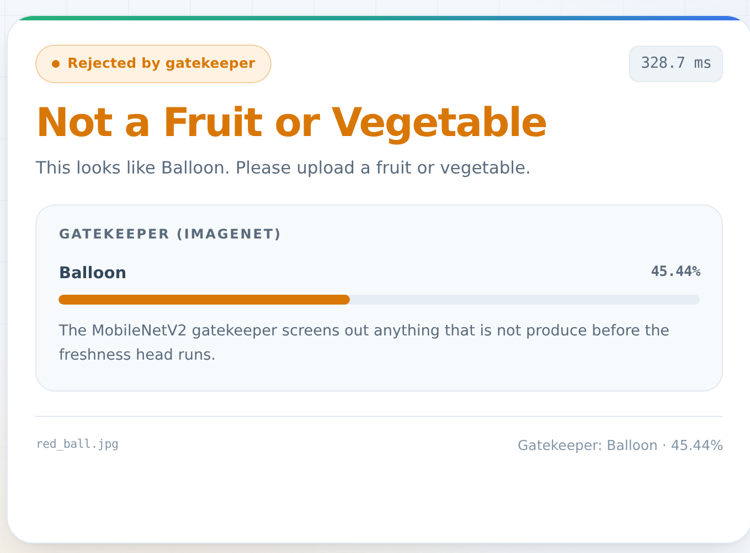
WORKING PROTOTYPE
Implementation beyond the report — an early step towards Future Scope item 3, “build something people can actually use”.
The trained models were packaged into a working web application.
• A FastAPI and Uvicorn backend serves the two trained models; the front end is a React (Vite) single-page application.
• Models are loaded once when the server starts rather than per request, so a prediction takes about 310 ms on CPU.
• An extra ImageNet MobileNetV2 acts as a gatekeeper: images that are not produce are rejected before the freshness model ever runs.
• Predictions below 65% confidence are reported as uncertain rather than guessed.
NOT PART OF THE THESIS EVALUATION
The gatekeeper and the web interface are engineering additions. Every accuracy figure in this presentation comes from the models evaluated in the report.
Live run: the gatekeeper rejecting a non-produce image, showing the ImageNet label and the measured latency.
FreshVision | Practice School-II | BML Munjal University
12

Slide 13
CONCLUSION, LIMITATIONS AND FUTURE WORK
CONCLUSIONS
• Transfer learning with a lightweight backbone works well for produce identification — 97.83% across 14 classes, on a CPU-only machine, in five epochs.
• Annotation-free freshness grading through a colour heuristic is a workable substitute for manual labelling — 80.41%, in the same range as prior work that paid for full manual annotation.
LIMITATIONS
FUTURE WORK
• Freshness labels come from a heuristic, not expert graders — so 80.41% measures agreement with that heuristic, not independently verified ground truth.
• The dataset is unevenly balanced; four classes have only 400 images each, which makes their individual metrics noisier.
• Both models trained on a short schedule of 5 epochs per stage, to fit a CPU-only compute budget.
• Only MobileNetV2 was tested as a backbone, and Phase 2 has not been evaluated at the time of writing.
1.
Finish and evaluate Phase 2
Complete the EfficientNetB0 and ensemble pipeline, and measure how much it actually improves on the 80.41% baseline.
2.
Test on outside data
Different lighting, different backgrounds and produce types beyond the current 14 — a stronger test of robustness than a held-out split.
3.
Build something people can use
MobileNetV2 is cheap to run, so a camera-based tool such as a mobile app is a natural next step.
FreshVision | Practice School-II | BML Munjal University
13

Slide 14
LEARNING OUTCOMES
01
Reading the literature to find a real gap
Existing work is either binary across two or three produce types, or finer-grained but fully hand-labelled. Seeing that gap is what set the direction of the project.
02
Transfer learning in practice
When to freeze a backbone, when to fine-tune it, and why a fine-tuning learning rate has to be far smaller than the original one.
03
Classical computer vision as a practical tool
HSV thresholding and morphological operations solved a labelling problem that deep learning alone could not solve cheaply.
04
Reading model behaviour from its outputs
Training curves, per-class precision and recall told us far more about what was wrong than overall accuracy ever did.
05
Working inside a real compute budget
All training ran on a CPU-only machine, which shaped the choice of backbone, the number of epochs and the input size.
06
Stating a system's limits honestly
80.41% measures agreement with our own heuristic, not verified ground truth — saying so plainly is part of reporting a result properly.
FreshVision | Practice School-II | BML Munjal University
14

Slide 15
REFERENCES
[1]
M. Sandler, A. Howard, M. Zhu, A. Zhmoginov and L.-C. Chen, “MobileNetV2: Inverted Residuals and Linear Bottlenecks,” Proc. IEEE/CVF CVPR, 2018, pp. 4510–4520.
[2]
M. Tan and Q. V. Le, “EfficientNet: Rethinking Model Scaling for Convolutional Neural Networks,” Proc. ICML, PMLR vol. 97, 2019, pp. 6105–6114.
[3]
D.-H. Lee, “Pseudo-Label: The Simple and Efficient Semi-Supervised Learning Method for Deep Neural Networks,” ICML Workshop (WREPL), 2013.
[4]
U. Amin, M. I. Shahzad, A. Shahzad, M. Shahzad, U. Khan and Z. Mahmood, “Automatic Fruits Freshness Classification Using CNN and Transfer Learning,” Applied Sciences, vol. 13, no. 14, p. 8087, 2023.
[5]
D. Ghosh and J. P. Singh, “A Hybrid CNN-LSTM Model for Accurate Fruit Freshness Classification Using Deep Learning,” Discover Artificial Intelligence, vol. 6, art. no. 134, 2026.
[6]
L. G. Fahad, S. F. Tahir, U. Rasheed, H. Saqib, M. Hassan and H. Alquhayz, “Fruits and Vegetables Freshness Categorization Using Deep Learning,” Computers, Materials & Continua, vol. 71, no. 3, pp. 5083–5098, 2022.
PROJECT REPOSITORY
https://github.com/2ViShAlv1/Fresh_Vision.git
FreshVision | Practice School-II | BML Munjal University
15

