Slide 1


FRESH VISION
PRACTICE SCHOOL-II
An AI-powered fruit & vegetable
freshness analyzer
Three MobileNetV2 models turn one photograph into an identified item, a five-level freshness grade and a shelf-life estimate — in under a second, in the browser.
Very fresh
Fresh
Slightly rotten
Rotten
Very rotten
SUBMITTED BY
FACULTY MENTOR
INDUSTRY MENTOR
Name: ___________________
ID: ___________________
Dr. XYZ
Designation
SOET, BMU
Mr. ABC
Designation
Organization name
School of Engineering & Technology · BML Munjal University
August 2025
67th KM Stone, NH-8, Gurugram, Haryana 122413
Notes:
Fresh Vision identifies a fruit or vegetable from a photo and grades how fresh it is, using three neural networks behind a web app.

Slide 2









CONTENTS
Outline of the presentation
01
06
About the PS-II station
Methodology
Organisation, department and mentors
Data, pseudo-labelling, training, deployment
02
07
Visit summary
Results & discussions
Eight-week work log
Accuracy, calibration, the working app
03
08
Problem identification
Learning outcomes
Why grading produce by eye fails
Technical and professional takeaways
04
09
Problem statement
References
What the system must solve
Papers, datasets and documentation
05
Fresh Vision in one line: identify the produce, grade its decay, explain the verdict.
Objectives of the work
Six measurable goals
Fresh Vision · Practice School-II
01

Slide 3

01
The PS-II station
Where the work was carried out, and what the eight weeks covered.
SECTION
— About the station
— Visit summary

Slide 4

SECTION 01
About the PS-II station
Station details to be completed before submission
About the Company
Est. date:
Turnover:
Product type:
Number of employees:
Department Visited
Name of department:
Nature of work:
Task allocated:
Faculty Mentor Details
Name:
Department:
Designation:
Contact info:
Fresh Vision · Practice School-II
02

Slide 5
SECTION 01
Visit summary
Eight weeks, from problem survey to a deployed application
Start date: ________________________
End date: ________________________
1
WEEK 1
5
WEEK 5
Studied the problem domain and surveyed CNN architectures for produce quality inspection.
Generated 5-level freshness pseudo-labels by HSV decay scoring; trained the freshness head.
2
WEEK 2
6
WEEK 6
Collected and unified the dataset — 14 produce classes, each with fresh and rotten images.
Fine-tuned the last 30 backbone layers and added inference-time confidence calibration.
3
WEEK 3
7
WEEK 7
Built the data pipeline: stratified 80/20 split and MobileNetV2 preprocessing generators.
Added the ImageNet gatekeeper and exposed the pipeline as a FastAPI service.
4
WEEK 4
8
WEEK 8
Trained the 14-class produce identifier on a frozen MobileNetV2 backbone.
Built the React + Vite frontend, ran end-to-end testing and documented the project.
Fresh Vision · Practice School-II
03
Notes:
The weekly lines mirror the actual build order of the project; add the real start and end dates.

Slide 6
02
The problem
What is broken about grading produce by eye, and what the system has to do about it.
SECTION
— Problem identification
— Problem statement
— Objectives

Slide 7


SECTION 02
Problem identification
Fruit and vegetable quality across retail stores, warehouses and the cold-chain is still judged by eye. Manual inspection is slow, subjective and inconsistent between graders, so spoiled produce reaches customers while sellable produce is thrown away. No cheap, objective tool grades produce from an ordinary photo.
Subjective
Not scalable
Binary labels only
Two graders disagree on the same crate — "slightly spoiled" has no shared definition.
Every unit has to be picked up and looked at, which is impossible at warehouse volume.
Public fresh/rotten datasets record two states, so no shelf-life guidance is possible.
What a useful answer has to contain
Very fresh
Fresh
Slightly rotten
Rotten
Very rotten
5-7 days
3-5 days
1-2 days
Discard
Discard
Fresh Vision · Practice School-II
04
Notes:
The five-level scale is what the project has to produce; the source data only distinguishes fresh from rotten.

Slide 8




SECTION 02
Problem statement
Design and deploy a system that, from a single ordinary photograph, verifies that the subject is actually produce, identifies which fruit or vegetable it is, and grades its decay on a five-level scale with a confidence score and an estimated shelf life — fast enough to run on commodity hardware inside a web browser.
VERIFY
IDENTIFY
GRADE
Is this produce at all?
Which fruit or vegetable?
How far gone is it?
Reject anything the models were never trained to grade.
14 classes, reported with the top-3 confidence scores.
Five decay levels, a confidence figure and a shelf-life estimate.
Deliverable: a browser-accessible tool whose verdict can be audited — every confidence score the pipeline used is shown, not just the final label.
Fresh Vision · Practice School-II
05

Slide 9


SECTION 02
Objectives of the work
Identify produce
01
Grade freshness
02
Classify a photo into one of 14 fruit and vegetable categories by transfer learning.
Predict five decay levels: very fresh, fresh, slightly rotten, rotten, very rotten.
Create fine labels
03
Reject bad input
04
Derive those five levels from binary fresh/rotten data, with no manual annotation.
Use an ImageNet gatekeeper so non-produce photos are refused, not misclassified.
Stay explainable
05
Deploy end-to-end
06
Surface top-3 identity scores, the full freshness distribution, shelf life and latency.
Serve the pipeline as a REST API behind a responsive single-page web application.
Fresh Vision · Practice School-II
06

Slide 10
03
Methodology
How the data, the labels, the models and the deployment were built.
SECTION
— Architecture
— Labelling
— Training
— Coverage

Slide 11



SECTION 03
System architecture
One image in, three models, one auditable verdict
Input image
JPG / PNG / WEBP · max 10 MB
Preprocess
Resize 224x224 · MobileNetV2 norm
MODEL 1
MODEL 2
MODEL 3
Gatekeeper
Produce identifier
Freshness classifier
Pretrained MobileNetV2 (ImageNet). Scans its top-5 labels for food keywords and rejects non-produce photos.
MobileNetV2 backbone plus a custom head, trained on the unified dataset. Reports a top-3 breakdown.
The same backbone trained on pseudo-labelled data, then calibrated at inference time.
Off-the-shelf · no training
Dense(14, softmax)
Dense(5, softmax)
Two guard rails before any verdict
Verdict
Not produce → rejected, with the gatekeeper's label
Identification under 65% → reported as uncertain
produce label + confidence · freshness level + full distribution · estimated shelf life · latency
Fresh Vision · Practice School-II
07

Slide 12




SECTION 03
Data & pseudo-labelling
Turning two labels into five without any manual annotation
The dataset
The gap
14 produce classes, each holding fresh and rotten folders
80 / 20 stratified train-validation split
Generators feed 224x224 batches of 32 images
Five decay levels were needed, but the source data carries only two. Hand-labelling thousands of images into five levels was not feasible in the project window, so the labels were generated automatically from image colour.
HSV DECAY-SCORING PIPELINE
01
02
03
04
05
RGB → HSV
Foreground mask
Decay mask
Decay score
Per-fruit buckets
Hue stays stable when the lighting changes.
Saturation separates fruit from background.
Brown pixels found inside the fruit region.
decayed px / fruit px × 100
Sorted per class, split into 5 groups.
Why per-fruit buckets: a rotten apple and a rotten banana brown at different rates, so one global threshold mislabels whole classes. Each class is bucketed against its own score distribution.
Fresh Vision · Practice School-II
08

Slide 13

SECTION 03
Transfer learning
MobileNetV2 backbone, custom head, two-phase training
NETWORK ARCHITECTURE
PHASE 1
77.8%
Feature extraction
MobileNetV2 backbone
validation accuracy
224x224x3 · ~2.2 M params · depthwise-separable convs, inverted residuals
Entire backbone frozen — only the new head trains
Adam, categorical cross-entropy, 5 epochs
GlobalAveragePooling2D
7x7x1280 feature map → 1280-vector
PHASE 2
80.4%
Dense(128, ReLU)
Fine-tuning
Task-specific representation
validation accuracy
Last 30 backbone layers unfrozen
Learning rate dropped to 1e-5, 5 further epochs
Dropout(0.3)
Regularisation against overfitting
Why this order: training everything at once sends large random gradients through the pretrained weights and destroys them. Early layers already encode generic edges and textures; only the later, task-specific layers are worth adapting.
Dense(N, Softmax)
N = 14 (identifier) or 5 (freshness)
Fresh Vision · Practice School-II
09

Slide 14
SECTION 03
What the models recognise
14 produce classes graded on a five-level decay scale
Apple
Banana
Bellpepper
Carrot
Cucumber
Grape
Guava
Jujube
Mango
Orange
Pomegranate
Potato
Strawberry
Tomato
FRESHNESS SCALE AND THE ADVICE IT CARRIES
Very fresh
Fresh
Slightly rotten
Rotten
Very rotten
5-7 days
3-5 days
1-2 days
Discard
Discard
Anything else is refused
Low confidence is admitted
The ImageNet gatekeeper checks its top-5 labels for food keywords, so a photo of a car or a face is rejected rather than forced into one of the 14 classes.
Below 65% identification confidence the app returns "unclear image" and asks for a better photo instead of guessing.
Fresh Vision · Practice School-II
10

Slide 15
04
Results & discussion
What the trained pipeline achieves, and what the finished application looks like.
SECTION
— Accuracy & calibration
— The deployed app
— Conclusion

Slide 16

SECTION 04
Results & discussion
Freshness classifier accuracy and inference-time calibration
80.4%
+2.6 pts
14
< 1 s
Freshness validation accuracy
Gained by fine-tuning
Produce classes covered
Typical inference latency
The raw freshness head over-predicted "slightly rotten" and almost never fired "very rotten". Rather than retrain, the probability vector is reweighted at inference and renormalised — a practical fix that visibly improved the verdicts.
Fresh Vision · Practice School-II
11
Notes:
Phase 1 to Phase 2 is a 2.6 point gain. The calibration weights multiply the three under- or over-fired classes before the distribution is renormalised.

Slide 17
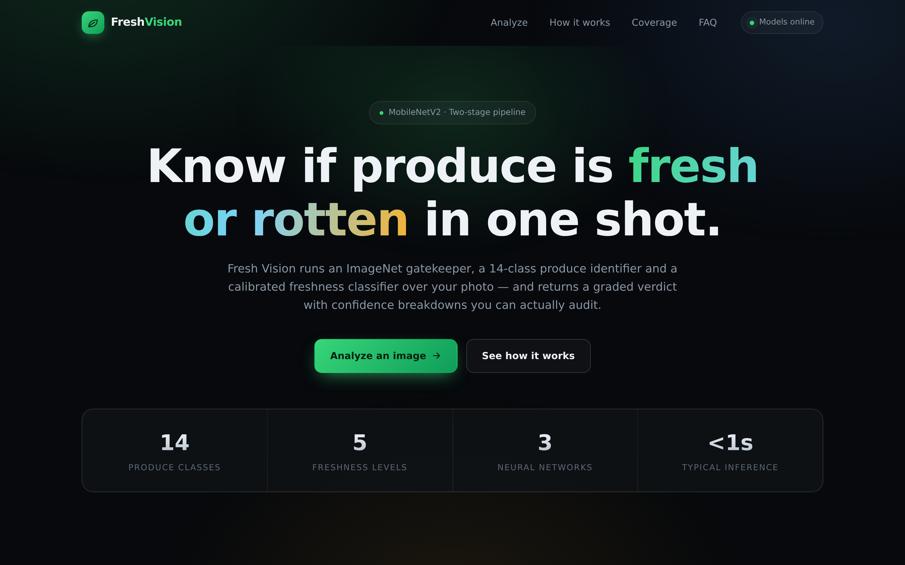
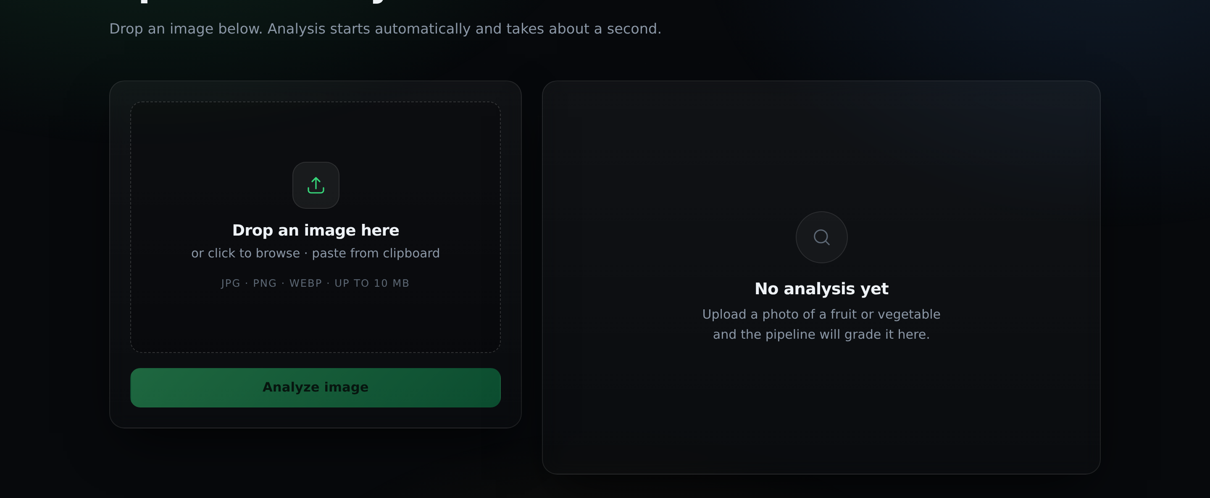
SECTION 04
The deployed application
FastAPI JSON service behind a React single-page interface
REST API
GET /api/health
Model load status (503 if a model is missing)
GET /api/classes
Produce and freshness label lists
POST /api/predict
Image upload → the full analysis JSON
What the user sees
Landing view — model status, headline and coverage stats
Headline verdict, e.g. "Fresh Tomato"
Produce and freshness confidence
Top-3 identification scores
The full 5-level freshness distribution
Estimated shelf life
The gatekeeper's own ImageNet label
Inference latency in milliseconds
Analysis view — drag-and-drop upload beside the verdict panel
Fresh Vision · Practice School-II
12
Notes:
Uploads are capped at 10 MB and held in memory only — nothing is written to disk. When frontend/dist exists the backend serves the built UI itself, so the whole app runs on one port.

Slide 18



CONCLUSION
An end-to-end produce quality analyser
Three cooperating MobileNetV2 models turn one photograph into an identified item, a five-level freshness grade, a confidence breakdown and a shelf-life estimate — in under a second on commodity hardware.
What worked
Limitations & next steps
Transfer learning reached 80.4% validation accuracy on a small dataset
HSV pseudo-labelling produced five levels with zero manual annotation
The gatekeeper stops confident nonsense on out-of-distribution photos
One-port deployment: the API serves the built React UI directly
Pseudo-labels are heuristic, not ground truth — accuracy is bounded by them
Calibration multipliers are hand-tuned; class weights on retraining are the proper fix
The keyword gatekeeper could be replaced by a trained binary produce detector
Data augmentation and per-class metrics are the next accuracy levers
Impact: the same pipeline generalises to warehouse intake checks, retail shelf audits and cold-chain monitoring — anywhere produce is currently graded by eye.

Slide 19



REFLECTION
Learning outcomes
Deep learning in practice
Working around missing labels
Built and trained CNN classifiers in Keras — transfer learning, frozen vs. unfrozen backbones, dropout and learning-rate choice for fine-tuning.
Data problems are often solved before modelling: classical HSV computer vision generated the five-level labels supervised learning needed.
Evaluation and honesty
Designing robust ML systems
Read confusion matrices and per-class precision/recall rather than a single accuracy figure, and recognised a systematic class bias in the raw output.
A deployed model needs guard rails — an input gatekeeper and a confidence threshold turn a fragile classifier into a system that admits when it does not know.
Full-stack deployment
Engineering communication
Wrapped the models in a FastAPI service and a React + Vite frontend; handled preprocessing parity, file limits, CORS and single-port static serving.
Documented the architecture and its trade-offs so the work is reproducible and explainable to a non-specialist audience.
Fresh Vision · Practice School-II
14

Slide 20
SOURCES
References
01
Sandler, M., Howard, A., Zhu, M., Zhmoginov, A., Chen, L.-C. (2018). MobileNetV2: Inverted Residuals and Linear Bottlenecks. IEEE/CVF CVPR, pp. 4510-4520.
02
Deng, J., Dong, W., Socher, R., Li, L.-J., Li, K., Fei-Fei, L. (2009). ImageNet: A Large-Scale Hierarchical Image Database. IEEE CVPR.
03
Pan, S. J., Yang, Q. (2010). A Survey on Transfer Learning. IEEE Transactions on Knowledge and Data Engineering, 22(10), 1345-1359.
04
TensorFlow / Keras documentation. Transfer learning and fine-tuning — tensorflow.org/tutorials/images/transfer_learning
05
FastAPI documentation. Modern high-performance Python web framework — fastapi.tiangolo.com
06
React and Vite documentation. react.dev · vite.dev
07
Fresh and Rotten Fruits/Vegetables image dataset. Public image dataset, unified into 14 produce classes with fresh/rotten subfolders.
Fresh Vision · Practice School-II
15

Slide 21
Thank you
Questions and discussion
Very fresh
Fresh
Slightly rotten
Rotten
Very rotten
Fresh Vision · Practice School-II · School of Engineering & Technology, BML Munjal University
Faculty Mentor: Dr. XYZ · Industry Mentor: Mr. ABC · August 2025

