Slide 1

PRACTICE SCHOOL-II · FINAL PRESENTATION
FRESH VISION
AI-Powered Fruit & Vegetable Quality Analyzer
Produce identification and fine-grained freshness grading from a single photo
Submitted by
Vishal Verma ID: [ Your BMU ID ]
FACULTY MENTOR
Dr. Aurobindo Behera
[ Designation ]
School of Engineering & Technology, BMU
INDUSTRY MENTOR
[ Industry Mentor Name ]
[ Designation ]
[ Organization Name ]
School of Engineering & Technology
BML Munjal University, 67th KM Stone, NH-8, Gurugram, Haryana 122413
September 2026
Notes:
[~30 sec] Good morning. I'm Vishal Verma, and this is my PS-II project: Fresh Vision, an AI-powered fruit and vegetable quality analyzer. It takes one photo of produce and tells you what it is and how fresh it is. Thank you to my faculty and industry mentors.

Slide 2
PS-II STATION & VISIT SUMMARY
Organisation details to be filled in from your PS-II allocation letter
WORK TIMELINE — EIGHT WEEKS
ABOUT THE STATION
Organisation [ Company / Station name ]
Department [ Department visited ]
Duration [ Start date ] – [ End date ]
W1
Dataset consolidation
14 produce classes, fresh/rotten folders per class
W2
Data pipeline
Stratified 80/20 split · MobileNetV2 preprocessing, 224x224
NATURE OF WORK
Applied computer vision — building and deploying an image-based produce quality-inspection system.
TASK ALLOCATED
› Identify the fruit or vegetable from a single photo
› Grade how far decay has progressed, not just fresh vs. rotten
› Ship it as a usable web application, not a notebook
Produce identifier
Transfer learning on MobileNetV2 -> 14-class head
W3
W4
Pseudo-labelling
HSV decay scoring turns 2 labels into 5 freshness levels
W5
Freshness classifier
Phase-1 training with the backbone frozen
W6
Fine-tuning
Last 30 layers unfrozen at learning rate 1e-5
W7
Calibration + prototype
Bias correction at inference · Streamlit prototype
DELIVERABLE
A deployed web application — three models behind a FastAPI service with a React user interface.
W8
Production build
FastAPI service + React (Vite) UI + gatekeeper integration
Fresh Vision · Practice School-II · SOET, BML Munjal University
2
Notes:
[~1 min] Briefly on the station and what I was asked to do. My task had three parts: identify the produce from a photo, grade how far decay has gone — not just fresh vs rotten — and ship it as a usable web application rather than a notebook.
Walk the timeline right-to-left quickly: first four weeks were data and the identifier, middle weeks were the freshness model and fine-tuning, last two weeks were calibration and the production build. Don't read every week — point at W4 and W8 as the turning points.

Slide 3
PROBLEM IDENTIFICATION
Fruit and vegetable quality is still judged by eye — one item at a time.
Manual & subjective
Grading depends on who is looking. Two inspectors give two answers, and consistency drops over a long shift.
Does not scale
A grocery chain or warehouse cannot hand-check every crate, so spoiled stock reaches the shelf and good stock gets thrown away.
Binary labels are not enough
Public produce datasets label images only fresh or rotten — a flag that cannot separate “use today” from “discard now”.
THE GAP
There is no lightweight, deployable system that does all three at once: identify the produce, grade how far decay has progressed on a fine-grained scale, and refuse images it has no business judging.
Off-the-shelf classifiers have no notion of “not produce” — show one a car and it still returns a fruit, confidently.
Fresh Vision · Practice School-II · SOET, BML Munjal University
3
Notes:
[~1.5 min] The problem. Produce quality is still judged by eye, one item at a time. That is subjective — two inspectors give two answers — and it does not scale: nobody hand-checks every crate, so spoiled stock reaches the shelf and good stock gets thrown away.
Then the technical gap, which is the point of this slide: the public datasets I could find label produce only as fresh or rotten. That binary flag cannot tell you "use this today" from "throw this out now". And a normal classifier has no idea what "not produce" means — show it a car and it will still confidently name a fruit.

Slide 4
PROBLEM STATEMENT & OBJECTIVES
PROBLEM STATEMENT
Design and deploy a lightweight computer-vision system that, from a single photograph, identifies the fruit or vegetable, grades its freshness on a five-level scale, and rejects inputs that are not produce — exposing every confidence value instead of hiding it.
OBJECTIVES OF THE WORK
1
Identify produce reliably
Train a 14-class identifier by transfer learning on MobileNetV2.
2
Create the labels that did not exist
Derive five fine-grained freshness levels from a binary fresh/rotten dataset, without manual re-annotation.
3
Grade freshness, then correct it
Train and fine-tune a freshness classifier, and calibrate its biased output at inference time.
4
Refuse what it cannot judge
Add an out-of-distribution gatekeeper and a confidence floor so bad inputs fail loudly, not silently.
5
Deploy it as a real application
A FastAPI service and a React single-page UI surfacing confidences, the full freshness distribution, shelf life and latency.
Fresh Vision · Practice School-II · SOET, BML Munjal University
4
Notes:
[~1 min] So the problem statement: from a single photo, identify the produce, grade freshness on a five-level scale, and reject inputs that aren't produce — while showing every confidence value rather than hiding it.
Five objectives follow from that. Read only the bold titles; the evaluator can read the rest. Emphasise objective 2 — creating labels that did not exist — because that was the hardest part of the project.

Slide 5
METHODOLOGY — END-TO-END WORKFLOW
OFFLINE — building the models (done once)
Unified dataset
14 produce classes fresh / rotten folders
HSV decay scoring
saturation mask isolates fruit brown-pixel ratio -> decay score
5 pseudo-labels
scores bucketed per fruit: very fresh to very rotten
Transfer learning
MobileNetV2 backbone Phase 1 frozen, Phase 2 tuned
trained models: fruit_veg_identifier.h5 + freshness_classifier_v2.h5
ONLINE — what happens to every uploaded photo
Photo upload
JPG / PNG / WEBP max 10 MB held in memory
Preprocess
RGB, resize 224x224 MobileNetV2 normalisation
Gatekeeper
ImageNet MobileNetV2 screens top-5 labels for produce keywords
Identify
14-class head confidence floor of 65%
Grade freshness
5-level head calibrated, then renormalised
not produce
“Not a Fruit or Vegetable”
below 65% confidence
“Unclear Image”
OUTPUT — graded verdict returned as JSON and rendered in the UI
produce label · freshness level · both confidences · full 5-level distribution · estimated shelf life · inference latency
Fresh Vision · Practice School-II · SOET, BML Munjal University
5
Notes:
[~2 min] How it works, in two halves.
The top lane is offline, done once. I started from the unified dataset, ran HSV decay scoring over it to produce five pseudo-labels, and then trained with transfer learning. That gives me the two .h5 model files.
The bottom lane is what happens to every uploaded photo at run time. Preprocess to 224x224 with MobileNetV2 normalisation — exactly what the models saw in training. Then the gatekeeper checks whether this is produce at all; if not, we stop and say so. Then the identifier names the fruit, and if it isn't at least 65% confident we stop and say "unclear" instead of guessing. Only if both checks pass does the freshness head run.
Point at the two orange branches — those are the two ways the system refuses to answer, and I'll show one working in the results.

Slide 6
SYSTEM ARCHITECTURE
CLIENT React 19 + Vite single-page app
Dropzone (drag-drop / paste) · ResultPanel · ScoreDial · ConfidenceBar · responsive dark-mode UI
POST /api/predict
multipart/form-data · max 10 MB · held in memory only
API FastAPI + Uvicorn backend/main.py
GET /api/health · GET /api/classes · POST /api/predict Pillow + NumPy build the 224x224 tensor
MODEL LAYER — TensorFlow / Keras, loaded once at startup
Gatekeeper
MobileNetV2 (ImageNet)
pretrained, 1000 classes top-5 produce keyword screen
Produce identifier
fruit_veg_identifier.h5
14 classes · 2.42 M params 158 layers · 11.6 MB
Freshness classifier
freshness_classifier_v2.h5
5 levels · 2.42 M params 158 layers · 23.8 MB
JSON RESPONSE
status (ok / uncertain / rejected) · headline verdict · top-3 produce · 5-level freshness distribution · shelf life · latency · thumbnail
Deployment no database and nothing written to disk; when frontend/dist exists the same Uvicorn process serves the built UI, so the whole application runs on one port.
Fresh Vision · Practice School-II · SOET, BML Munjal University
6
Notes:
[~1.5 min] The architecture, top to bottom. A React 19 single-page app posts the image as multipart form data — capped at 10 MB, held in memory, never written to disk. FastAPI with Uvicorn takes it, Pillow and NumPy build the tensor.
The model layer holds all three models, loaded once at startup rather than per request — that's what keeps latency down. The two custom models are about 2.4 million parameters each; the identifier is 11.6 MB, the freshness model 23.8 MB.
Everything comes back as one JSON object with the full picture, including the whole freshness distribution and the latency. And when the React build exists, the same Uvicorn process serves the UI too — so the whole application runs on one port, with no database.

Slide 7
KEY IMPLEMENTATION
01
Transfer learning on MobileNetV2
A 53-layer depthwise-separable CNN with inverted residual blocks — chosen because it is small enough to serve on CPU. Custom head: GlobalAveragePooling → Dense(128, ReLU) → Dropout(0.3) → Dense(N, softmax).
Phase 1 frozen backbone, head only, 5 epochs Phase 2 last 30 layers, LR 1e-5, 5 epochs
02
Pseudo-labelling with classical computer vision
The dataset had only two labels; five were needed. Each image is converted to HSV, the fruit is separated from the background with the saturation channel, and brown/decayed pixels are masked inside it.
decay_score = decayed px / fruit px × 100 -> bucketed per fruit type into 5 levels
03
Calibration and guardrails at inference
The freshness head over-predicted “slightly rotten” and almost never fired “very rotten”. Fixed multipliers reweight it and the distribution is renormalised, so probabilities still sum to 1.
slightly_rotten x0.3 rotten x1.5 very_rotten x2.5 ID floor 65% gatekeeper floor 20%
Stack Python · TensorFlow / Keras · NumPy · Pillow · FastAPI · Uvicorn · React 19 · Vite
Fresh Vision · Practice School-II · SOET, BML Munjal University
7
Notes:
[~1.5 min] Three decisions worth defending.
One: transfer learning on MobileNetV2, chosen because it is small enough to serve on CPU. I trained in two phases — head only with the backbone frozen, then unfroze the last 30 layers at a very small learning rate so I didn't wreck the pretrained weights.
Two, and this is the part I'm most pleased with: the dataset only had two labels and I needed five. Instead of hand-labelling thousands of images, I used classical computer vision — convert to HSV, isolate the fruit using the saturation channel, mask the brown decayed pixels inside it, and turn that into a decay score. Bucketing that score per fruit type gives five levels. Per fruit type matters, because a rotten banana and a rotten apple are not the same colour.
Three: the freshness head was biased — it over-predicted "slightly rotten" and almost never fired "very rotten". I corrected that at inference with fixed multipliers and renormalised, plus the two confidence floors.

Slide 8
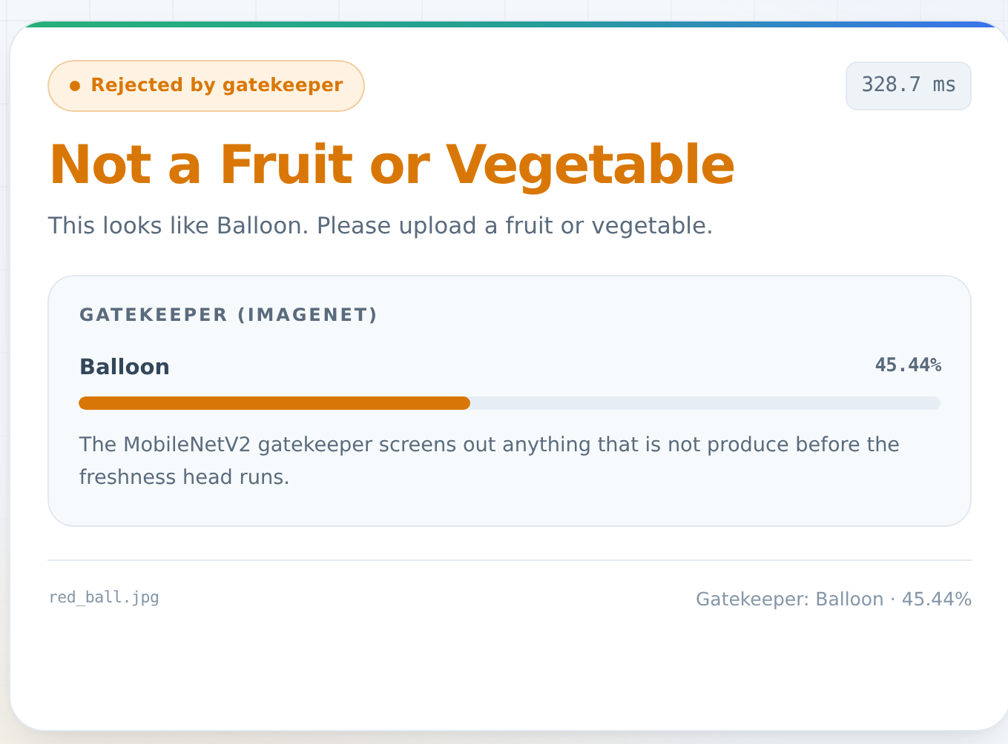
RESULTS & DISCUSSION
LIVE RUN — the gatekeeper rejecting a non-produce image
FRESHNESS CLASSIFIER — VALIDATION ACCURACY
100
77.8%
80.4%
75
50
25
0
Phase 1
backbone frozen
Phase 2
fine-tuned
+2.6 points from unfreezing the last 30 layers
80.4%
validation accuracy freshness, fine-tuned
14 / 5
produce classes / freshness levels
3
models in the inference pipeline
~310 ms
warm inference, CPU-only measured via /api/predict
35.4 MB
total trained-model footprint on disk
DISCUSSION
▪ Fine-tuning the last 30 layers was worth it — validation accuracy rose from 77.8% to 80.4%, while the frozen backbone kept training stable on a small dataset.
▪ The guardrails work: non-produce inputs return “Not a Fruit or Vegetable”, and anything under 65% returns “Unclear Image” with its top-3 matches — the system fails visibly rather than guessing.
▪ At ~35 MB and ~310 ms per image on CPU, the pipeline deploys on ordinary hardware — no GPU and no database.
Fresh Vision · Practice School-II · SOET, BML Munjal University
8
Notes:
[~2.5 min] Results. On the left, the freshness classifier: 77.8% validation accuracy with the backbone frozen, 80.4% after fine-tuning the last 30 layers — a 2.6 point gain.
On the right is a genuine run against the deployed system, not a mock-up. I uploaded a non-produce image and the gatekeeper caught it: "Not a Fruit or Vegetable", with what ImageNet actually thought it was and the confidence. That is the guardrail doing its job. The other guardrail behaves the same way — anything under 65% comes back as "Unclear Image" with its top-3 closest matches.
The tiles are the numbers I'd defend: 80.4% validation accuracy, 14 classes across 5 freshness levels, 3 models, roughly 310 ms per image warm on CPU, and 35 MB of models in total.
Be honest if asked: the freshness labels are pseudo-labels, not human ground truth, so 80.4% is accuracy against those labels. That's the main limitation and the first thing I'd fix.

Slide 9
CONCLUSION & KEY ACHIEVEMENTS
A complete, working system was delivered end to end — dataset to models to API to user interface — not a notebook and not a demo.
Built the whole pipeline
Three models behind one FastAPI service and a React UI, running on a single port with no GPU and no database.
Solved the missing-label problem
Classical computer vision (HSV decay scoring) turned a binary fresh/rotten dataset into five usable freshness levels, with zero manual annotation.
Improved the model measurably
Two-phase transfer learning lifted freshness validation accuracy from 77.8% to 80.4%, and inference-time calibration corrected a real class bias.
Made the system honest
An out-of-distribution gatekeeper and a 65% confidence floor turn silent misclassifications into visible “rejected” and “uncertain” states.
Practical significance the footprint (~35 MB, CPU-only, ~310 ms per image) is small enough for in-store or warehouse screening, and every confidence value is exposed so a human can overrule the model.
Fresh Vision · Practice School-II · SOET, BML Munjal University
9
Notes:
[~45 sec] To conclude — I delivered a complete working system, dataset through to deployed UI. The achievement I'd point to is solving the missing-label problem with classical CV instead of manual annotation, and the fact that the system refuses to answer when it shouldn't, rather than guessing quietly. At 35 MB and CPU-only, it is small enough to actually run where produce is handled.

Slide 10
LEARNING OUTCOMES
1
Transfer learning in practice
Why a small dataset rules out training from scratch, and why you freeze the backbone first and fine-tune later at a much smaller learning rate.
2
Reading a CNN architecture
Depthwise separable convolutions, inverted residuals and linear bottlenecks — and picking a model for the deployment target rather than for a benchmark.
3
Data-centric problem solving
When the labels you need do not exist, engineer them: classical CV became a labelling tool instead of waiting on manual annotation.
4
Debugging model behaviour
Diagnosing class bias from the output distribution and correcting it at inference, and choosing confidence thresholds deliberately.
5
Full-stack ML deployment
FastAPI service design, loading models once at startup, handling multipart uploads safely, and serving a built React SPA from the same process.
6
Engineering judgement
Documenting trade-offs honestly — pseudo-labels are not ground truth, calibration is not retraining — and being able to state the system's limits.
Fresh Vision · Practice School-II · SOET, BML Munjal University
10
Notes:
[~45 sec] Six things I took away — technical, but also practical. Transfer learning strategy, reading a CNN architecture well enough to choose one for the deployment target, engineering labels when they don't exist, debugging model behaviour from its output distribution, deploying a model as a real service, and being able to state honestly what the system cannot do.

Slide 11
REFERENCES
[1]
M. Sandler, A. Howard, M. Zhu, A. Zhmoginov and L.-C. Chen, “MobileNetV2: Inverted Residuals and Linear Bottlenecks,” Proc. IEEE/CVF CVPR, 2018. arXiv:1801.04381.
[2]
J. Deng, W. Dong, R. Socher, L.-J. Li, K. Li and L. Fei-Fei, “ImageNet: A Large-Scale Hierarchical Image Database,” Proc. IEEE CVPR, 2009.
[3]
Keras, “Keras Applications — MobileNetV2,” documentation. https://keras.io/api/applications/mobilenet/
[4]
TensorFlow, “Transfer learning and fine-tuning,” official tutorial. https://www.tensorflow.org/tutorials/images/transfer_learning
[5]
S. Ramírez, “FastAPI,” official documentation. https://fastapi.tiangolo.com
[6]
Meta Open Source, “React,” documentation. https://react.dev · Vite. https://vite.dev
PROJECT REPOSITORY
github.com/2ViShAlv1/Fresh-Vision — models, FastAPI backend, React frontend, training and labelling code
Fresh Vision · Practice School-II · SOET, BML Munjal University
11
Notes:
[brief] References — the MobileNetV2 and ImageNet papers, the Keras and TensorFlow documentation I worked from, and the frameworks. The full code, models and training scripts are in the repository. Thank you — happy to take questions.

