Slide 1
Checkers

Slide 2
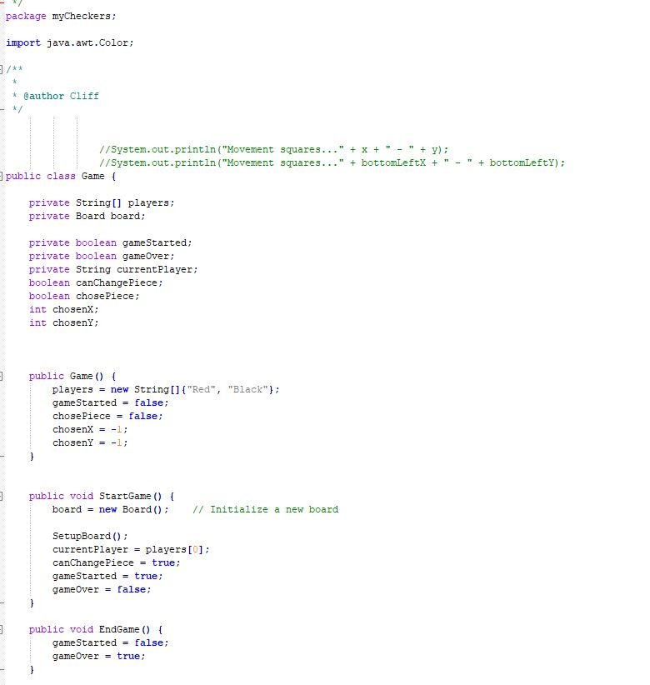
Code

Slide 3
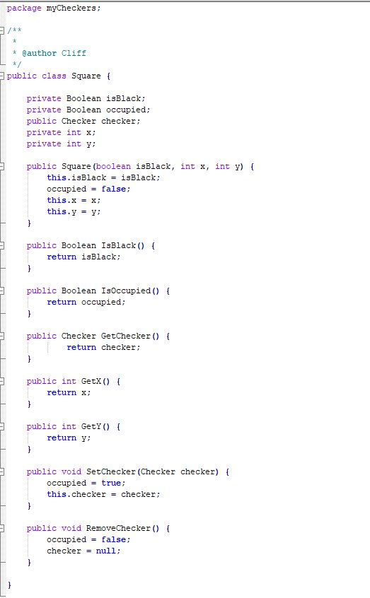
Code cont.

Slide 4
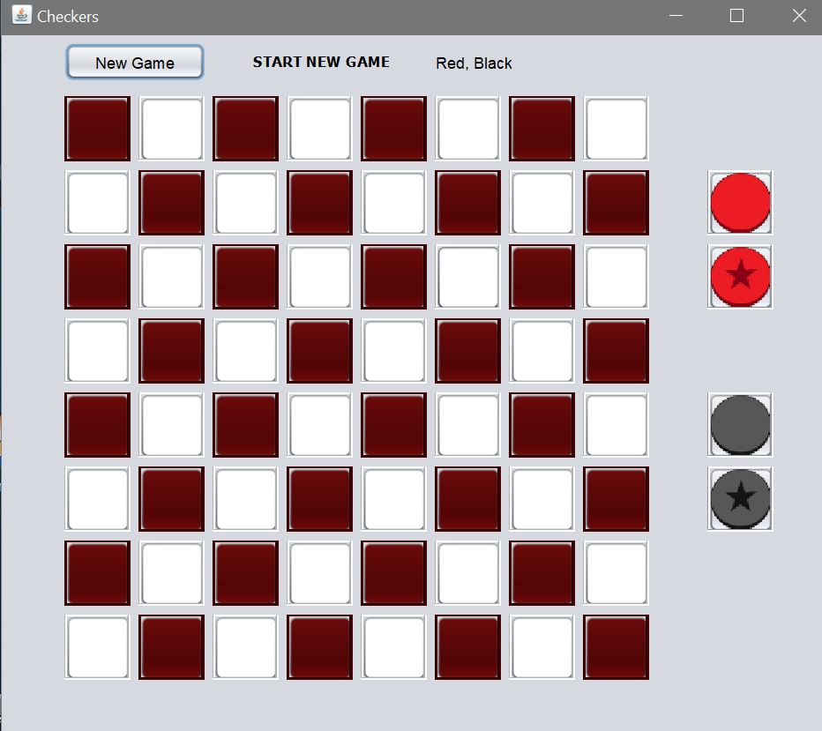
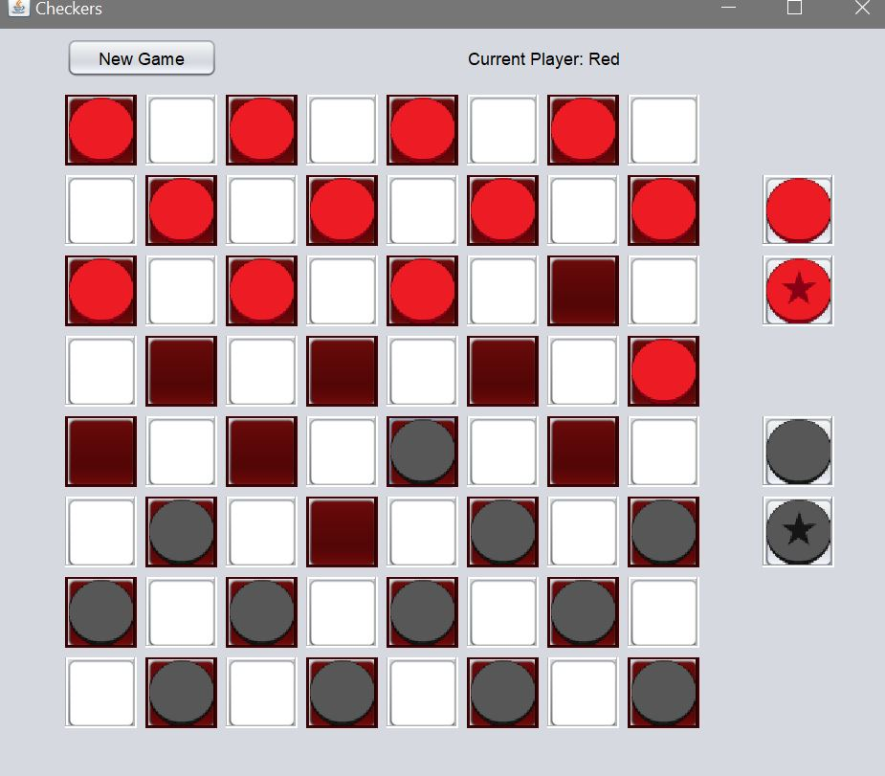
Game play

Slide 5
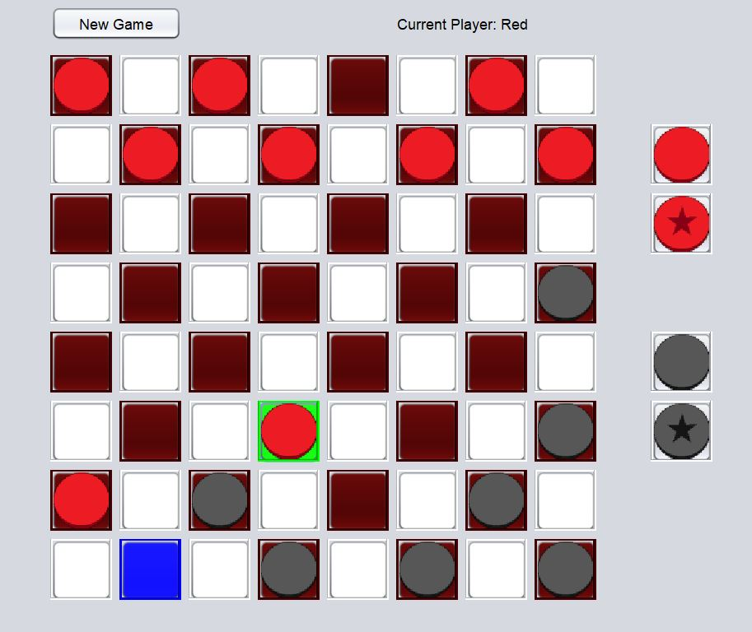
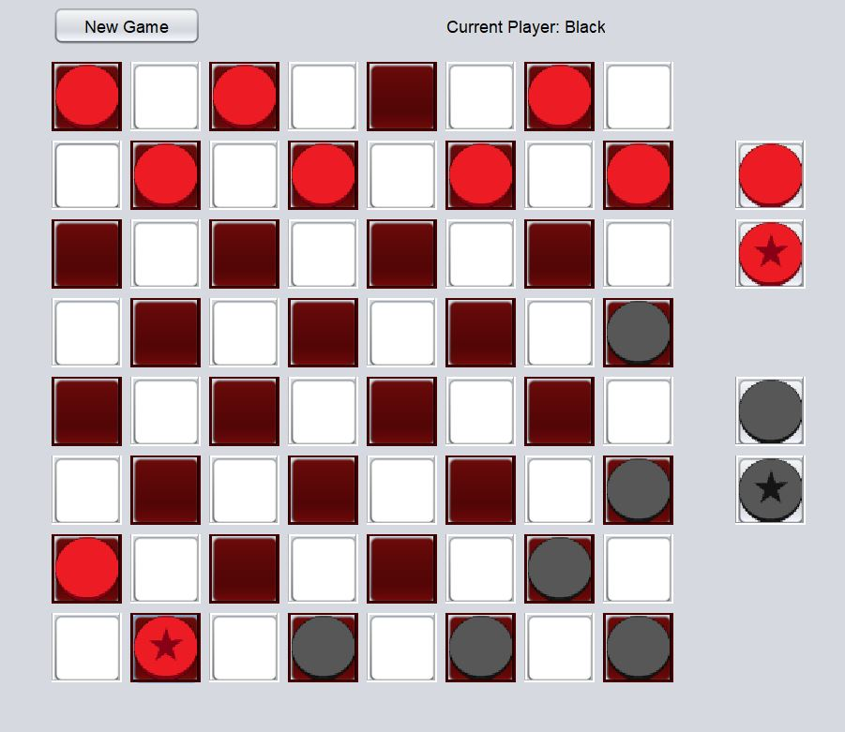
More Game Play

Slide 6
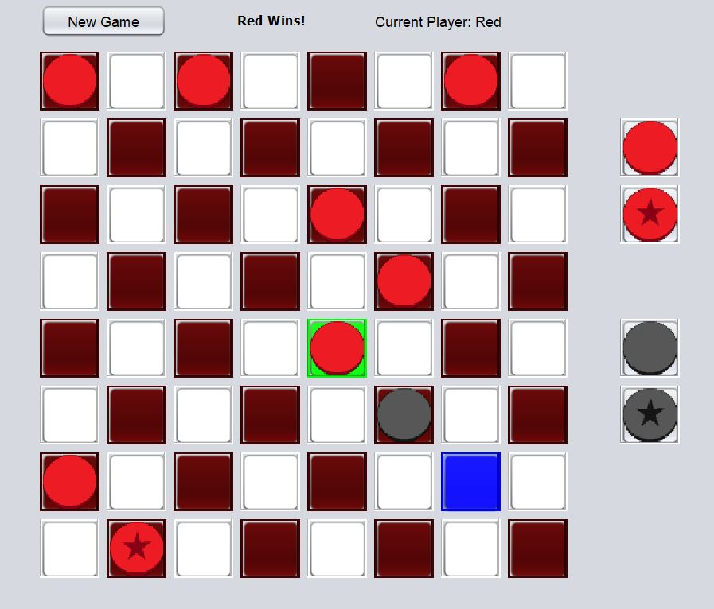

Game End

Slide 7

Future updates
Maybe update the Game End procedure
Maybe have a counter for the pieces each player has left
Create a single player mode with ai as the 2nd player

