Slide 1
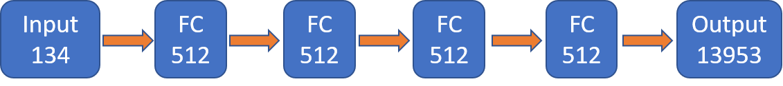
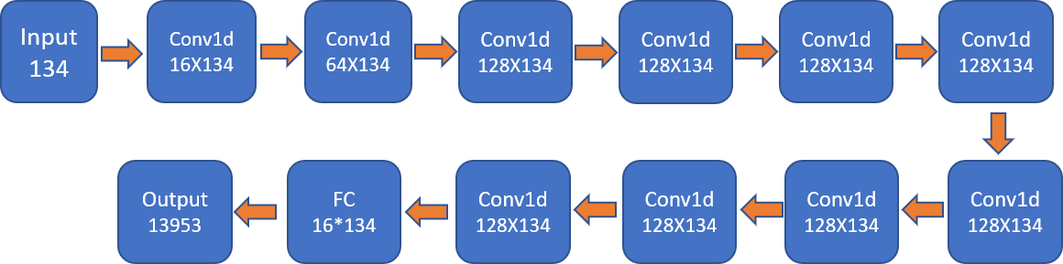
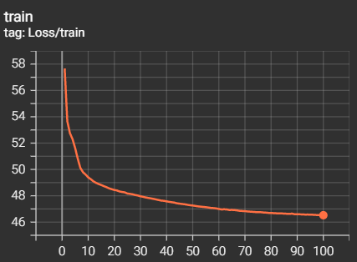
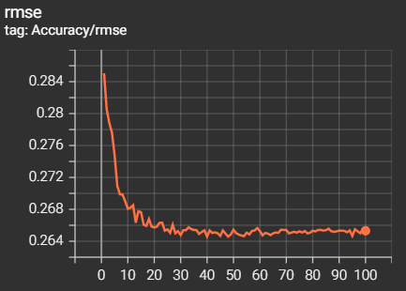
Predicting one modality from another of single cell data
Ashish Kumar Singh
Problem
Given a dataset of any two modalities of a single cell, predict all the features of one modality based on all features of second modality. Neurips 2021 Competition. Predict protein to gene expression modality conversion ADT-to-GEX
Approach
Train neural networks to predict modalities in Pytorch Understand and implement competition winner models
Experiment with deeper models and 1d convolution layers
Test Set Results
Conclusion
ConvNet also performs similar to benchmark models for modality
prediction of single cell data
Novel
ConvNet6
 | RMSE | Pearson Correlation
Novel (Neurips) | 0.2654 | 76.76%
ConvNet6 | 0.2665 | 76.81%
ConvNet12 | 0.2645 | 76.95%
ConvNet12
Luecken et. al. “A sandbox for prediction and integration of DNA, RNA, and protein data in single cells”
https://openproblems.bio/neurips_2021/

