Slide 1
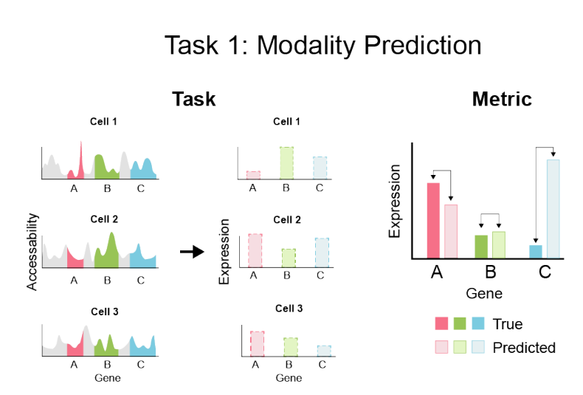
Predicting one modality from another of single cell data
Ashish Kumar Singh
Problem
Genetic information flows from DNA to RNA to protein. Given a dataset of any two modalities of a single cell, predict all the features of one modality based on all features of second modality. This was Task 1 in a NeurIPS 2021 competition.
Approach
Train neural networks to predict modalities Understand and implement competition winner models
Experiment with deeper models and 1d convolution layers Pitfalls
Deeper model might not train properly (vanishing/exploding
gradients)
Convolution layers might not be helpful if nearby features in
modalities are highly independent
Luecken et. al. “A sandbox for prediction and integration of DNA, RNA, and protein data in single cells”
https://openproblems.bio/neurips_2021/

