Slide 1
CS 161 Intro. To Artificial Intelligence
Week 6, Discussion 1D

Slide 2
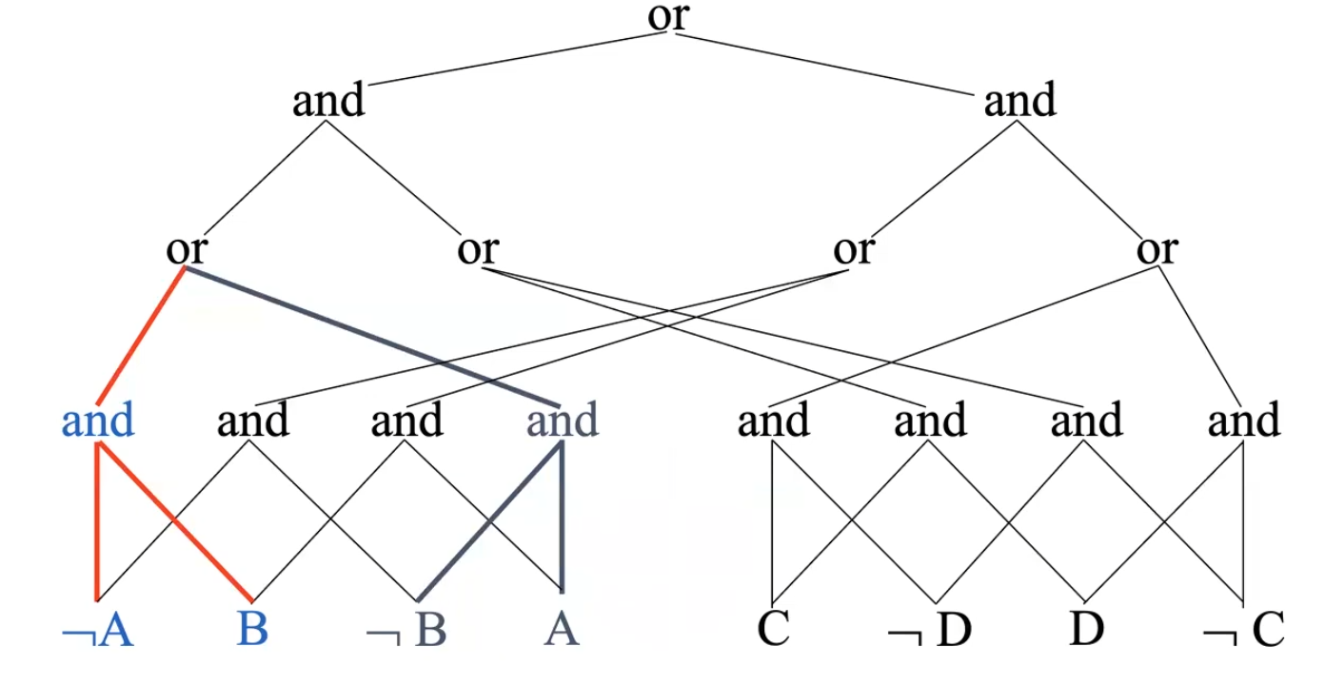
Tractable Circuits
NNF - Negation Normal Form Circuit:
Only AND and OR gates, Negation only on literals
Decomposability - DNNF:
Any AND gate’s children’s subcircuits do not share variables.
Determinism - d-DNNF
For any pair of an OR gate’s children, a and b:
(a AND b) is unsatisfiable
You can only ever have either a or b “active”/”high”.
Smoothness
All children of an OR gate mention the same variables.

Slide 3
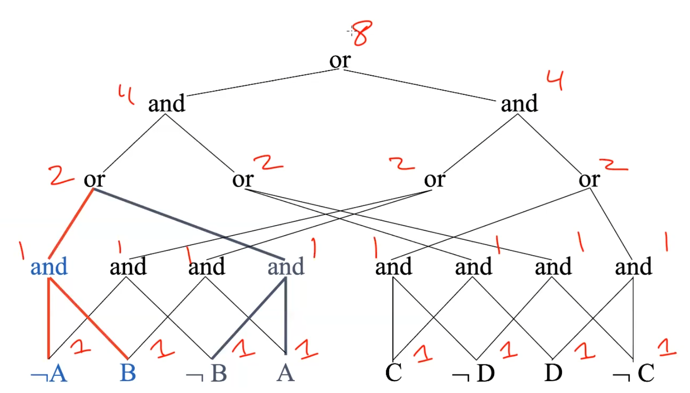
Model Counting
True is 1, False is 0.
Any literal, positive or negative, is 1.
An AND gate is the PRODUCT of its children.
An OR gate is the SUM of its children.

Slide 4
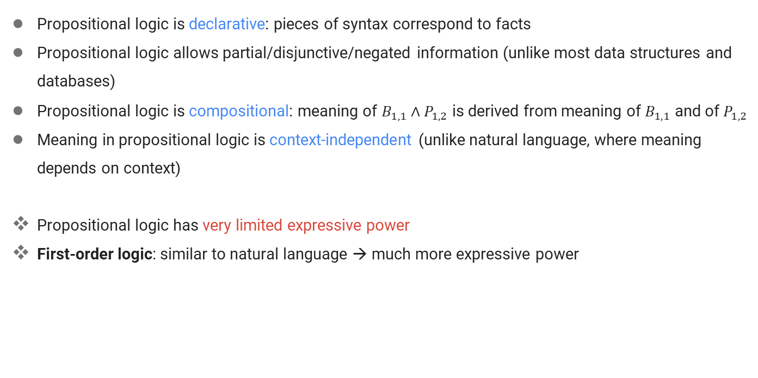
Limitation of Propositional Logic

Slide 5
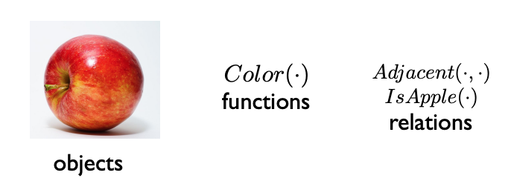
First Order Logic (FOL) - Syntax
Syntax – how to write sentences:
The same as in Propositional Logic, we have sentences in FOL.
A sentence is evaluated as True/False with respect to a model.
Assume a world contains:
Objects: A “thing in the world”
Relations: Also called predicates, like a function, but returns True or False.
Functions: Operator that maps object(s) to single object。

Slide 6
FOL - Basic Elements
Objects (terms):
Constant: Apple, Mary, Unicorn, etc.
Variable: x, y, z, etc. (by convention, variables are represented by lowercase letters)
Complex terms (having functions): Mother(Mary), Color(Apple), Size(Unicorn), etc.
Ground term: a term without variables
Apple, Color(Apple), etc.
Predicates (evaluated as True/False):
Properties (unary): UCLAStudent(Mary)
Relations (n-ary): the set of tuples of objects that are related
Love(Richard, Mary), Brother(Richard, James), etc.
Functions (Return another constant)

Slide 7
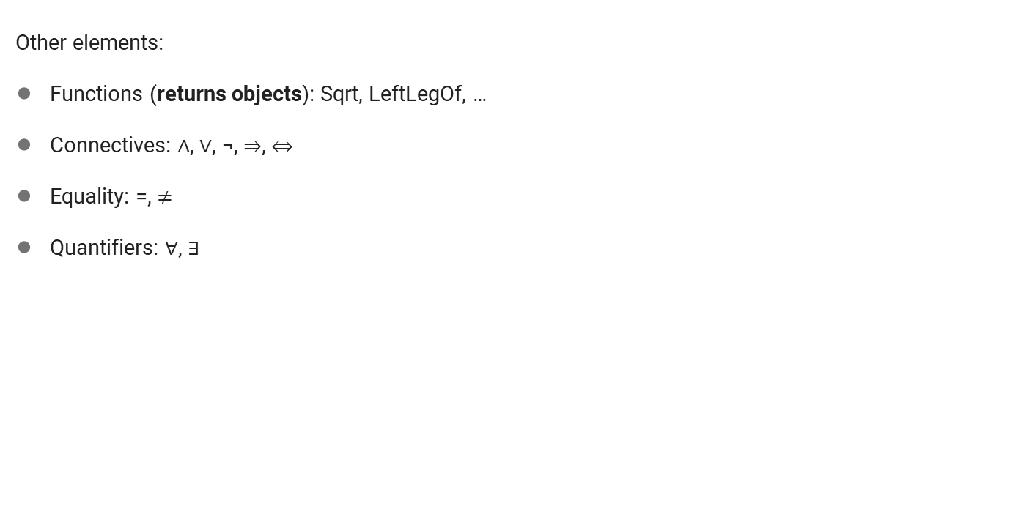
FOL - Basic Elements
All domain in-specific; just parts of FOL
Vocabulary - Domain Specific Ideas:
Constants: 2, Jack, UCLA
Predicates: Adjacent
Functions: LeftOF

Slide 8
FOL – Sentence Types
Term: Constant or Variable or
Function (term1, …, term n)
Atomic Sentences: one predicate and objects (terms)
In the form of Predicate(term1, …, termN):
UCLAStudent(Mary) (predicate and constant)
UCLAStudent(x) (predicate and variable)
Married(Mother(Mary), Father(Mary)) (predicate, constant, function)
Complex Sentences:
Made from atomic sentences using connectives:
Under20(Mary) ∧ UCLAStudent(Mary)
Color(Apple)=Red
Sold(John, Car1, Tom) ⟹ ¬ Owns(John, Car1)
∀x UCLAStudent(x)⇒Person(x)
∃x UCLAStudent(x)∧Under20(x)
A sentence is evaluated as True/False with respect to a model.
Function: Maps Object(s) to Object
Relation: Holds between Objects,
returns True or False
Notes:
The following is NOT a sentence:
Mary, x, Mother(Mary). They are objects!

Slide 9
FOL - Quantifiers
Quantifiers: express properties of entire collections of objects, instead of enumerating objects by name.
Universal quantification ∀ (For all)
∀x King(x) ⇒ Person(x)
Naturally uses ⇒
Equivalent to a huge disjunction over all objects that could become x
Existential quantification ∃ (There exists)
∃x King(x) ∧ OlderThan30(x)
Naturally uses ∧
Equivalent to a huge disjunction over all objects that could become x
Uniqueness Quantifier ∃!
E.g. ∃!x King(x) -- There is exactly one king
Equivalent to ∃x king(x) ∧ [∀y king(y) ⇒ (x = y)]
Notes:
E.g. For all x, if x is a king, then x is a person
The sentence ∀ x P , where P is any logical expression, says that P is true for every object x
Naturally, universal quantification goes with implication and existential quantification goes with "and"

Slide 10
FOL - Quantifiers
Nesting quantifiers:
Same type quantifiers: order doesn't matter
∀x ∀y (Paren(x,y) ∧ Male(y) ⇒ Son(y,x))
∃x ∃𝑦 (Loves(x,y) ∧ Loves(y,x))
∃x, 𝑦 (Loves(x,y) ∧ Loves(y,x))
Mixed quantifiers: order does matter
∀x ∃𝑦 (Loves(x,y))
Everybody has someone they love.
∃x ∀y (Loves(x,y))
There is someone who loves everyone.
∀y ∃𝑥 (Loves(x,y))
Everybody has someone who loves them.
∃𝑦 ∀x (Loves(x,y))
There is someone who is loved by everyone.
Notes:
E.g. For all x, if x is a king, then x is a person
The sentence ∀ x P , where P is any logical expression, says that P is true for every object x
Naturally, universal quantification goes with implication and existential quantification goes with "and"

Slide 11
Quantifiers - Example
What do the following sentences mean?
Example for ∀:
∀x, IsBook(x) ⇒ HasAuthor(x)
∀x, IsBird(x) ⇒ HasFeather(x)
Example for ∃:
∃x, Person(x) ∧ Name(x, George)
∃x, Course(x) ∧ PreRequisite(x, CS161)

Slide 12
Quantifiers - Example
What do the following sentences mean?
Example for ∀:
∀x, IsBook(x) ⇒ HasAuthor(x) Every book has an author
∀x, IsBird(x) ⇒ HasFeather(x) Every bird has feather
Example for ∃:
∃x, Person(x) ∧ Name(x, George) Exists some person whose name is George
∃x, Course(x) ∧ PreRequisite(x, CS161) Exists some course whose pre-requisite is CS161

Slide 13
Quantifiers - Example
Are they equivalent? What do they mean?
∀x King(x) ⇒ Person(x)
∀x King(x) ∧ Person(x)
∃x King(x) ∧ OlderThan30(x)
∃x King(x) ⇒ OlderThan30(x)

Slide 14
Quantifiers - Example
Are they equivalent? What do they mean?
They are NOT equivalent!
∀x King(x) ⇒ Person(x) For any x, if x is king, then x is person
∀x King(x) ∧ Person(x) For any x, x is a king and a person
Everything in the domain is both a king and a person (too strong)
∃x King(x) ∧ OlderThan30(x) Exists some x, x is king and is older than 30
∃x King(x) ⇒ OlderThan30(x) ∃x ￢King(x) ∧OlderThan30(x)
Exists some x, s.t. King(x) is false or OlderThan30(x) is true.
There is one person that's not a king, this is true. If there is anything that's older than 30, this is true (too weak)

Slide 15
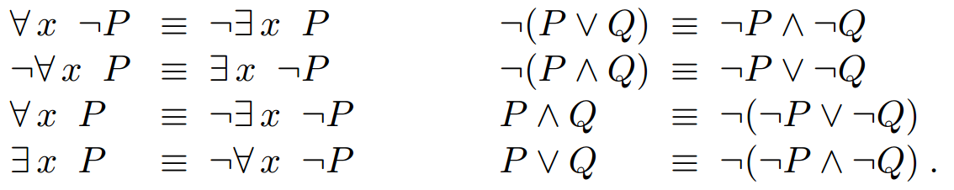
Quantifiers – Logical Equivalence
∀ and ∃:
E.g.
∀x King(x) ⇒ Person(x) is equivalent to: ¬∃𝑥 ¬(King(x) ⇒ Person(x))
∃x Likes(x, Broccoli) is equivalent to: ¬∀x ¬Likes(x, Broccoli)

Slide 16
Quantifiers – Variable Scope
Variable scope:
The scope of a variable is the sentence to which the quantifier syntactically applies.
∀𝐱 King(x) ⇒ Person(x), this quantifier applies for all x
∀𝐱 King(x) ∨ (∃ 𝐱 Brother(x, Richard))
This sentence is allowed. The variable belongs to the innermost quantifier that mentions it, so it will not be subject to any other quantification
Equivalent sentence: ∀𝐱 King(x) ∨ (∃z Brother(z, Richard))
Cause confusion. Not recommended. Use different variable names!
Not well-formed
∃x P(y)
All variables should be properly introduced!
Ground expression
No variable/ built from constants
E.g. King(Richard) ⇒ Person(Richard)

Slide 17
Translating English into FOL
How to write the following English sentences by FOL?
Richard has (at least) two brothers
∃ x, 𝑦 Brother(x, Richard) ∧ Bother(y, Richard)
∃ x, 𝑦 Brother(x, Richard) ∧ Bother(y, Richard) ∧ (𝑥≠𝑦)

Slide 18
Translating English into FOL
How to write the following English sentences by FOL?
Richard has (at least) two brothers
∃ x, 𝑦 Brother(x, Richard) ∧ Bother(y, Richard)
∃ x, 𝑦 Brother(x, Richard) ∧ Bother(y, Richard) ∧ (𝑥≠𝑦)

Slide 19
Translating English into FOL
How to write the following English sentences by FOL? What if we can only use ∀ and ∃?
Everyone has exactly one mother.
∀x ∃𝑦 Mother(y, x)
∀x ∃y Mother(y, x) ∧ [∀𝐳 𝐌𝐨𝐭𝐡𝐞𝐫(𝐳, 𝐱) ⇒ (𝐲=𝐳)]
Notes:
Ax E!y Mother(y, x)

Slide 20
Translating English into FOL
How to write the following English sentences by FOL? What if we can only use ∀ and ∃?
Everyone has exactly one mother.
∀x ∃𝑦 Mother(y, x)
Everyone has at least one mother
∀x ∃y Mother(y, x) ∧ [∀𝐳 𝐌𝐨𝐭𝐡𝐞𝐫(𝐳, 𝐱) ⇒ (𝐲=𝐳)]
Notes:
Ax E!y Mother(y, x)

Slide 21
Translating English into FOL
How to write the following English sentences by FOL?
1. Sibling” is symmetric
2. “Every gardener likes sunshine
3. Some people can be fooled all the time.
∃𝑥 ∀𝑡
4. Everyone can be fooled some of the time.
∀𝑥 ∃𝑡

Slide 22
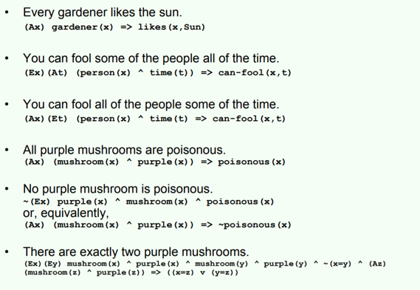
Translating English into FOL

Slide 23

FOL - Models
In logical system, a sentence is evaluated as True or False with respect to a model (possible world).
In Propositional Logic, a model is an assignment for some sentences
E.g.,
If a sentence 𝛼 is true in model m, we say that model m satisfies 𝛼
𝑀(𝛼) ≔ the set of all the models that satisfy 𝛼
Q: What about in First-Order Logic?
A: Much more complex!

Slide 24
FOL - Models
A model in FOL consists of:
A set of objects (domain elements)
A set of predicates + what values will be returned (relations of objects)
A set of functions + what values will be returned (functional relations of objects)
An atomic sentence predicate(term1, …, termN) is true iff the objects referred to by term1, …, termN are in the relation referred to by predicate

Slide 25
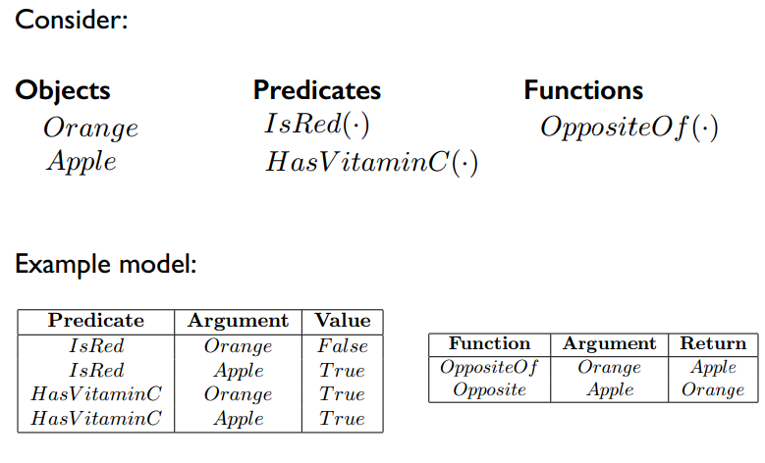
FOL - Model Example
https://www2.cs.duke.edu/courses/spring15/compsci270/slides/270_6.pdf

Slide 26
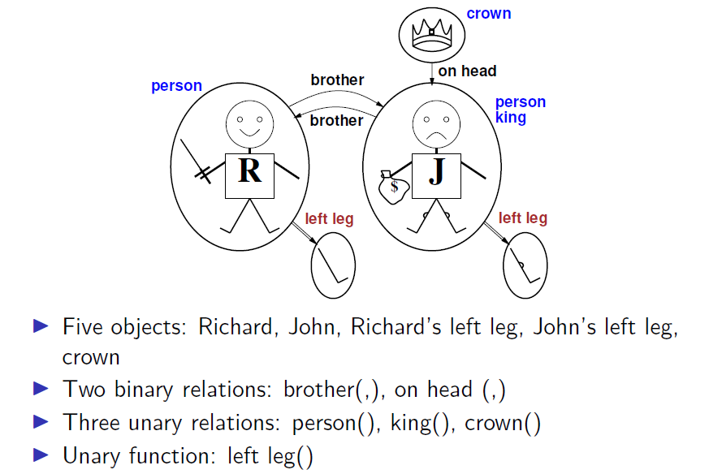
FOL - Model Example

Slide 27
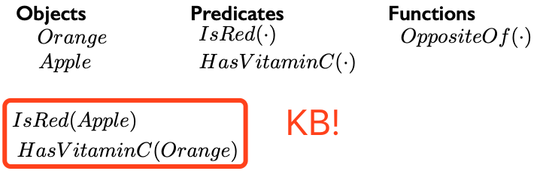
KB in FOL
A knowledge base (KB) is now:
A set of objects.
A set of predicates.
A set of functions.
A set of sentences using the predicates, functions, and objects, and asserted to be true.

Slide 28
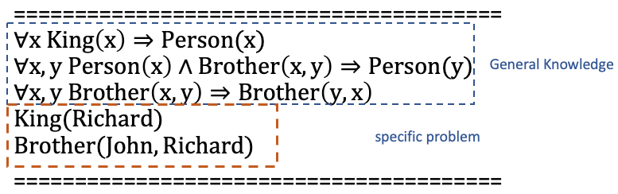
KB in FOL - Example
Another example of KB:

