Slide 1
MVP
Black → Content
Green → Buttons
Blue → Logic

Slide 2
Home Page
Log In
Sign Up
Review your Manager
Search for a Manager
View Companies
<Upload a data set of all US Companies>

Slide 3
Review Your Manager
Manager’s Company: ______________
Manager’s Company email address: __________________
Manager’s Name: (First) ____________ (Last) _________________
Manager’s Title: ___________________
Manager’s LinkedIN Profile URL: ________________________________ (Type NA if the Manager does not have a LinkedIN profile)
[Next]
“We do save, store or share any of your information except your review. Everything about YOU remains ANONYMOUS. The Information required below is for verification purposes only”
Your Name: (Optional) _______________________
Your Email Address / Phone for verification: ________________
 “Please review, read and accept our terms and conditions”
[Begin Review]
Direct the user to ‘Manager Review’ page

Slide 4
Search for a Manager
Managers Company: ______________
Managers Company email address: __________________
Managers Name: (First) ____________ (Last) _________________
Managers Title: ___________________
Manager’s LinkedIN Profile URL: ________________________________ (Type NA if the Manager does not have a LinkedIN profile)
[Submit]
If similar profile exists, “We found the following profiles, please select if one of these profiles is of the Manager that you would like to review”
Once the user clicks on the listed profile, the user is directed to the “Review Manager- Existing” page
If similar profile does not exist, “We did not find any matching profiles. You will be the first person to review First Name Last Name (Manager)”
Show the above message for 2 seconds and then direct the user to ‘Review Your Manager’ page
Name | Title(s) | Company(s)

Slide 5
Review Manager - Existing
Are you First Name Last Name? [Yes] [No]
If Yes, Go to “Claim your Profile”
Is this the Manager that you would like to Review? [Yes] [No]
If No, Go to “Search for a Manager” page
If Yes, “We do save, store or share any of your information except your review. Everything about YOU remains ANONYMOUS. The Information required below is for verification purposes only”
Your Name: (Optional) _______________________
Your Email Address / Phone for verification: ________________
 “Please review, read and accept our terms and conditions”
[Begin Review]
Direct the user to the ‘Manager Review’ page
Name | Title(s) | Company(s)

Slide 6
Manager Review
Scale of 1 to 5
Leadership: Does s/he have leadership skills and leads by example?
Mentorship: Does s/he provide mentoring to the team and helps them become more effective both personally and professionally?
Clarity of Thoughts: Is s/he clear in their thought and approach and articulate in conveying it to the team?
Happiness: Do you and rest of the team feel happy while you work with them?
Emotional Intelligence: Does s/he have the ability to identify and manage their own emotions and the emotions of others?
Managing Chaos: Does s/he perform well under ambiguity and pressure?
Allocation: Does s/he allocate responsibilities and sets clear timelines?
Accountability: Does s/he hold themselves accountable for not meeting expectations?
Likability: Is s/he genuinely likable?
Integrity: Would you consider him/her to retain their honesty and morality in any situation?
Deserves a Raise?: Does his/her performance merit a salary raise?
Deserves a Hug?: Do you find him/her to be an excellent human being and want to give them a hug?
PROVIDE YOUR FEEDBACK: _______________________________________________________________________________
[Submit]
“Thank You for submitting the review. Your review will not only help the Manager improve but also help potential new employees reporting to this manager make an informed decision”
Would you like to invite any of your colleagues or friends to review First Name Last Name (Manager)? [Yes] [No]
If Yes, direct the user to ‘Invite a Colleague or Friend” page
If No, “Thank You for submitting the review. Your review will not only help the Manager improve but also help potential new employees reporting to this manager make an informed decision”

Slide 7
Claim your Profile
Name: (First) ____________ (Last) _________________
Company: ______________
Email address: (Company) __________________
LinkedIN URL: ________________________________ (Type NA if you do not have a LinkedIN profile)
Title: ___________________
Phone: __________________
[Next]
User Name: ______________
Password: ________________
Security Questions: _______________
[Submit]
“Thank You for Claiming your Profile. Please use our training tools to enhance our skills and also let us know if you find any reviews to be inappropriate.”
Direct the user to his/her “Manager Dashboard” page after showing the above message for 3 seconds

Slide 8
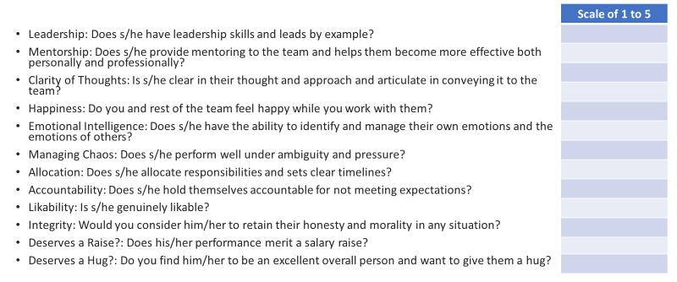
Manager Dashboard
Review Chart
Review Comments
Direct the user to “Dispute a Review” page
Learn, Improve, Grow
<Upload multiple articles, videos, blogs, etc. on a variety of relevant topics>
Reviews
Review 1 ……………..………………. Read More | Write a note for yourself | [Dispute this Review]
Review 2 ……………..………………. Read More | Write a note for yourself | [Dispute this Review]

Slide 9
Dispute a Review
Is this the review that you are trying to dispute? [Yes] [No]
<Review> ……………………………………………………………………………………………..
………………………………………………………………………………………………………………..
If Yes, Provide Reason: __________________________________
______________________________________________________
 “Please review, read and accept our terms and conditions”
[Submit]
“We have received your dispute and will review and take action shortly”
Direct the user to his/her “Manager Dashboard” page after showing the above message for 3 seconds
If No, direct the user back to his/her “Manager Dashboard” page

Slide 10
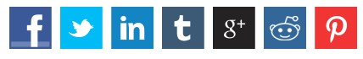
Invite a Colleague or Friend
Please provide below the details of the Colleague or Friend that you would like to review First Name Last Name (Manager):
Name: (First) ____________ (Last) _________________
Email address (will not be shared): _________________
Phone (will not be shared): _______________________
[Submit]
Spread the word, share via

Slide 11
View Companies
<User types the company’s name in the search box. The search box suggests name of the company as the user types in the letters and the user can either continue typing or select a company form the drop down list.>
If a Manager from the Company has been reviewed on the platform, the user will be directed to the Company Page
“Would you like to Review a Manager who worked at “<Company Name>”?” [Yes] [No]
If Yes, direct the user to “Review your Manager” page
If No, direct the user to “Home” page
If a Manager from the Company has not been reviewed on the platform, ““We did not find any review for employees working at “<Company Name>”. You will be the first person to review an employee from “<Company Name>”.
Show the above message for 2 seconds and then direct the user to ‘Review Your Manager’ page
Company Name | Manager Name | Number of Reviews
ABC | Name 1
ABC | Name 2

