Slide 1
Lambda Calculus
Brady Dean – 2bdkid.github.io

Slide 2
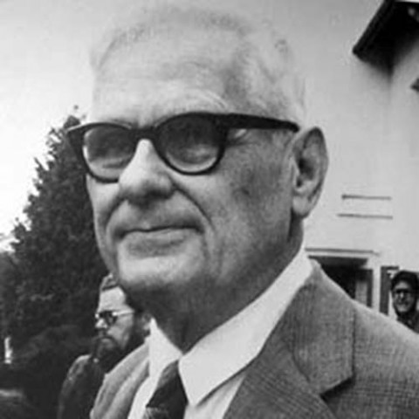
What is it?
Lambda Calculus is a mathematical model of computation created by Alonzo Church in the 1930s.
Lambda Calculus can encode any computable thing in the same way Turing Machines can.
Both models of computation can be shown to be equivalent.

Slide 3
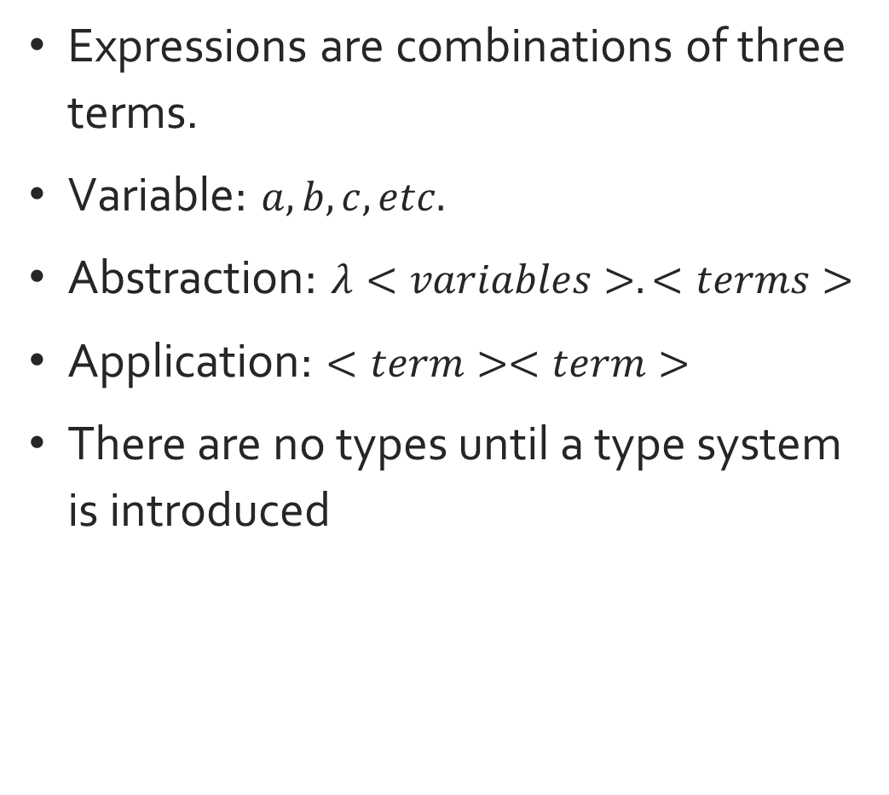
How does it work?
Expressions are combinations of three terms.
Variable: $a, b, c, etc.$
Abstraction: $λ<variables>.<terms>$
Application: $<term><term>$
There are no types until a type system is introduced

Slide 4

Examples
$\left(λxyz.xz\left(yz\right)\right)\left(λm.λn.m\right)\left(λp.p\right)$
$\left(λx.λy.xyy\right)\left(λa.a\right)b$
$(λz.z)(λz.zz)(λz.zy)$
$(λxyz.xz\left(yz\right))(λx.z)(λx.a)$

Slide 5
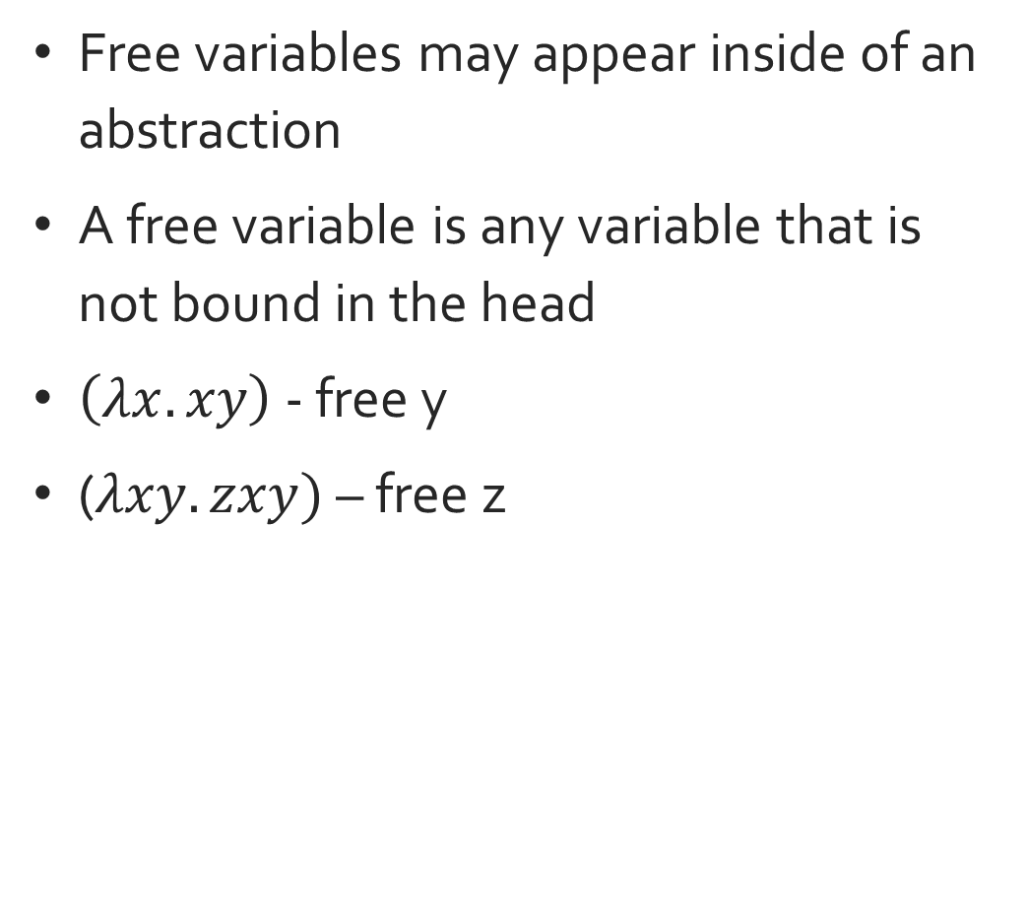
Free Variables
Free variables may appear inside of an abstraction
A free variable is any variable that is not bound in the head
$\left(λx.xy\right)$ - free y
($λxy.zxy)$ – free z

Slide 6
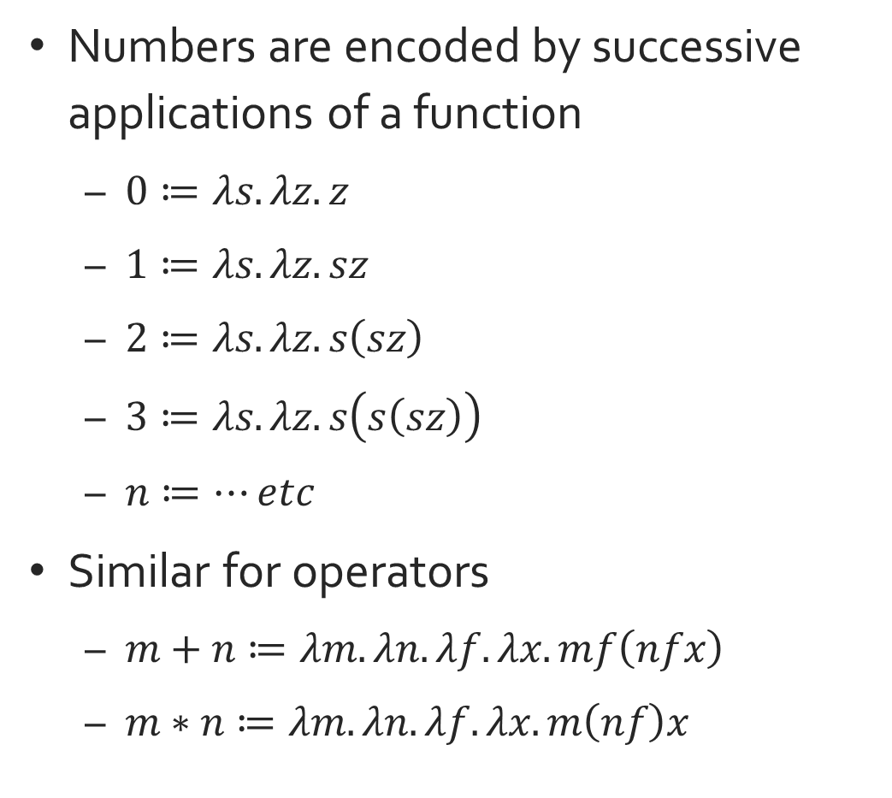
How to use it?
Numbers are encoded by successive applications of a function
$0≔λs.λz.z$
$1≔λs.λz.sz$
$2≔λs.λz.s\left(sz\right)$
$3≔λs.λz.s\left(s\left(sz\right)\right)$
$n≔…etc$
Similar for operators
$m+n≔λm.λn.λf.λx.mf\left(nfx\right)$
$m∗n≔λm.λn.λf.λx.m\left(nf\right)x$

Slide 7
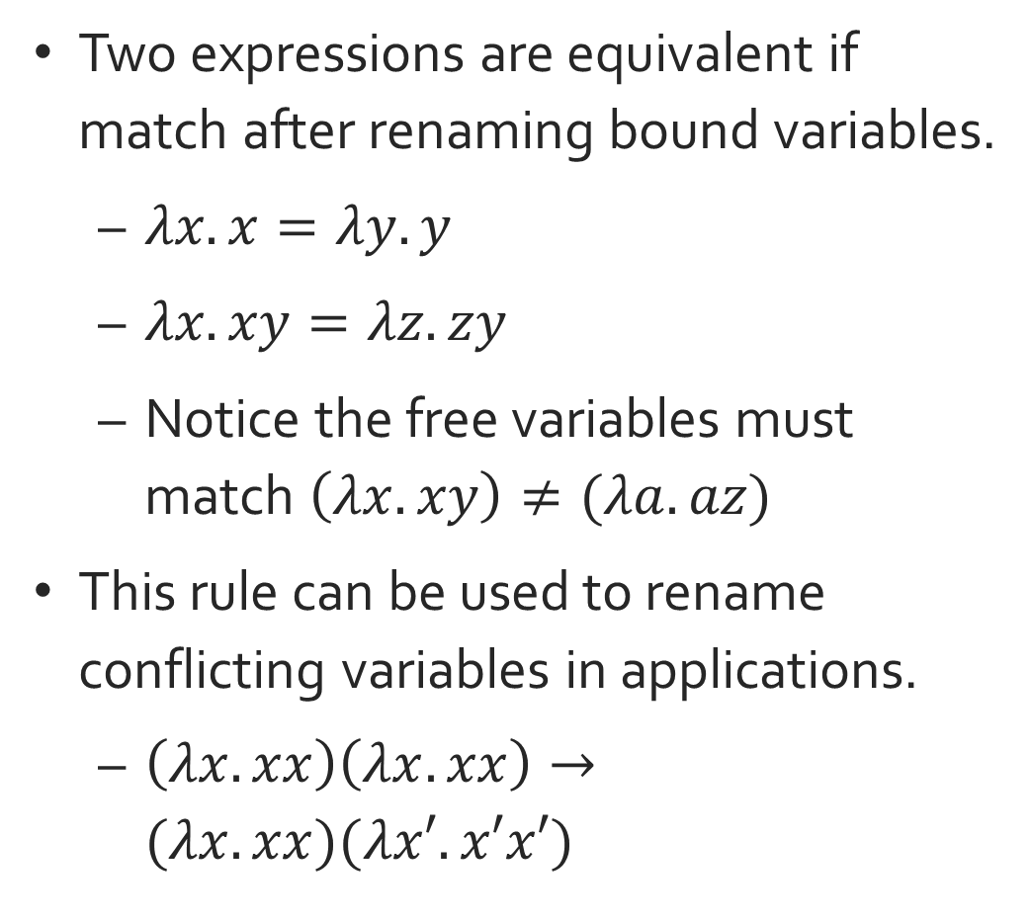
Alpha Equivalence
Two expressions are equivalent if match after renaming bound variables.
$λx.x=λy.y$
$λx.xy=λz.zy$
Notice the free variables must match $\left(λx.xy\right)≠(λa.az)$
This rule can be used to rename conflicting variables in applications.
$\left(λx.xx\right)\left(λx.xx\right)→(λx.xx)(λx′.x′x′)$

Slide 8
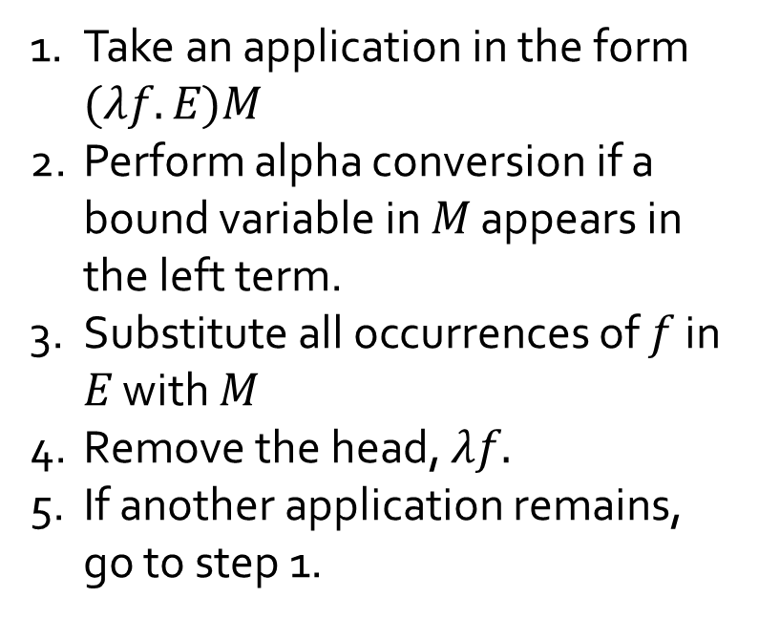
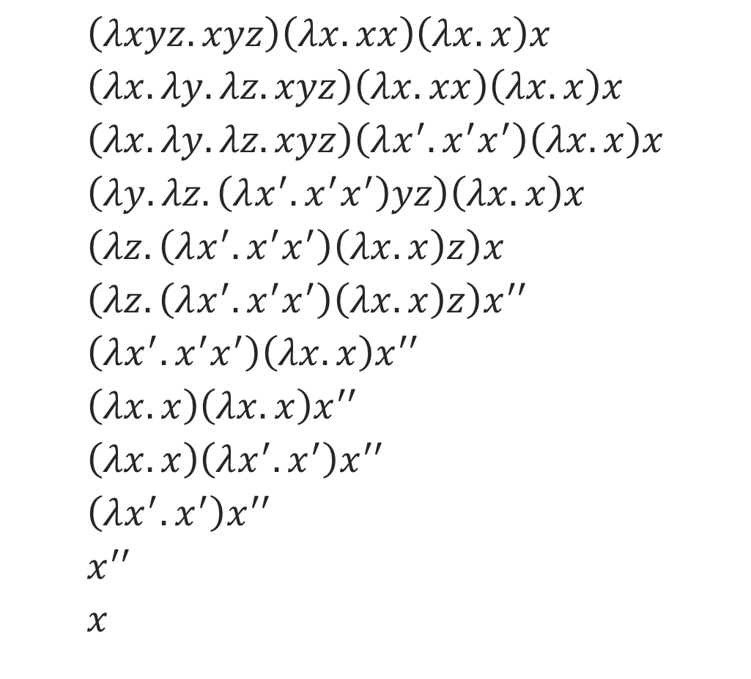
Beta Reduction
$$\left(λxyz.xyz\right)\left(λx.xx\right)\left(λx.x\right)x \\ \left(λx.λy.λz.xyz\right)\left(λx.xx\right)\left(λx.x\right)x \\ \left(λx.λy.λz.xyz\right)\left(λx^{′}.x^{′}x^{′}\right)\left(λx.x\right)x \\ \left(λy.λz.\left(λx^{′}.x^{′}x^{′}\right)yz\right)\left(λx.x\right)x \\ \left(λz.\left(λx^{′}.x^{′}x^{′}\right)\left(λx.x\right)z\right)x \\ \left(λz.\left(λx^{′}.x^{′}x^{′}\right)\left(λx.x\right)z\right)x^{′′} \\ \left(λx^{′}.x^{′}x^{′}\right)\left(λx.x\right)x^{′′} \\ \left(λx.x\right)\left(λx.x\right)x^{′′} \\ \left(λx.x\right)\left(λx^{′}.x^{′}\right)x^{′′} \\ \left(λx^{′}.x^{′}\right)x^{′′} \\ x^{′′} \\ x$$
Take an application in the form $(λf.E)M$
Perform alpha conversion if a bound variable in $M$ appears in the left term.
Substitute all occurrences of $f$ in $E$ with $M$
Remove the head, $λf.$
If another application remains, go to step 1.

Slide 9
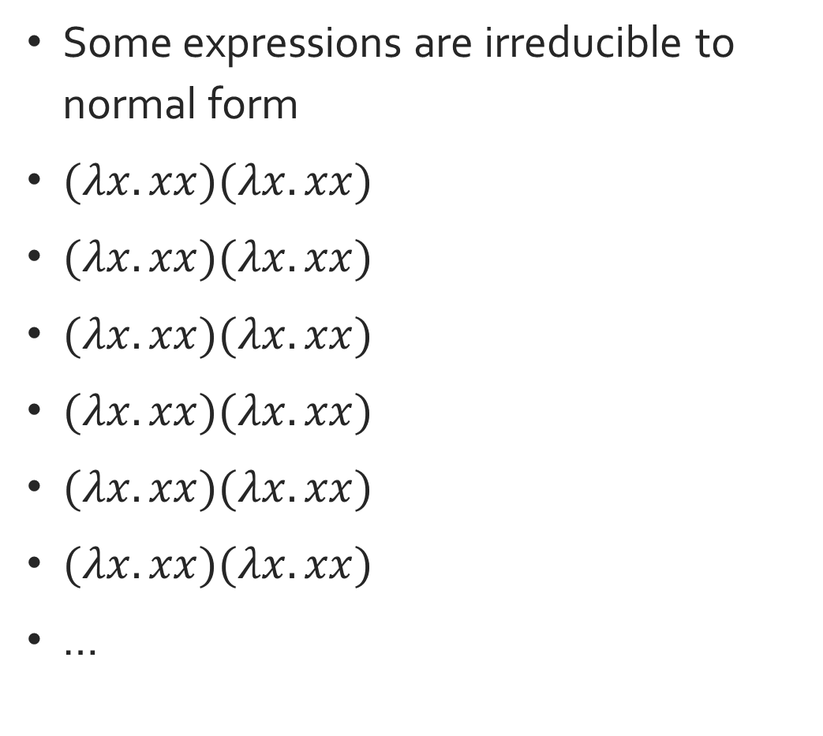
Divergence
Some expressions are irreducible to normal form
$(λx.xx)(λx.xx)$
$(λx.xx)(λx.xx)$
$(λx.xx)(λx.xx)$
$(λx.xx)(λx.xx)$
$(λx.xx)(λx.xx)$
$(λx.xx)(λx.xx)$
…

Slide 10
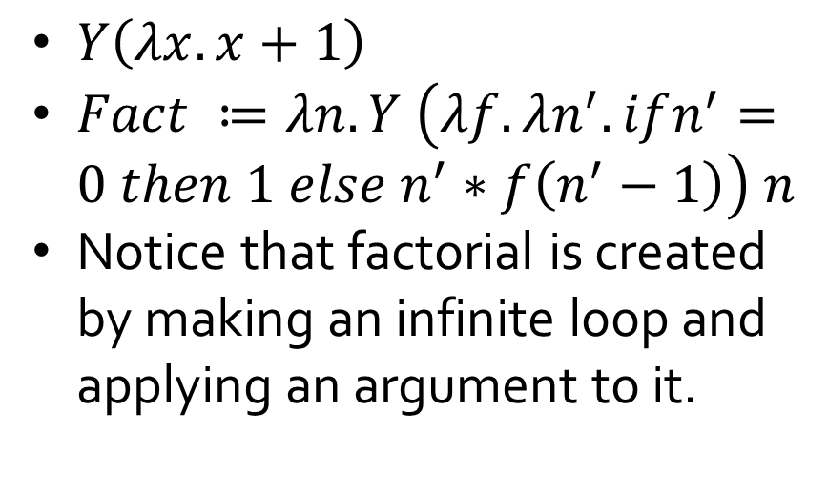
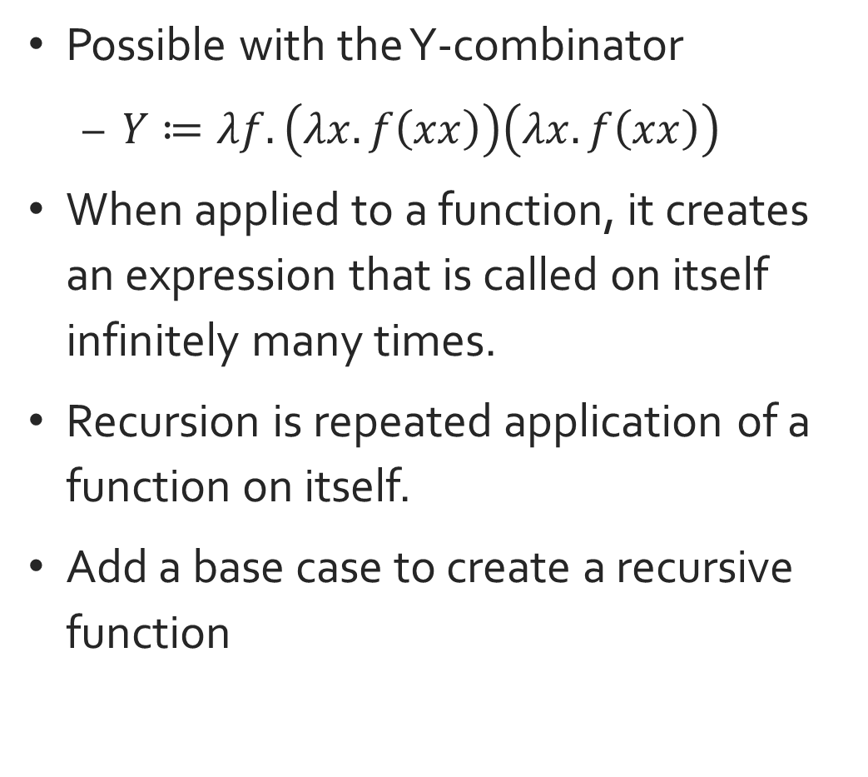
Recursion
Possible with the Y-combinator
$Y≔λf.\left(λx.f\left(xx\right)\right)\left(λx.f\left(xx\right)\right)$
When applied to a function, it creates an expression that is called on itself infinitely many times.
Recursion is repeated application of a function on itself.
Add a base case to create a recursive function
$Y\left(λx.x+1\right)$
$Fact ≔λn.Y \left(λf.λn^{′}.ifn^{′}=0 then 1 else n^{′}∗f\left(n^{′}−1\right)\right) n$
Notice that factorial is created by making an infinite loop and applying an argument to it.

Slide 11
More Information
2bdkid.github.io/lambda_quickstart.pdf

