Slide 1


COEN 506
Network Security and Cryptography
Lecture 1

Slide 2


Slide 3
Course Objectives
Understand basic issues, concepts, principles, and mechanisms in computer network security
  Basic security concept
  Authentication
  Standards
  Network Security
  Cryptography

Slide 4
Introduction

Slide 5
What is Security?
Security is the protection of assets.
The three main aspects are:
prevention
detection
re-action

Slide 6
Computer Security
deals with the prevention and detection of unauthorised actions by users of a computer system.
the protection afforded to an automated information system in order to attain the applicable objectives of preserving the integrity, availability and confidentiality of information system resources (includes hardware, software, firmware, information/data, and telecommunications)

Slide 7
Network Security
Taking Necessary measures to prevent attacks, intrusions, interference, damage and unauthorized use of the networks and information transmitted over network
Preventing unexpected accidents to help networks run in a stable and reliable state and ensure the integrity , confidentiality and availability of network information and data.

Slide 8
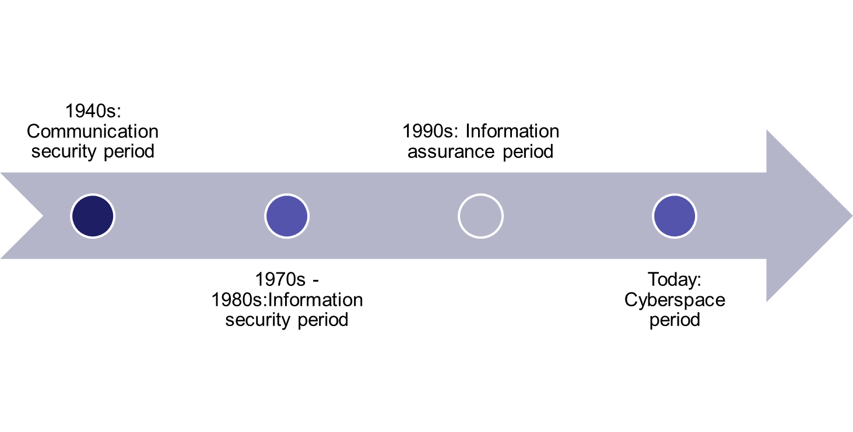
Evolution of Network Security

Slide 9
Communication Security Period
In the 40s, communication technologies were underdeveloped and data was stored in different locations
Information systems security was limited to ensuring physical security of information and confidentiality of communication security

Slide 10
Information Security Period
Application of computer and network technologies security grew into a large scale use and data transmission could be completed through computer networks
Main objective of security was to ensure integrity, availability and confidentiality

Slide 11
Information Assurance Period
The focus of information security advanced to inclusion of Controllability and non-repudiation in addition to confidentiality, availability and integrity
Controllability: puts monitoring in place to protect information and system from attacks
non-repudiation: to ensure neither sender or receiver can deny the information.

Slide 12
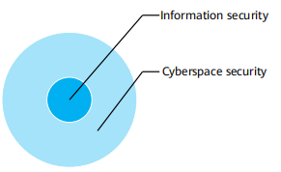
Cyberspace Security Period
The attention of information security expanded and upgraded to cyberspace security. With the aim of ensuring that the system security of the entire cyberspace including facilities , data, user and operations

Slide 13
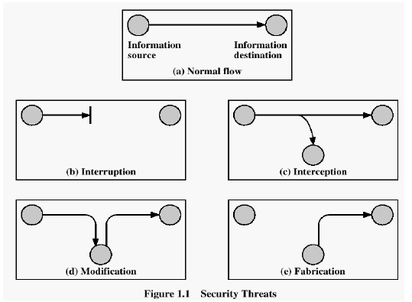
Security Attacks

Slide 14
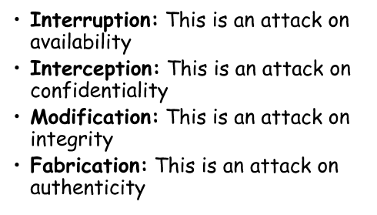
Security Attacks

Slide 15
Classify Security Attacks as
passive attacks - eavesdropping on, or monitoring of, transmissions to:
  obtain message contents, or
  monitor traffic flows
active attacks – modification of data stream to:
  masquerade of one entity as some other: man-in-the-middle
  replay previous messages
  modify messages in transit
  denial of service

Slide 16

Passive Attack - Interception
Notes:
A useful means of classifying security attacks, used both in X.800 and RFC 2828, is in terms of passive attacks and active attacks. A passive attack attempts to learn or make use of information from the system but does not affect system resources.
Passive attacks are in the nature of eavesdropping on, or monitoring of, transmissions. The goal of the opponent is to obtain information that is being transmitted. Two types of passive attacks are:
+ release of message contents - as shown above in Stallings Figure 1.2a here
+ traffic analysis - monitor traffic flow to determine location and identity of communicating hosts and could observe the frequency and length of messages being exchanged
These attacks are difficult to detect because they do not involve any alteration of the data.

Slide 17
Passive Attack: Traffic Analysis
Observe traffic pattern
Notes:
A useful means of classifying security attacks, used both in X.800 and RFC 2828, is in terms of passive attacks and active attacks. A passive attack attempts to learn or make use of information from the system but does not affect system resources.
Passive attacks are in the nature of eavesdropping on, or monitoring of, transmissions. The goal of the opponent is to obtain information that is being transmitted. Two types of passive attacks are:
+ release of message contents - as shown above in Stallings Figure 1.2a here
+ traffic analysis - monitor traffic flow to determine location and identity of communicating hosts and could observe the frequency and length of messages being exchanged
These attacks are difficult to detect because they do not involve any alteration of the data.

Slide 18
Active Attack: Interruption
Block delivery of message
Notes:
A useful means of classifying security attacks, used both in X.800 and RFC 2828, is in terms of passive attacks and active attacks. A passive attack attempts to learn or make use of information from the system but does not affect system resources.
Passive attacks are in the nature of eavesdropping on, or monitoring of, transmissions. The goal of the opponent is to obtain information that is being transmitted. Two types of passive attacks are:
+ release of message contents - as shown above in Stallings Figure 1.2a here
+ traffic analysis - monitor traffic flow to determine location and identity of communicating hosts and could observe the frequency and length of messages being exchanged
These attacks are difficult to detect because they do not involve any alteration of the data.

Slide 19
Active Attack: Fabrication
Fabricate message
Notes:
A useful means of classifying security attacks, used both in X.800 and RFC 2828, is in terms of passive attacks and active attacks. A passive attack attempts to learn or make use of information from the system but does not affect system resources.
Passive attacks are in the nature of eavesdropping on, or monitoring of, transmissions. The goal of the opponent is to obtain information that is being transmitted. Two types of passive attacks are:
+ release of message contents - as shown above in Stallings Figure 1.2a here
+ traffic analysis - monitor traffic flow to determine location and identity of communicating hosts and could observe the frequency and length of messages being exchanged
These attacks are difficult to detect because they do not involve any alteration of the data.

Slide 20

Active Attack: Replay
Notes:
Active attacks involve some modification of the data stream or the creation of a false stream and can be subdivided into four categories: masquerade, replay, modification of messages, and denial of service:
masquerade of one entity as some other
replay previous messages (as shown above in Stallings Figure 1.3b)
modify/alter (part of) messages in transit to produce an unauthorized effect
denial of service - prevents or inhibits the normal use or management of communications facilities
Active attacks present the opposite characteristics of passive attacks. Whereas passive attacks are difficult to detect, measures are available to prevent their success. On the other hand, it is quite difficult to prevent active attacks absolutely, because of the wide variety of potential physical, software, and network vulnerabilities. Instead, the goal is to detect active attacks and to recover from any disruption or delays caused by them.

Slide 21
Active Attack: Modification
Modify message
Notes:
Active attacks involve some modification of the data stream or the creation of a false stream and can be subdivided into four categories: masquerade, replay, modification of messages, and denial of service:
masquerade of one entity as some other
replay previous messages (as shown above in Stallings Figure 1.3b)
modify/alter (part of) messages in transit to produce an unauthorized effect
denial of service - prevents or inhibits the normal use or management of communications facilities
Active attacks present the opposite characteristics of passive attacks. Whereas passive attacks are difficult to detect, measures are available to prevent their success. On the other hand, it is quite difficult to prevent active attacks absolutely, because of the wide variety of potential physical, software, and network vulnerabilities. Instead, the goal is to detect active attacks and to recover from any disruption or delays caused by them.

Slide 22
Handling Attacks
  Passive attacks – focus on Prevention
    Easy to stop
    Hard to detect
  Active attacks – focus on Detection and Recovery
    Hard to stop
    Easy to detect
Notes:
Consider the role of a security service, and what may be required.
Note both similarities and differences with traditional paper documents, which for example:
have signatures & dates;
need protection from disclosure, tampering, or destruction;
may be notarized or witnessed;
may be recorded or licensed

Slide 23
Contributing Factors
Lack of awareness of threats and risks of information systems
Wide-open network policies
  Many Internet sites allow wide-open Internet access
Vast majority of network traffic is unencrypted
Lack of security in TCP/IP
Complexity of security management and administration
Exploitation of software bugs: e.g. Sendmail bugs
Cracker skills keep improving

Slide 24
Levels of Impact
Impact from a security breach can be defined in three levels :
  Low
  Moderate
  High
Notes:
We can define three levels of impact on organizations or individuals should there be a breach of security (i.e., a loss of confidentiality, integrity, or availability). These levels are defined in FIPS PUB 199:
• Low: The loss could be expected to have a limited adverse effect on organizational operations, organizational assets, or individuals. A limited adverse effect means that, for example, the loss of confidentiality, integrity, or availability might (i) cause a degradation in mission capability to an extent and duration that the organization is able to perform its primary functions, but the effectiveness of the functions is noticeably reduced; (ii) result in minor damage to organizational assets; (iii) result in minor financial loss; or (iv) result in minor harm to individuals.
• Moderate: The loss could be expected to have a serious adverse effect on organizational operations, organizational assets, or individuals. A serious adverse effect means that, for example, the loss might (i) cause a significant degradation in mission capability to an extent and duration that the organization is able to perform its primary functions, but the effectiveness of the functions is significantly reduced; (ii) result in significant damage to organizational assets; (iii) result in significant financial loss; or (iv) result in significant harm to individuals that does not involve loss of life or serious, life-threatening injuries.
• High: The loss could be expected to have a severe or catastrophic adverse effect on organizational operations, organizational assets, or individuals. A severe or catastrophic adverse effect means that, for example, the loss might (i) cause a severe degradation in or loss of mission capability to an extent and duration that the organization is not able to perform one or more of its primary functions; (ii) result in major damage to organizational assets; (iii) result in major financial loss; or (iv) result in severe or catastrophic harm to individuals involving loss of life or serious life threatening injuries.

Slide 25
Security Objectives
Confidentiality (Secrecy):
Prevent/Detect/Deter improper disclosure of information
Integrity:
Prevent/Detect/Deter improper modification of information
Availability:
Prevent/Detect/Deter improper denial of access to services provided by the system

Slide 26
Security Services
Confidentiality: protection of any information from being exposed to unintended entities.
  Information content
  Parties involved
  Where they are, how they communicate, how often, etc.
Authentication(Availability): assurance that an entity of concern or the origin of a communication is authentic - it’s what it claims to be or from
Integrity: assurance that the information has not been tampered with

Slide 27
Security Services
Non-repudiation: offer of evidence that a party is indeed the sender or a receiver of certain information
Access control: facilities to determine and enforce who is allowed access to what resources, hosts, software, network connections
Security management: facilities for coordinating users’ service requirements and mechanism implementations throughout the enterprise network and across the internet
– Trust model
– Trust communication protocol
– Trust management infrastructure

Slide 28


