Slide 1
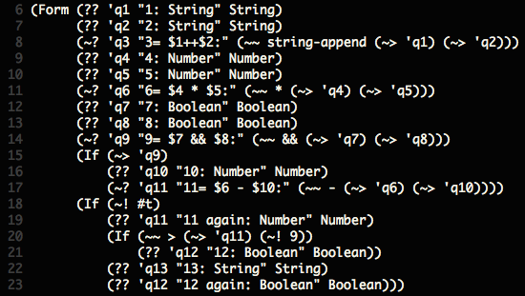
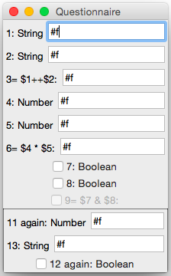
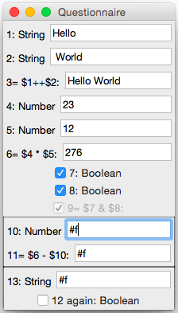
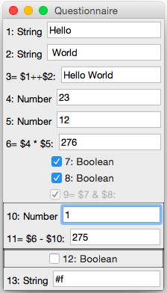
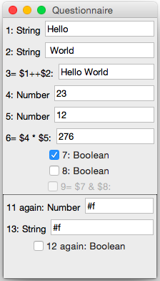
ordinary question
computed question
question name (variable)
expected type of answer
first
group
label shown to user
nested
group of
second
group
second
group
expression of computation
(a) questionnaire source code
(b) original GUI, without user input (all values undefined), first and nested group of second group not shown (question 9 & 11 are undefined), the second group is always shown (constant true)
(c) after answering questions 1—8, first group shown (computed question 9 evaluates to true) shadowing the original question 11 with its computed version
(d) after answering questions 10, question 11 is defined; its value is > 9 such that the nested group is shown and its question 12 shadows the original version
(e) deselecting question 8 deactivates the first group, such that the original questions 11 & 12 are active again

