Slide 1
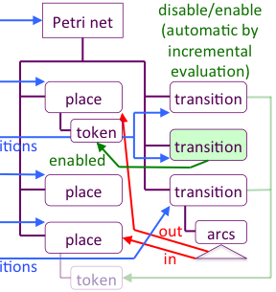
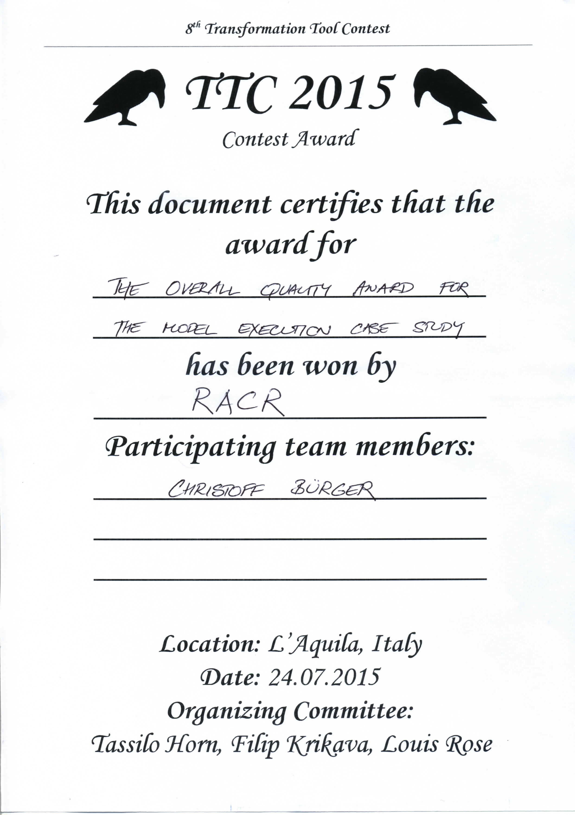
fUML Activity Diagrams with RAG-controlled rewriting
A RACR solution of the 8th Transformation Tool Contest
TTC 2015 task: execution of fUML Activity Diagrams.
= true
RACR solution: diagram to Petri net interpreter, uses a reference attribute grammar to
deduce memoized abstract syntax graph well-suited for execution by rewriting.
memoized, deduced abstract syntax graph
reuse of enabled analysis permits convenient, focused rewrite specification
incremental
enabled analysis
RAG-controlled rewriting: declarative, seamless combination of reference attribute grammars & graph rewriting (RACR: reference implementation, Scheme library).
transformation-aware RAG-based analyses (incremental evaluation)
analyse-aware rewrite-based transformations (analyses deduce rewrites)
mutual control
Efficient Analyses
Efficient Rewriting
Programmed /
RAG Controlled Rewriting
RACR
Christoff Bürger (christoff.burger@cs.lth.se, https://github.com/christoff-buerger/racr)
Dept. of Computer Science, Faculty of Engineering, LTH, Lund University, Lund, Sweden

