Slide 1
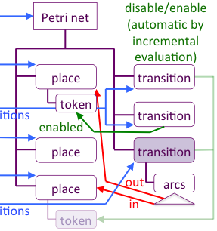
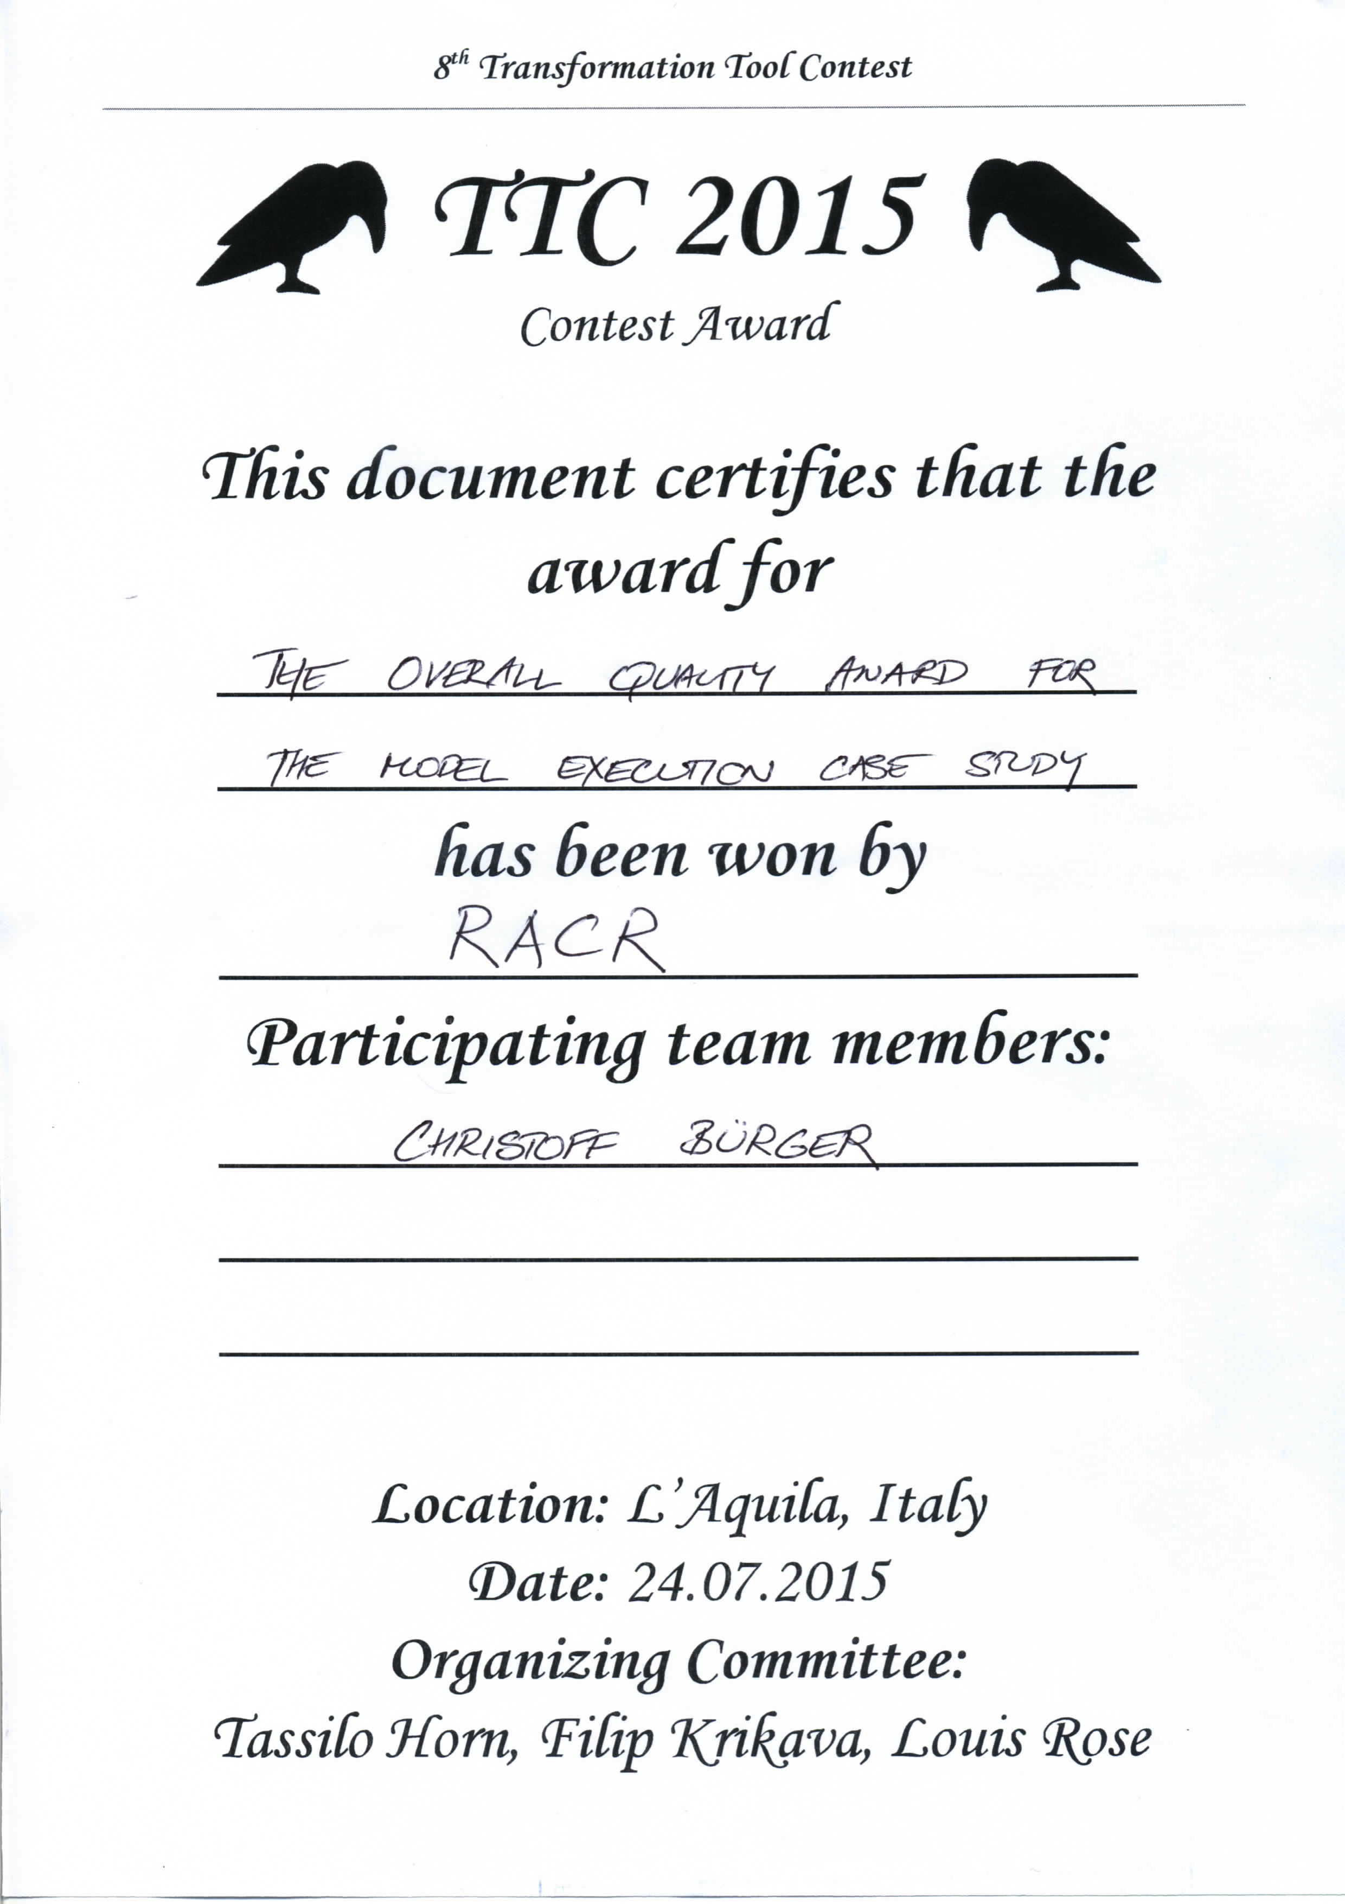
fUML Activity Diagrams with RAG-controlled Rewriting
A RACR Solution of the 8th Transformation Tool Contest
TTC 2015 task: execution of fUML Activity Diagrams.
= true
RACR Solution: diagram to Petri net interpreter, uses a reference attribute grammar to
deduce memoized abstract syntax graph well-suited for execution by rewriting.
Original Input Tree
Derived Petri Net
memoized, deduced abstract syntax graph
activity
petrinet
Petri net
incoming
place
variable
edge
node
place
transition
reuse of enabled analysis permits convenient, focused rewrite specification
variable
edge
outgoing
transitions
transition
edge
node
place
place
transition
edge
node
place
place
out
arcs
expr.
transitions
token
in
enabled
incremental
enabled analysis
v-lookup
semantic overlay graph (excerpt):  name analysis  code generation  enabled analysis
RAG-controlled rewriting: declarative, seamless combination of reference attribute grammars & graph rewriting (RACR: reference implementation, Scheme library).
transformation-aware RAG-based analyses (incremental evaluation)
analyse-aware rewrite-based transformations (analyses deduce rewrites)
mutual control
Efficient Analyses
Efficient Rewriting
Programmed /
RAG Controlled Rewriting
RACR
Christoff Bürger (christoff.buerger@cs.lth.se, https://github.com/christoff-buerger/racr)
Dept. of Computer Science, Faculty of Engineering, LTH, Lund University, Lund, Sweden

