Slide 1
fUML Activity Diagrams with RAG-controlled rewriting
A RACR¹ solution of The TTC 2015 Model Execution Case
Christoff Bürger
Department of Computer Science, Faculty of Engineering, LTH
Lund University Lund, Sweden
christoff.burger@cs.lth.se
¹ https://github.com/christoff-buerger/racr

Slide 2
TTC 2015 background

Slide 3
8th Transformation Tool Contest
Task: execution of fUML Activity Diagrams.
= true

Slide 4
8th Transformation Tool Contest

Slide 5
RACR solution background

Slide 6
General solution idea
Interpreter consisting of two parts …
Activity Diagram → Petri net compiler (analyses)
Petri net interpreter (state transformations)
… implemented using RAG-controlled rewriting.

Slide 7
RAG-controlled rewriting
RAG-controlled rewriting = RAGs + graph rewriting
reference attribute grammar for declarative analyses
reference attributes induce semantic overlay graph on top of abstract syntax tree (AST) >> extend AST to ASG
enables deduction and analyses of graph structure
>> deduced, memoized abstract syntax graph (ASG)
graph rewriting for ASG transformations
left hand: ASG pattern (ASTs connected via reference attributes)
right hand: manipulations on matched, underlying AST
>> ASG changes with AST (updated by RAG)
seamless combination:
use of analyses to deduce rewrites
rewrites automatically update analyses
>> incremental
mutual control

Slide 8
RACR
reference implementation of RAG-controlled rewriting in Scheme
R6RS library; API for:
ASG schema definition (AST schema + attribution)
ASG querying (AST + attributes)
rewriting (imperative/RAG-controlled/fixpoint; primitive/pattern-based; or combination of all)
https://github.com/christoff-buerger/racr

Slide 9
Solution

Slide 10
fUML Activity Diagram compiler
attributes for:
name analysis (symbolic name resolution)
incoming & outgoing edges
variables
type analysis (expression types)
well-formedness analysis (only TTC solution that rejects malformed diagrams)
code generation (i.e., Petri net generation)
reference attributes

Slide 11
fUML Activity Diagram → Petri net

Slide 12
fUML Activity Diagram → Petri net

Slide 13
Petri net interpreter
attributes for:
name analysis
well-formedness analysis
enabled analysis (kind of name analysis)
rewrites for execution (firing)
delete consumed tokens
add produced tokens
reuse

Slide 14
ASG
initial tree
(original input diagram)
derived Petri net
activity
petrinet
Petri net
incoming
variable
edge
node
place
place
transition
variable
edge
outgoing
transitions
transition
edge
node
place
place
transition
edge
node
place
place
out
arcs
transitions
in
expr.
token
enabled
v-lookup
semantic overlay graph (excerpt):  name analysis  code generation  enabled analysis

Slide 15
Execution (RAG-controlled rewriting)
initial tree
(original input diagram)
derived Petri net
activity
petrinet
Petri net
incoming
variable
edge
node
place
place
transition
variable
edge
outgoing
token
transitions
produce!
transition
edge
node
place
place
transition
fire!
edge
node
place
place
out
arcs
transitions
in
expr.
token
enabled
consume!
v-lookup
semantic overlay graph (excerpt):  name analysis  code generation  enabled analysis

Slide 16
Execution (RAG-controlled rewriting)
initial tree
(original input diagram)
derived Petri net
activity
petrinet
Petri net
disable/enable
(automatic by
incremental
evaluation)
incoming
variable
edge
node
place
place
transition
variable
edge
outgoing
token
transitions
transition
enabled
edge
node
place
place
transition
edge
node
place
place
out
arcs
transitions
in
expr.
token
v-lookup
semantic overlay graph (excerpt):  name analysis  code generation  enabled analysis

Slide 17
Evaluation

Slide 18
Implementation quality
straightforward rewriting thanks to attribute-based analysis (rewrites leverage on analyses)
focused rewriting (just actual state changes)
efficient, although naïvely specified (incremental)
declarative (automatic deduction of evaluation orders for intertwined analyses & rewriting)
interactive (convenient runtime API for user-driven analyses & state changes)

Slide 19
Lines of code
no further software artefacts

Slide 20
Performance
execution times in ms
(cf. solution description)

Slide 21
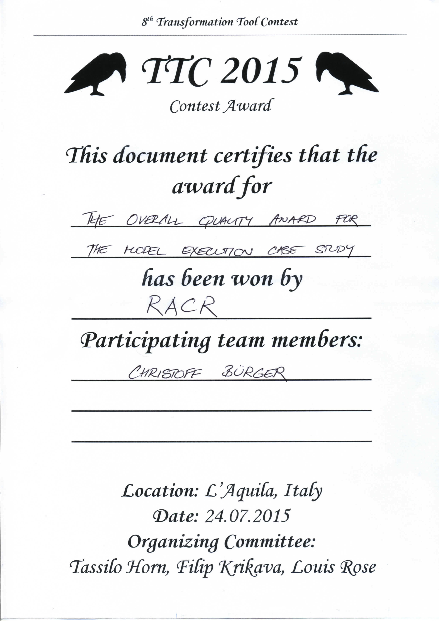
Conclusion

Slide 22
Benefits of RAG-controlled rewriting
interactive
…
runtime models
declarative
incremental
meta programming
IDEs
incremental reasoning
model transformation
…
Efficient Analyses
Efficient Rewriting
Programmed /
RAG Controlled Rewriting
RACR

