Slide 1

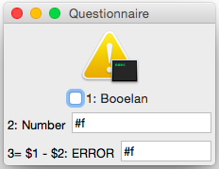
not well-formed warning
The questionnaire can still be used. Computations are performed; computations on undefined yield undefined. In group conditions, undefined is treated as false.
(a) erroneous questionnaire (subtracting from a Boolean value is a type error)

