Slide 1



Stay quiet,
and Run wild
Mobile Resource Delivery for
Time Competing Stations
Presenter：叶璨铭(YeCanming)

Slide 2



目录
CATALOGUE
Introduction
to MRDTCS
3 Dimensional
Formalization
Heuristic Methods by
EDA
Experiments
2

Slide 3

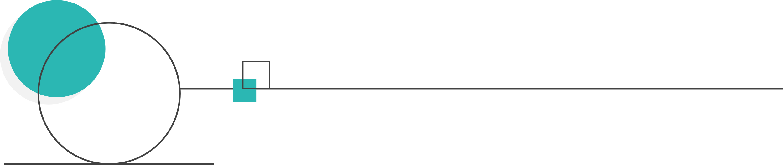
1
Introduction

Slide 4





Problem Formulation
Introduction
Single objective
Bound constrained
Numerical，Not Combinatorial
Minimize
Rule: black box, budget limited.

Slide 5
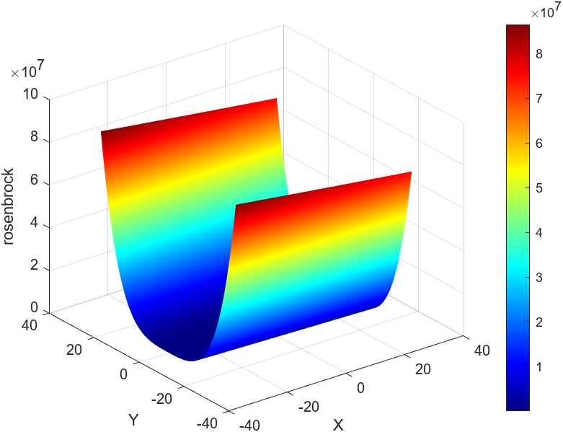
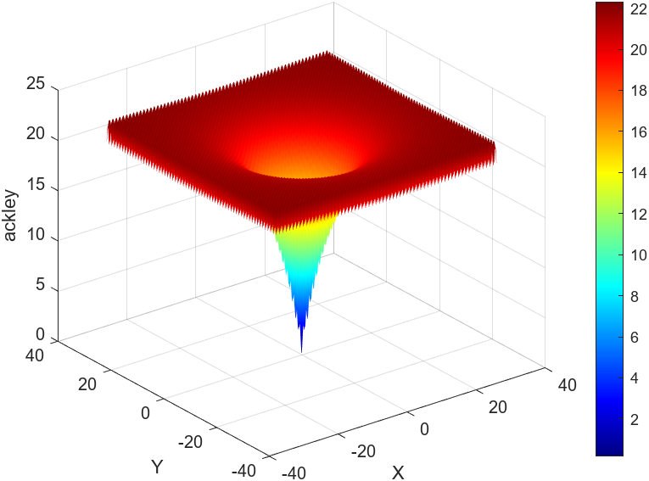
Type of functions
Introduction
Deterministic vs Stochastic
Unimodol vs Multimodol
Are them unimodol?
FEP should be faster on Unimodol
FEP should be beter on Multimodol
Differentialable vs not Differentialable
Hartigan’s dip test
Notes:
Yes, No

Slide 6
2
Engineering Difficulty

Slide 7
Abstraction for evo operators
Engineering difficulty
Operators are Mappings in Population Space
Population Initialization Operators
Lecture2: Recombination and Mutation
Lecture3: Population Selection Operators
Hyper parameters Initialization，Update and Selection

Slide 8
Abstraction of algorithm
Engineering difficulty
The Strategy Tree
Uniform Reset
Uniform Initialzation
Normal Mutation
Tournament Selection q=10
Cauthy Mutation
Tournament Selection q=50
Gaussian Initialzation
Student T Mutation
Tournament Selection q=100

Slide 9
Abstraction of algorithm
Engineering difficulty
The Design Pattern:
strategy pattern
template method pattern
abstract factory pattern

Slide 10
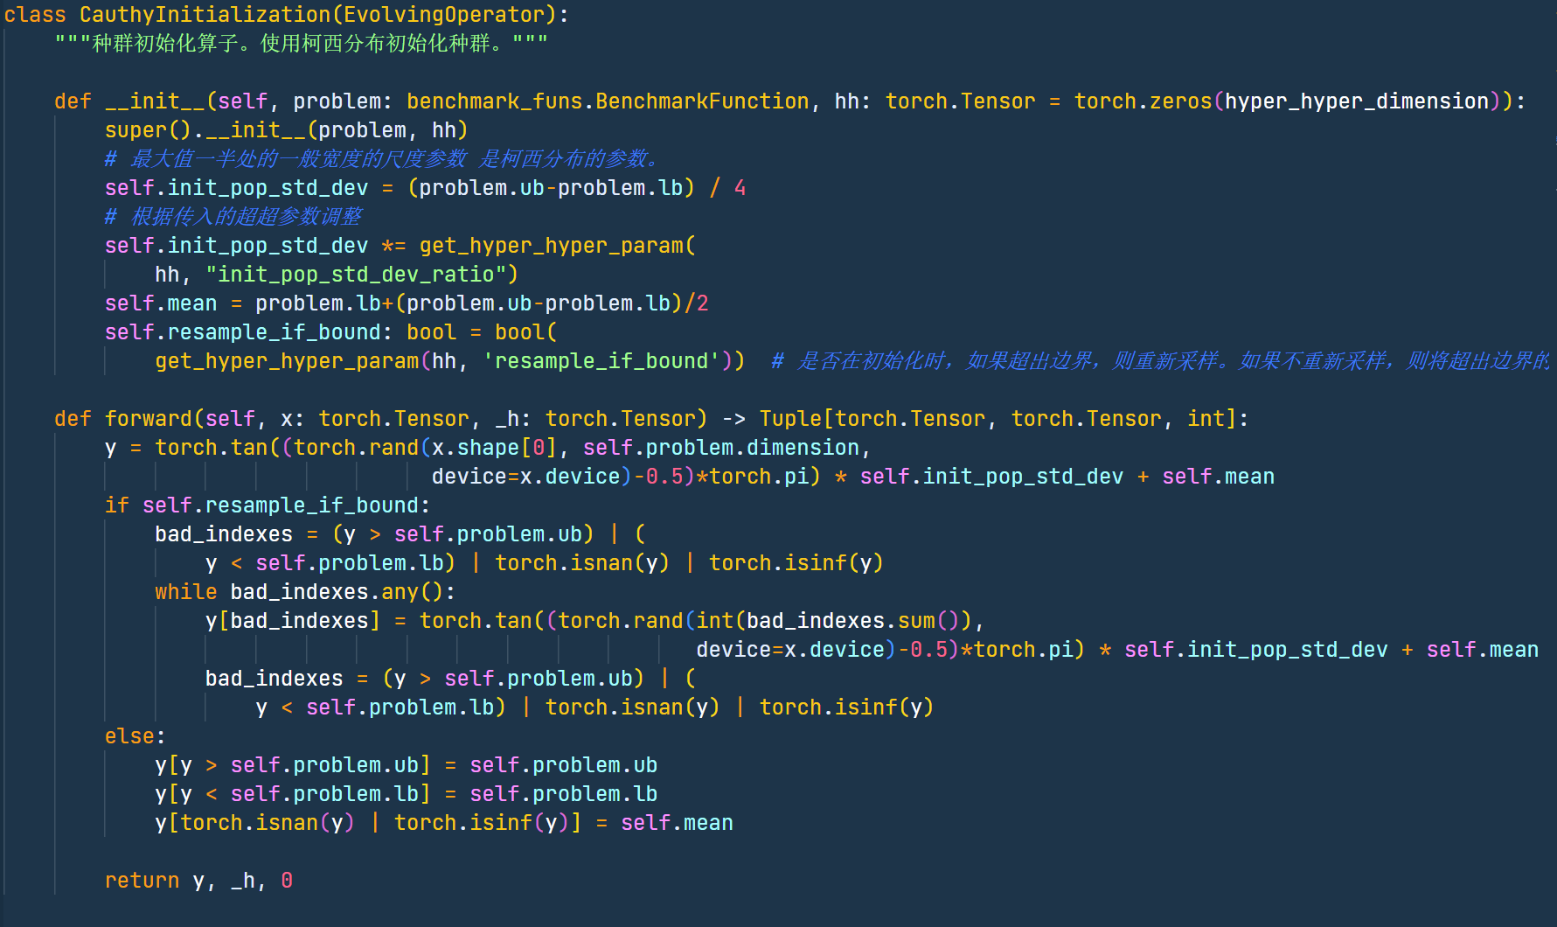
Implementation of Strategies(Python)
Engineering difficulty

Slide 11
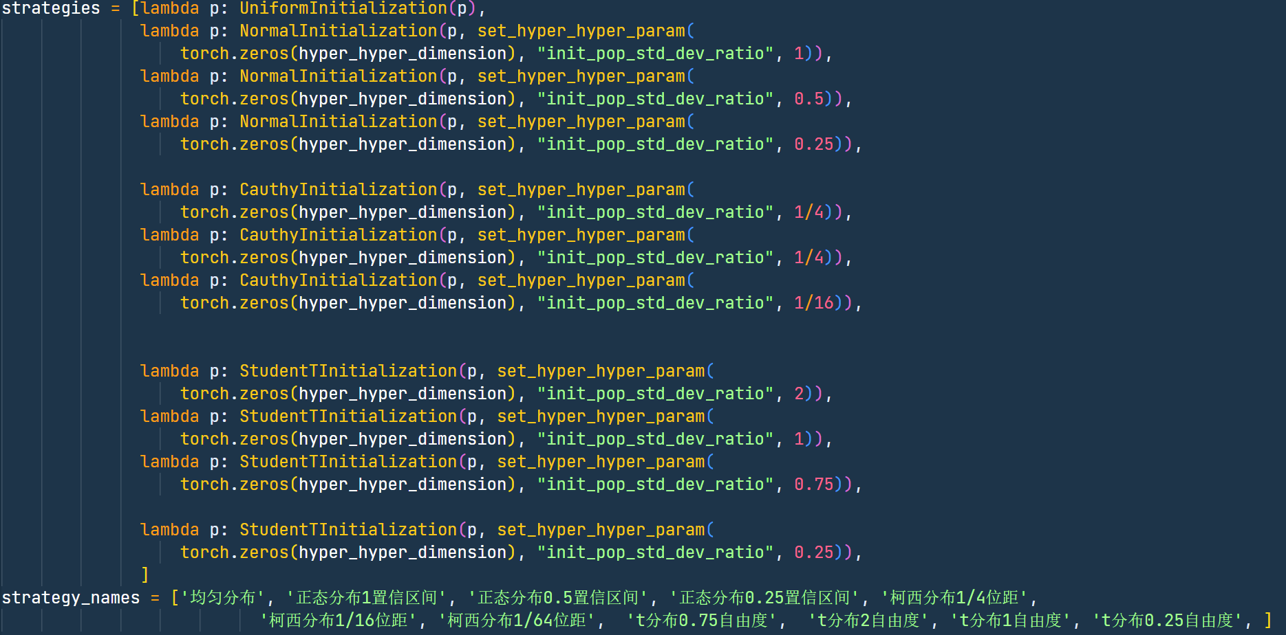
Implementation of Strategies(Python)
Engineering difficulty

Slide 12
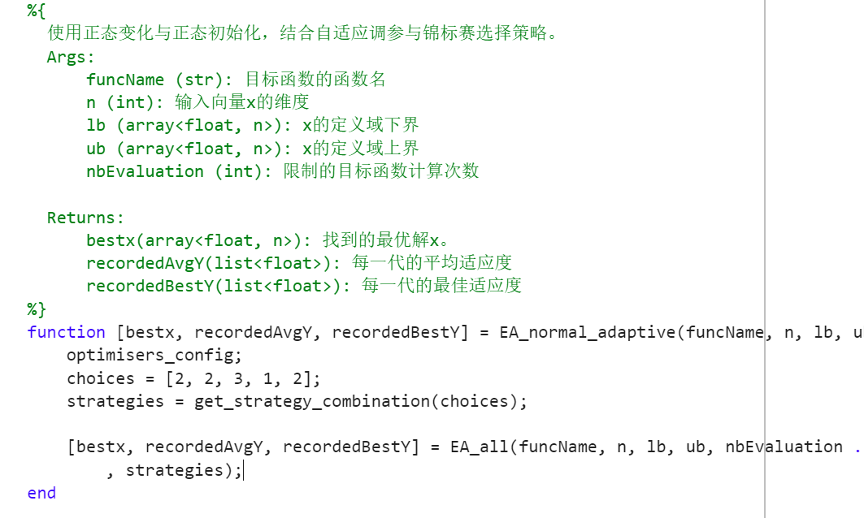
Implementation of Algorithms(MATLAB)
Engineering difficulty

Slide 13



Implementation of Cauthy
Engineering difficulty

Slide 14
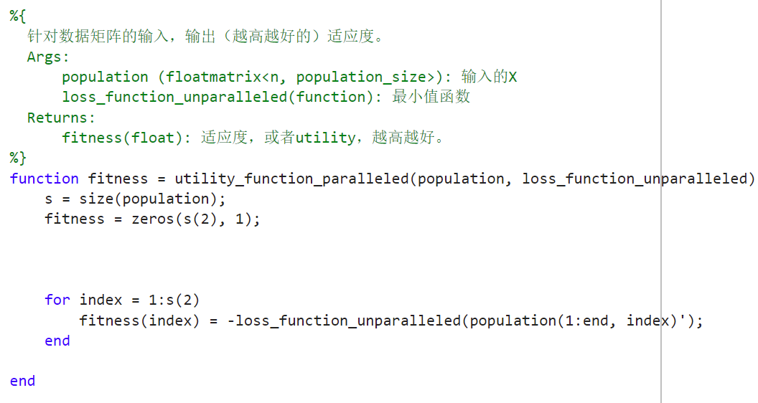
MATLAB is Slow
Engineering difficulty
Fitness function is not vectorize, 6.10 times slower than python

Slide 15
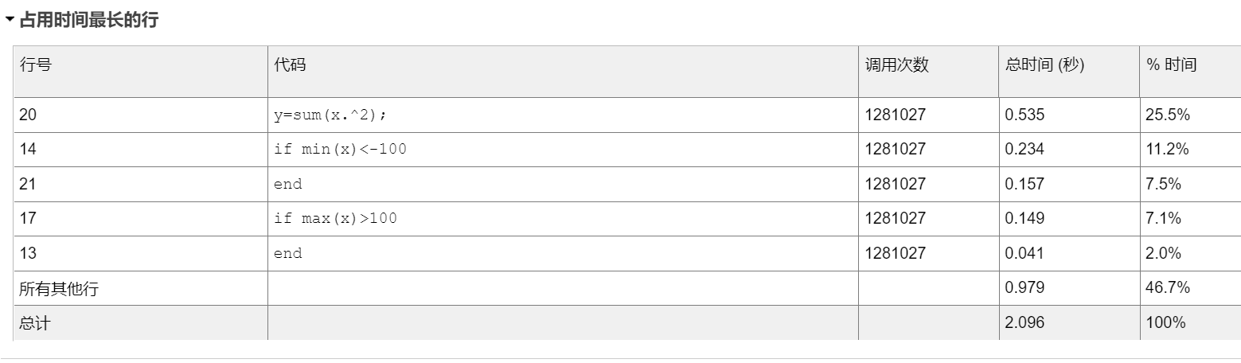
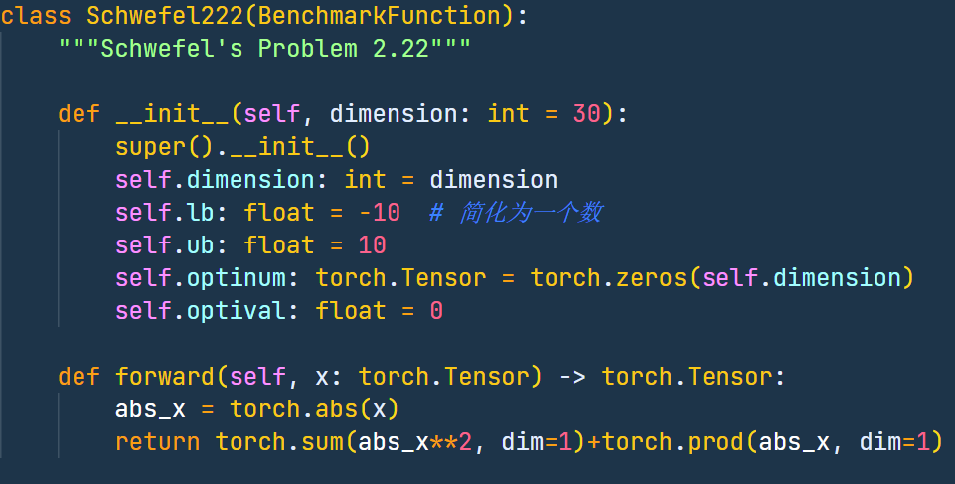
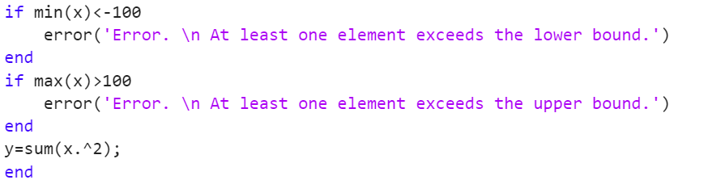
MATLAB is Slow
Engineering difficulty
Weak abstraction ability entails tedious checking code consumes much times.

Slide 16
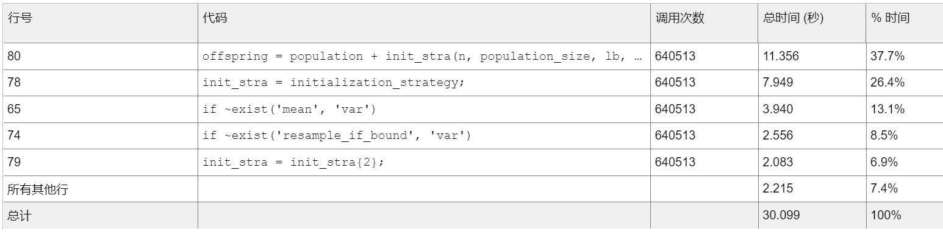
MATLAB is Slow
Engineering difficulty
MATLAB syntax practice waste much performance

Slide 17
3
Strategy Evolving Algorithm

Slide 18
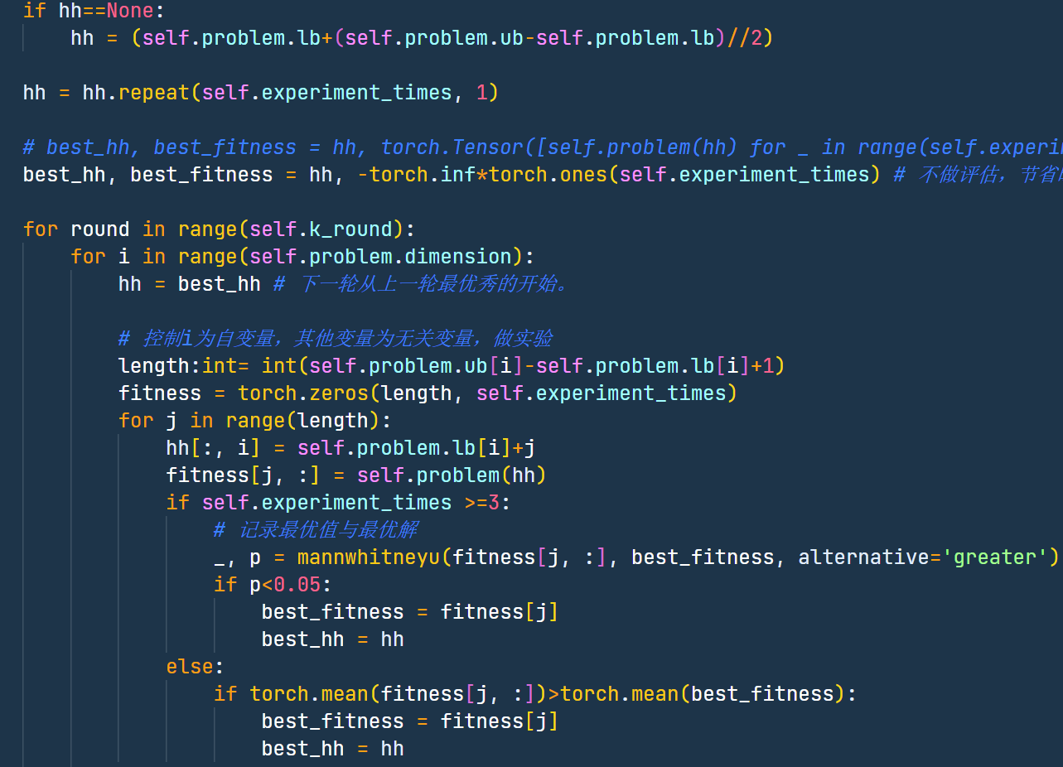
Student Tuning Experiment
Strategy Evolving Algorithm

Slide 19
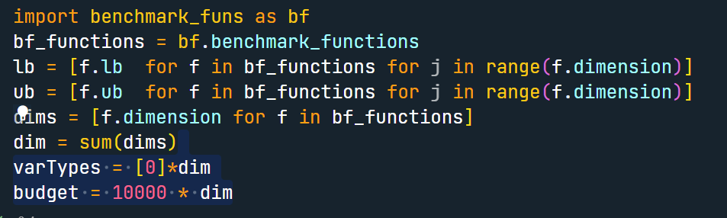
Aggregate Evolving
Strategy Evolving Algorithm

Slide 20
Near Zero is all you need?
Strategy Evolving Algorithm

Slide 21
4
Futher plans

Slide 22
Future Plans
Mixture-of-Experts Layer

Slide 23
Future Plans
Convert it to Gradient based optimization
Design a reward function to make it reinforcement learning
Design the action model and perception model to make it bayesian filter
Make the population size changeable
What if there is the reset probability is 1？

Slide 24

Thanks

