Slide 1
Leveraging Stable Diffusion for Monocular Depth Estimation via Image Semantic Encoding
Authors: Jingming Xia, Guanqun Cao, Guang Ma, Yiben Luo, Qinzhao Li, John Oyekan

Slide 2
Background & Motivation
Approaches | Input | Characteristic
Traditional Depth Sensing | Data from Specialized hardware (LiDAR; Depth Cameras) | Expensive or Impractical for certain applications
Monocular Depth Estimation | Single RGB Image | Cost-effective
Training Stability
Generalization Ability
High Computational Cost
Contrastive Language-Image
Pre-training (CLIP)
Hard to Train
CNN
GAN
General Diffusion
Model
Stable Diffusion
Deep-Learning Based Monocular Depth Estimation Approaches
CLIP: mapping textual descriptions to incorporate semantic context with image features
However, in complex outdoor scenes, accurate text prompts are hard to create due to diverse and complex visuals.
Notes:
Gan ： model collapse / convergence issue

Slide 3
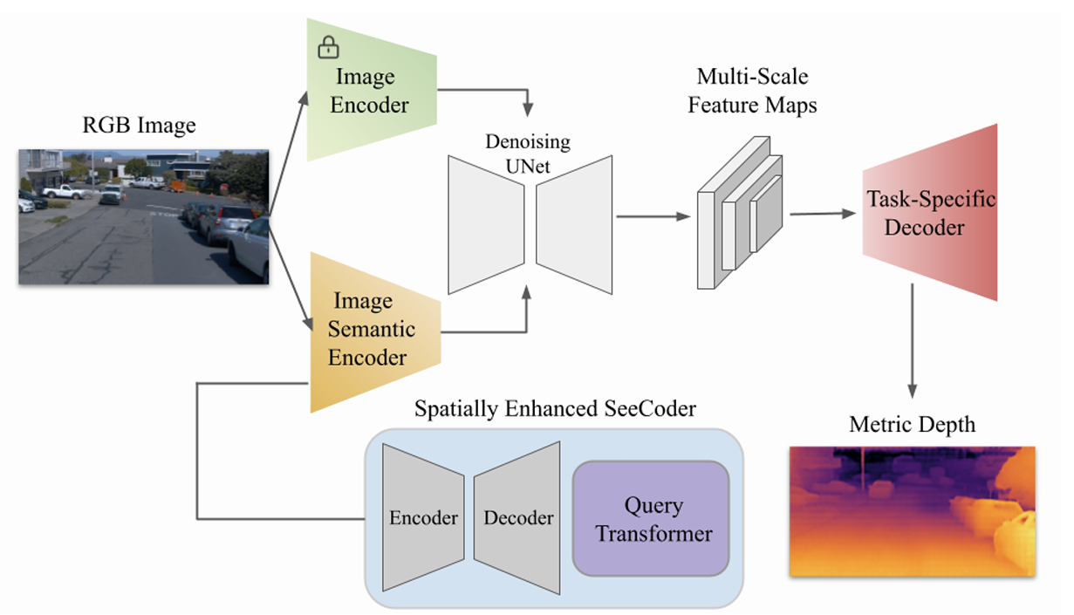
Methodology - Overview
Directly extract semantic context from images without relying on textual descriptions.
Notes:
describe

Slide 4


Methodology – Latent Feature Extractor
RGB
Image
Image
Encoder
Latent Features
z
$$z=E_{VAE}\left(x\right), x∈{\text{ℝ}}^{H×W×3}$$
The output compact and informative representations is leveraged for the subsequent depth map generation.
This module captures essential features while discarding irrelevant details, reducing computational cost and easing convergence.
Notes:
Encoders : Encoder of a pre-trained variational autoencoder (VAE)
Parameters of encoders is frozen

Slide 5
Methodology – Spatially Enhanced Semantic Encoder
Dilated Convolution
& Spatial Attention
SWIN-L
Encoder
Query
Transformer
Decoder
Image
Semantic
Encoder
148
Semantic
Vectors
144 Local Query
RGB
Image
4 Global Query
1. SWIN-L backbone encoder convert images into multi scale feature maps.
2. These feature maps are up-sampled through the decoder to obtain refined multi scale representations.
3. These representations are fed into Transformer to generate semantic vectors by cross-attn and self-attn.
Notes:
144 Local queries perform cross-attention with the decoder’s multi-scale feature maps to focus on specific regions,
4 global queries concatenate with the local queries and perform self-attention to capture overall context

Slide 6
Methodology – Denoising UNet
Latent Features z
Multi-Scale
Feature Maps
Encoder
Decoder
Semantic Vectors
skip connections
The denoising UNet reconstructs the depth map from the noisy latent representations.
To integrate semantic guidance, the denoising UNet applies cross-attn with semantic embeddings.
Notes:
The encoder and decoder are connected through skip connections, enabling the network to capture both global context and fine-grained details effectively
This cross-attn helps the UNet focus on relevant semantic cues during both upsampling and downsampling, improving depth map accuracy across multiple scales.

Slide 7
Methodology – Task-Specific Decoder
Multi-Scale
Feature Maps
Task-Specific
Decoder
Metric Depth
DeConv
Conv
Upsamp: bilinear interpolation
The final output is a high-resolution metric depth map, effectively capturing detailed spatial information from the input feature representations.
Notes:
The combination of deconvolution and bilinear upsampling enables efficient feature refinement and enhances spatial resolution without significantly increasing computational complexity.

Slide 8
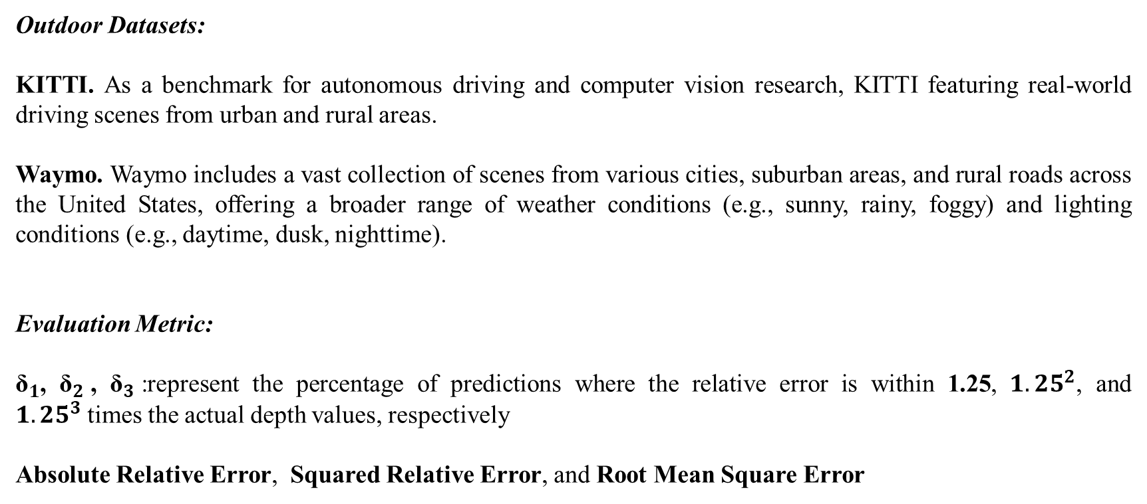
Experiments - Setup
Outdoor Datasets:
KITTI. As a benchmark for autonomous driving and computer vision research, KITTI featuring real-world driving scenes from urban and rural areas.
Waymo. Waymo includes a vast collection of scenes from various cities, suburban areas, and rural roads across the United States, offering a broader range of weather conditions (e.g., sunny, rainy, foggy) and lighting conditions (e.g., daytime, dusk, nighttime).
Evaluation Metric:
${\text{δ}}_{1}$, ${\text{δ}}_{2}$, ${\text{δ}}_{3}$:represent the percentage of predictions where the relative error is within 1.25, ${1.25}^{2}$, and ${1.25}^{3}$times the actual depth values, respectively
Absolute Relative Error, Squared Relative Error, and Root Mean Square Error
Notes:
describe

Slide 9
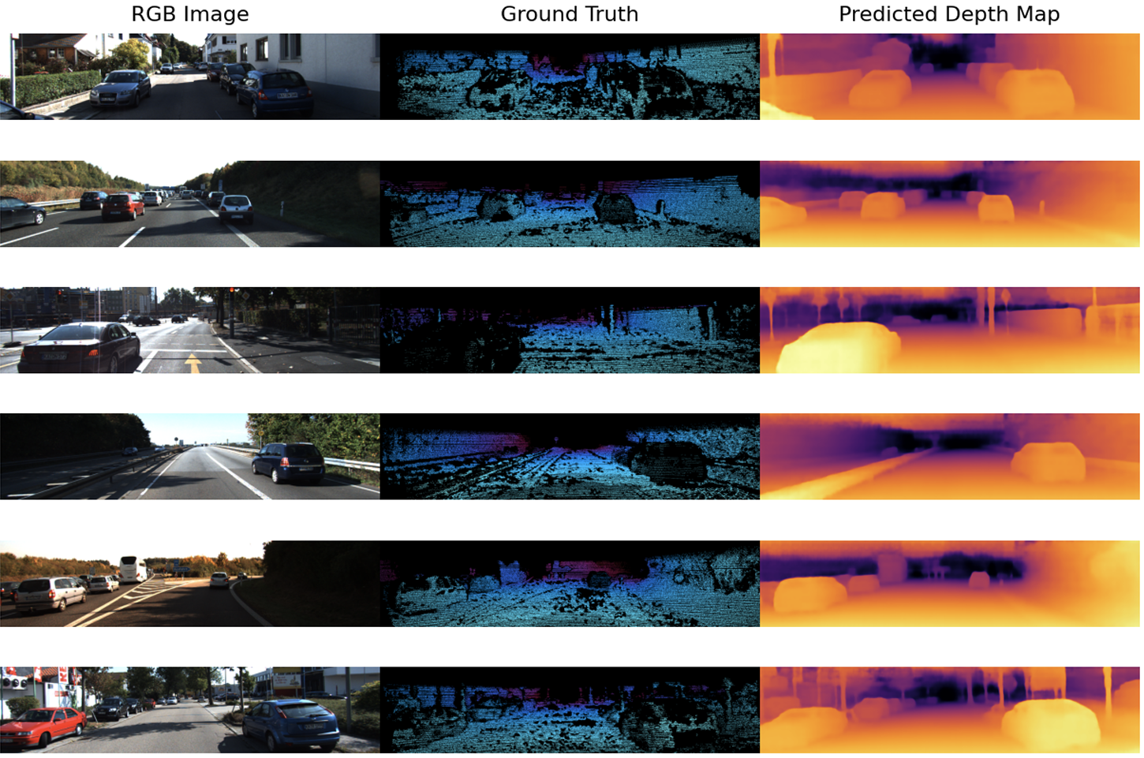
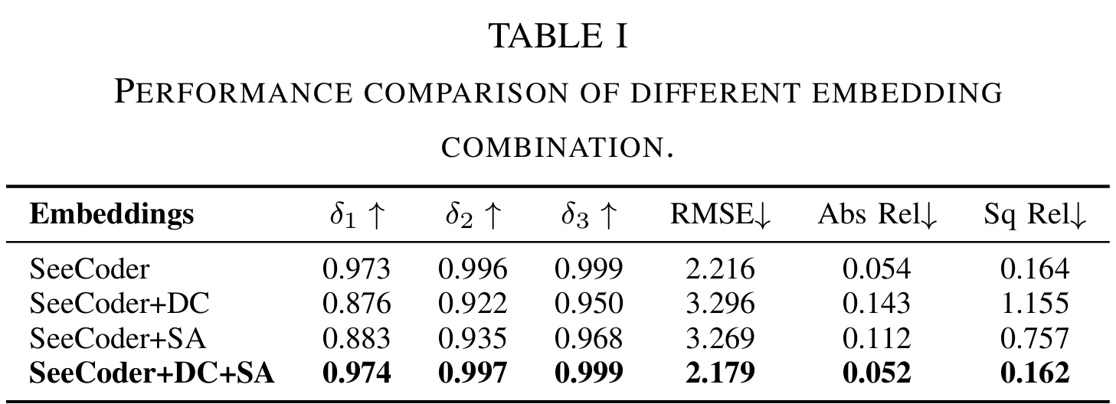
Experiments – Results on KITTI
Ablation Study
The visualization of selected samples from the KITTI dataset.
Notes:
describe

Slide 10
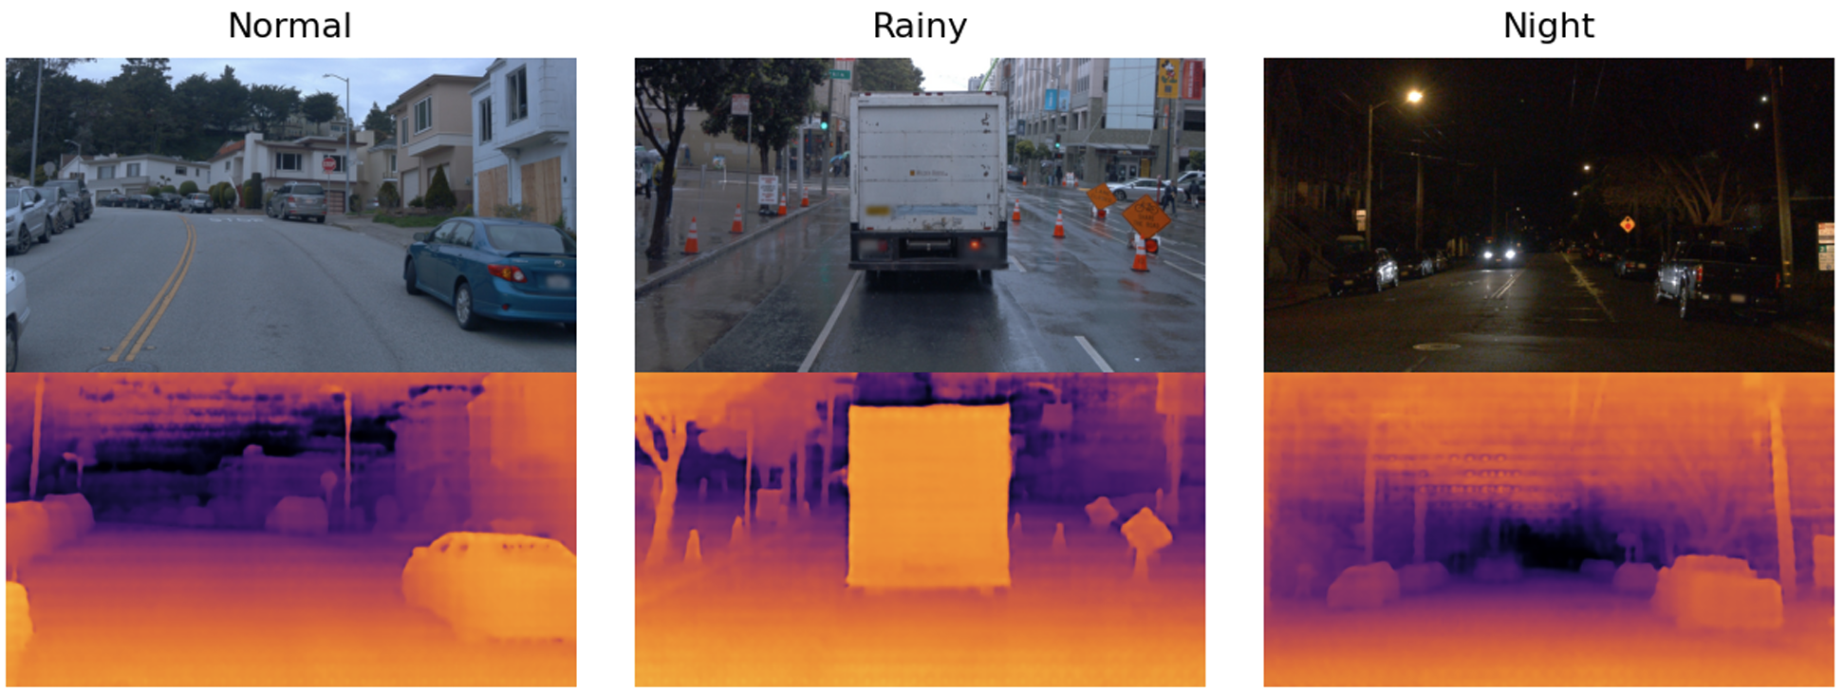
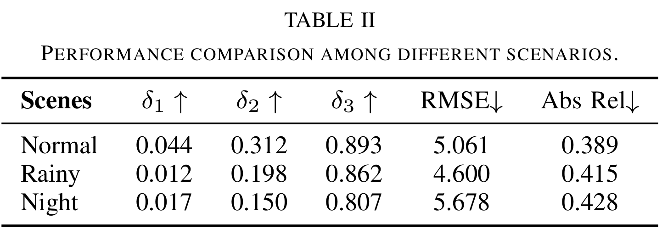
Experiments – Results on Waymo
The visualization of selected samples from the Waymo dataset.
Notes:
describe

Slide 11
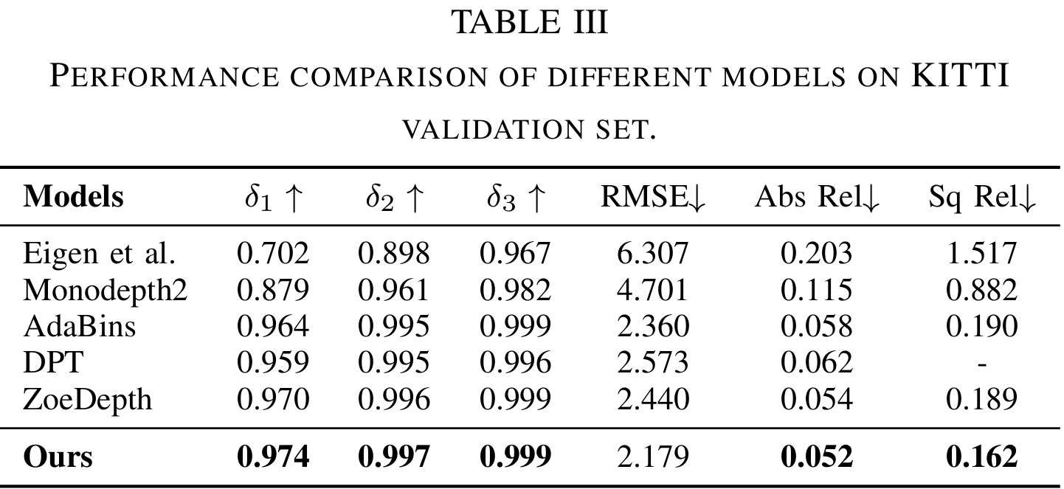
Experiments – Results on Waymo
Notes:
describe

Slide 12
Conclusions
This paper presents a novel approach to monocular depth estimation in complex outdoor scenarios, and performs experiments under diverse conditions and outdoor visuals.
Novelty:
Introduce a spatial enhanced module to extract the semantic context in images to guide the depth estimation without relying on the annotated image description.
Drawbacks:
The two encoders in the framework—Image Encoder and Semantic Encoder—have different processing speeds. This delay mismatch may cause the extracted features to come from slightly different frames, leading to misaligned depth predictions, especially in dynamic scenes.
Notes:
describe

