Slide 1


Slide 2
Tourism and Data Science: What is your next move?

Slide 3
FIGURE 1: Project Phases
Probabilistic analysis of traveler “next steps” (city level)
5
1
2
3
4
Procuring Data (scraping)
Data structuring
Data exploration and clean-up
Analysis and Visualization of Network
Exploring twitter options
Exploring and scraping Travel Blog
Exploring and scraping Trip Advisor
Data objects and structures
Build the network
First relevant visualizations;
Anything looks funny?
First hypothesis?
Clean-up, e.g.: eliminate long-stay travelers; empty blogs; etc.
Unsupervised learning:
- Clustering/ communities
- Network centrality
- other?
Visualizations:
Geographic visualization
Interactive visualization?
Supervised learning:
Bringing in more data;
Choosing model
Predictions
Validation and cross-validation
Optimizing model parameters
Results and visualizations
6
Prepare Output Materials
Notebook (s) of our process
Video
Website
Presentation

Slide 4
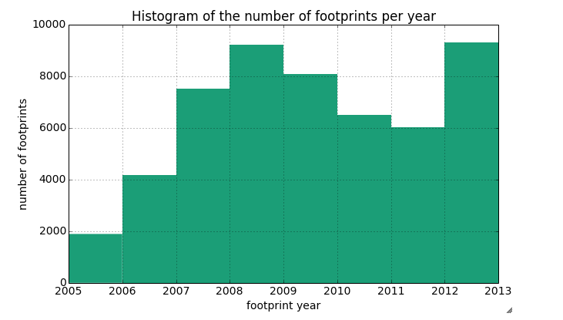
About 53K foot prints

Slide 5
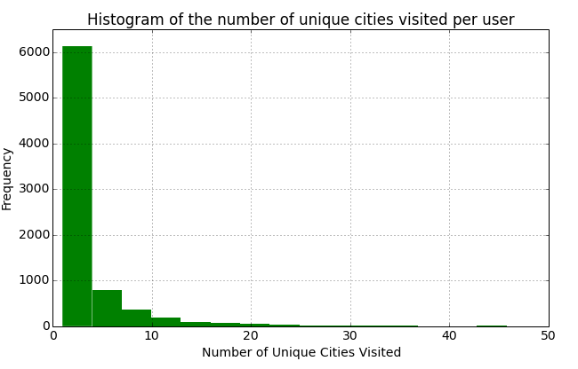

Slide 6
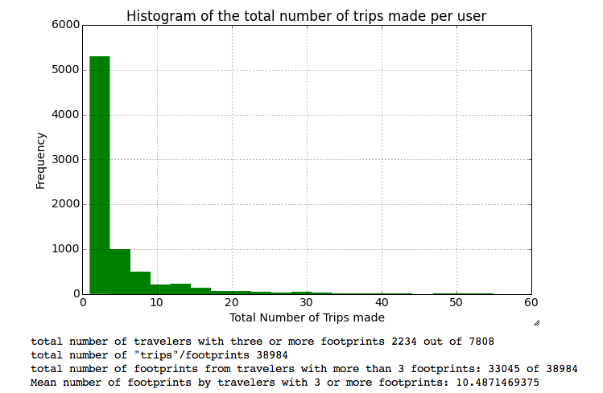

Slide 7
Popular Destinations
NYC
LA
San Francisco
Chicago
Las-Vegas

Slide 8
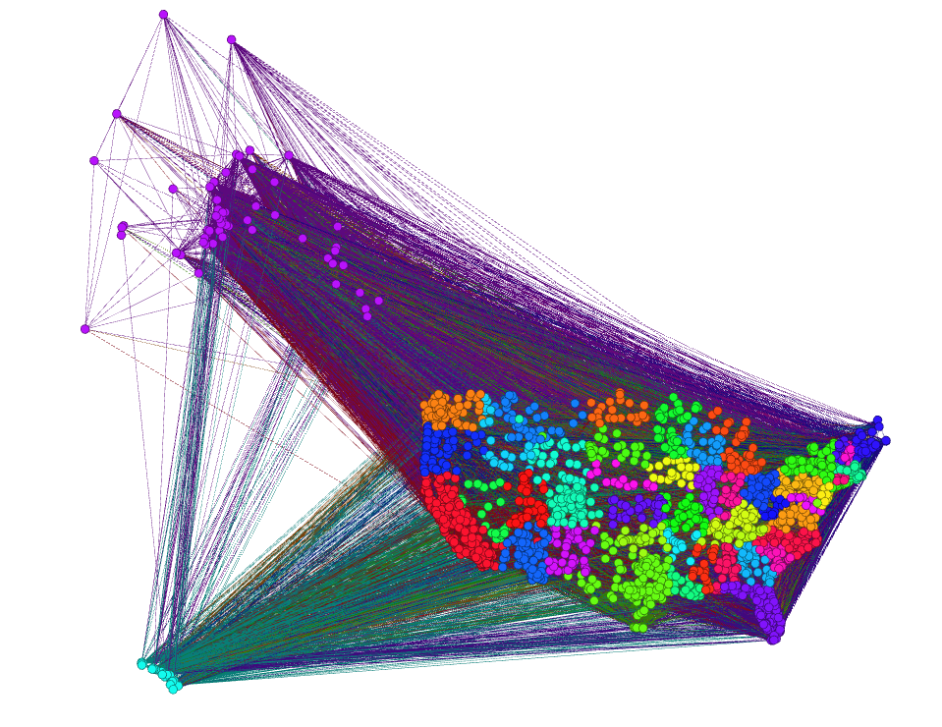
Network Analysis

Slide 9
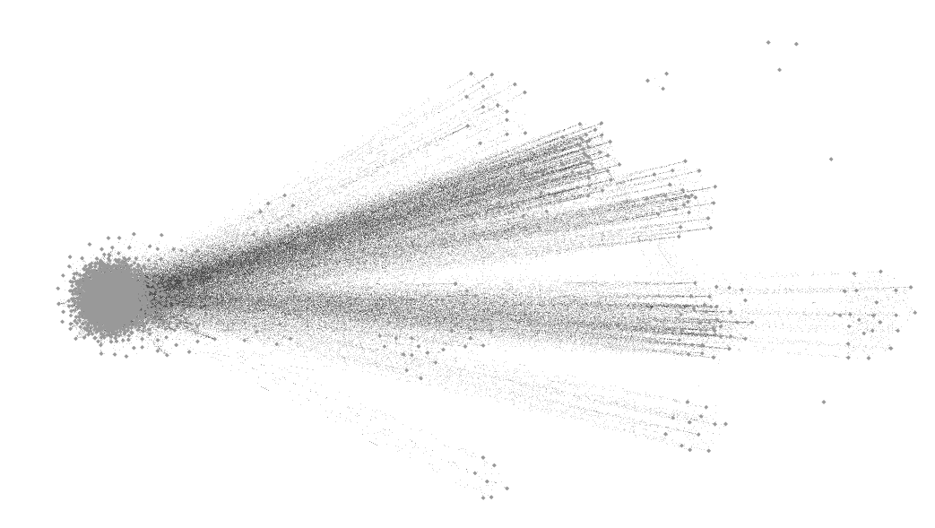
Force Directed Layout

Slide 10
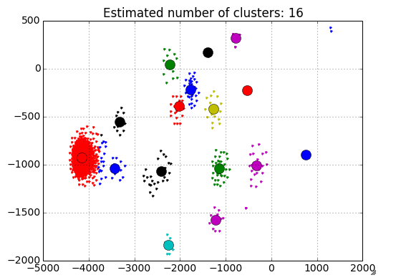
Clustering: Giant Component

Slide 11
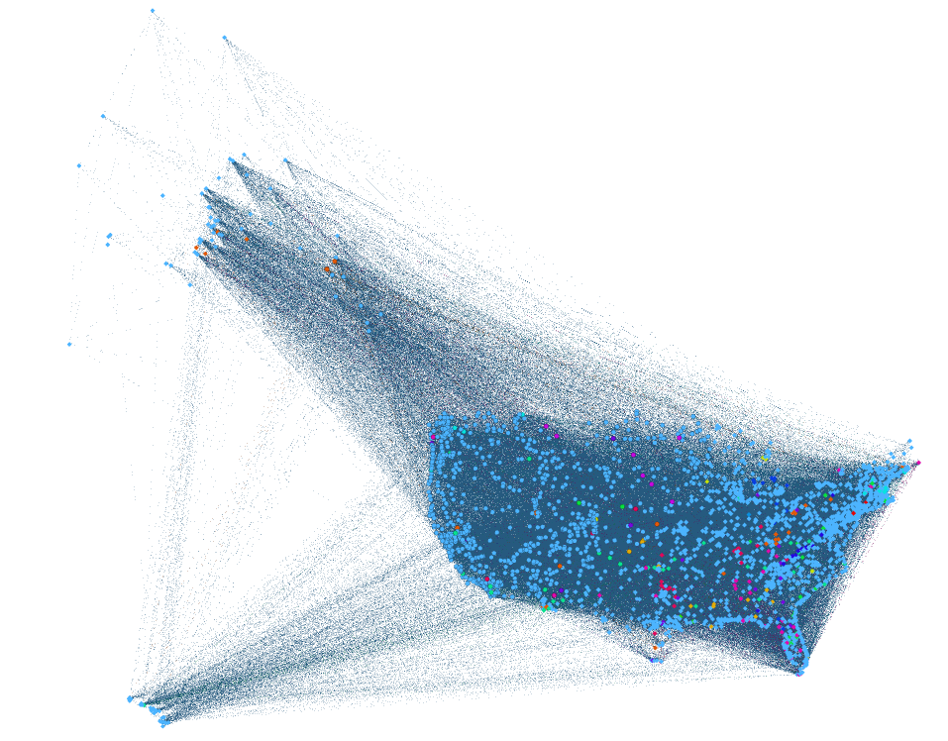
No Geographical Structure

Slide 12
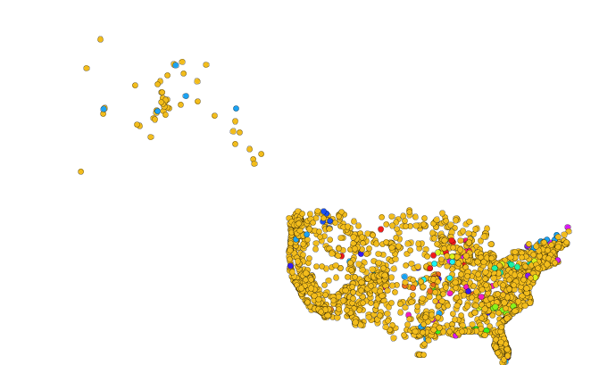
Clustering of the Giant Component

Slide 13
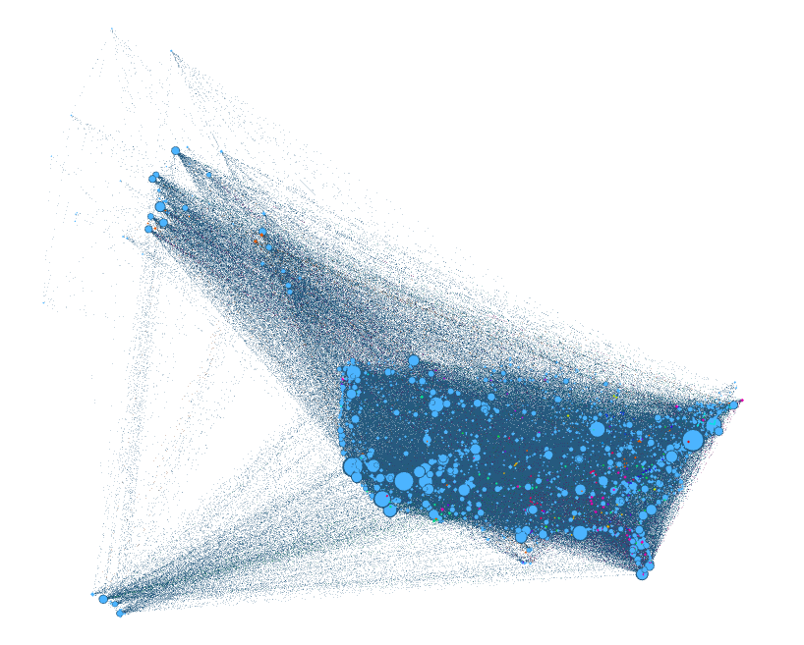
Page Rank

Slide 14
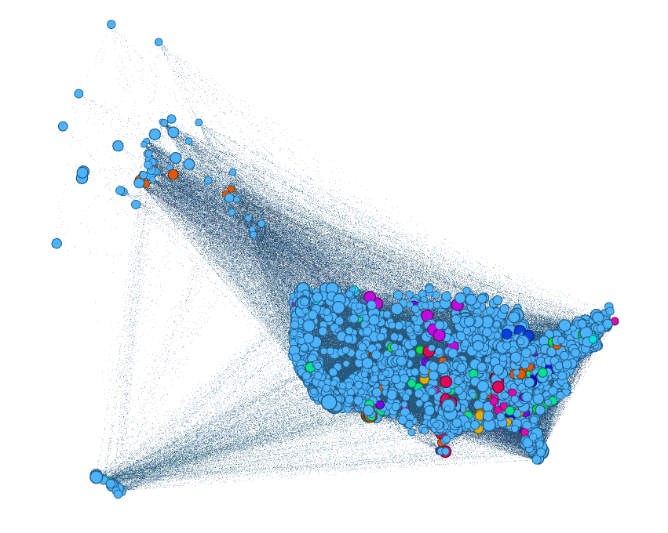
Closeness Centrality

Slide 15
Learning Traveller’s Next Steps
Bayesian Classifier
Markov Chain
~ 2 percent accuracy

Slide 16
Conclusion
More Data
More contextual information based on the cities
More time for analysis

