Slide 1
Neural Networks and Genetic Algorithms
Buzzoni Marco (marco.buzzoni2@studio.unibo.it)
Francesconi Alessandro (alessand.francescon2@studio.unibo.it)
Università degli Studi di Bologna LM Informatica 2012/13

Slide 2
Today’s outline
Neural Networks
The Neuroscience: introduction to biological neural networks
From biological to artificial neural networks
Genetic Algorithms

Slide 3
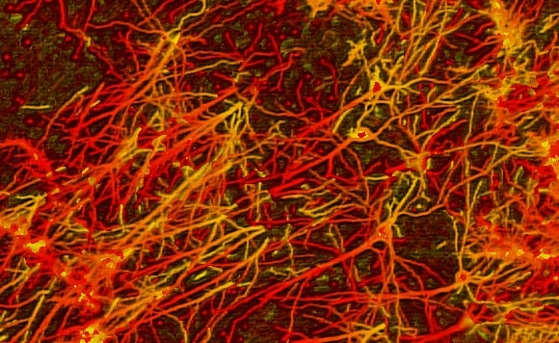
The Neuroscience
Our brain is, substantially, a Parallel Information Processing System.
It contains about 10 BILLION nerve cells, called neurons, each one connected to other ones by synapses.

Slide 4
The Neuroscience
A biological neural network is an interconnection of neurons whose sequential or parallel activation is defined with a precise logic.
BUT WHAT IS AN "ACTIVATION"?

Slide 5
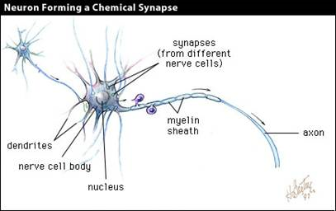
The Neuroscience
The neuron continuously receives signals from these inputs and then performs a little bit of… magic.
For our purposes, we can simplified this action as a sum of those inputs values. Then, if this sum is greater than a threshold, the neuron fires an “affermative” response.

Slide 6
Biological neural networks

Slide 7
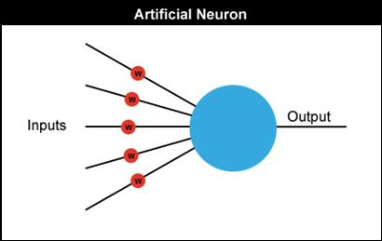
Artificial neural networks
"Weights" are simply signed floating point numbers

Slide 8
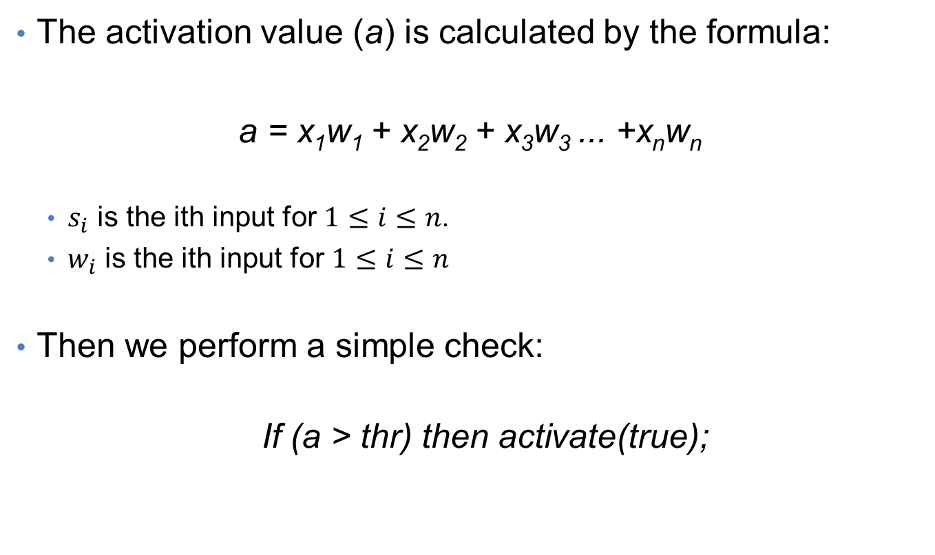
Artificial neural networks
The activation value (a) is calculated by the formula:
a = x₁w₁ + x₂w₂ + x₃w₃ ... +x_{n}w_{n}
$s_{i}$ is the ith input for $1≤i≤n$.
$w_{i}$ is the ith input for $1≤i≤n$
Then we perform a simple check:
If (a > thr) then activate(true);

Slide 9
We made a neuron! … but how to build the network?
For most of the problems, an artificial neural network is a data structure composed by 3 layers:
Input layer
Hidden
layer
Output layer

Slide 10
Artificial neural network
Input layer holds the input data coming from the problem, for example, the current state of an environment (properly discretized) or the input obtained from sensors.
Output layer contains the solution to the problem, that can be more or less complex:
From one resulting number (there will be only one neuron)
To a set of n numbers ("do action X with properties Y, W, and Z")
How about the Hidden layer? Works as a mapper between inputs and outputs. The number of internal neurons specifies the precision of the outputted data.

Slide 11
Different kinds of neural networks
Based on the data flow:
Feed-forward: there is no need to synchronize the inputs of a neuron.
Recurrent: there is loops inside the neural network.

Slide 12
Different kinds of neural networks
Based on learning algorithm:
Supervised learning: the expected output is known, the neural network is trained to map the input values to the right output.
Unsupervised learning: the expected output is unknown, the task of the neural network is to adjust the weights itself to obtain a correct output.

Slide 13
A simple example: AND
We want implement the AND operation with neural network. To do this only one neuron is needed, with 2 input and 1 output (the result of the operation).

