Slide 1
Deep Learning models for question answering
Sujit Pal & Abhishek Sharma
Elsevier Search Guild Question Answering Workshop
October 5-6, 2016

Slide 2
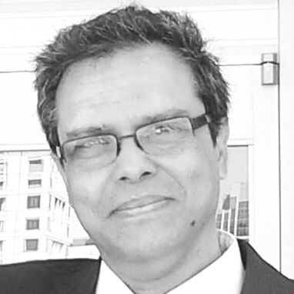
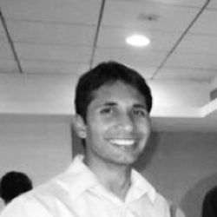
About Us
Sujit Pal Technology Research Director Elsevier Labs | Abhishek Sharma Organizer, DLE Meetup and Software Engineer, Salesforce

Slide 3
How we started
Watching Udacity “Deep Learning” videos taught by Vincent Vanhoucke.
Watching “Deep Learning for Natural Language Processing” (CS 224d) videos taught by Richard Socher.
Thinking that it might be interesting to do “something” around Question Answering and Deep Learning.

Slide 4
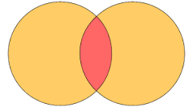
What we knew
Machine
Learning
Search
(Lucene/Solr/ES)
Python
Natural
Language Processing
Deep
Learning
Keras
gensim
Question
Answering
Tensorflow

Slide 5
Identify Scope

Slide 6
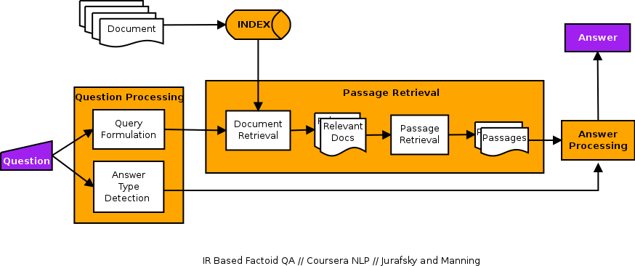
Question Answering Pipeline

Slide 7
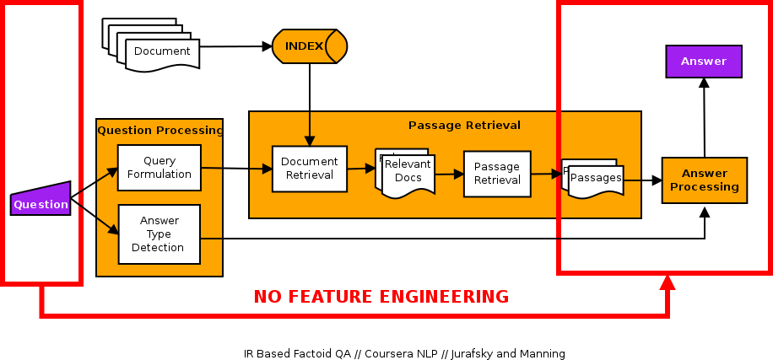
Question Answering Pipeline

Slide 8
Research

Slide 9
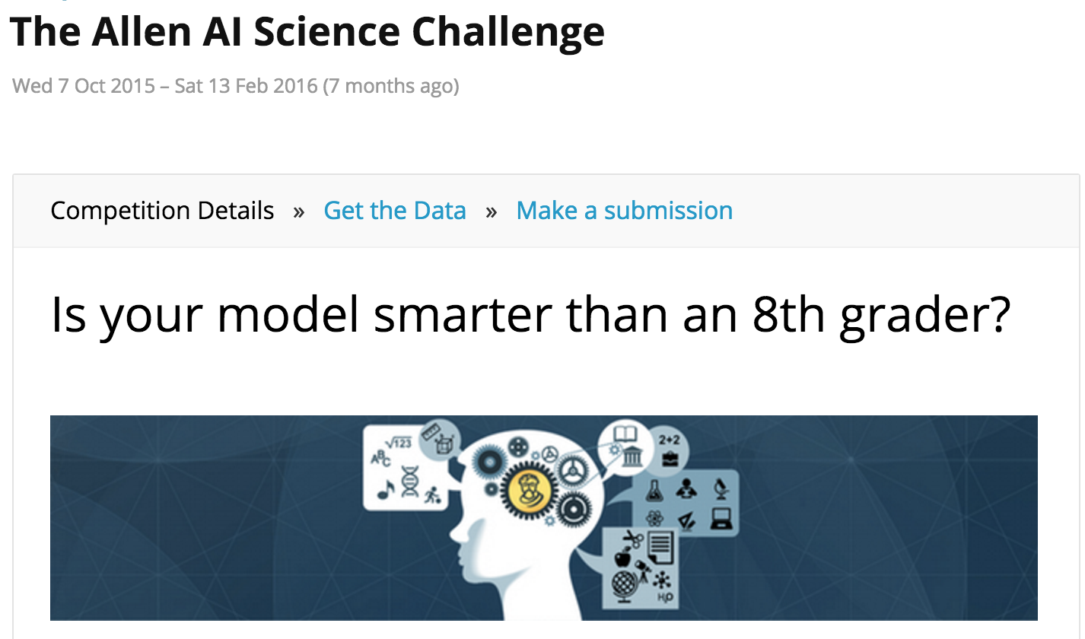
This had just ended…
and the #4 ranked entry used Deep Learning for their solution.

Slide 10
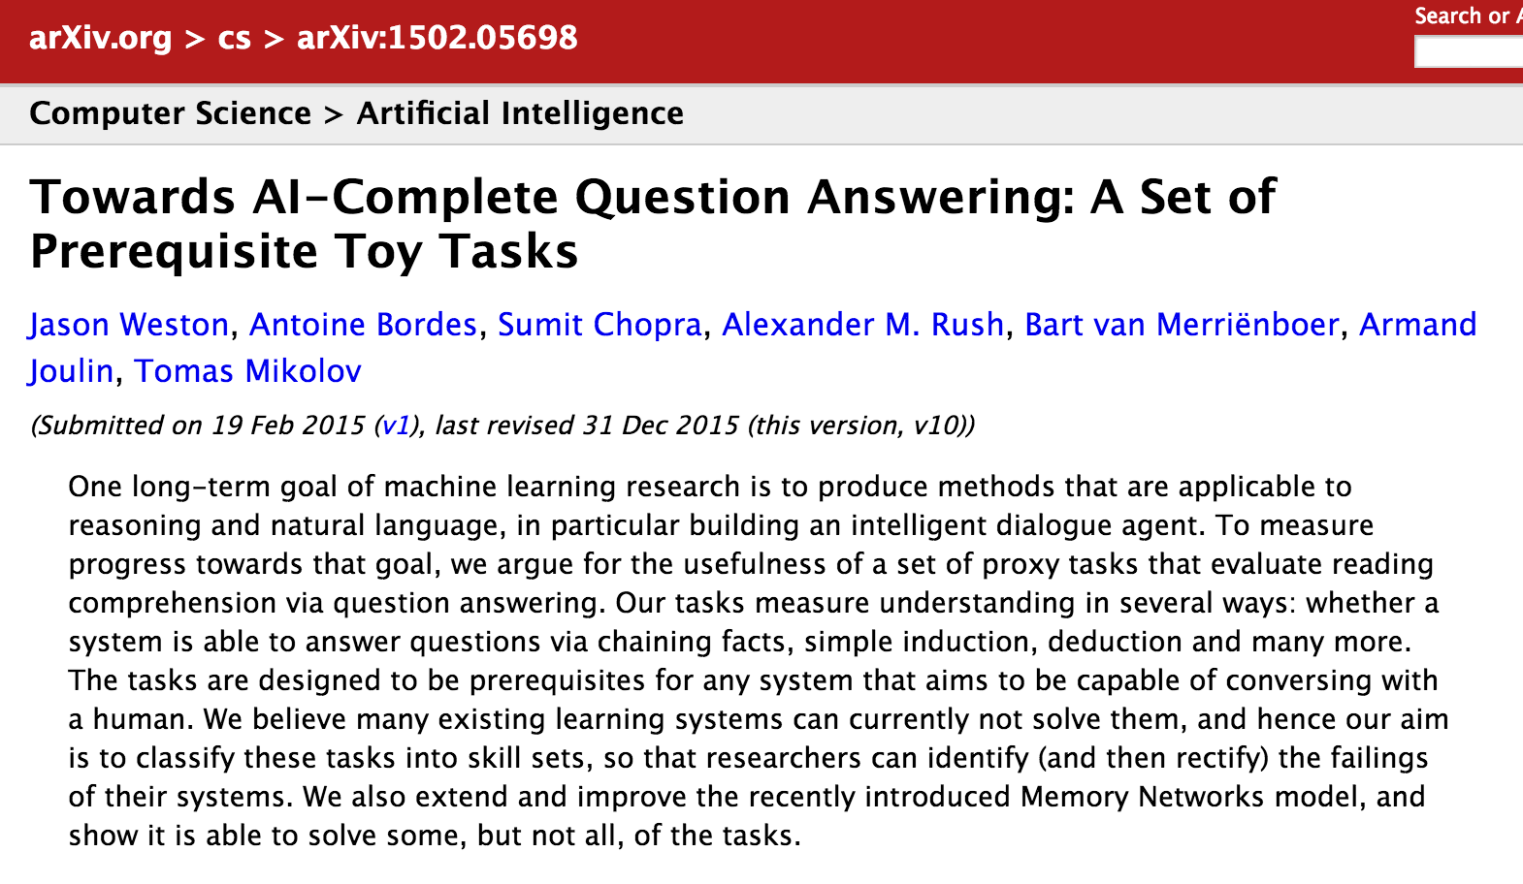
Notes:
Proposing the bAbI dataset.

Slide 11
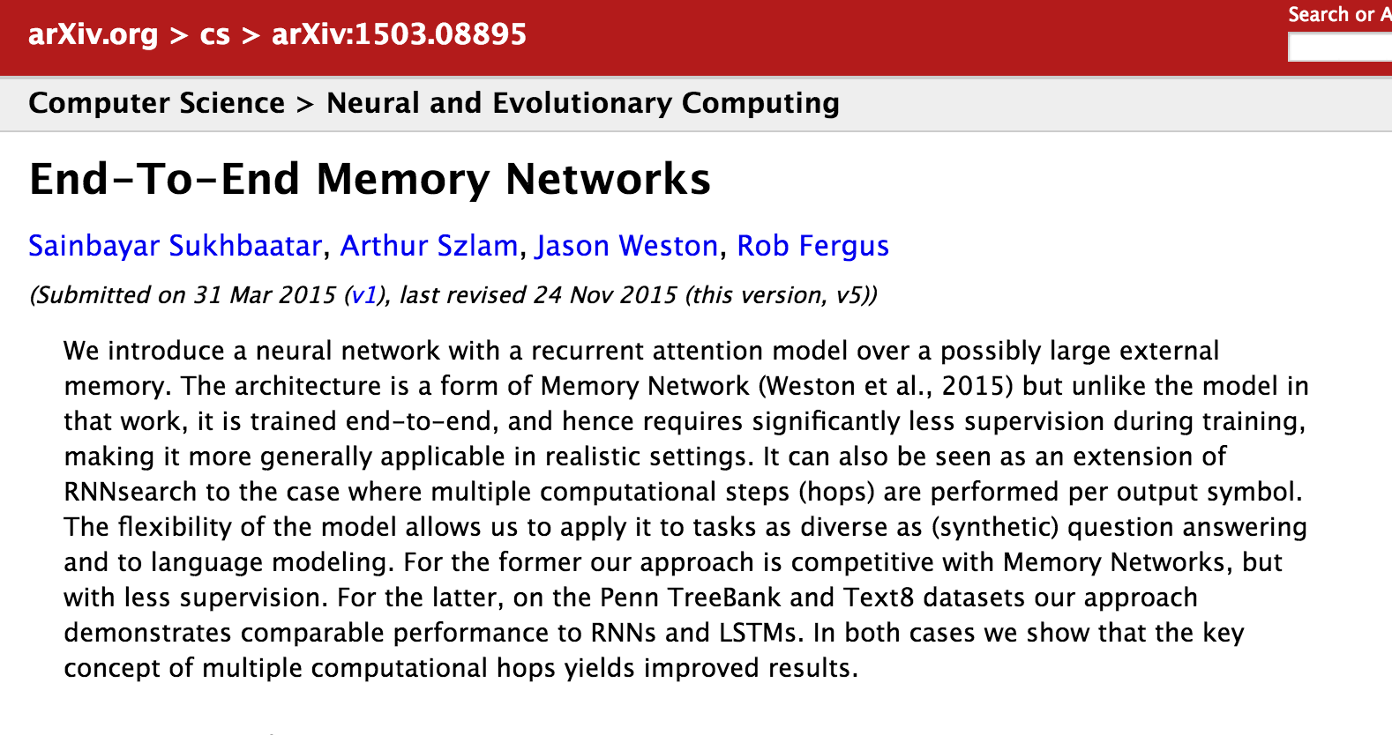
Notes:
Recurrent attention model over large external memory.

Slide 12
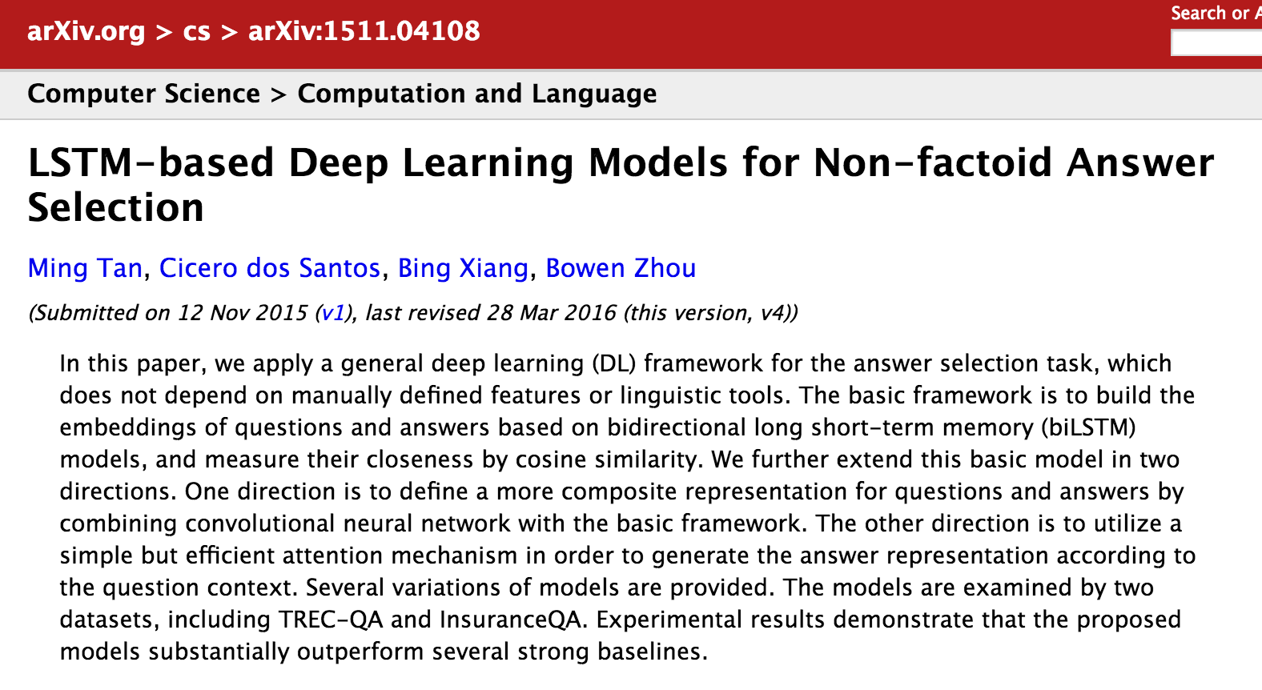
Notes:
Closest to our use case, this is what our solution to the Kaggle comp is based on.

Slide 13
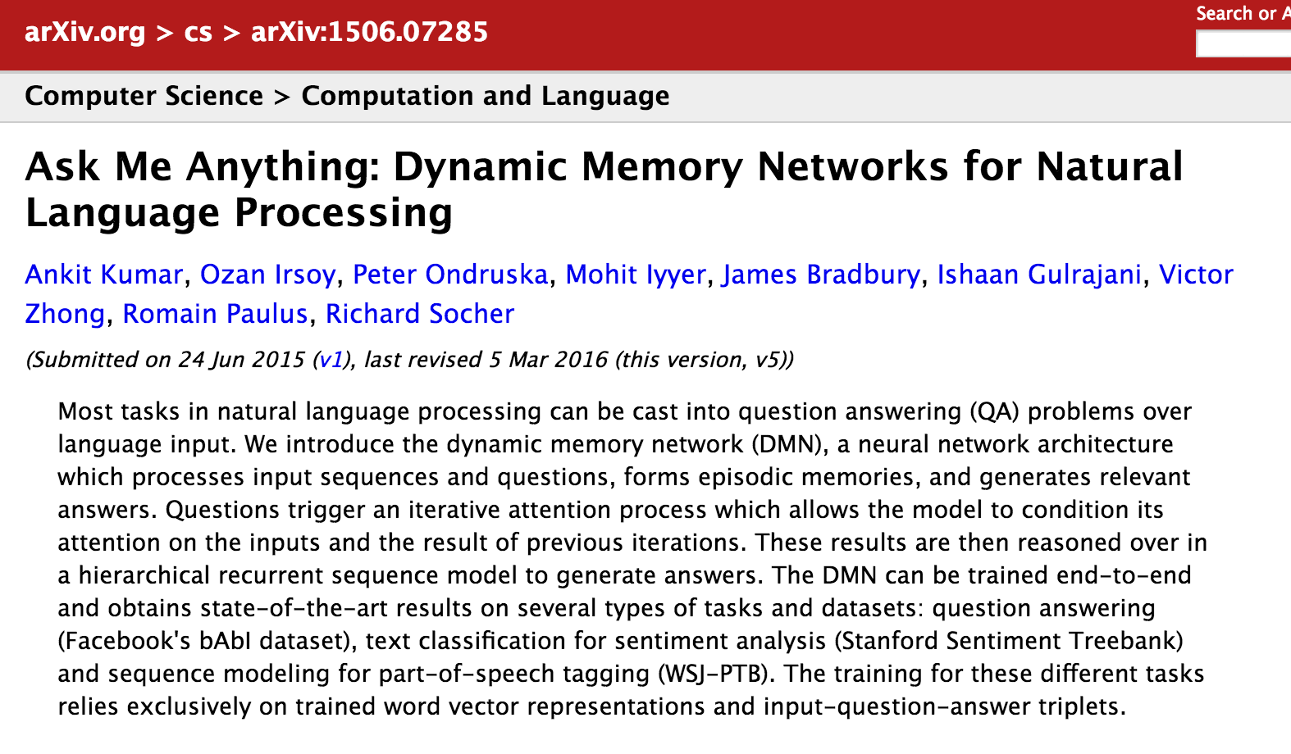
Notes:
Socher’s dynamic memory models.

Slide 14
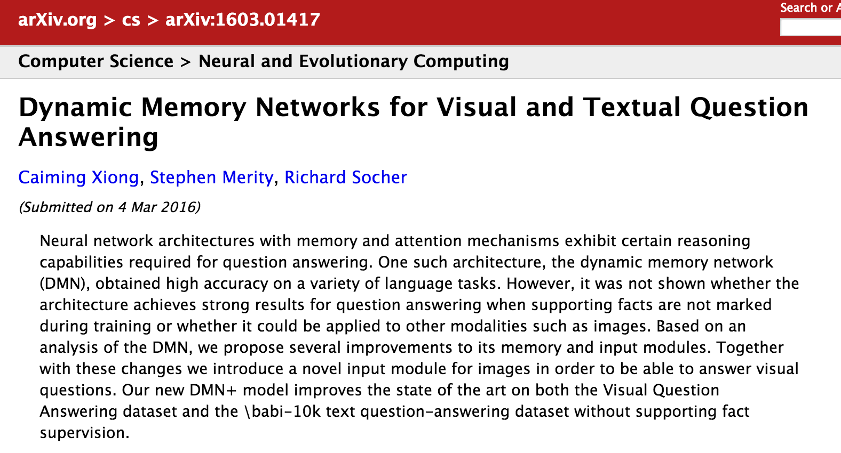
Notes:
DMN, bAbI, Socher again

Slide 15
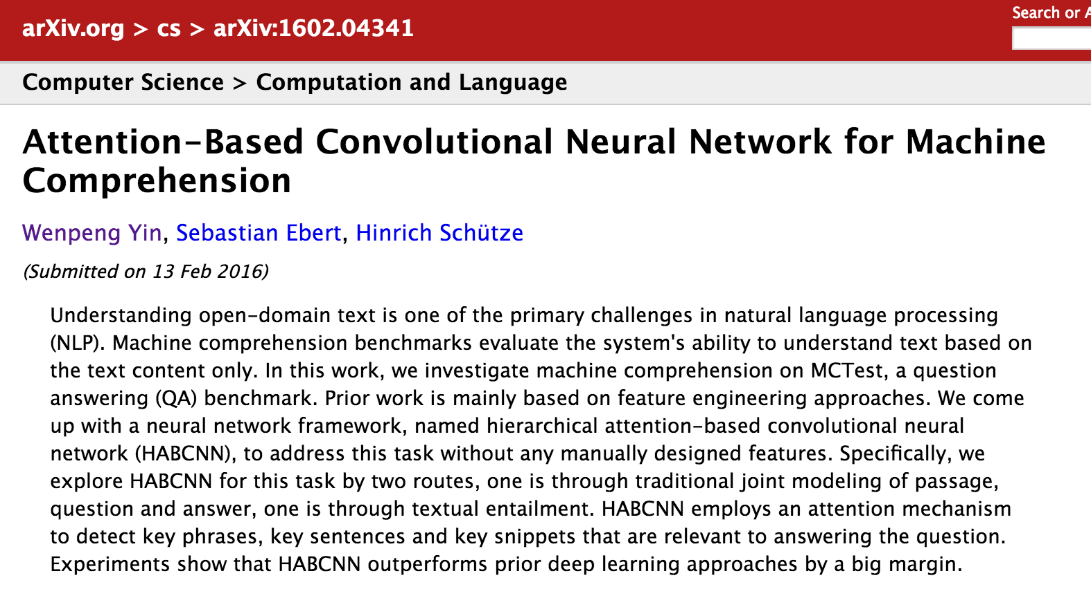
Notes:
MCTest Benchmark, HABCNN

Slide 16
Building Blocks
Notes:
[1] bAbI dataset,
[2] representation size (number of words),
[3] MCTest Benchmark, Hierarchical Attention Based CNN (HABCNN),
[4] DMN, Richard Socher
[5]

Slide 17
Building blocks
Most DL Networks (including Question Answering models) composed out of these basic building blocks.
Fully Connected Network
Word Embedding
Convolutional Neural Network
Recurrent Neural Network

Slide 18
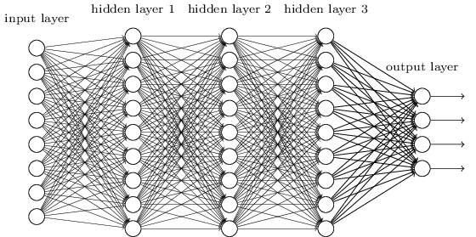
Fully Connected Network
Workhorse architecture of Deep Learning.
Number of layers and number of units per layer increased for more complex models.
Used for all kinds of problem spaces.
Credit: neuralnetworksanddeeplearning.com

Slide 19
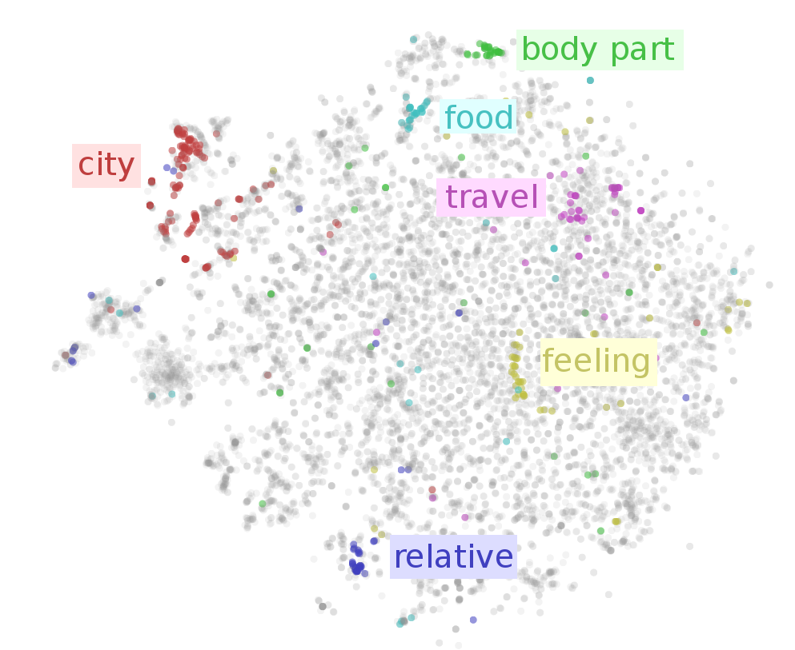
Word Embedding
Projects sparse 1-hot vector representation onto denser lower dimensional space.
Unsupervised technique.
Embedding space exhibits Distributional Semantics.
Has almost completely replaced traditional distributional features in NLP (Deep Learning and non Deep Learning).
Word2Vec (CBOW and Skip-gram), GloVe.
Credit:Sebastian Ruder // sebastianruder.com

Slide 20
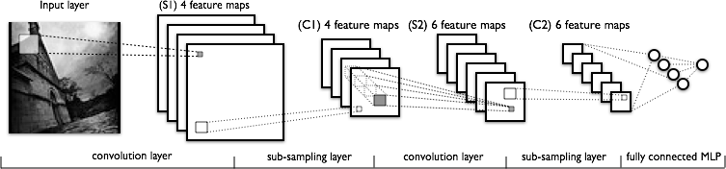
Convolutional Neural Network
Alternate Convolution and Pooling Operations to extract relevant features
Mainly used in Image recognition, exploits geometry of image.
1D variant (Convolution and Pooling) used for text.
Exploits word neighborhoods and extracts “meaning” of sentences or paragraphs.
Credit: deeplearning.net

Slide 21
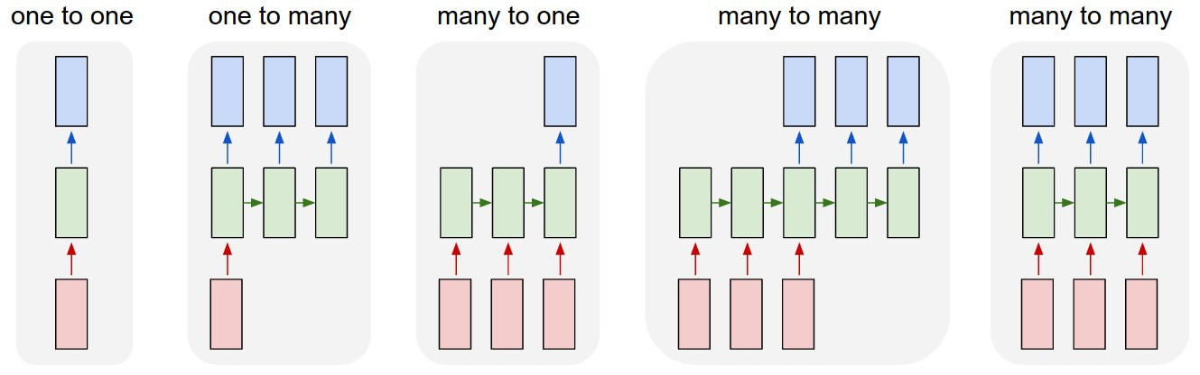
Recurrent Neural Network
Works with sequence input (such as text and audio).
Exploits temporal nature of the data.
Many variations possible (shown below).
Basic RNN suffers from vanishing gradient problem – addressed by Long Short Term Memory (LSTM) RNNs.
Gated Recurrent Unit (GRU) another variant with simpler structure and better performance than LSTM.
Credit: Andrej Karpathy // karpathy.github.io

Slide 22
Start with bAbI
Notes:
[1] bAbI dataset,
[2] representation size (number of words),
[3] MCTest Benchmark, Hierarchical Attention Based CNN (HABCNN),
[4] DMN, Richard Socher
[5]

Slide 23
bAbI Dataset
Synthetic Dataset (1000, 10k, … records)
Composed of actors, places, things, actions, etc.
Released by Facebook Research
Single supporting fact
Two supporting facts
Three supporting facts
Two argument relations
Three argument relations
Yes/No questions
Counting
Lists/sets
Simple Negation
Indefinite Knowledge
Basic Coreference
Conjunction
Compound Coreference
Time Reasoning
Basic Deduction
Basic Induction
Positional Reasoning
Size Reasoning
Path Finding
Agent’s Motivations

Slide 24
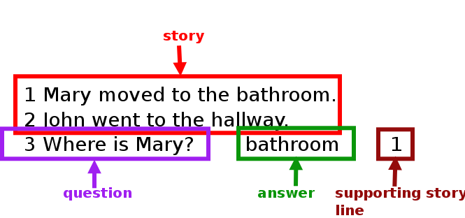
bAbI Format (task 1)

Slide 25
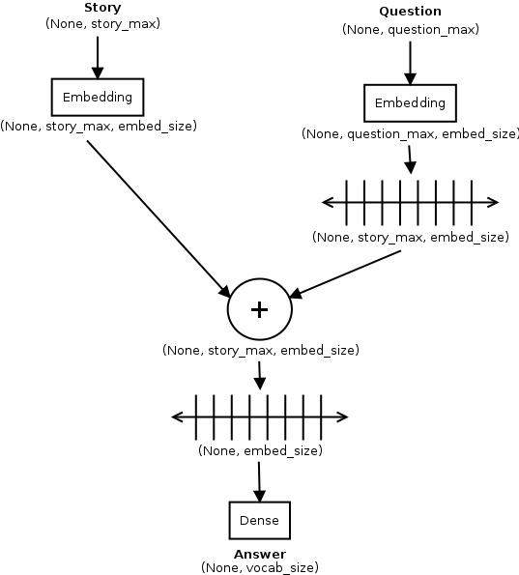
bAbI LSTM
Implementation based on the paper: Towards AI-Complete Question Answering: A Set of Prerequisite Toy Tasks.
Test accuracy reported in paper: 50%.
Test accuracy achieved by implementation: 56%.
Code is here.

Slide 26
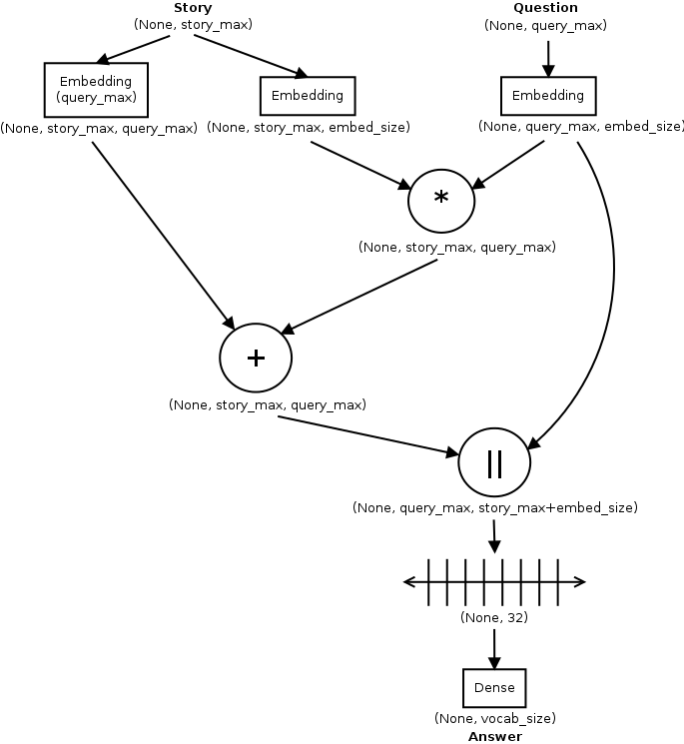
bAbI MemNN
Implementation based on the paper: End-to-end Memory Networks.
Test accuracy reported in paper: 99%.
Test accuracy achieved by implementation: 42%.
Code is here.

Slide 27
Back to Kaggle
Notes:
[1] bAbI dataset,
[2] representation size (number of words),
[3] MCTest Benchmark, Hierarchical Attention Based CNN (HABCNN),
[4] DMN, Richard Socher
[5]

Slide 28
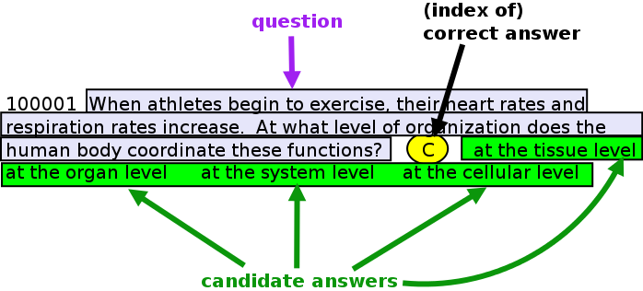
Data Format
2000 multiple choice 8th Grade Science questions with 4 candidate answers and correct answer label.
2000 questions without correct answer label.
Each question = 1 positive + 3 negative examples.
No story here.

Slide 29
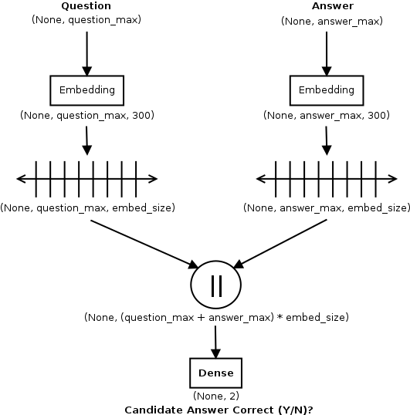
QA-LSTM
Implementation based on the paper: LSTM-based Deep Learning Models for Non-factoid Answer Selection.
Test accuracy reported in paper: 64.3% (InsuranceQA dataset).
Test accuracy achieved by implementation: 56.93% (unidirectional) and 57% (bidirectional).
Code: unidirectional, bidirectional

Slide 30
Our Embedding Approach
3 approaches to Embedding
Generate from Data
Use External model for lookup
Initialize with External model, then fine tune.
Not enough question data to generate good embedding.
Used pre-trained Google News word2vec model (trained with 3 billion words)
Model has 3 million word vectors of dimension (300,).
Uses gensim to read model.

Slide 31
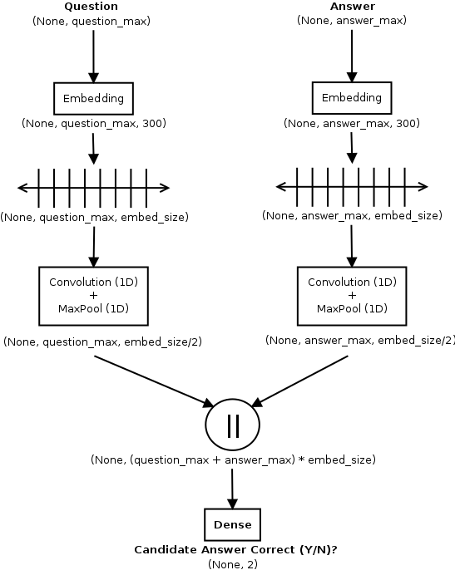
QA-LSTM-CNN
Additional CNN Layer for more effective summarization.
Test accuracy reported in paper: 62.2% (InsuranceQA dataset).
Test accuracy achieved by implementation: 56.3% (unidirectional), did not try bidirectional.
Code is here.

Slide 32
Incorporating Attention
Vanishing Gradient problem addressed by LSTMs, but still shows up in long range Q+A contexts.
Solved using Attention Models
Based on visual models of human attention.
Allow the network to focus on certain words in question with “high resolution” and the rest at “low resolution”.
Similar to advice given for comprehension tests about reading the questions, then scanning passage for question keywords.
Implemented here as a dot product of question and answer, or question and story vectors.

Slide 33
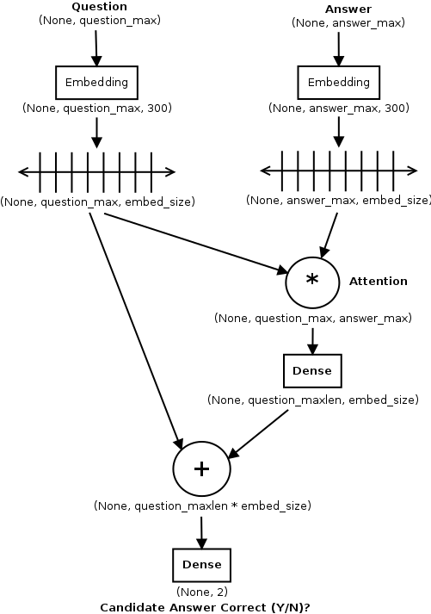
QA-LSTM + Attention
Attention vector from question and answer combined with question.
Test accuracy reported in paper: 68.4% (InsuranceQA dataset).
Test accuracy achieved by implementation: 62.93% (unidirectional), 60.43% (bidirectional)
Code: unidirectional, bidirectional.

Slide 34
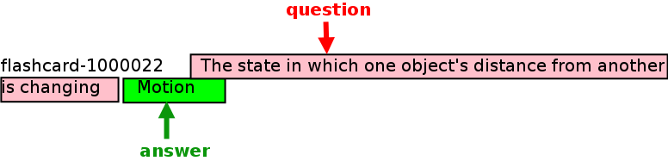
Incorporating External Knowledge
Contestants were allowed/advised to use external sources such as ConceptNet, CK-12 books, Quizlets, Flashcards from StudyStack, etc.
Significant crawling/scraping and parsing effort involved.
4th place winner (tambietm) provides parsed download of StudyStack Flashcards on his Google drive.
Flashcard “story” = question || answer

Slide 35
Using Story Embedding
Build Word2Vec model using words from Flashcards.
Approximately 500k flashcards, 8,000 unique words.
Provides smaller, more focused embedding space.
Good performance boost over default Word2Vec embedding.
Model | Default Embedding | Story Embedding
QA-LSTM with Attention | 62.93 | 76.27
QA-LSTM Bidirectional with Attention | 60.43 | 76.27

Slide 36
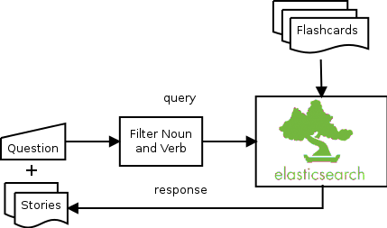
Relating Story to Question
Replicate bAbI setup: (story, question, answer).
Only a subset of flashcards relate to given question.
Using traditional IR methods to generate flashcard stories for each question.

Slide 37
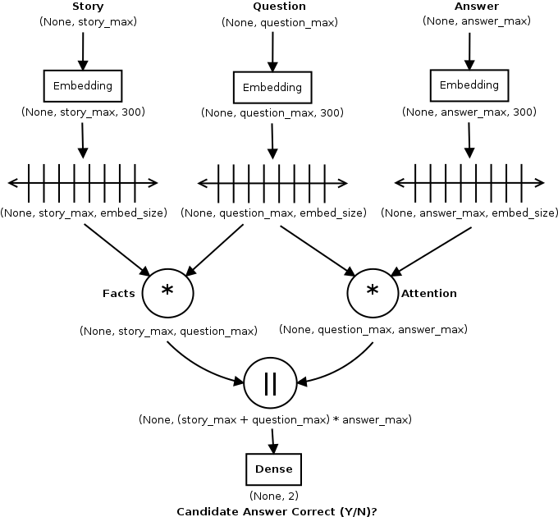
QA-LSTM + Story
Story and Question combined to create Fact vector.
Question and Answer combined to create Attention vector
Fact and Attention vectors concatenated.
Test accuracy achieved by implementation: 70.47% (unidirectional), 61.77% (bidirectional).
Code: unidirectional, bidirectional.

Slide 38
Results
Model Specifications | Test Accuracy (%)
QA-LSTM (Baseline) | 56.93
QA-LSTM Bidirectional | 57.0
QA-LSTM + CNN | 55.7
QA-LSTM with Attention | 62.93
QA-LSTM Bidirectional with Attention | 60.43
QA-LSTM with Attention + Custom Embedding | 76.27 *
QA-LSTM Bidirectional w/Attention + Custom Embedding | 76.27 *
QA-LSTM + Attention + Story Facts | 70.47
QA-LSTM Bidirectional + Attention + Story Facts | 61.77

Slide 39
Model Deployment
Our models predict answer correct vs. incorrect.
Task is to choose the correct answer from candidate answers.
Re-instantiate trained model with Softmax layer removed.
Run batch of (story, question, answer) for each candidate answer.
Select best scoring answer as correct answer.

Slide 40
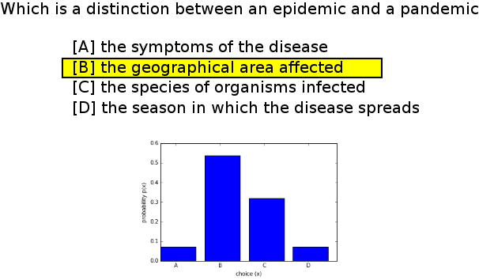
Deploying Model - Example

Slide 41
Future Work
Would like to implement Dynamic Memory Network (DMN) and Hierarchical Attention Based Convolutional Neural Network (HABCNN) models against this data.
Would like to submit to Kaggle to see how I did once Keras Issue 3927 is resolved.
Would like to try out these models against Stanford Question Answering Dataset (SQuAD) based on Wikipedia articles.
Would like to investigate Question Generation from text in order to generate training sets for Elsevier corpora.

Slide 42
Administrivia
Code for this talk:https://github.com/sujitpal/dl-models-for-qa
Contact me for questions and suggestions: sujit.pal@elsevier.com

Slide 43
Closing Thoughts
Deep Learning is rapidly becoming a general purpose solution for nearly all learning problems.
Information Retrieval approaches are still more successful on Question Answering than Deep Learning, but there are many efforts by Deep Learning researchers to change that.

Slide 44
Thank you.

