Slide 2
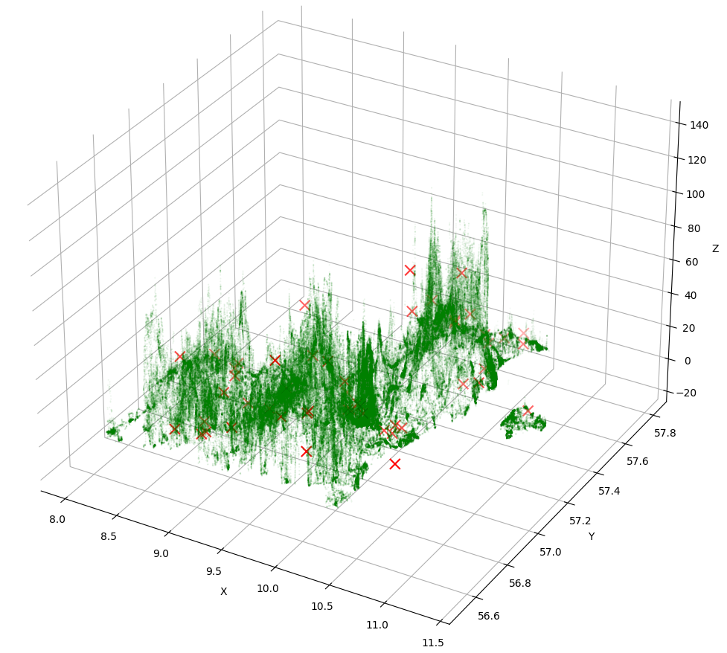

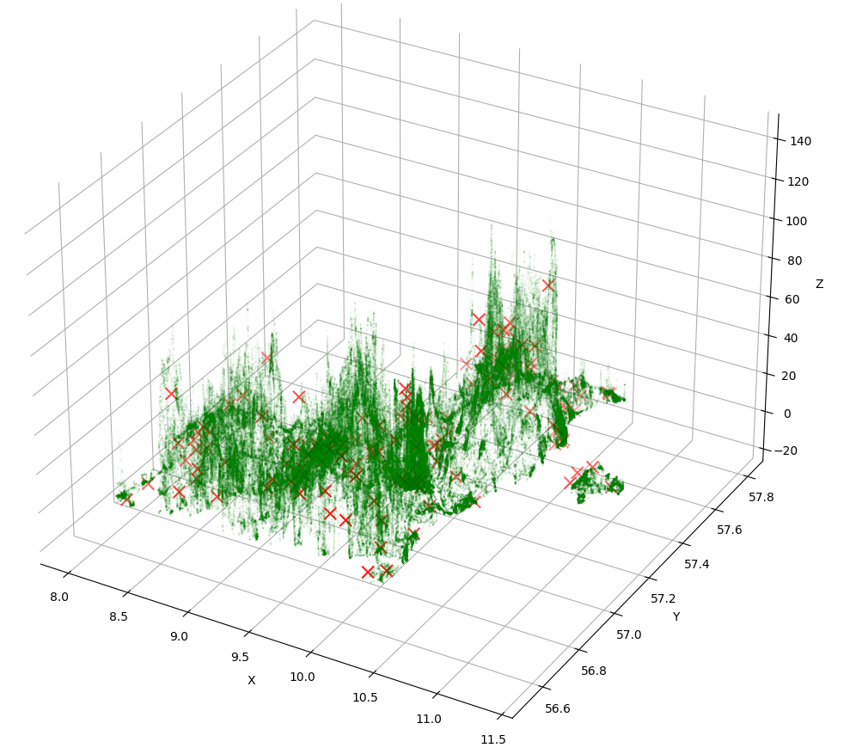

linear 50(rep 5), 100(rep 9), 140(rep 9) – 3droad data size 434874,3 (NO PCA NEEDED)

