Slide 2

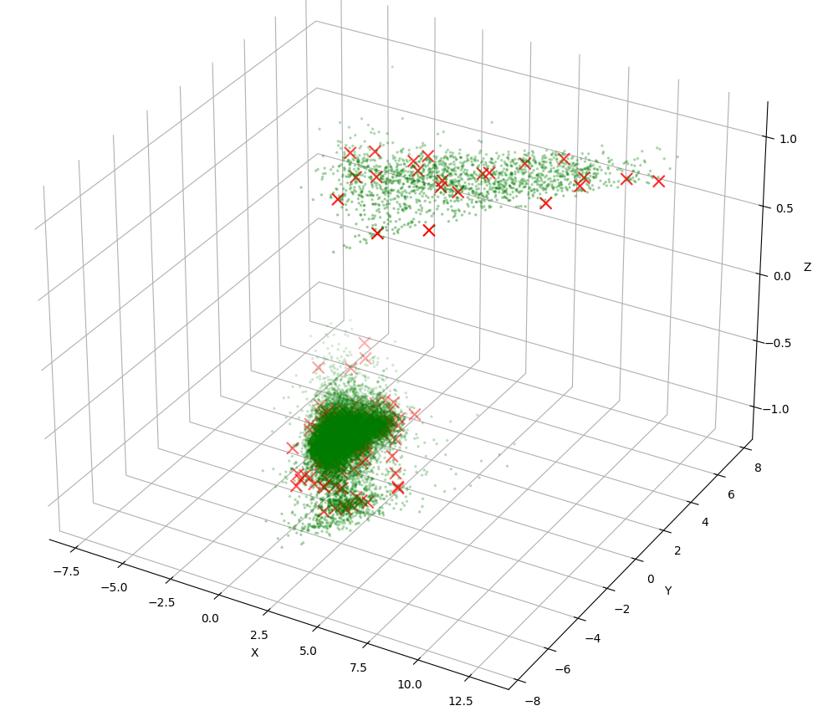
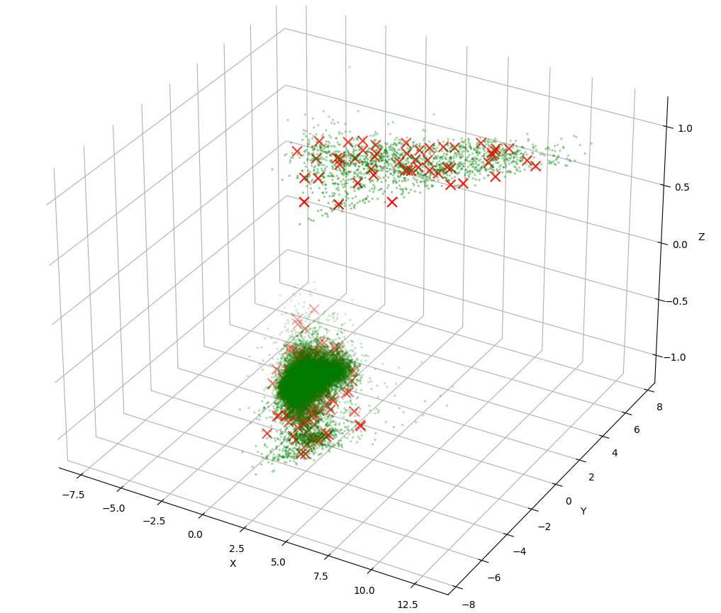
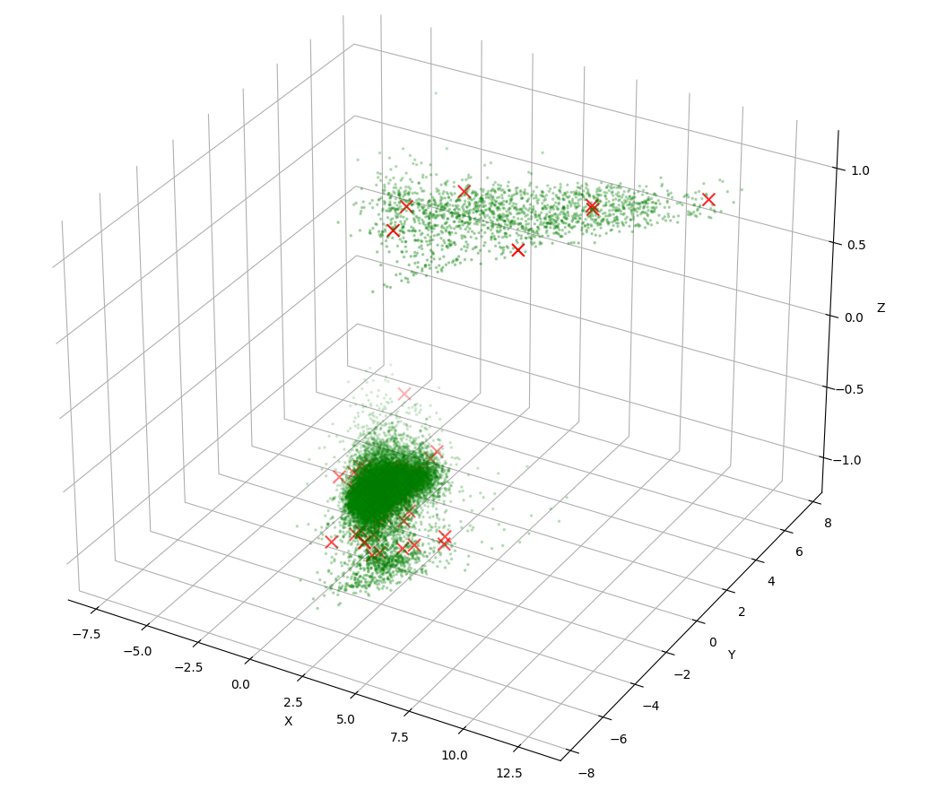
logistic 100(rep 4), 300(rep 1), 500(rep 0) – HTRU data size 17897,3

