Slide 2
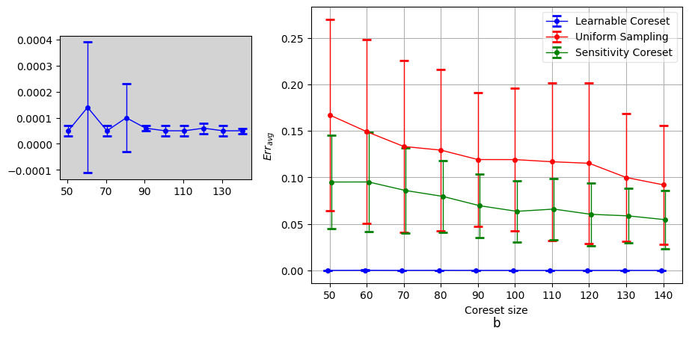
Linear
Loss as in icml poster

Slide 3
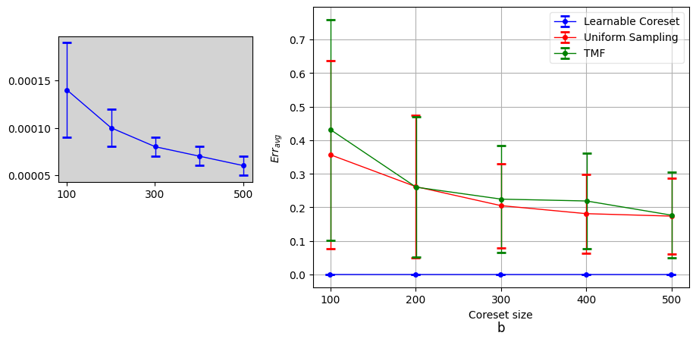
Logistic
Loss as in icml poster

Slide 4
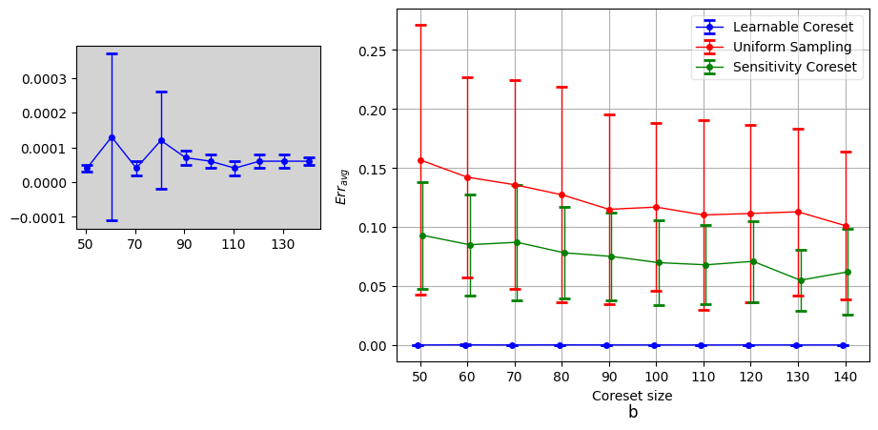
Linear
New loss for journal version

Slide 5
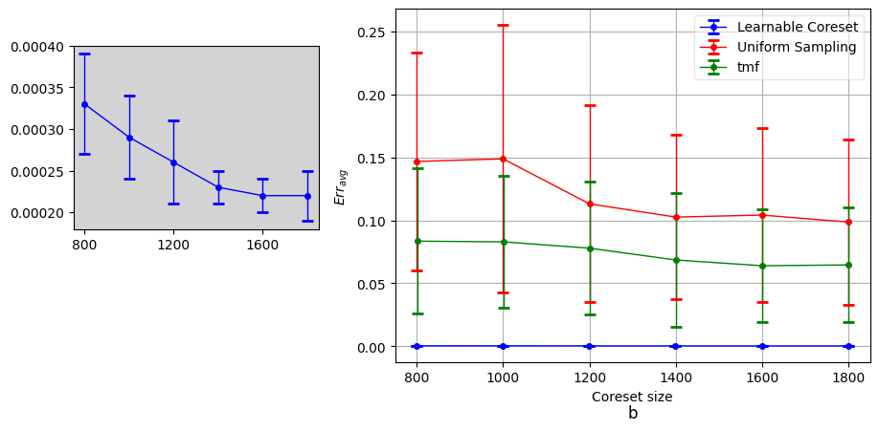
SVM

