Slide 2
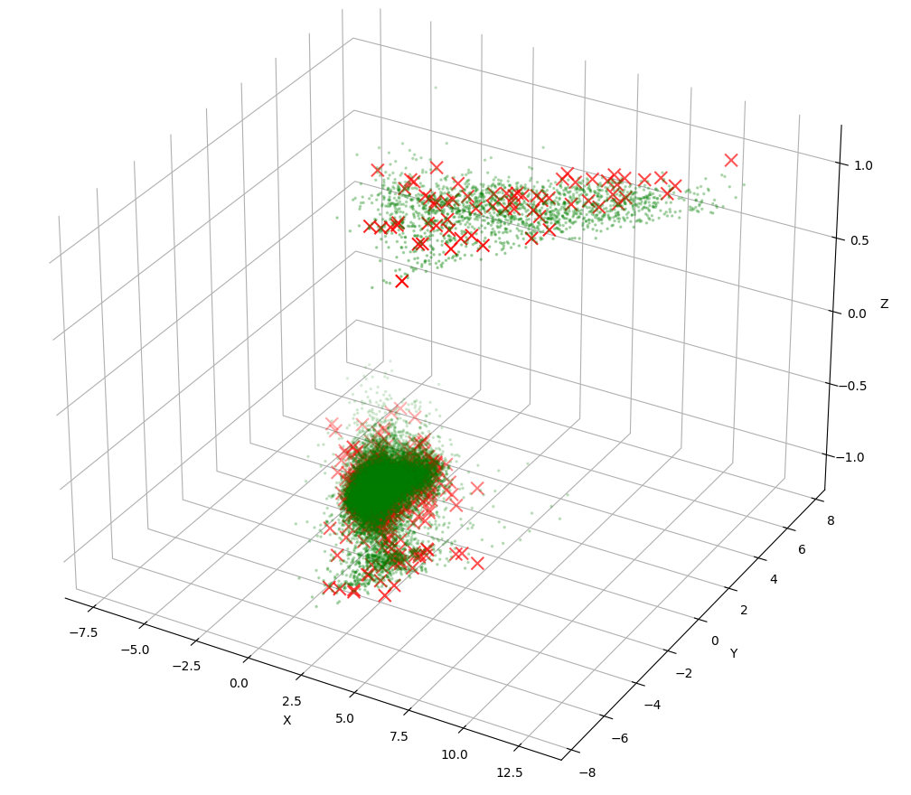

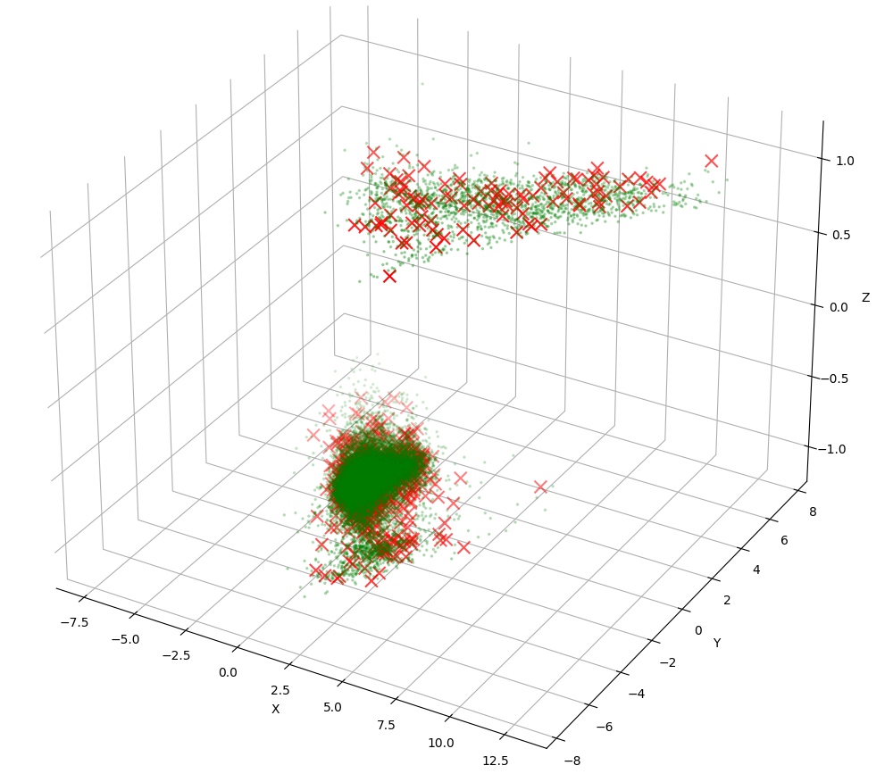
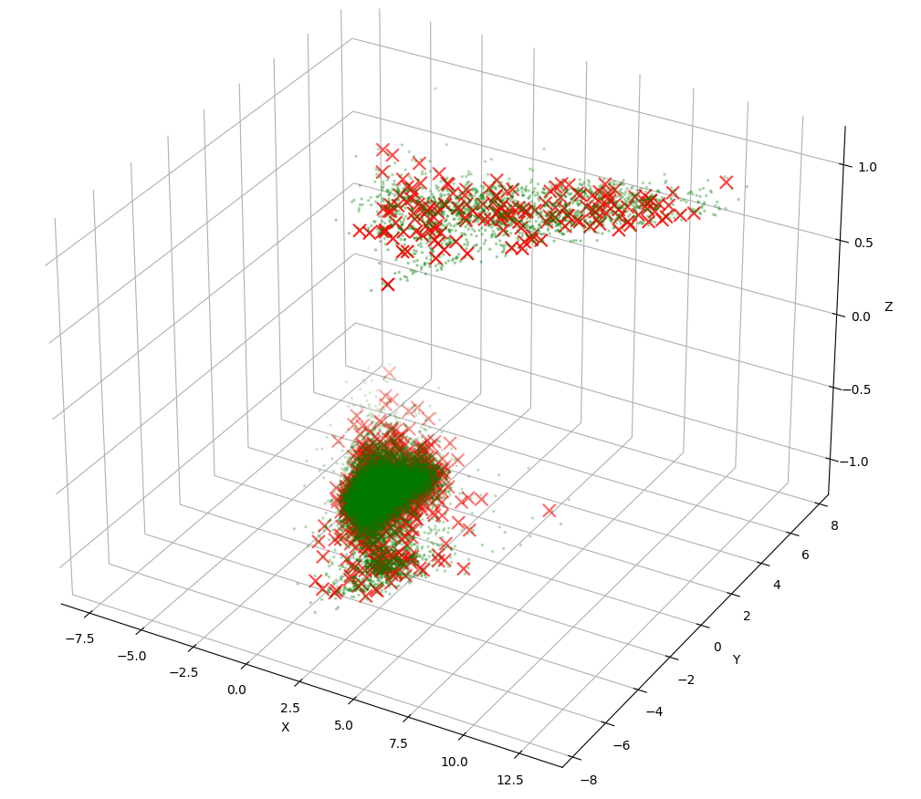
Svm 800(rep 0), 1200(rep 0), 1800(rep 0) – HTRU data size 17897,3

