Slide 1

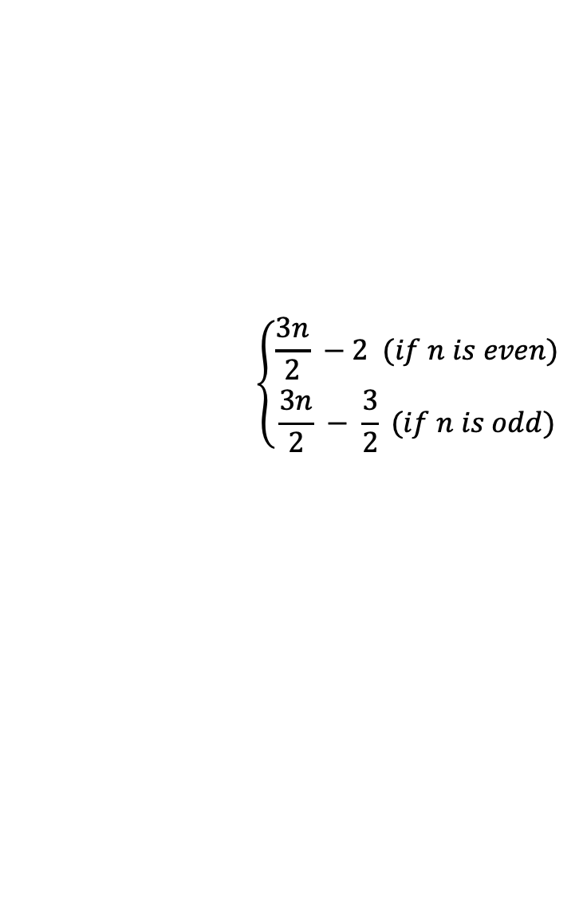
$$\left\{\begin{aligned}\frac{3n}{2} −2 (if n is even) \\ \frac{3n}{2} − \frac{3}{2} (if n is odd)\end{aligned} \right.$$
If n is even
If n is odd

