Slide 1
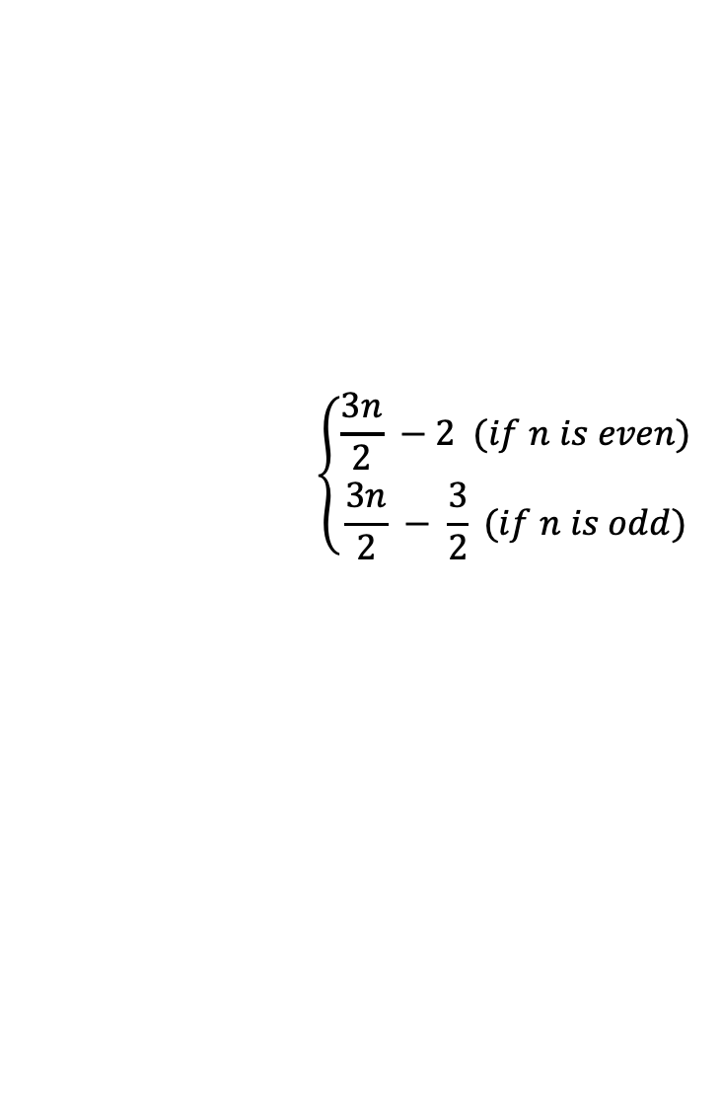
$$\left\{\begin{aligned}\frac{3n}{2} −2 (if n is even) \\ \frac{3n}{2} − \frac{3}{2} (if n is odd)\end{aligned} \right.$$

Slide 2

초기상태
3 | 1 | 0 | 1 | 4
0
1
2
3
4
Step1. negate A[abs(A[0)]
3 | 1 | 0 | -1 | 4
0
1
2
3
4
Step2. negate A[abs(A[1)]
3 | -1 | 0 | -1 | 4
0
1
2
3
4
Step3. negate A[abs(A[2)]
-3 | -1 | 0 | -1 | 4
0
1
2
3
4
Step4. negate A[abs(A[3)]
-3 | -1 | 0 | -1 | 4
0
1
2
3
4
Notes:
A = [3, 2, 1, 1, 4]

