Slide 1

Notes:
Src: https://unsplash.com/photos/fpZZEV0uQwA

Slide 2


Slide 3
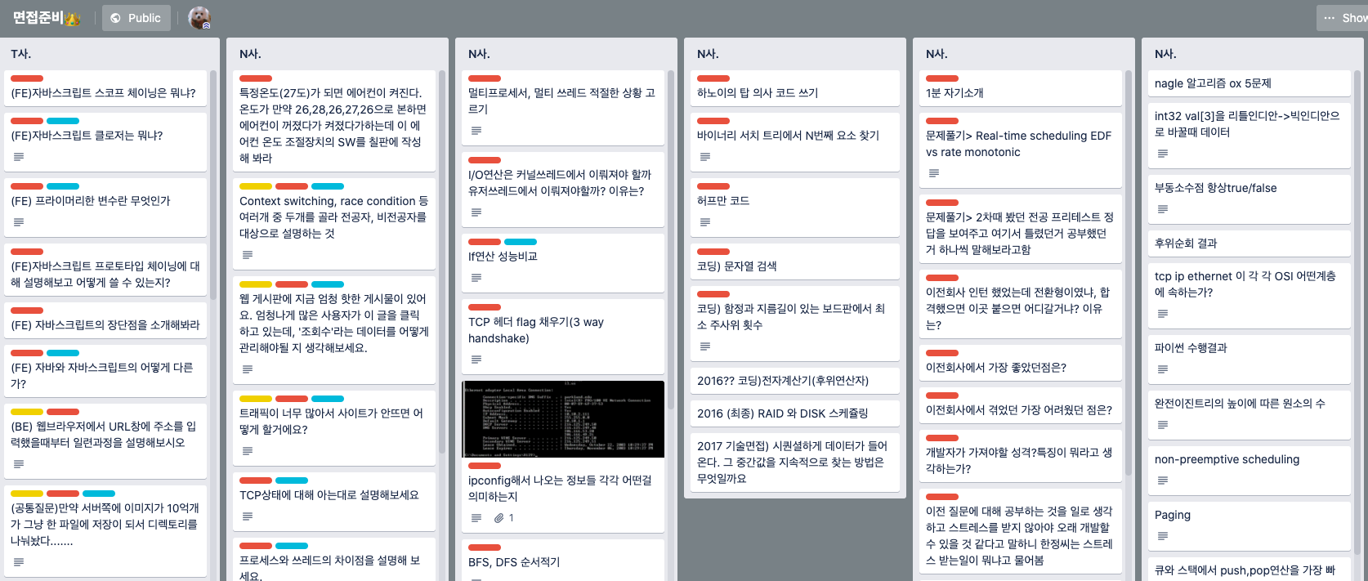

Slide 4
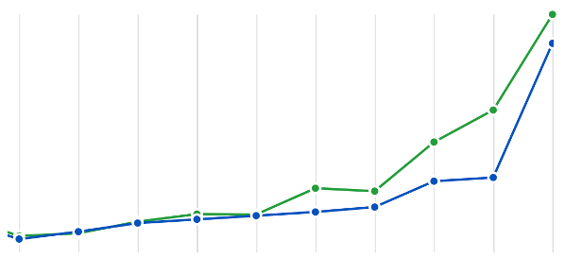
Notes:
03/17 ~ 03/25

